Slide 1
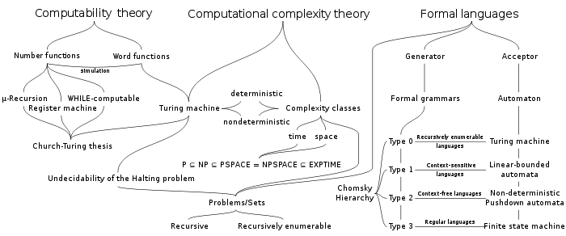

Slide 2
Type 3: Regular Expressions

