Slide 1
MyMovie
12/04/2018
Data Focused Python - Mini 2, Section A, 2018
Group 1

Slide 2
AGENDA
Vision
Team
Problem
Solution /Product
Market
Business Model
Competition
Launch Strategy
Lessons Learned

Slide 3
VISION
Empower producers to make
successful movies
by making informed decisions using historical movie data

Slide 4





TEAM
Shayne Bement
U.S. Fulbright Scholar University of Bamenda, Cameroon
LinkedIn
Jeffrey Curran
Ex-Data Analyst Coop at Legendary Applied Analytics
LinkedIn
Ghazal Erfani
Ex-Data Analyst at VTS
LinkedIn
Naphat Korwanich
Ex-Product Lead at Grab (SE Asia ride-hailing app)
LinkedIn
Asvin Sripraiwalsupakit, ASA
Ex-Actuary at Prudential Life Assurance Thailand
LinkedIn
Notes:
For each team member, include:
Photo
Name (and link to LinkedIn profile)
Title
Experience

Slide 5
PROBLEM (CUSTOMER PAIN)
Global box office spending is at an all time high of 44 Billion USD
movie companies are moving away from the error prone one-person green-lighting systems of the past that led to countless box office flops
ScriptBook uses machine learning to analyze
screenplays and predict box office returns.
Costs $5,000 per screenplay run through the algorithm
With such a high cost, this service is not accessible to small screenwriters attempting to make a case for their film or green-lighting committees tasked to review ideas on a regular basis
Notes:
With global box office spending at an all time high of 44 Billion USD, many movie companies are attempting to move away from the error prone one man green-lighting systems of the past that led to countless box office flops. ScriptBook is is a service that uses machine learning to analyze screenplays and predict box office returns. Costs $5,000 per screenplay run through the algorithm With such a high cost, this service is not accessible to small screenwriters attempting to make a case for their film, or a green-lighting committee tasked to review ideas on a regular basis

Slide 6
SOLUTION
Data Source
Model
Output
MovieLens
Revenue Estimator
Name, Genre, Rating
Linear Regression
The Numbers: Where Data and the Movie Business Meet
k-nearest Neighbors Algorithm
Revenue & Budget Analysis
Production Budget, Revenue, Tickets Sold
Logistic Regression
Decision Tree
Wikipedia, IMDbPY, Kaggle
Movie Rating Analysis
Actor/Actresses, Award, Films from books
Notes:
The product is based on Python-based mathematical model with periodically updated data source
Explain your product
Articulate the value proposition
Demonstrate the impact on your customer (dollars / time saved, etc.)

Slide 7
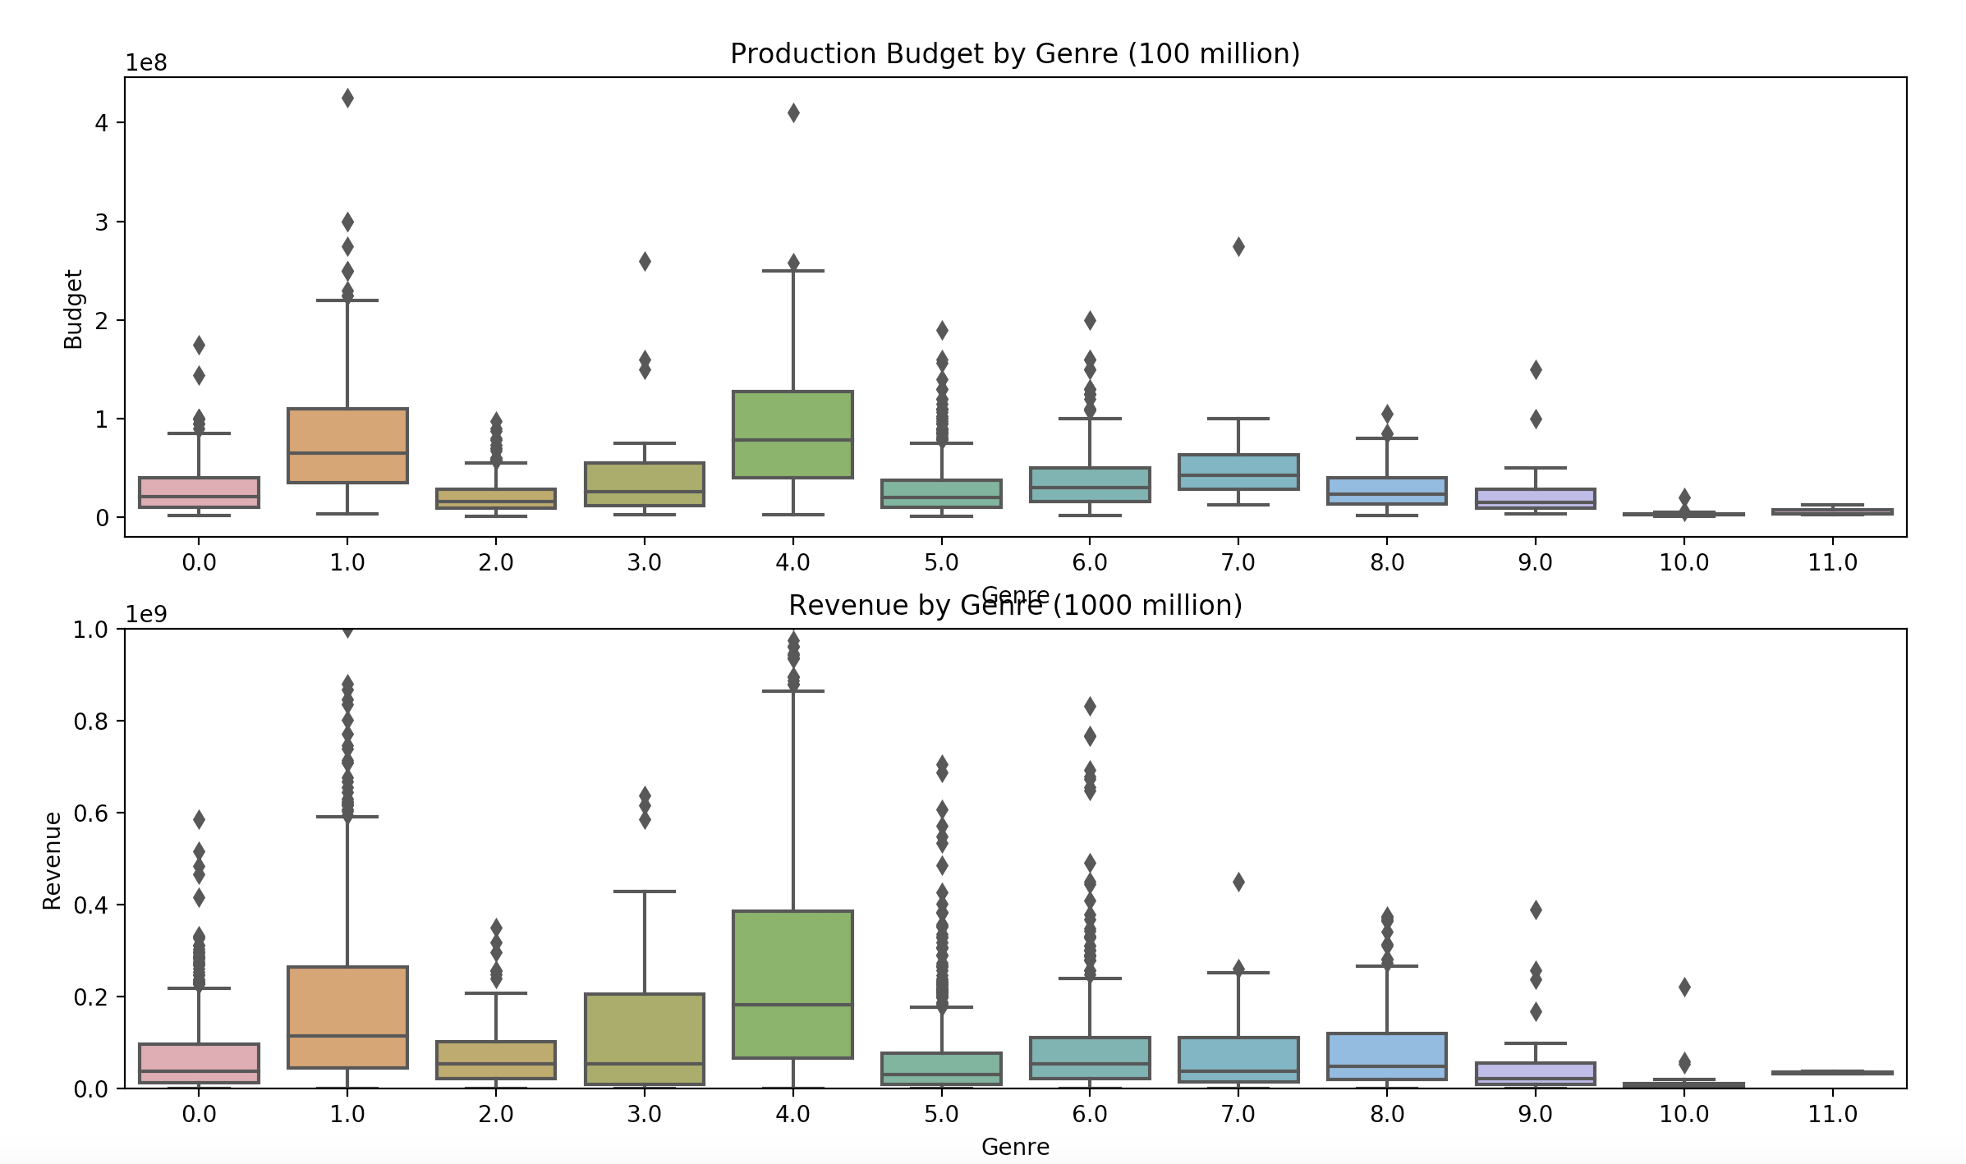
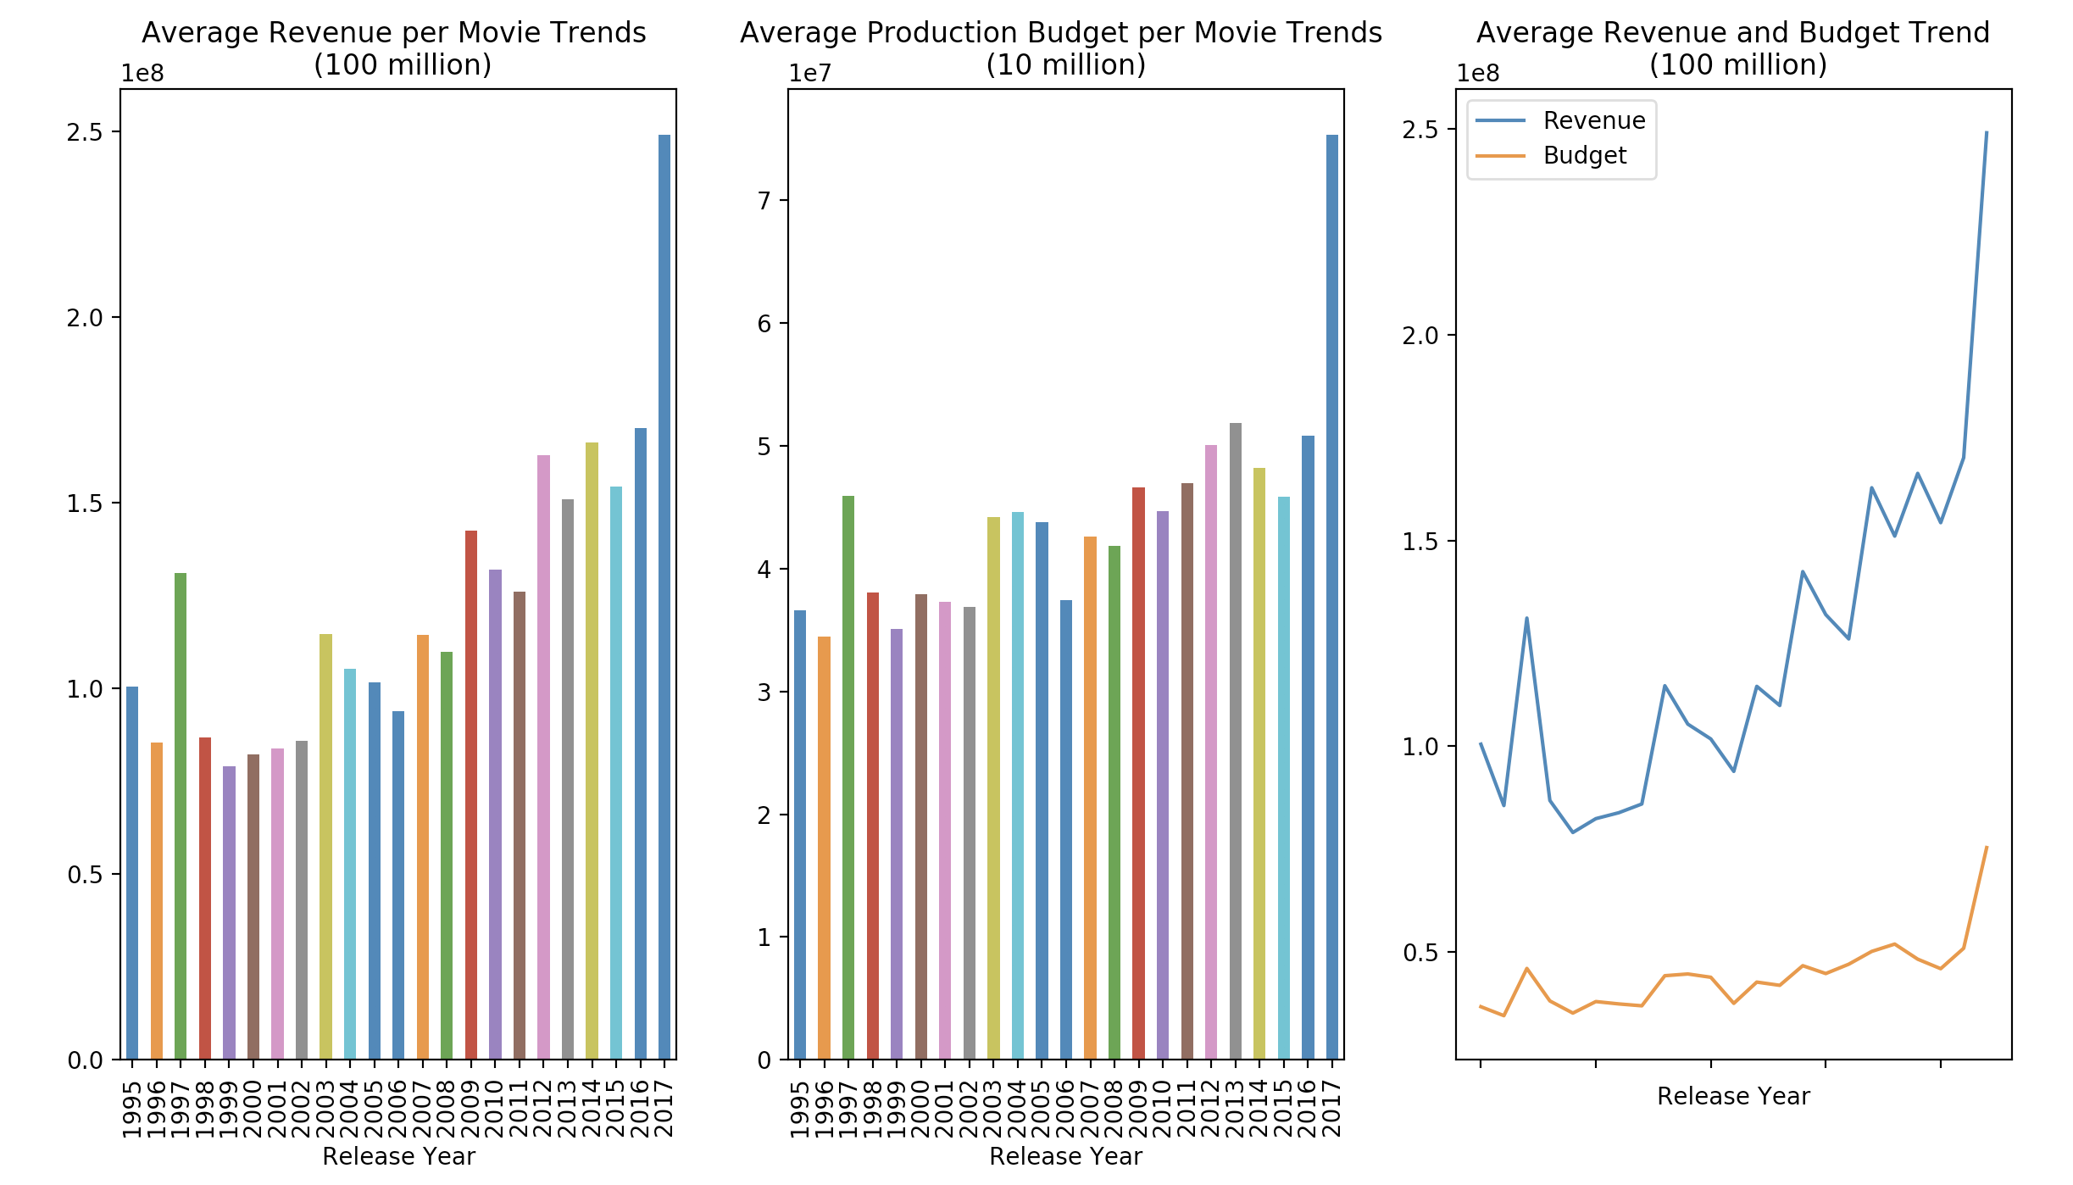
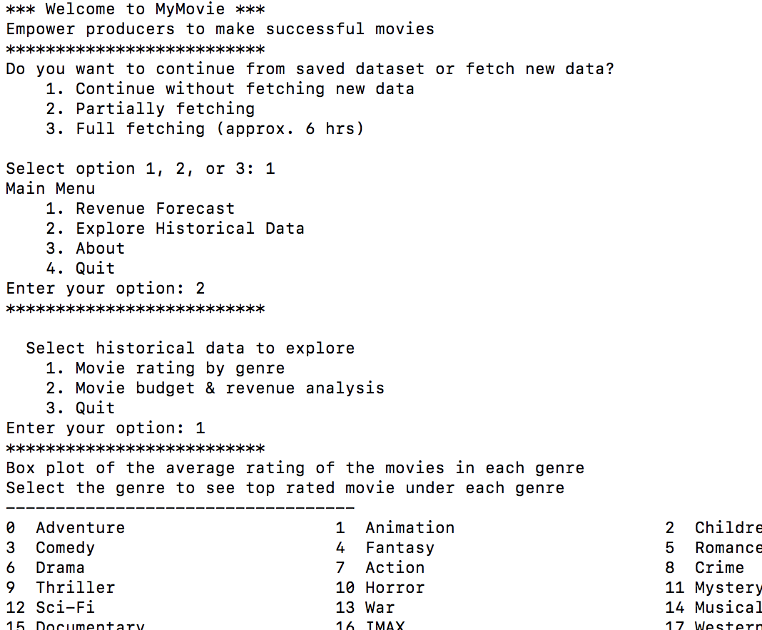
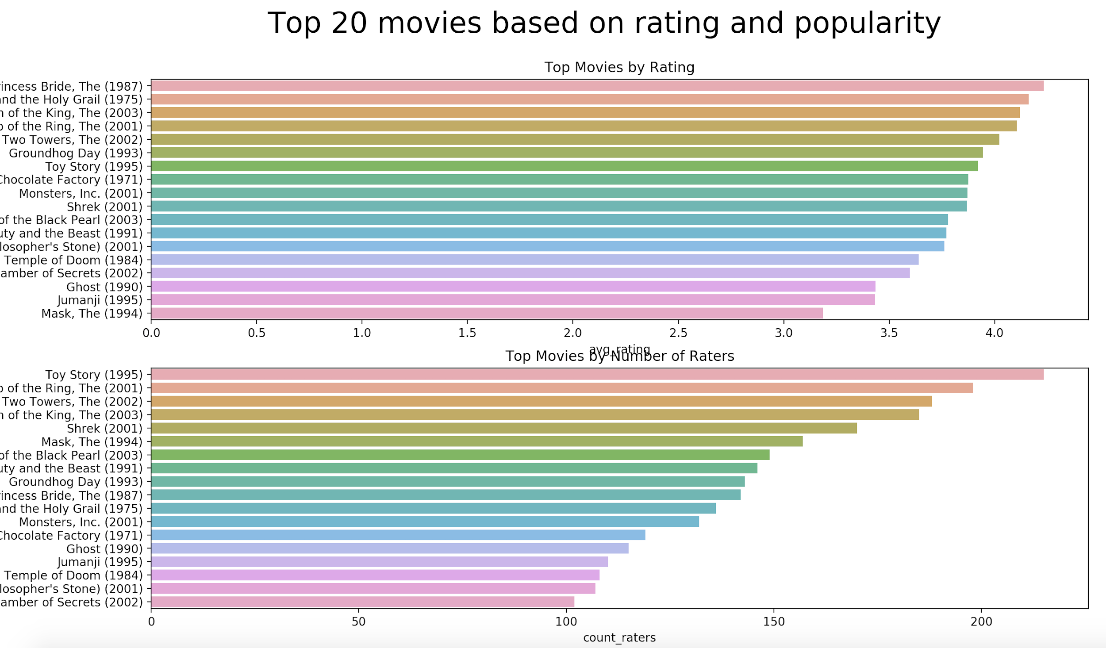
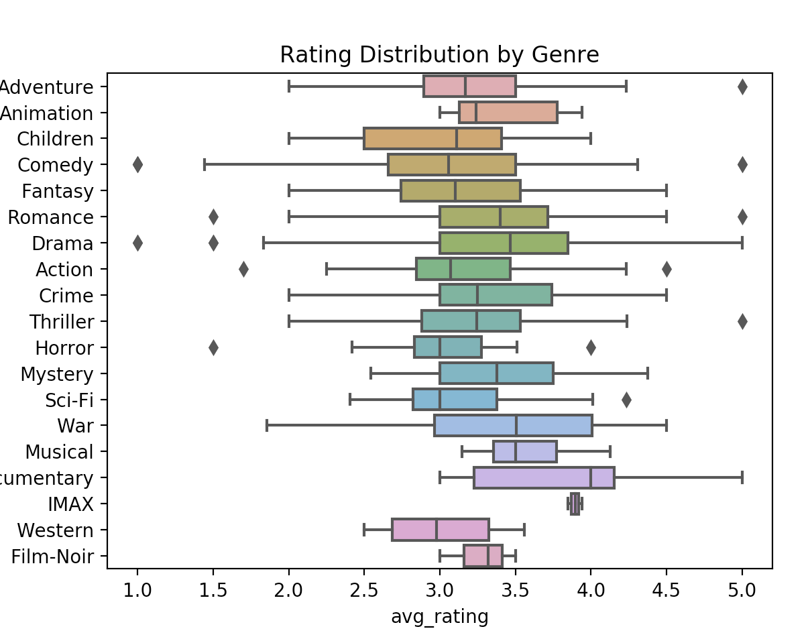
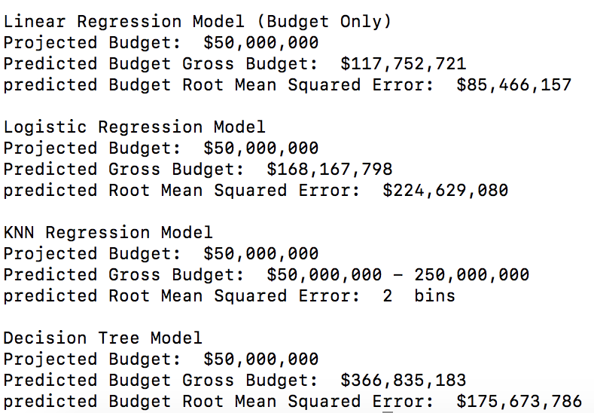
PRODUCT
Notes:
Explain your product
Articulate the value proposition
Demonstrate the impact on your customer (dollars / time saved, etc.)

Slide 8
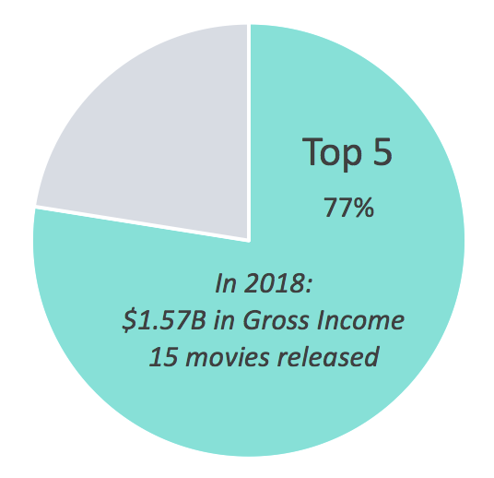
MARKET
140 film production companies ¹
Average of 3 producers involved in early stages of film production ²
MyMovie Revenue per Production Company
20 producers
$72,000 / year
1. https://stephenfollows.com/how-many-movie-producers-per-film/
2. https://www.boxofficemojo.com/studio/
Notes:
Describe your market / target customer How big is the market? What are the market forces / drivers?
Average of 3 producers involved in early stages of film production as of 20131 About 140 production companies released movies in 20182 Top 5 have 77.5% of the movie market share made an average of 1.57B in total gross income in 2018 Released an average of 15 movies in 2018

Slide 9
BUSINESS MODEL
Business Model
Financial Metrics
Revenue
Cost
Average Order Value: $4,800/year
Subscription Revenue
Acquisition/R&D cost
Maintenance cost
Annual revenue: $480,000
Number of orders: 100
Subscription Plan
Lifetime Value: $10,300
Lite Package:
$299/month
Premium Package:
$499/month
Average profit margin: 50%
Customer retention rate: 75%
Discount rate: 10%
Notes:
Assume 50% basic pack, 50% premium pack

Slide 10

COMPETITION
ScriptBook
Uses machine learning to analyze screenplays and predict box office returns
Cost prohibitive
Requires a full screenplay
Internal Analytics Divisions
Not accessible for smaller or independent screenplay writers
Time-consuming

Slide 11
LAUNCH STRATEGY (1/2)
Premium
Producers get expected gross of a movie based on basic movie ideas
Lite
Screenwriters gauge the potential success of the project and are better-prepared for idea pitches
We will leverage input prediction made in subsequent models and continue to propel the product in a more accurate, more useful tool.
Notes:
We’re targeting two main categories of customers: Screenwriters and Producers. Ideally screenwriters utilize a “lite” version of our product to gauge the potential success of their project and go to pitch meetings well prepared to sell their idea. Producers can use a fully-functioned version to run the numbers and predict what profits they can expect when funding the film [should we add the ability to predict movie cost as well?]. We’re going to advertise the service through Hollywood connections.
Thought about film festivals, but this isn’t really a product for indie films?
We’re going to leverage each prediction we make in every following prediction, in this way we will continue to propel the product in a more accurate, more useful tool.

Slide 12
LAUNCH STRATEGY (2/2)
Begin by testing our product against existing movies and showing the accuracy of the product at selected venues to garner our initial customer base
Target The Producers Guild of America as well as notable gatherings of potential customers including the
2019 Hollywood Producer Summit, Produced By New York 2019, and others.

Slide 13
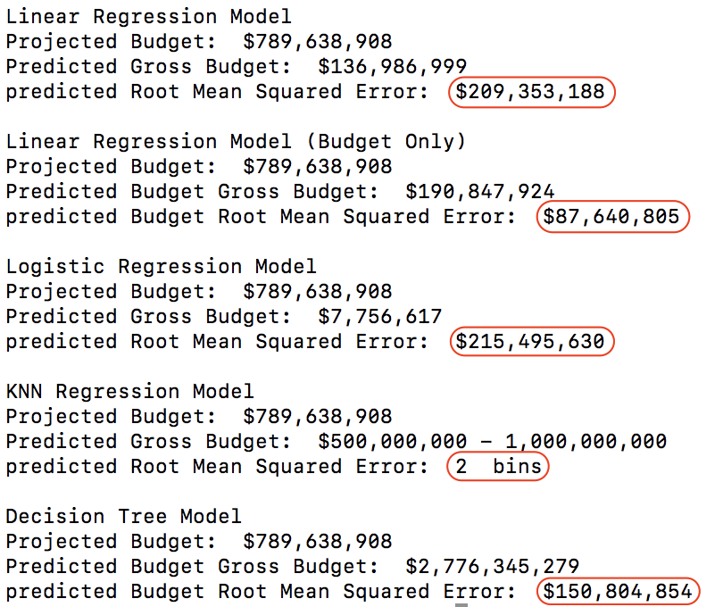
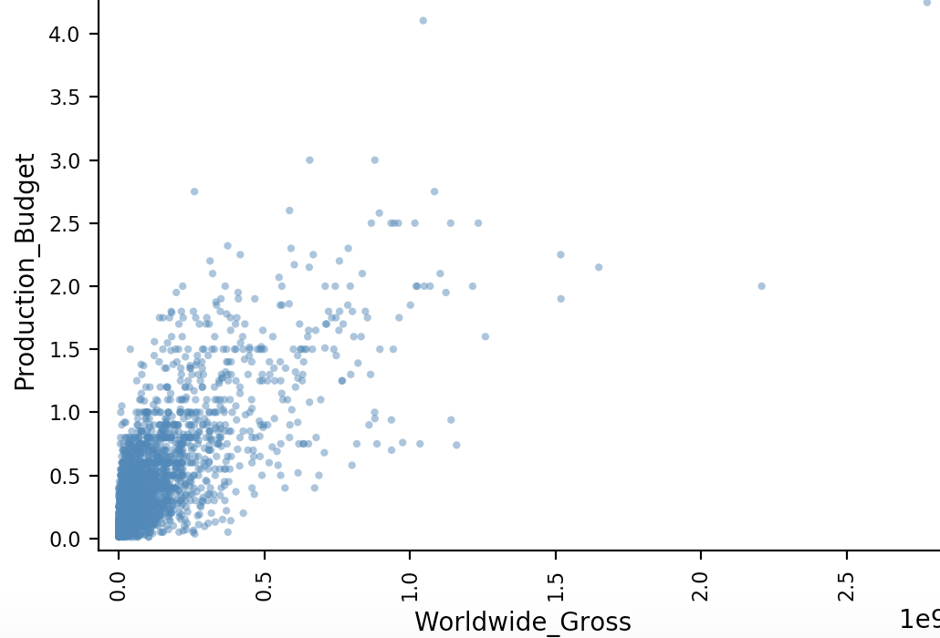
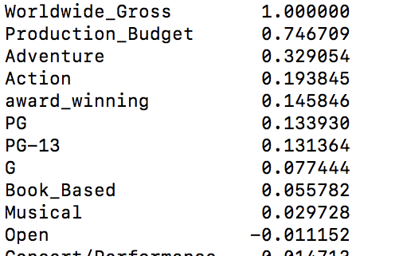
LESSONS LEARNED
Share more code, faster
Choose your model wisely

