Slide 1

Sony Music
Capstone Project
Summer 2019
Zhexin Chen
Ghazal Erfani
Gaurij Hardikar
Daniel Lesser
Phani Pasumarthi
Social Media
and Success
in the Music Industry

Slide 2

Agenda
Introduction
Purpose
Data Collection & Processing
Exploratory Analysis
3 Analytical Approaches
Recommendations
Final Deliverable
Lessons Learned
Future Work

Slide 3

Introduction

Slide 4
Purpose

Slide 5
Data Collection & Processing

Slide 6
Exploratory Analysis

Slide 7
NLP

Slide 8
GMM

Slide 9
Regression

Slide 10
Recommendations

Slide 11
Sample Recommendation
Diego Torres
Top 3 Rock Artists
Twitter mix: 55%
Twitter mix: 37%
Photo mix: 52%
Photo mix: 63%
Positive posts: 47%
Positive posts: 74%
17.4
5.3
146 characters
63 characters

Slide 12
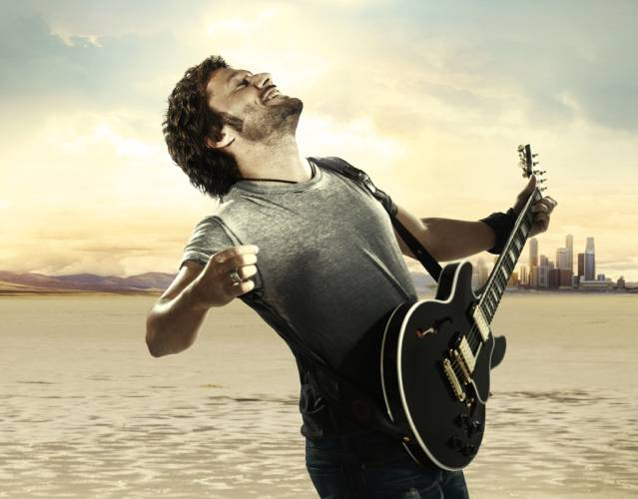
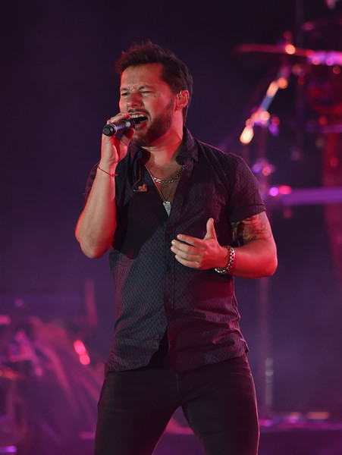
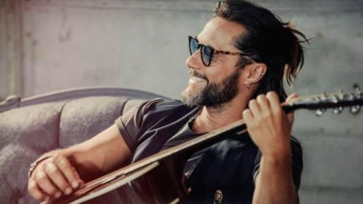
Sample Recommendation (cont.)
Baseline regression prediction
Feature | Value | Recommendation
Platform | Facebook | Post more on Instagram
Posts in last 7 days | 9 | Post less frequently
# characters in post |  | Post shorter posts
Post type | Link | Post more photos
Social Engagement Score
Adjustments to regression
Feature | Value | Numerical Impact
Platform | Facebook | -
Posts in last 7 days | 2
# characters in post
Post type | Text-> Photo
Social Engagement Score

Slide 13







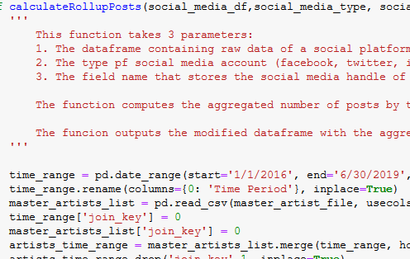



Final Deliverable Pipeline
Extracted Dataset
3
3
1
2
Exploratory Data Analysis
Gaussian Mixture Modeling
Natural Language Processing
‘Master’ Combined Social Data Notebook
4
xgboost Regression
Model
Qualitative Artist
Recommendations
Quantitative Artist
Recommendations
5

Slide 14
Lessons Learned

Slide 15
Future Work

Slide 16
Thank you

