Slide 1


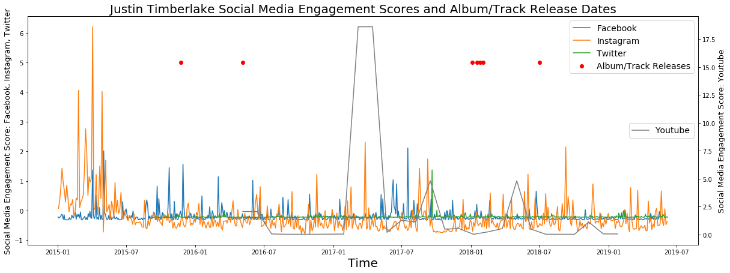

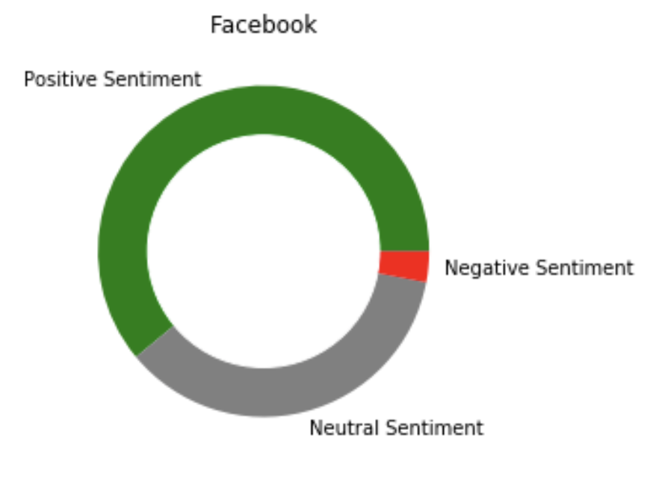
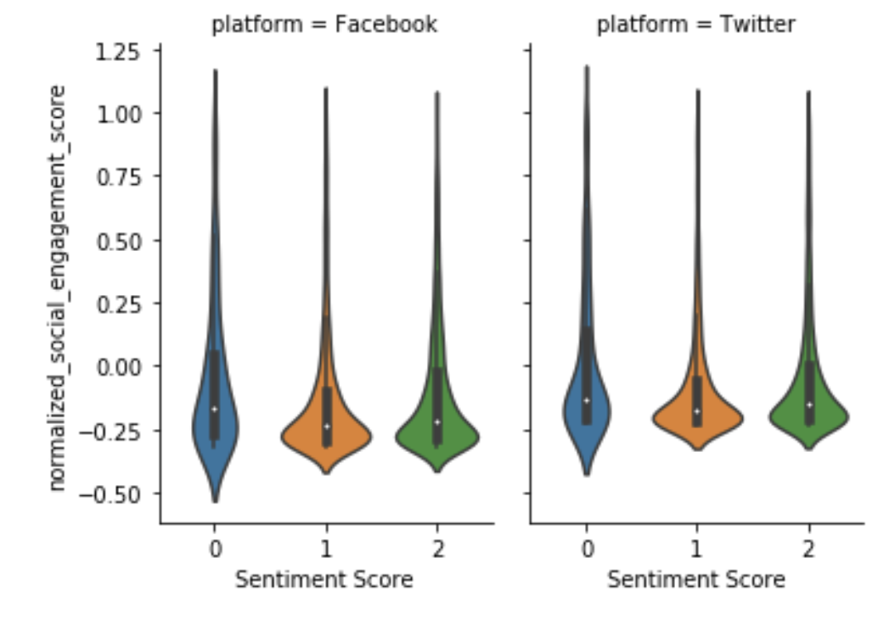
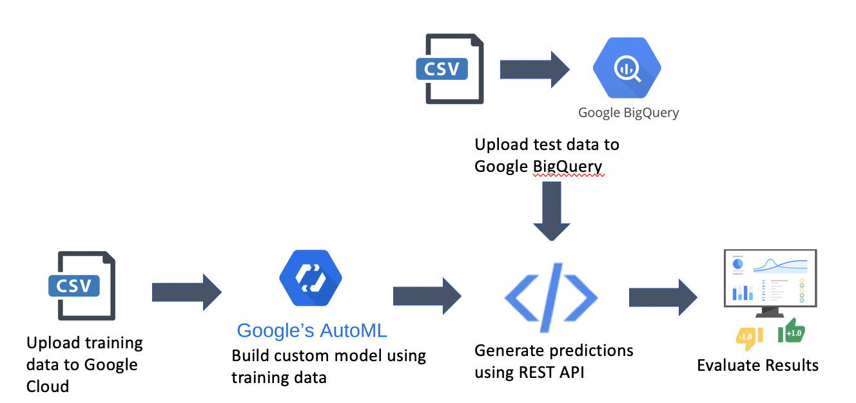
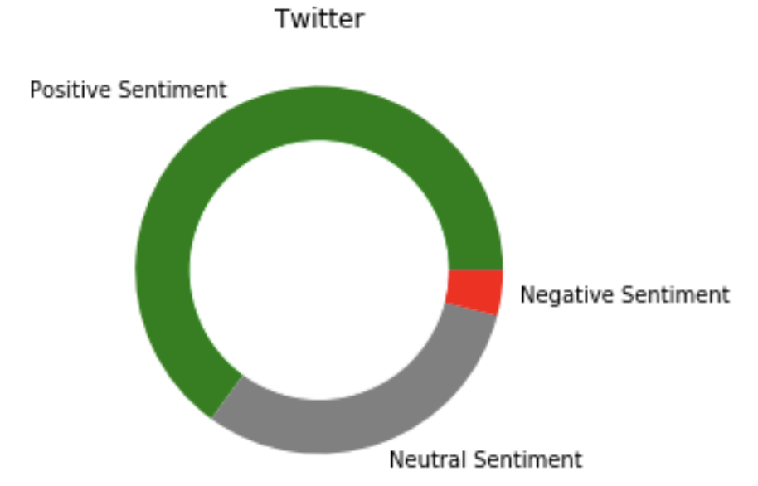
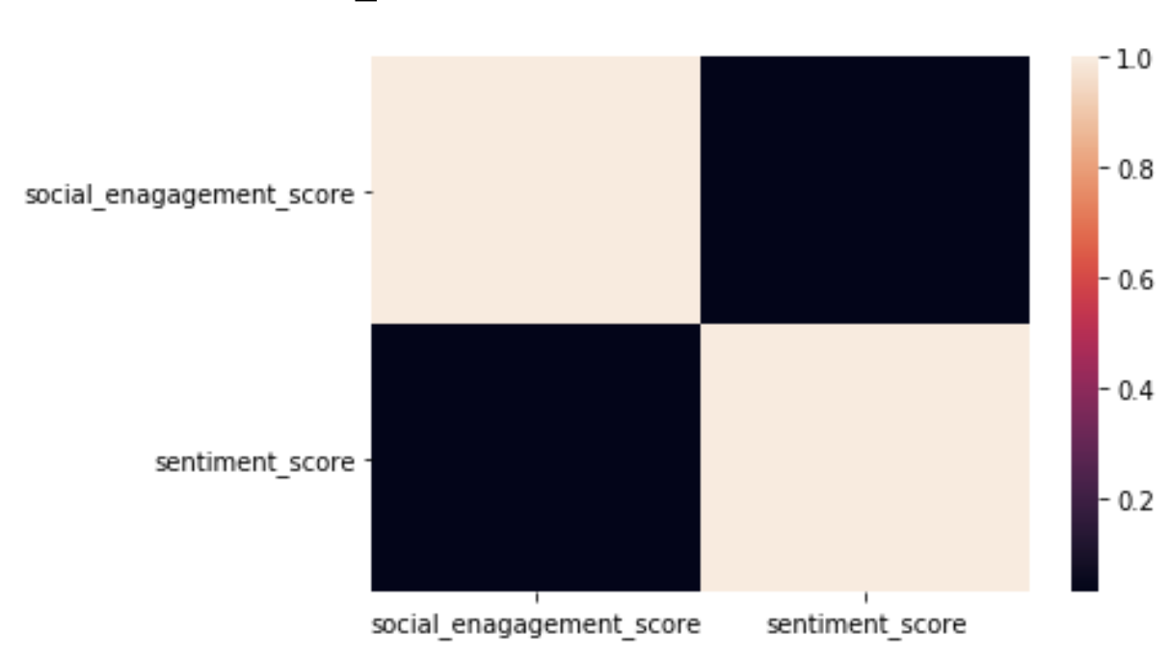
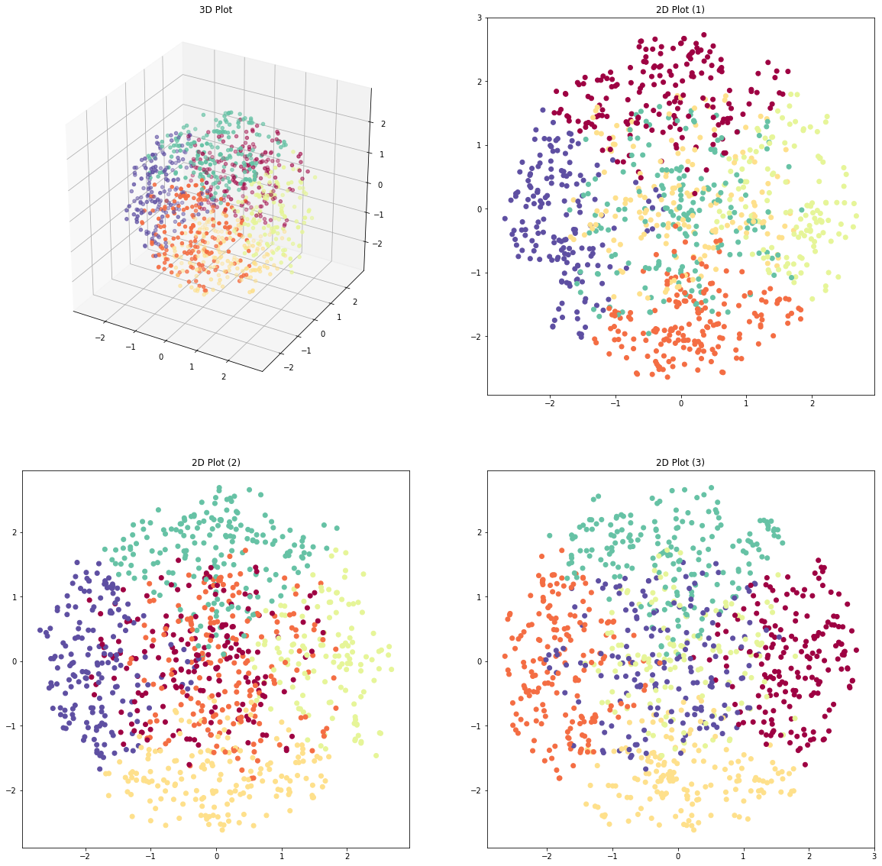





Social Media and Success in the Music Industry
Introduction
Exploratory Analysis
Success Prediction
Social media music promotion is a necessity in today’s world. Artists are building their own personal brand by engaging with their fans online.
Sony aims to better understand how to promote content on social media and support artist development.
High frequency of posts
Method
Example: Instagram
Linear regression and feature selection for each social media
A linear regression for 23 features and 214k observations with -0.85 R² score on the test set
Difficult to discern relationship between social media activity and engagement by visual exploration
Model selection with cross validation
Cross validation with multiple models: Lasso, Ridge, Random Forest, XGBoost, etc
For a better understanding, we took 3 approaches:
Best model to predict social engagement scores
A XGBoost Regression with 300 estimators and 9 max depth, getting 0.58 R² Score on the test set
Purpose
Social Engagement Success Prediction
Social Media Activity Clustering
Social Media Sentiment Analysis
What can we get from regressions?
How does artist activity on Twitter, Facebook, Instagram, and YouTube drive social media engagement?
How does activity differ by platform?
Can we make recommendations around when, where, and how they should engage in social media?
Quantitative
Feature Importances
Coefficients
Qualitative
... | description_length | genre_rock | last_7_days | ...
... | 0.005 | 0.342 | 0.027 | ...
... | genre_rock | ...
... | (+) 0.122 | ...
Activity Clustering
A lot of takeaways from these models:
The less frequently you post, the higher engagement you get
You will get higher engagement by posting short, instead of long
Being a rock singer, you will get higher engagement on Instagram
…
1. Dimensionality Reduction
27 Features
Sentiment Analysis
PCA
t-SNE
3 Features
2. Gaussian Mixture Modeling
Number of Clusters = 6
Cluster 3
- High Rock &
Electronic Engagement
- Early Morning Posts
- Close to Release-Date Posts
- Would benefit from
more photo posts
Data Processing
Cluster 5
- Older Artists
- Afternoon Posts
- High Facebook Engagement
- Would benefit from
early morning posts
3D Plot
2D Plot (1)
6 Genres
Findings:
Significant proportion of artist posts are positive. The trend is similar between Facebook posts and tweets.
No significant correlation found between Social Engagement Scores and Tweets/Facebook Posts.
141 Artists
Future Work
6 Data Sources
2D Plot (2)
2D Plot (3)
Cluster 4
- Low Post Frequency
- Early Morning Posts
- High Instagram Engagement
- Frequent Twitter Posts
-Would benefit from more Instagram posts
- Would benefit from more photo posts
- Would benefit from
lower-frequency posts
Beyond Social Media Predict artist success on music streaming platforms based on social media activity across various platforms.
Searching for New Talent Leverage Social Media presence to help music managers identify up-and-coming artists that will contribute to the success of Sony Music
13 Core Features
1M Observations
Notes:
Social media music promotion is necessity in today’s world. Artists are building their own personal brand by engaging with their fans online.
Sony aims to better understand how to promote content on social media and support artist development.

