Slide 1
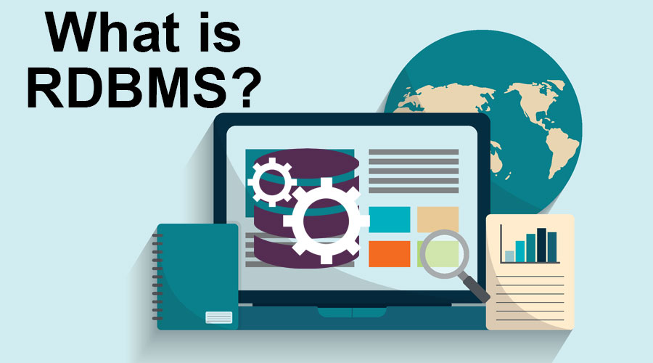

Slide 2
What is a RDBMS
A relational database management system (DBMS) is software that allows you to manipulate the content of relational databases. ... SQL (acronym for Structured Query Language) is the most popular computer language used to formulate relational algebra queries.

Slide 3
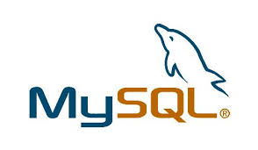
What is MSQL
MySQL is a database management system, the most popular of the open source SQL database servers, is developed, distributed and supported by MySQL AB. MySQL AB is a trading company, founded by the developers of MySQL, who develop their business in services around MySQL.

Slide 4
functionality
Written in C and C ++.
Tested on a wide variety of different compilers.
Works on many platforms. See Section 2.1.1, “Operating Systems Supported by MySQL”.
Uses GNU Automake, Autoconf and Libtool for better portability. Has APIs for C, C ++, Eiffel, Java, Perl, PHP, Python, Ruby and Tcl.
See Chapter 24, MySQL API. Completely multi-threaded, thanks to the kernel threads.
This means that you can use it easily on a server with multiple processors
Provides transactional and non-transactional table engines. Very fast B-tree index, with index compression.
Relative ease of adding a new table engine.
This is useful if you want to add an SQL interface to your in-house database.
Very fast memory allocation system, exploiting threads.

Slide 5
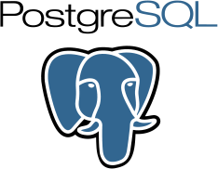
What is PostgreSQL
PostgreSQL is a powerful, open source object-relational database system that uses and extends the SQL language combined with many features that safely store and scale the most complicated data workloads. The origins of PostgreSQL date back to 1986 as part of the POSTGRES project at the University of California at Berkeley and has more than 30 years of active development on the core platform.

Slide 6
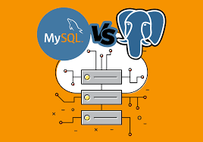
MSQL vs POSTEGERSQL

Slide 7
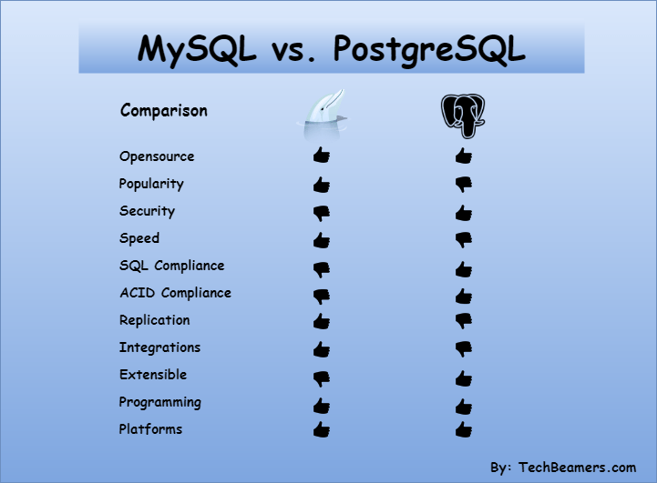

Slide 8
MySQL is a pure RDBMS whereas PostgresSQL is an object-relational DBMS.
Both these support Solaris, Windows OS, Linux, OS X. Additionally, MySQL runs on FreeBSD and PostgreSQL on HPUX.
MySQL is from Oracle while PostgreSQL PostgreSQL runs by a group of many companies a.k.a. PGDG.
My SQL is not extensible, whereas PostgreSQL has it.
PhpMyAdmin enables GUI and SQL interface for MySQL. Wherein, the pgAdmin tool does the same for PostgreSQL.
MySQL has builtin tools for offline database backup, whereas PostgresSQL takes full backup online.
PostgreSQL has built-in SSL support, but it doesn’t come in MySQL by default.

Slide 9
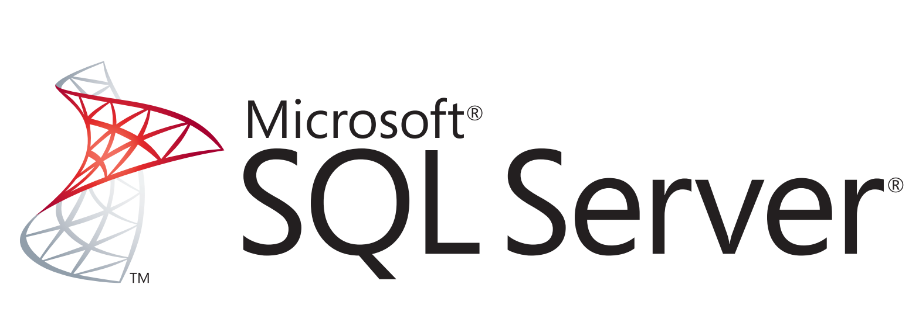
What is SQL Server
Microsoft SQL Server is a database management system (DBMS) in SQL language incorporating, among other things, an RDBMS (relational DBMS ") developed and marketed by the Microsoft company. It works on Windows and Linux OS (since March 2016), but it is possible to launch it on Mac OS via Docker, because there is a download version on the Microsoft site

Slide 10
PostgreSQL vs SQL Server
PostgreSQL and SQL Server (or MSSQL) are two widely used relational databases. Although they share a number of core traits, there are major differences between them. In this article, we provide a detailed rundown of the similarities and differences between PostgreSQL and SQL Server. Among the most significant distinctions is that PostgreSQL is open source, while SQL Server is owned and licensed by Microsoft. In addition, you will learn about differences between the two systems when it comes to licensing and cost, ease of use, SQL syntax and compliance, data types, available features, performance, and security, among many others. Over 40 topics are covered in head-to-head comparisons. It will be particularly useful for organizations who are thinking of making the switch from a commercial to an open-source database, but need more information on the possible trade-offs and advantages of the two systems. However, it is intended for anyone who is curious to learn more about relational databases. We conclude that SQL Server has historically been popular with organizations that rely on other Microsoft products, but PostgreSQL has risen to the top of the field not only because of the advantages of going open source but also for its robust features and active community of users.

Slide 11
Thank you for your attention

