Slide 1
Predicting Credit Card Defaults

Slide 2
Data
Data was taken from Kaggle
This dataset contains information on default payments, demographic factors, credit data, history of payment, and bill statements of credit card clients in Taiwan from April 2005 to September 2005.
API
https://www.fraudlabspro.com/developer
A small amount of data was also collected from an API on credit card default data, but wasn’t used as it was too difficult to merge

Slide 3
1.
EDA
Working with our data

Slide 4
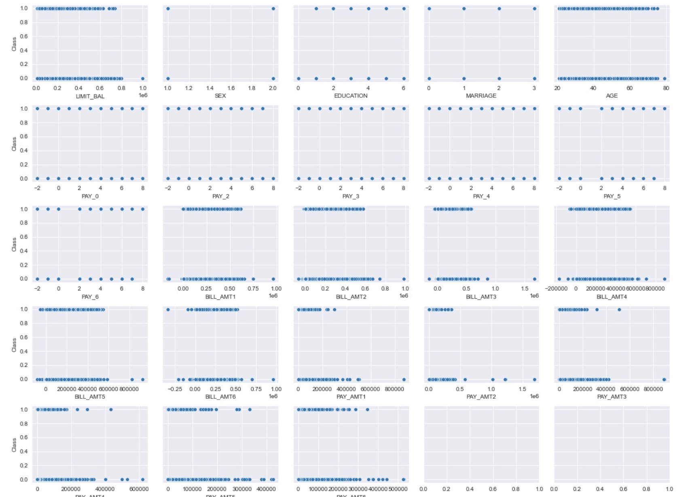
EDA
Relationship between target and predictor variables

Slide 5
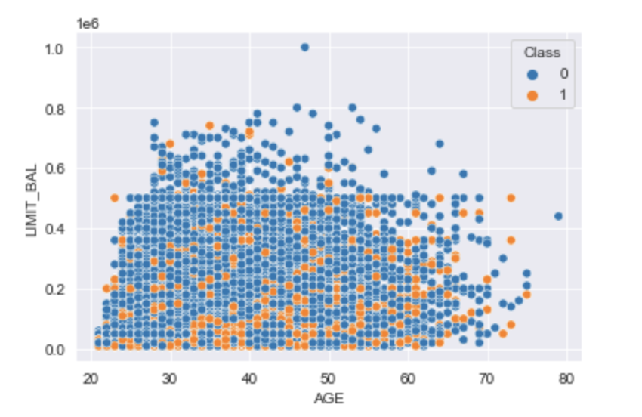
EDA
Probability a customer defaults based on age and their limit balance on their account

Slide 6
2.
Feature Engineering

Slide 7
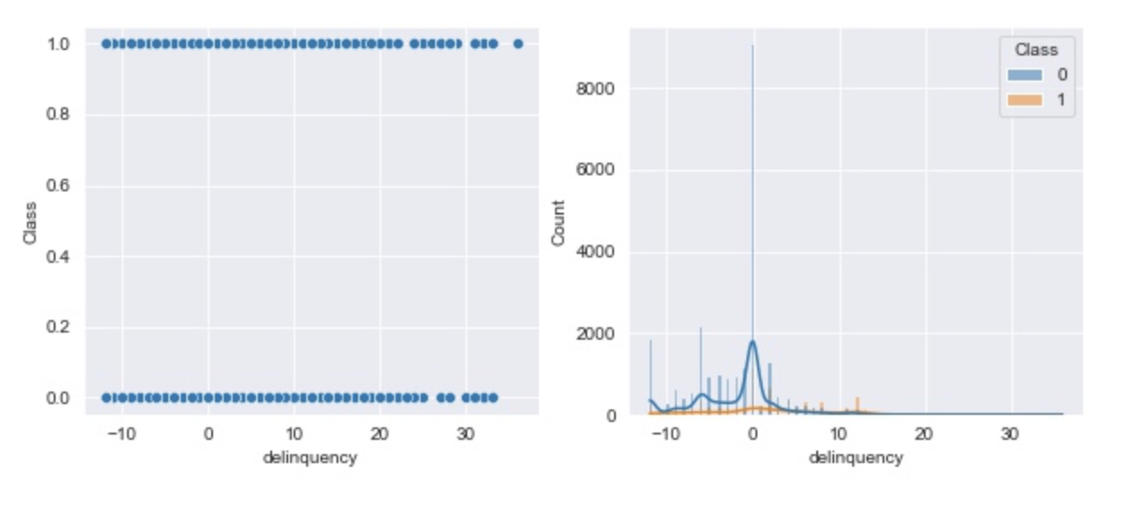
Feature Engineering
Delinquency, probability of default, and exposure at default are studied

Slide 8
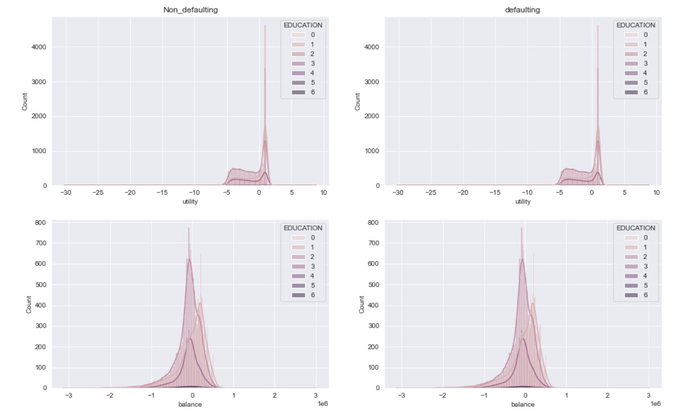
Feature Engineering
credit utilization rate
credit utility
Distribution of credit utility based on Education between Defaulting and Non-defaulting customers

Slide 9
3.
Model Fitting

Slide 10
Model Fitting
Multiple models including logistic regression, KNN(k-nearest neighbors), decision tree, random forest, SVM(support vector machine) and gridsearch & XGboost are all tested and compared. Pipeline is used with GridSearch. SMOTE and ADASYN are implemented to deal with the imbalance problem.

Slide 11
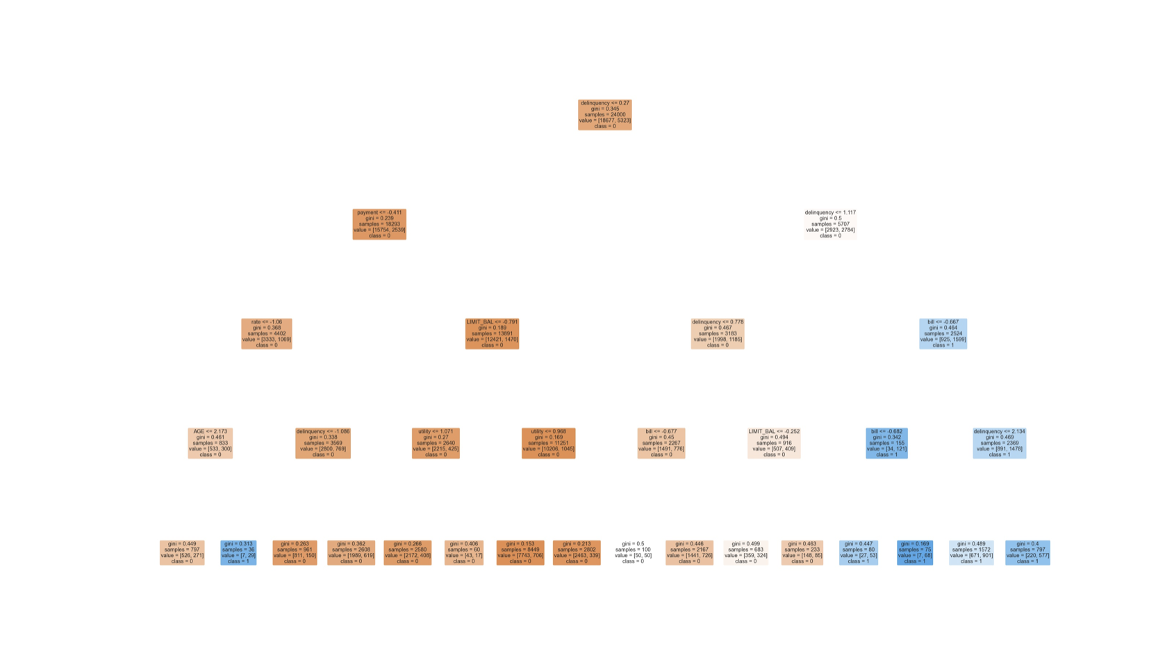
Model Fitting
Decision Tree

Slide 12
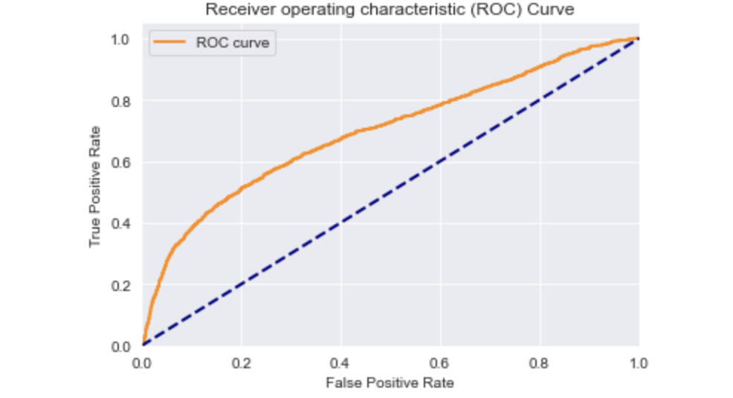
ROC Curve

Slide 13
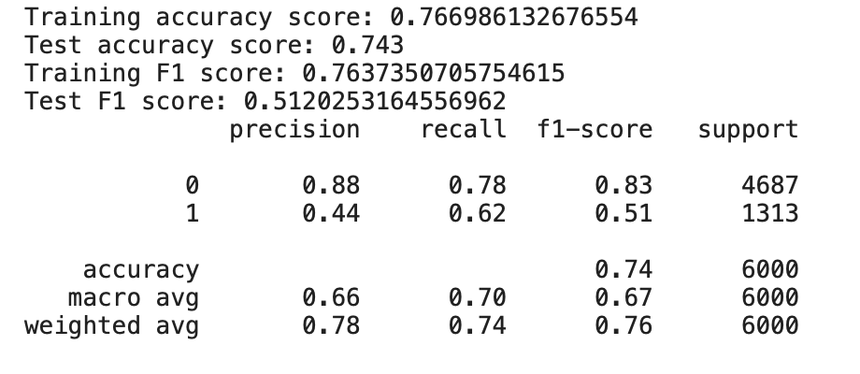
Results for XGBoost

Slide 14
Conclusion and next steps
The feature SEX and EDUCATION have different probability of default payment, according to both the statistical test and model evaluation, which means male/female and different education levels have significant effects.
Both continuous variables and categorical variables play important roles in the modeling. Different models mark different strong predictors.
The credit card default payment problem has a highly imbalanced dataset. Even the data is processed with SMOTE technique, some metrics still don’t show satisfactory results. Because the real probability of default is unknown, we may implement artificial neural network to accurately estimate the real probability of default.
XGboost serves as the best one in all classification models, but it also becomes expensive when we set up more hyperparameters in grid search.

Slide 15
Thank you!

