Slide 1


Model Lift in Machine Learning
Key facts about Lift
LIFT typically shows how much better the classification model performs.
The Lift curve is an important chart to visualize the analysis of binary classification model, which shows the ratio of a model to a random guess.
See more: Open the Notes below for more information.
Notes:
QuickStarter has created an outline to help you get started on your presentation. Some slides include information here in the notes to provide additional topics for you to research.
Summary:
Machine learning is the scientific study of algorithms and statistical models that computer systems use to perform a specific task without using explicit instructions, relying on patterns and inference instead. It is seen as a subset of artificial intelligence. Machine learning algorithms build a mathematical model based on sample data, known as "training data", in order to make predictions or decisions without being explicitly programmed to perform the task. Machine learning algorithms are used in a wide variety of applications, such as email filtering and computer vision, where it is difficult or infeasible to develop a conventional algorithm for effectively performing the task.
More key facts:
Academic conference: AAAI 2016, NIPS 2015, ICML 2016, IJCAI 2016, KDD 2016, CVPR 2016, ICASSP 2016, ICDM 2015, ACL 2016, CHI 2016, European Conference on Artificial Intelligence (ECAI) 2016, WWW 2016, CIKM 2015, ICPR 2016, UAI 2015, SIGIR 2016, IJCNN 2015, ECCV 2016, ICCV 2015, ICIP 2015, GECCO 2016, LREC 2016, ICRA 2016, AAMAS 2016, COLING 2014, IROS 2015, ICANN 2014, EMNLP 2015, SDM 2016, SMC 2016, PAKDD 2016, Interspeech 2015, EACL 2014, IEEE CEC 2015, ICME 2016, NAACL 2016, COLT 2015, ICMLA 2015, ICDE 2016, VLDB 2015, SIGMOD 2016, ICONIP 2015, ICC 2016, SIGGRAPH 2015, WSDM 2016, MICCAI 2015, GLOBECOM 2015, STOC 2016

Slide 2
Related topics to Lift in ML
Python
machine learning
TP, FP, FN, TN
Confusion matrix
ROC
AUC

Slide 3
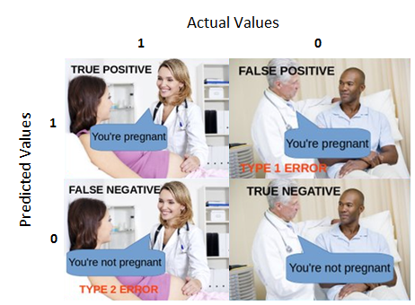
TP FP FN TN
Confusion matrix

Slide 4
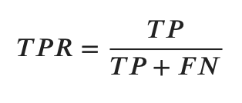
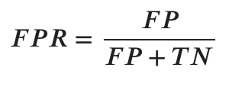
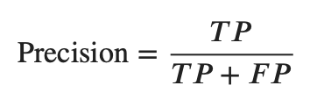
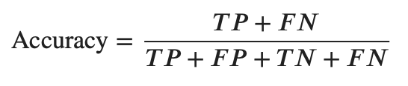

True Positive Rate (TPR)
False Positive Rate (FPR)
Precision (PRE)
Accuracy (ACC)
Notes:
Consider talking about:
Relation to data mining
Relation to optimization
Relation to statistics

Slide 5
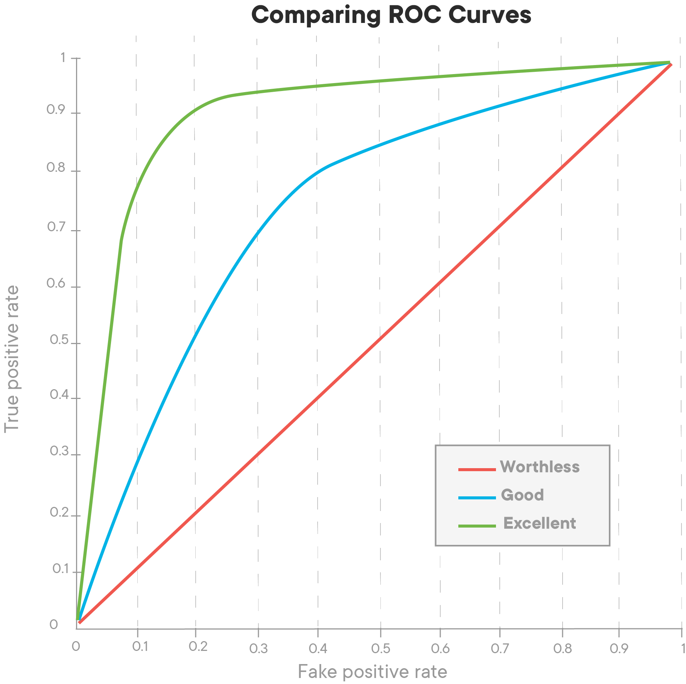
ROC curve (Receiver Operating Characteristics curve)
AUC (Area Under Curve)
An AUC of 1 being a perfect classifier, and an AUC of .5 being that which has a precision of 50%.
Notes:
Consider talking about:
Machine learning tasks

Slide 6
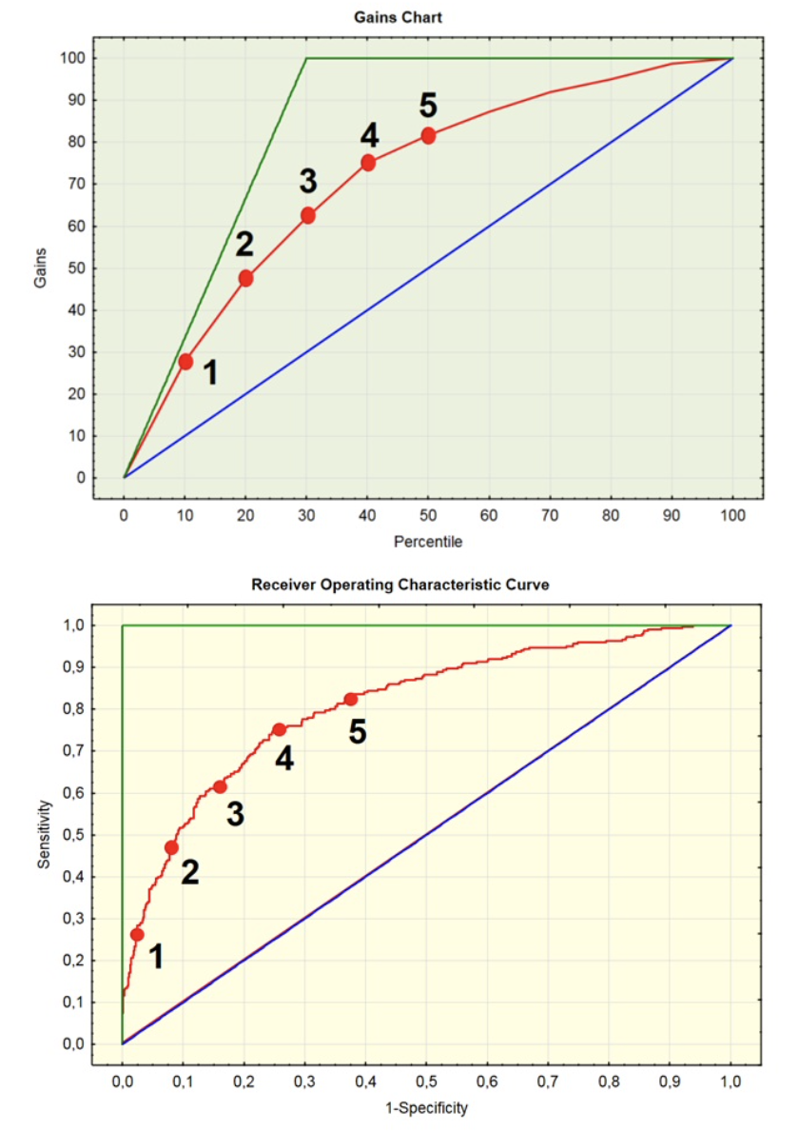
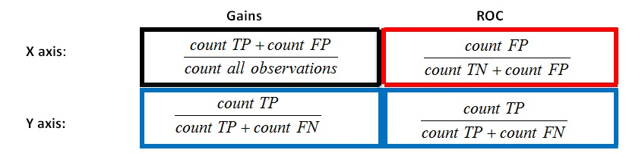
Notes:
Consider talking about:
Types of learning algorithms
Models
Training models

Slide 7
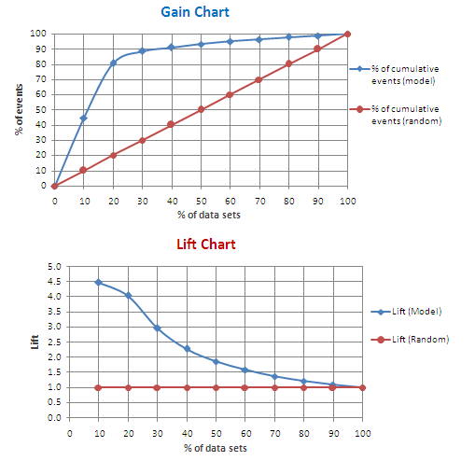
TP FP FN TN
A Lift chart come directly from a Gains chart, where the X axis is the same, but the Y axis is the ratio of the Gains value of the model and the Gains value of a model choosing customers randomly.
In other words, it shows how many times the model is better than the random choice of cases.

