Slide 1
Toronto Restaurant
Capstone Project

Slide 2
Business Problem
The client would like to open a new restaurant.
This restaurant would be situated in the financial district of Toronto.
They are specifically targeting employees’ lunches near the "First Canadian Place" building, which is located in the heart of the financial district. They believe there is room for another restaurant / take-away.
What is already available?
What restaurant is recommended?
Should it be low-end or high-end?

Slide 3
Data gathering
Sources
Foursquare API
Self generated excel sheet with restaurant prices
Data for the following restaurant cuisines were collected
Thai
Steak
Italian
Sandwich
Sushi
French
Mexican
Retrieve all restaurant cuisines within 1.5km from target market
Combine the data and clean it
Collect the average price per restaurant
Combine the 2 tables (restaurants with average price)
Analyze the final table

Slide 4
Methodology
Collect all cuisines data
Collect average price for data
Combine the data
Show range in prices
Show frequency of each type
Show a cluster of each restaurant type
Predict possible prices for cuisines to estimate business possibilities

Slide 5
Data issues and cleaning
Searches were made regarding each cuisine type how this did not necessarily only bring back food type places.
The 11 rows of data consisted of the following erroneous data
Embassy / Consulate (e.g. Italian Consulate)
Residential Building (Apartment / Condo)
Neighborhood
Gym / Fitness Center
Clothing Store
Government Building
These were removed from the dataframe

Slide 6
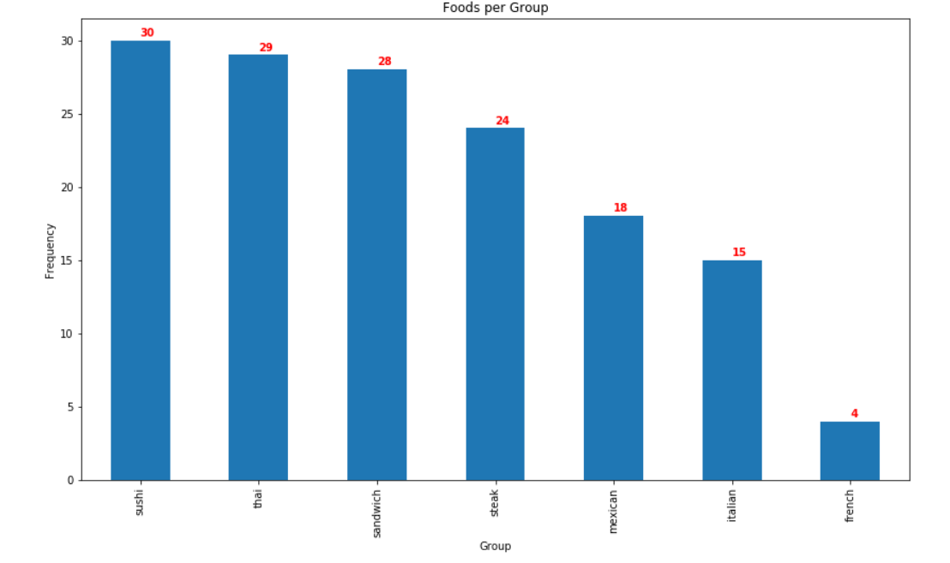
Results
159 rows were found within 1.5km
After data cleaning, 148 rows were left
Frequency of each cuisine
Sushi(>30) exceeded the limit
Thai(29) was at the limit
French(4) was the lowest

Slide 7
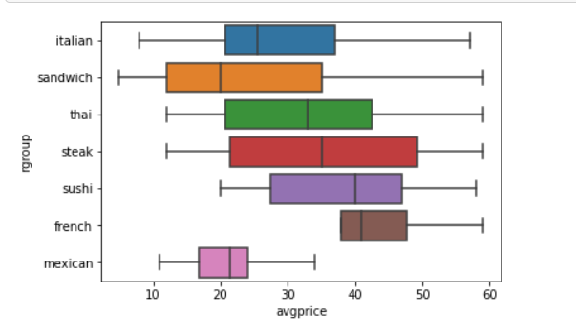
Results
Box Plot Analysis of Average Prices
Range of each cuisine
Italian had the widest range with very cheap and very expensive
Sandwiches had the bulk in the cheap area
French ranged only in expensive ranges

Slide 8
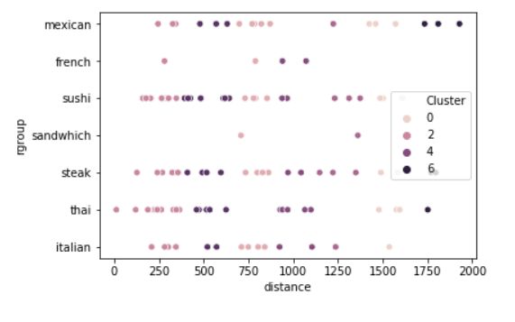
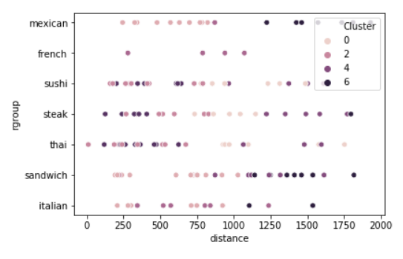
Results
Using a clustering analysis it the K-means analysis the data was first normalized to get an appropriate view.
Without normalization the distance field overwhelmed all other statistics
Pre Normalization
(Clusters very bound around distance field only)
With Normalization

Slide 9
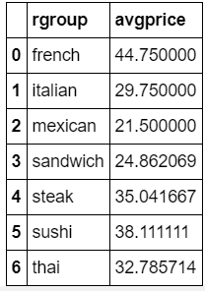
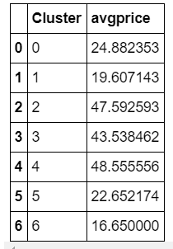
Conclusion
Sushi is the most saturated with more than 30 restaurants therefore one can either
go with Thai (2nd highest) with an average price of $33 or
go for the least saturated market (French) with only 4 restaurants, average price of $ 45
French might be better as there's less competition and a higher price attached

