Slide 1
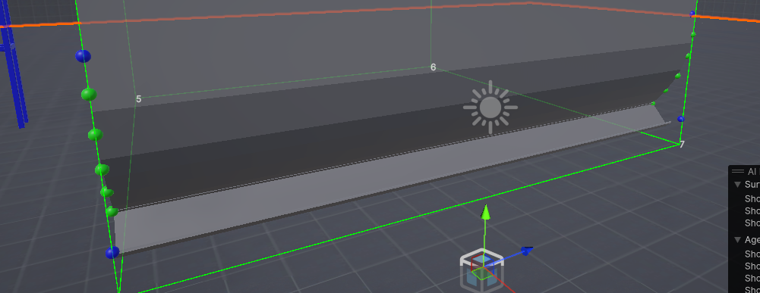
곡면 5(r5)
R1 = -12.23, 4.56, 17.2
R2 = -12.43, 4.56, 9.79
R3 = -12.425, 4.269, 9.792
R4 = -12.242, 4.255, 17.305
R1
R2
R4
R3

Slide 2
곡면 4(r4)
R1 = -12.242, 4.255, 17.305
R2 = -12.425, 4.269, 9.792
R3 = -12.46, 3.940999, 9.792
R4 = -12.277, 3.927, 17.305
R1
R4
R2
R3

Slide 3
곡면 3 (r3)
R1 = -12.277, 3.927, 17.305
R2 = -12.46, 3.940999, 9.792
R3 = -12.565, 3.613999, 9.792
R4 = -12.382, 3.6, 17.305
R1
R4
R2
R3

Slide 4
곡면 2 (r2)
R1 = -12.382, 3.6, 17.305
R2 = -12.565, 3.613999, 9.792
R3 = -12.731, 3.351999, 9.792
R4 = -12.548, 3.338, 17.305
R1
R4
R2
R3

Slide 5
곡면 1 (r1)
R1 = -12.548, 3.338, 17.305
R2 = -12.731, 3.351999, 9.792
R3 = -12.913, 3.082999, 9.792
R4 = -12.73, 3.069, 17.305
R1
R4
R2
R3

