Slide 1
SEMI-SUPERVISED CLASSIFICATION WITH
GRAPH CONVOLUTIONAL NETWORKS
Thomas N.Kipf & Max Welling (ICLR 2017)
Presenter: 강홍석

Slide 2
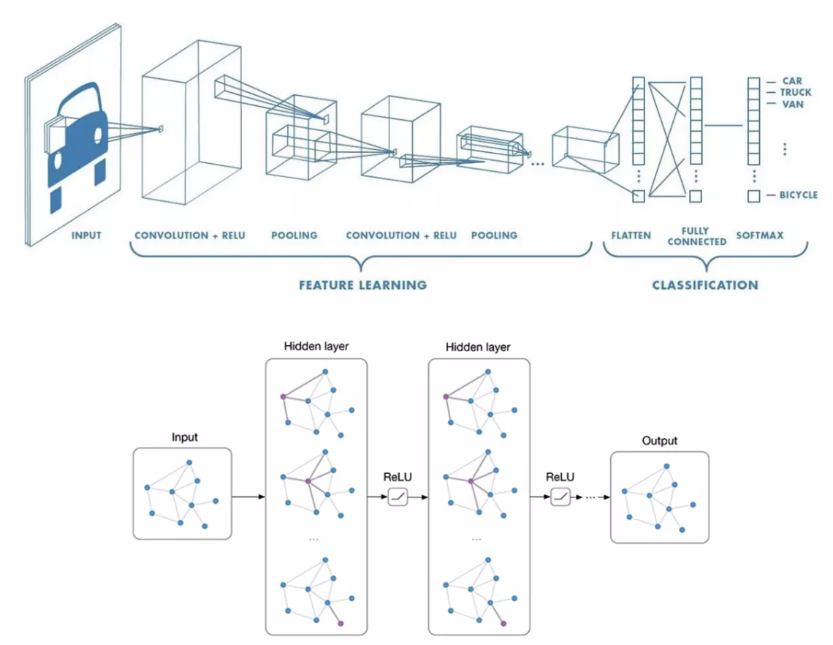
GCN - Graph Convolutional Networks
CNN on Image using convolution
GCN on Graph using convolution

Slide 3
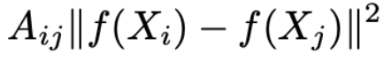
Problem Definition
problem of classifying nodes in graph, but labeled only subset of data
=> graph-based semi-supervised learning
Previous approaches
=> graph Laplacian regularization term in loss function
=> 연결되어 있는 node 들은 비슷한 label 값을 가진다는 assumption
=> Graph Capacity Restriction
Notes:
Lo = supervised loss
lambda = weight A = adjacency matrix X = node feature vector
f() = neural network
delta = graph Laplacian = D - A

Slide 4
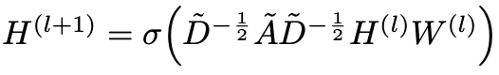
Theoretical Motivation
Layer-wise propagation rule of GCN
Spectral Graph Convolution (Graph Fourier Transform)
First-Order Approximation with Chebyshev Polynomials
Renormalization Trick

Slide 5
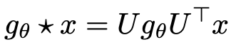
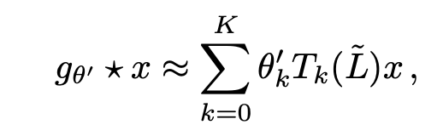
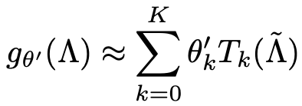
Theoretical Motivation
1. Spectral Graph Convolution (Graph Fourier Transform)
expensive computation
=> Chebyshev Polynomials
gθ: filter x: signal of nodes L: laplacian matrix
UΛU⊤ : eigen decomposition of L D: Degree matrix IN = identity matrix

Slide 6

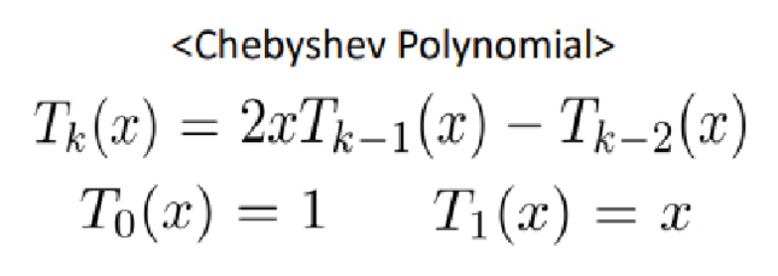
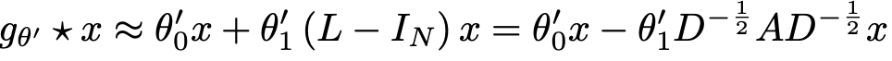
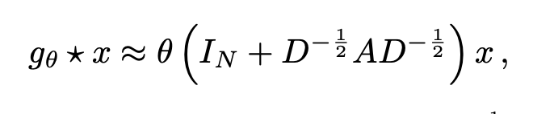
Theoretical Motivation
2. First-Order Approximation of Chebyshev Polynomial
K = 1
θ = θ0′ = −θ1′
λmax = 2

Slide 7
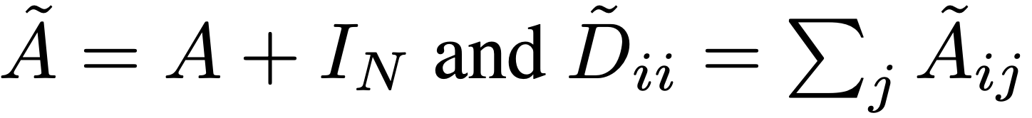

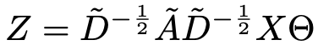
Theoretical Motivation
3. Renormalization Trick
exploding or vanishing gradient issues

Slide 8
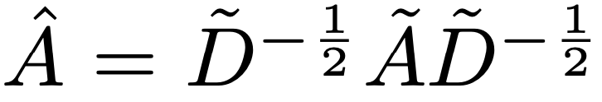

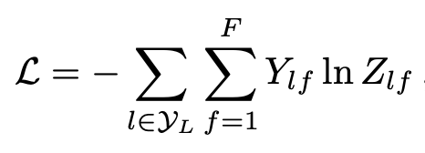
Method
Two-layer GCN for semi-supervised node classification on graph
Pre-processing step
Forward Model
Cross-entropy Loss

Slide 9
Experiments
Experiments for performance of GCN
GCN
semi-supervised embedding
Deep Walk
Planetoid
…
Experiments for proof of layer-wise propagation rule
Second-Order approximation
Third-Order approximation
No renormalization
…
Notes:
Manifold Regularization
semi-supervised embedding
label propagation
Deep Walk
Iterative Classification Algorithm
10 randomly drawn dataset

Slide 10
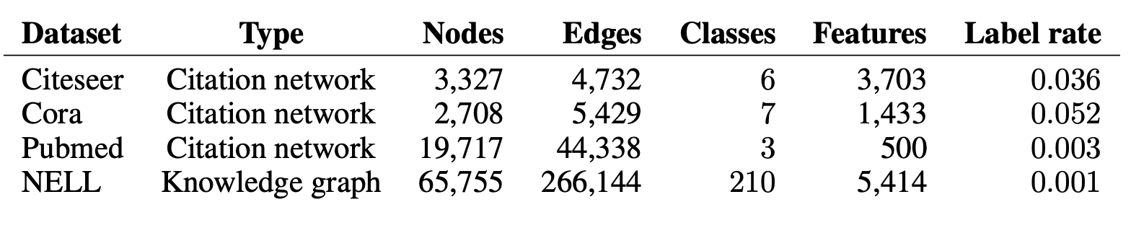
Experiments - Dataset

Slide 11
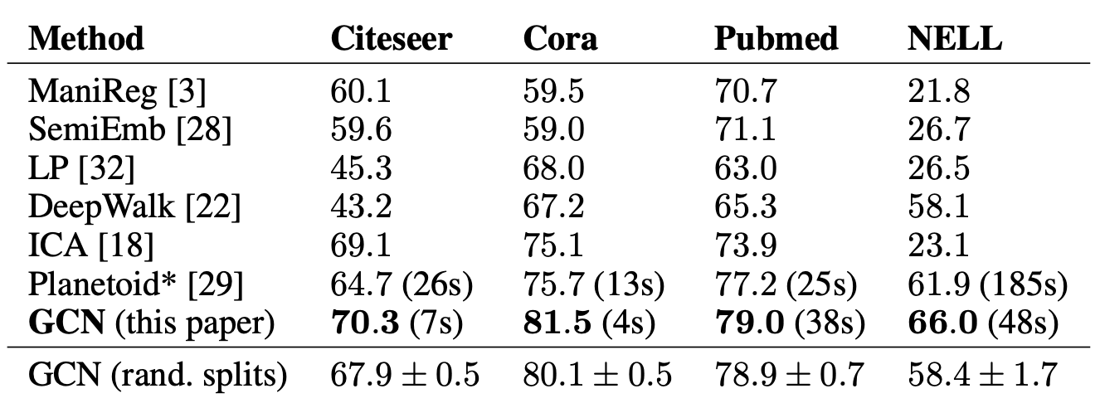
Experiments - Results of GCN and baseline methods
Notes:
Manifold Regularization
semi-supervised embedding
label propagation
Deep Walk
Iterative Classification Algorithm
10 randomly drawn dataset

Slide 12
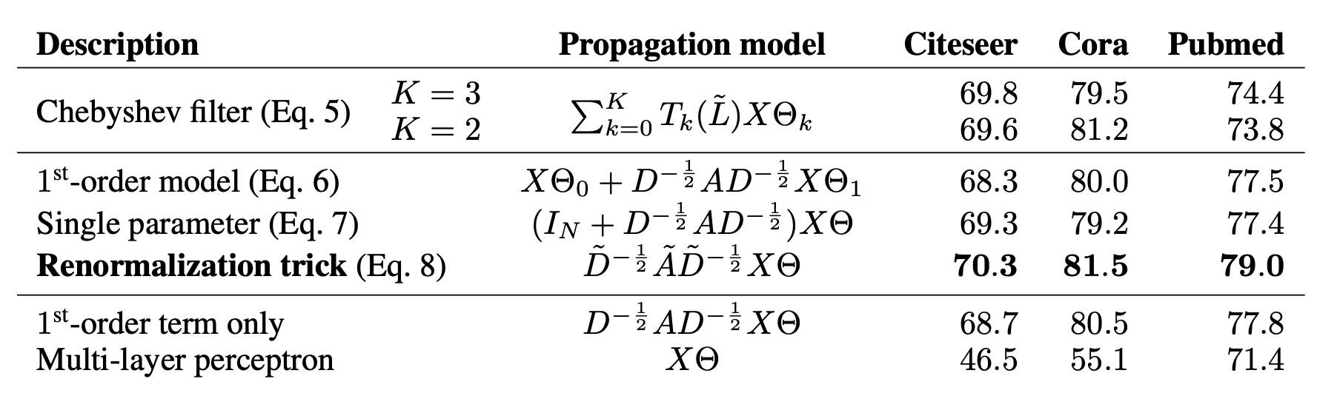
Experiments - Results of Propagation models
Notes:
Manifold Regularization
semi-supervised embedding
label propagation
Deep Walk
Iterative Classification Algorithm
10 randomly drawn dataset

Slide 13
Limitations & Future Work
Memory requirement
현재 실험에서는 full-batch gradient descent로 진행하기 때문에 요구 메모리 양이 data size에 linear하게 증가한다. dataset이 큰 경우에는 mini batch로 작동하도록 하여야 한다.
Directed edges and edge features
GCN framework는 undirected graph에 대해서 support 한다.
Limiting Assumptions
self connection과 edge to neighbor node의 가중치가 둘이 같다는 전제가 있지만, 이후에는 trainable weight을 이용하여 학습하도록 하는 실험이 필요하다.

Slide 14
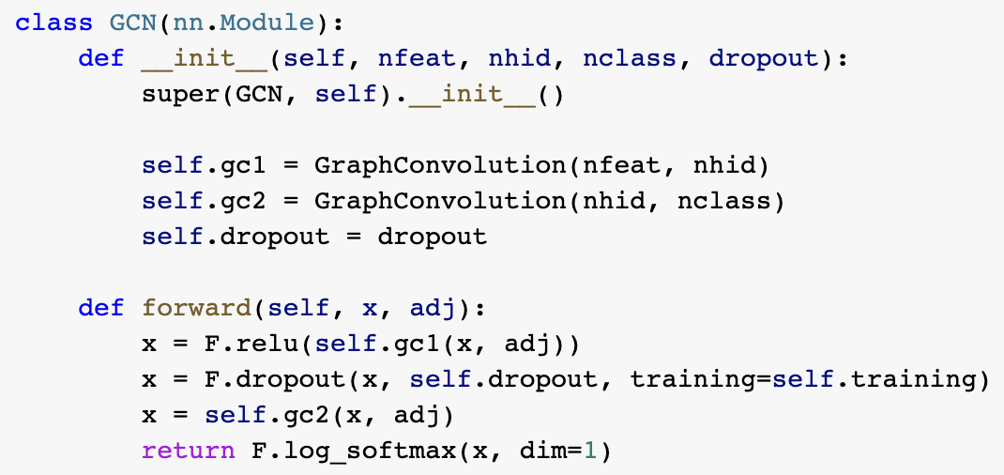
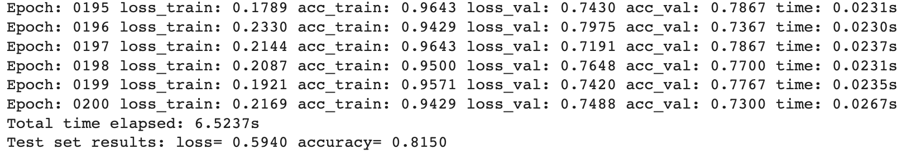
Implementation
GCN training on Cora dataset
Accuray = 0.8150
Same results with the Paper

