Slide 1




1. Send graphic data to VNC Server
3. Transform frame buffer and display
VNC Server
2. Convert graphic data to RBF and send them to clients.
VNC Client

Slide 2
1. Send graphic data to VNC Server
3. Transform frame buffer and display
VNC Server
2. Convert graphic data to RBF and send them to clients.
VNC Client

Slide 3
1. Send graphic data to VNC Server
3. Transform frame buffer and display
VNC Server
2. Convert graphic data to RBF and send them to clients.
VNC Client

Slide 4
3. Send graphic data to VNC Server
1. Transform frame buffer and display
VNC Server
2. Convert graphic data to RBF and send them to clients.
VNC Client

Slide 5
User Session
User Session
…
Graphics
Keyboard Mouse
Graphics
Keyboard Mouse
Session Management
RDP Graphic Driver
RDP Protocol
TCP/IP Protocol

Slide 6
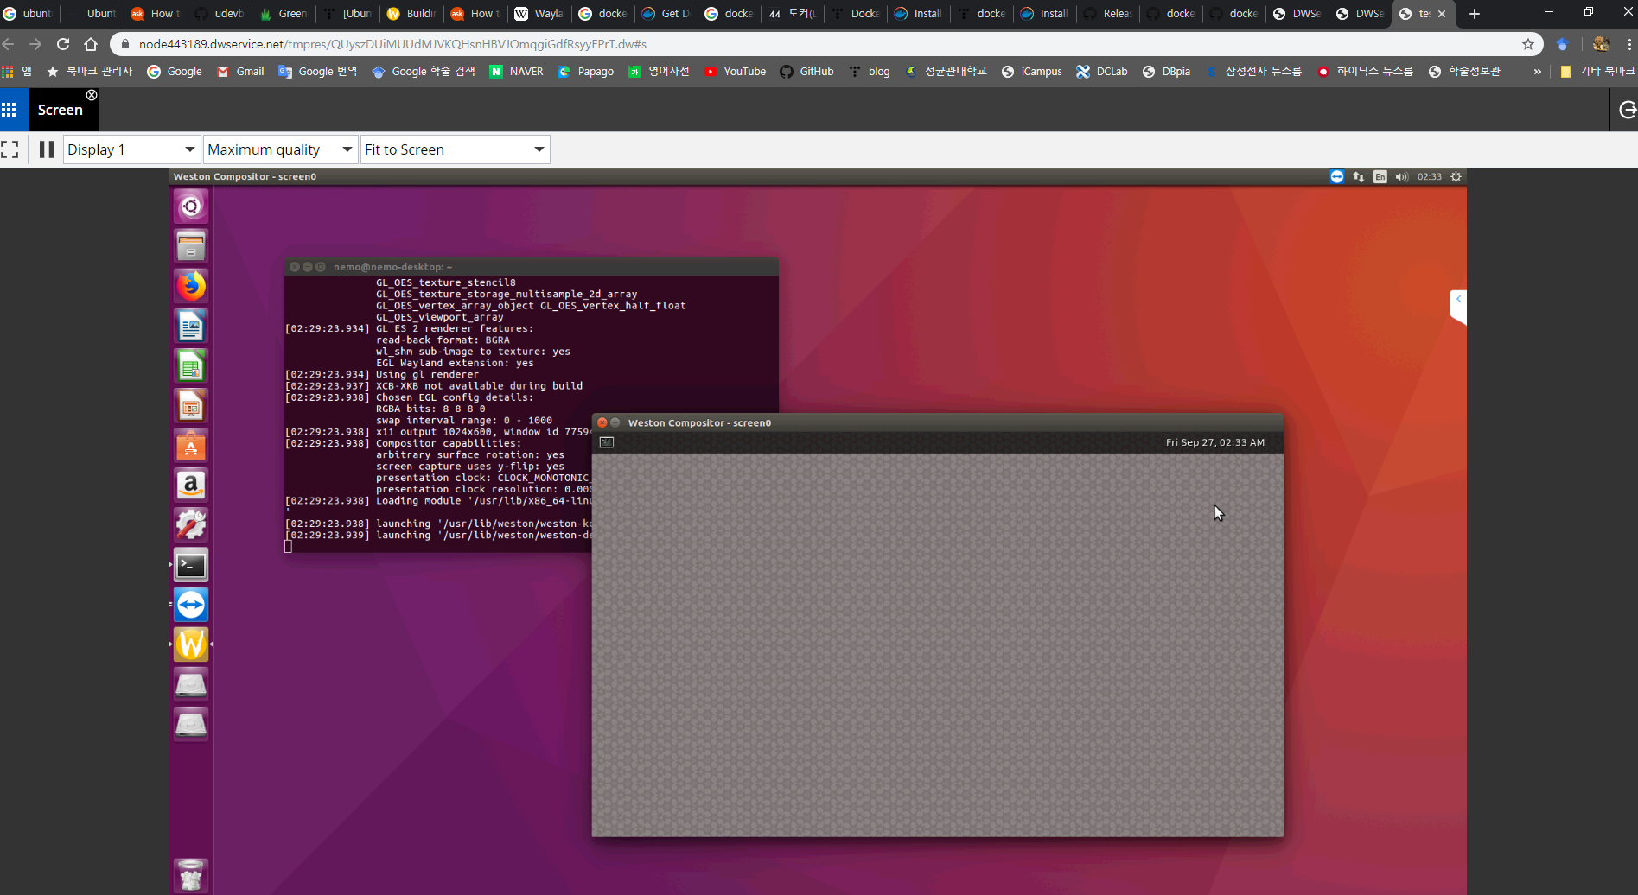

Slide 7
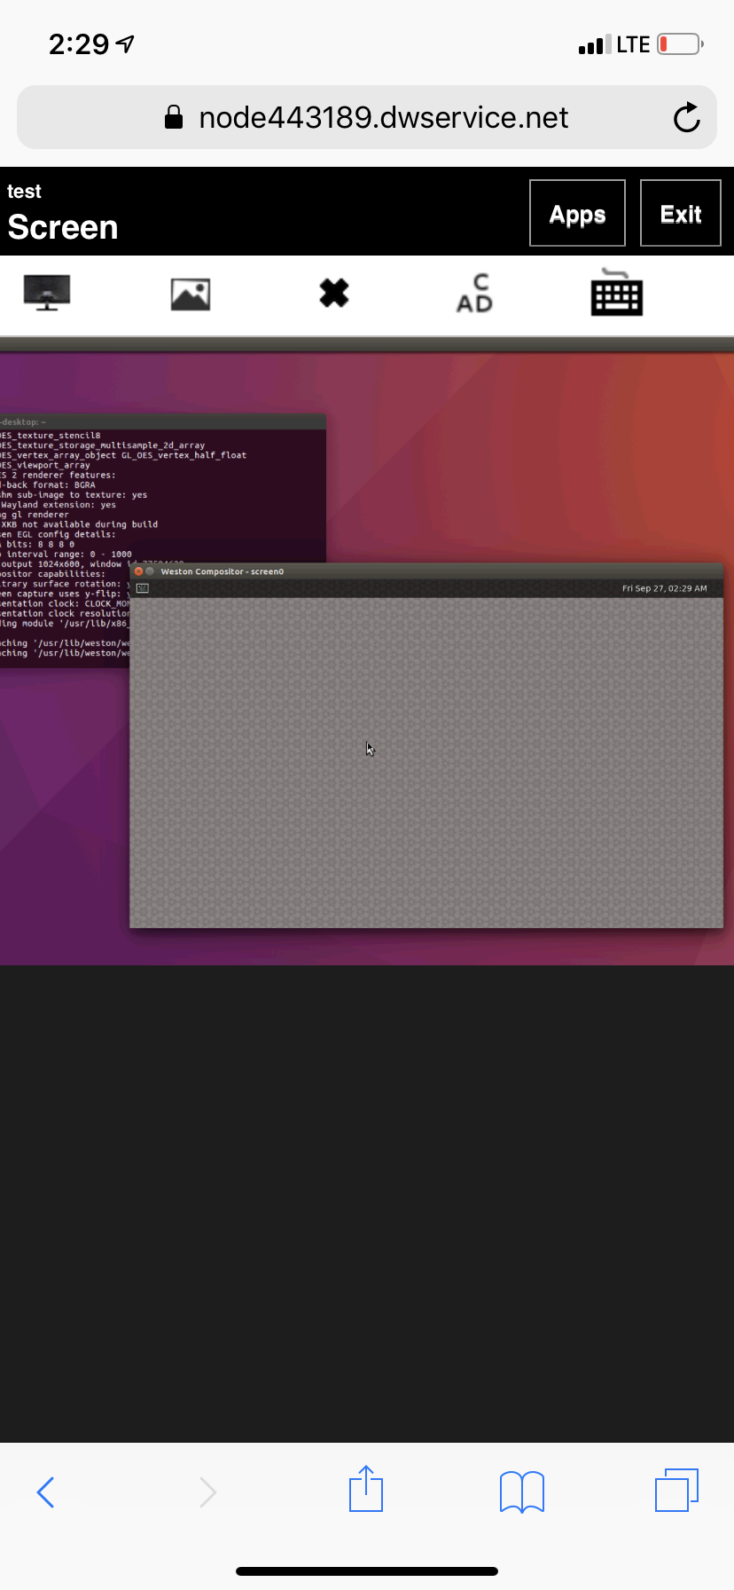

Slide 8
