Slide 1
Intelligent Open Source License
Recommandation System
Zamo Rzgar Ahmed | 2120246004
Naser Al Musalhi | 2120246005
Gheith Alrawahi | 2120246006
Gheyath AL Mamoori | 2120246020
Mohamed Sidi | 2120246048
2025

Slide 2
Why Licensing Matters in Open Source
01. Defines how others can use, change, or share your code.
02. Protects your legal rights.
03. Builds trust and encourages collaboration.
04. Avoids legal conflicts.
Notes:
Licensing is one of the most important parts of open-source software. A license tells others what they can or cannot do with your code.
Without a license, your project is technically “closed” — even if it’s on GitHub.
A good license gives protection to both the developer and the users. It also helps your project grow by allowing collaboration and reuse in a safe way.
But choosing the right license can be confusing — that’s where my tool comes in.

Slide 3
The Problem
01. Too many licenses: MIT, GPL, Apache, etc.
02. Developers are unsure which one fits.
03. Existing guides are complex or unclear.
Notes:
But here is the problem.
There are many licenses available — MIT, GPL, Apache, BSD, and more. Each one has different rules. Choosing the right one can be confusing, especially for new developers.
Many existing tools are too technical or hard to understand.
That’s why I created this tool — to simplify the decision.

Slide 4
What Is the Open License Generator?
01. A simple web tool.
02. Asks a few questions.
03. Recommends the best license.
04. Allows download and admin control.
Notes:
The Open License Generator is a smart quiz-based tool.
You just answer a few simple questions about your project — like:
Do you want commercial use?
Should users share improvements?
Based on your answers, the tool calculates the best matching license and shows it to you.
You can download the license file and even manage it from the admin panel.

Slide 5
Technology Stack
Backend: Laravel PHP Framework
Admin Panel: Filament PHP
Database: SQLite
Frontend: Tailwind CSS
Deployment: Docker-ready for local and cloud hosting
Notes:
The app is built fully with open-source technologies.
Laravel is used for the backend logic, and FilamentPHP is used for the admin panel to manage licenses and questions.
It’s lightweight, uses SQLite for easy testing, and works inside Docker for local or remote deployments.

Slide 6
How the Tool Works
01. User fills out a short questionnaire.
02. Each answer has a score related to licenses
03. The tool calculates which license fits best
04. The user sees the result and can download the license text.

Slide 7
License Selection Algorithm
1
Start Quiz.
2
For Each Question:
- User selects an option
- Add scores to related licenses
3
After All Questions Answered:
calculate total sum score for each
license based on answers
Notes:
Let me explain how the tool chooses the best license.
Each question in the quiz has several answer options. Each option is linked to one or more licenses, and gives them a score.
When the user completes the quiz, the tool adds up the scores for each license.
At the end, the license with the highest total score is recommended. If two or more licenses have the same highest score, we show them all.
This scoring system gives flexibility and makes the recommendation based on what really matters to the user — such as whether they want to allow commercial use, modifications, or require attribution.
The logic is stored in the database and can be updated at any time by the admin.

Slide 8
License Selection Algorithm
4
Find license(s) with the highest total score
5
Show recommended license(s) and allow download
Notes:
Let me explain how the tool chooses the best license.
Each question in the quiz has several answer options. Each option is linked to one or more licenses, and gives them a score.
When the user completes the quiz, the tool adds up the scores for each license.
At the end, the license with the highest total score is recommended. If two or more licenses have the same highest score, we show them all.
This scoring system gives flexibility and makes the recommendation based on what really matters to the user — such as whether they want to allow commercial use, modifications, or require attribution.
The logic is stored in the database and can be updated at any time by the admin.

Slide 9
Algorithm Design Highlights
Dynamic: Easy to add new licenses or update questions
Transparent: Admin can see how licenses are scored
Open Source: Anyone can use or improve the code

Slide 10

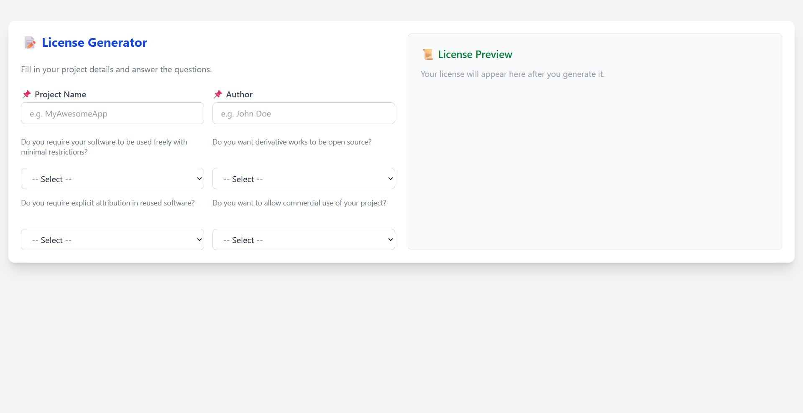
Live Demo

Slide 11

Project GitHub Repository

Slide 12
Future Work
01.
02.
Add more licenses (e.g., EPL, MPL)
Support multiple languages
03.
04.
Add explanations for each license
API access for developers
Notes:
In the future, I plan to:
Add more licenses
Make the tool available in multiple languages
Provide short explanations for each license
And maybe offer an API for other tools to connect

Slide 13
Conclusion
01. Licensing is essential for open source.
02. This tool helps choose the best license easily.
03. Tool built with modern open-source stack.
04. Ready to grow and help the community.
Notes:
The Open License Generator is a smart quiz-based tool.
You just answer a few simple questions about your project — like:
Do you want commercial use?
Should users share improvements?
Based on your answers, the tool calculates the best matching license and shows it to you.
You can download the license file and even manage it from the admin panel.

Slide 14

Questions

