Slide 1
Grafica si Design-ul Circuitelor Electronice (GDCE) Electronic Design Automation (EDA) Computer Aided Design (CAD) Proiectare Asistata de Calculator (PAC)
Course 1
Lecturer Adrian AVRAM, Ph.D.
adrian.avram@upt.ro

Slide 2
Necessary knowledge
Knowledge required to complete the EDA course:
A. Romanian section
DEO – Dispozitive Electronice si Optice
MCTE – Materiale, Componente si Tehologie Electronica
CEF – Circuite Electronice Fundamentale
B. Politehnica International section
1. ED – Electronic Devices
2. EC – Electronic Circuits
3. MCET – Materials, Components and Electronic Technology

Slide 3
Coverage Area
Coverage area with CAD knowledge:
CIA – Circuite Integrate Analogice (an II, sem.2)
CID – Circuite Integrate Digitale (an II, sem.1)
PCE – Proiect Circuite Electronice (an II, sem.2)
CTEE – Constructia si Tehnologia Echipamentelor Electronice (an IIi, sem.2)

Slide 4
Introduction
Before digging into the details of electronic design parts, we will take a moment to discuss computer-aided engineering (CAE) tools in general. Computer-aided engineering tools cover all aspects of engineering design from drawings to analysis to manufacturing. Computer-aided design (CAD) is a category of CAE that is related to the physical layout and drawing development of a system design. CAD programs specific to the electronics industry are known as electronic CAD (ECAD) or electronic design automation (EDA). EDA tools reduce development time and cost because they allow designs to be simulated and analyzed prior to purchasing and manufacturing hardware. Once a design has been proven through drawings, simulations, and analysis, the system can be manufactured. Applications used in manufacturing are known as computer-aided manufacturing (CAM) tools. CAM tools use software programs and design data (generated by the CAE tools) to control automated manufacturing machinery to turn a design concept into reality.

Slide 5
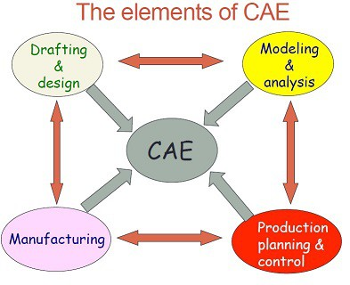
The stages of designing an electronic module

Slide 6
The stages of designing an electronic module
Drafting & design (Functional design): consists in choosing the components necessary for the application and determining how to interconnect them. The result of the functional design is an electronic scheme. At this stage the computer can be used for the description, synthesis and simulation of the electronic scheme, using programs from the CAE (Computer Aided Engineering) category.
Modeling (Equipment design): choosing the components from the manufacturers' catalogs, then depending on their size and application-specific requirements, choosing the equipment housing and designing the interface panels. CAD (Computer Aided Design) programs focused on geometric processing (AutoCad, Catia, etc.) are particularly useful at this stage.
Modeling (Design of printed wiring): allocation on the wiring (trace) of a space corresponding to each component of the electronic scheme and their interconnection through conductive paths arranged on one or more levels, forests and via. At this stage it is critical to use a CAD software dedicated to PCB design, which should take over at least the operation of scale generation of wiring drawings.
Notes:
Proiectarea funcţională: constă în alegerea componentelor necesare aplicaţiei şi determinarea modului de interconectare a acestora. Rezultatul proiectării funcţionale îl reprezintă o schemă electronică. În această etapă calculatorul poate fi utilizat pentru descrierea, sinteza şi simularea schemei electronice, utilizând programe din categoria CAE ( Computer Aided Engineering).
Concepţia echipamentului: alegerea componentelor din cataloagele producătorilor, apoi în funcţie de gabaritul acestora şi cerinţele specifice aplicaţiei, alegerea carcasei echipamentului şi proiectarea panourilor de interfaţă. Programe de tip CAD ( Computer Aided Design ) orientate pe procesări geometrice (AutoCad, Catia, etc) sunt deosebit de utile în această etapă.
Proiectarea cablajului imprimat: alocarea pe cablaj a unui spaţiu corespunzător fiecărei componente din schema electronică şi interconectarea acestora prin trasee conductoare dispuse pe unul sau mai multe niveluri, paduri şi via. În această etapă este critică utilizarea unui software de tip CAD dedicat proiectării PCB, care să preia cel puţin operaţia de generare la scară a desenelor de cablaj.
Analiza modulului virtual: este o etapă ce se poate realiza exclusiv cu ajutorul calculatorului, ce constă în estimarea parametrilor electrici, electromagnetici, termici şi mecanici reali, luând în considerare nu doar efectele urmărite ale structurii de interconectare, ci şi cele parazite, legate de cuplaje, reflexii, radiaţii, etc. Această etapă le validează pe cele anterioare şi permite estimarea fiabilităţii şi predicţia timpului de viaţă al viitorului produs.
Generarea fişierelor de fabricaţie (CAM = Computer Aided Manufacture): ţinând cont de faptul că marea majoritate a utilajelor implicate în fabricarea cablajelor imprimate sunt automatizate şi comandate de către calculator, este necesară transcrierea informaţiilor proiectului într-un format independent de software-ul utilizat şi care poate fi înţeles de către calculatoarele de proces, prin generarea unor fişiere specifice (de tip listă-de-comenzi).

Slide 7
The stages of designing an electronic module
Analysis (Analysis of the virtual module): it is a stage that can be performed exclusively with the help of the computer, which consists in estimating the real electrical, electromagnetic, thermal and mechanical parameters, taking into account not only the intended effects of the interconnection structure, but also the parasitic ones. , reflections, radiation, etc. This stage validates the previous ones and allows the estimation of the reliability and the prediction of the life time of the future product.
Manufacturing (Generation of computer files) (CAM = Computer Aided Manufacture): taking into account that the vast majority of machines involved in the manufacture of printed wiring are automated and controlled by the computer, it is necessary to transcribe project information in a format independent of the software used and which can be understood by process computers, by generating specific files (of order-list type).
Notes:
Proiectarea funcţională: constă în alegerea componentelor necesare aplicaţiei şi determinarea modului de interconectare a acestora. Rezultatul proiectării funcţionale îl reprezintă o schemă electronică. În această etapă calculatorul poate fi utilizat pentru descrierea, sinteza şi simularea schemei electronice, utilizând programe din categoria CAE ( Computer Aided Engineering).
Concepţia echipamentului: alegerea componentelor din cataloagele producătorilor, apoi în funcţie de gabaritul acestora şi cerinţele specifice aplicaţiei, alegerea carcasei echipamentului şi proiectarea panourilor de interfaţă. Programe de tip CAD ( Computer Aided Design ) orientate pe procesări geometrice (AutoCad, Catia, etc) sunt deosebit de utile în această etapă.
Proiectarea cablajului imprimat: alocarea pe cablaj a unui spaţiu corespunzător fiecărei componente din schema electronică şi interconectarea acestora prin trasee conductoare dispuse pe unul sau mai multe niveluri, paduri şi via. În această etapă este critică utilizarea unui software de tip CAD dedicat proiectării PCB, care să preia cel puţin operaţia de generare la scară a desenelor de cablaj.
Analiza modulului virtual: este o etapă ce se poate realiza exclusiv cu ajutorul calculatorului, ce constă în estimarea parametrilor electrici, electromagnetici, termici şi mecanici reali, luând în considerare nu doar efectele urmărite ale structurii de interconectare, ci şi cele parazite, legate de cuplaje, reflexii, radiaţii, etc. Această etapă le validează pe cele anterioare şi permite estimarea fiabilităţii şi predicţia timpului de viaţă al viitorului produs.
Generarea fişierelor de fabricaţie (CAM = Computer Aided Manufacture): ţinând cont de faptul că marea majoritate a utilajelor implicate în fabricarea cablajelor imprimate sunt automatizate şi comandate de către calculator, este necesară transcrierea informaţiilor proiectului într-un format independent de software-ul utilizat şi care poate fi înţeles de către calculatoarele de proces, prin generarea unor fişiere specifice (de tip listă-de-comenzi).

Slide 8
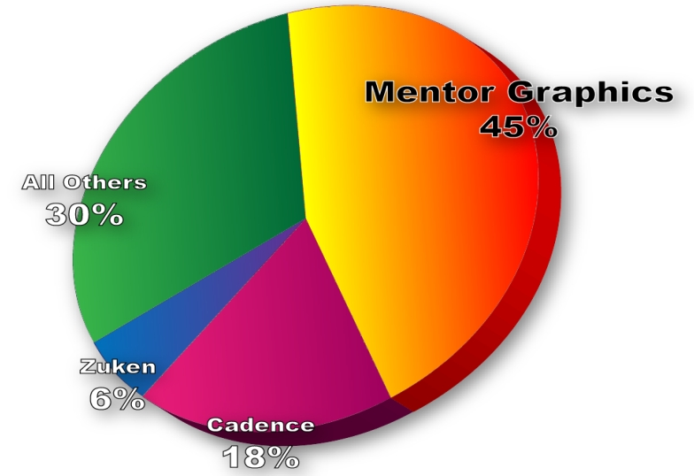
TYPES OF CAD TOOLS
CadSoft: Eagle
Altium: Protel
NI: MultiBoard
PADS
Expedition
(BoardStation)
CadStar
CR-5000
OrCad
Allegro

Slide 9
Classification by complexity
(range of design tools)
Simplu
Moderat
Complex
CR-5000
Expedition
Allegro
CadStar
Protel
OrCad
PADS
Eagle
MultiBoard

Slide 10
Classification by flexibility
(ability to adapt to a specific design flow)
Rigid
Moderat
Flexibil
CR-5000
Expedition
Allegro
Protel
PADS
Eagle
MultiBoard
CadStar
OrCad

Slide 11
Classification according to the learning curve
(ability according to the learning curve)
Uşor
Moderat
Dificil
Allegro
CR-5000
Expedition
Eagle
CadStar
PADS
MultiBoard
Protel
OrCad

Slide 12
Classification by destination
(according by demands)
Hobby
Semi-profesional
Profesional
CR-5000
Expedition
Allegro
CadStar
Protel
OrCad
PADS
Eagle
MultiBoard

Slide 13
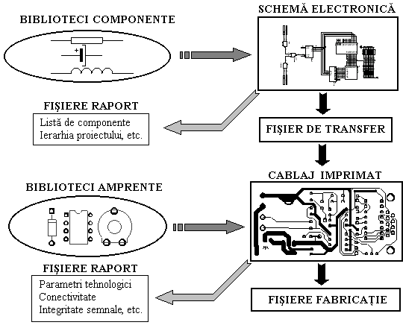
The contents of a printed circuit board project
The design of an electronic module involves the steps presented in the previous paragraph, one of which is the design of the printed wiring. Next figure shows the elements that a printed wiring project must contain and the correlations between them.

Slide 14
Schematic capture
Schematic capture or schematic entry is a step in the design cycle of electronic design automation (EDA) at which the electronic diagram, or electronic schematic of the designed electronic circuit is created by a designer.
This is done interactively with the help of a schematic capture tool also known as schematic editor.

Slide 15
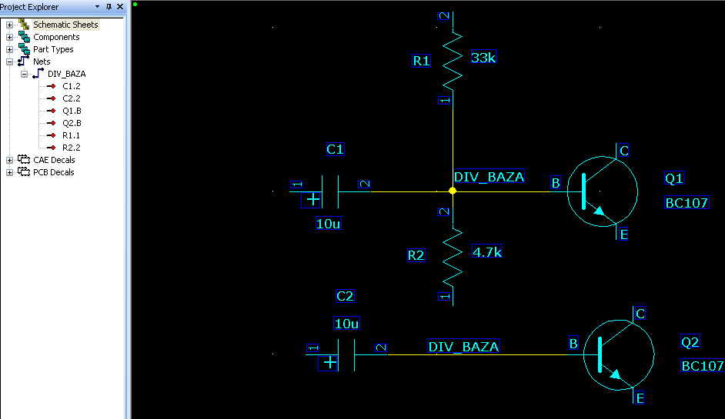
Circuit diagram
A simplified conventional graphical representation of an electrical circuit.
A schematic diagram shows the components of the circuit as simplified standard symbols. It shows the connections between the devices, including power and signal connections.

Slide 16
Schematic capture
Symbols used:
Components symbols:
Passive components (resistor, capacitor, etc)
Active components (BJT, FET, etc)
Integrated circuits, etc
Connectivity symbols:
Wire,
Label,
Bus.
Graphic symbols:
Text,
Line,
Polygons.

Slide 17
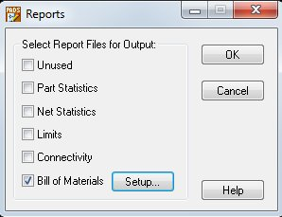
Generating Reports
Use the Reports dialog box to produce any of six different types of reports on the current schematic. You can save these reports as text files on your hard disk or output them to a printer.
On the File menu, click Report.
In the Reports dialog box, select each report you want to generate. PADS Logic directs all reports, except the netlist report, padsnet.asc, into a single text file, report.rep.
Unused Report
Part Statistics Report
Net Statistics Report
Limits Report
Connectivity Report
Bill of Materials Report
To specify or modify the report characteristics of the Bill of Materials report, click Setup.

Slide 18
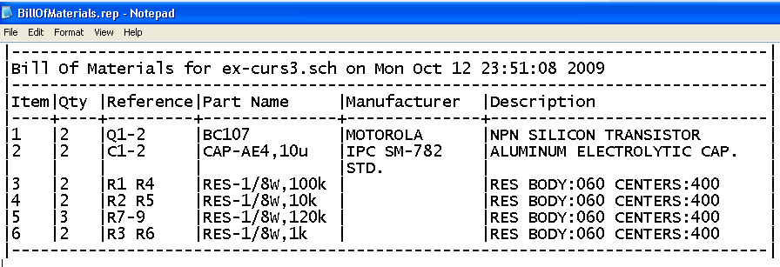
Output Report files
Bill Of Materials = BOM
The Bill of Materials report produces a user-configurable list of the parts contained in the current schematic. You can direct any part attribute in the schematic to a Bill of Materials report.
Usual extracted information:
- Part Name
- Quantity of the same part type
- Parts references
- Manufactures, Cost, etc
- Short description
There is a limit of 12 attributes in the Bill of Materials report

Slide 19
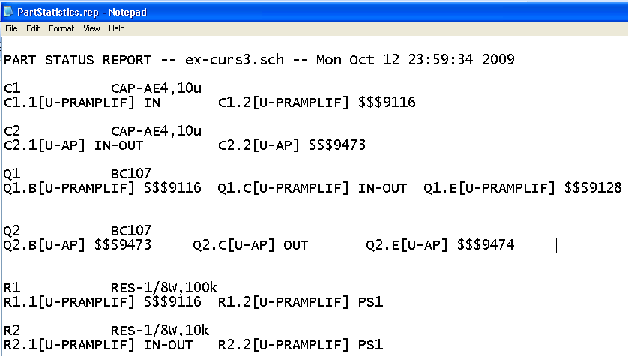
Output Report files
2. Part Statistics Report
The Part Statistics report lists information about all parts in the schematic. The report includes the reference designator name and part type for each part in the schematic, and for each pin on the part, the pin type, sheet location, and signal name. Use this report to locate possible errors in the schematic.

Slide 20
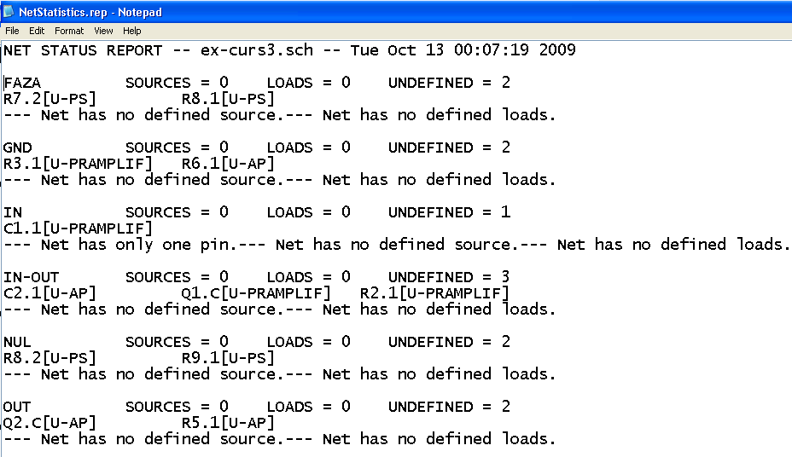
Output Report files
3. Net Statistics - report lists information for each net in the schematic. The report includes the reference designator name and pin number for all parts in the net. PADS Logic flags possible errors (for example, nets with no inputs or no outputs, nets with multiple outputs, etc.) for further examination. Use this report to locate possible errors in the schematic.
Error messages that can occur:
Net has only one pin: a net going to an off-page flag not connected elsewhere.
Net has no defined source: there is no pin in the net that has a pin type of Source.
Net has no defined loads: there is no pin in the net that has a pin type of Load.
Net has multiple sources - be sure they are tieable: the net has more than 1 pin with the pin type Source.

Slide 21
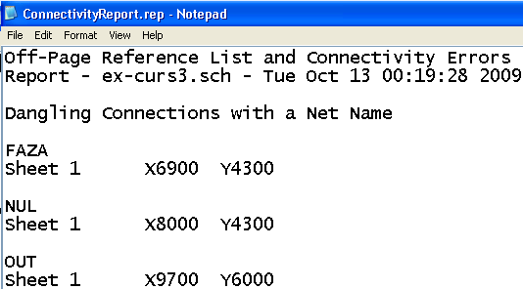
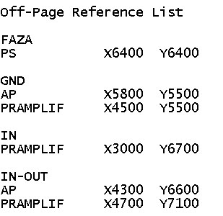
Output Report files
4. Connectivity Report
The Connectivity report lists the X,Y coordinate location and sheet number of all off-page, ground, and power symbols in the schematic.
Tip: Use the report to quickly locate an off-page symbol using the S (Search) command.
An error message appears when a net contains only one off-page reference. Subnets tied together without a visible net name are identified by flagging them as missing an off-page symbol.

Slide 22
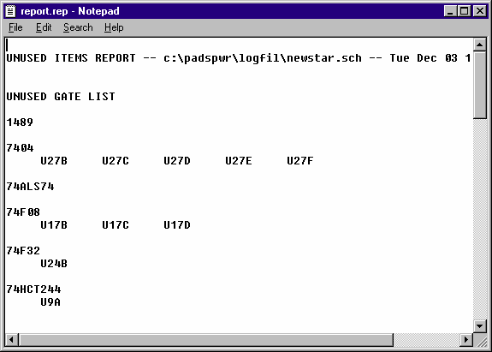
Output Report files
5. Unused Report
The Unused report lists all unused gates and pins in the schematic. Use this report for trouble shooting and to maximize part usage. The Unused report first lists unused parts and gates, followed by a list of unused pins on each part.

Slide 23
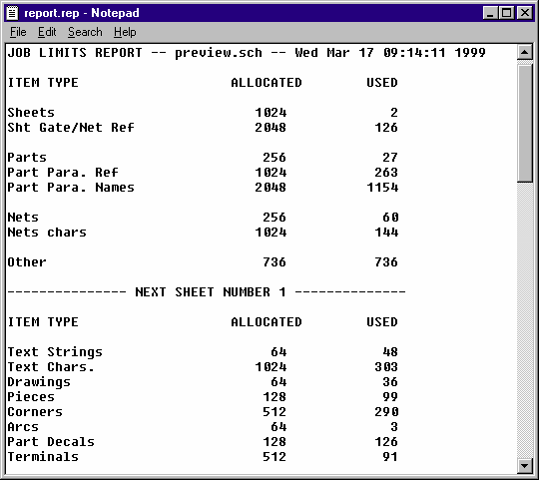
Output Report files
6. Limits Report
The Limits report indicates the maximum number of each PADS Logic data item (parts, nets, text) your system will allow, as well as the current count of each of these items in the schematic. This limit varies depending on the amount of virtual memory that is available.
The report has two parts.
The first is a list of items whose limits are common to the entire schematic. The second is a count, for each schematic sheet, of the items whose limits apply for each sheet.
You should periodically run a Limits report to ensure that you are not approaching the system's limit for any item.
If you exceed the Maximum No. of Items for any item, you cannot continue adding those items to the schematic. The solution is to split the design into multiple schematics, run separate netlists for each schematic, then merge the netlists using a text editor.

Slide 24
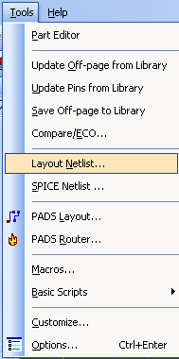
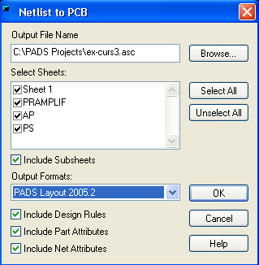
Tools
3. NETLIST
- TOOLS – Layout Netlist – You can create netlists compatible with few PADS Layout versions. All formats support optional output of subsheets, design rules, part attributes, and net attributes.
- TOOLS – SPICE Netlist – After you add parts (with SPICE attributes) to your schematic, or add SPICE attributes to existing parts, you can create a SPICE netlist in preparation for simulation.

Slide 25
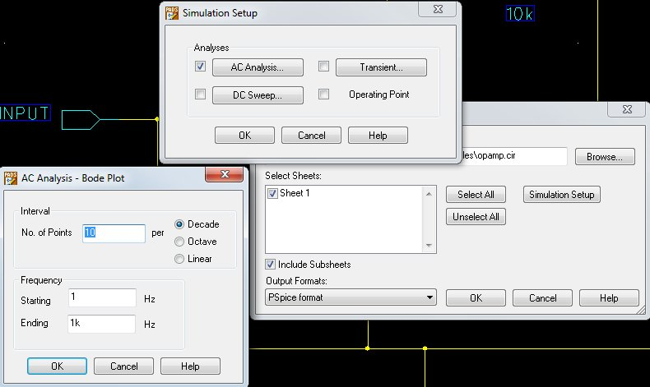
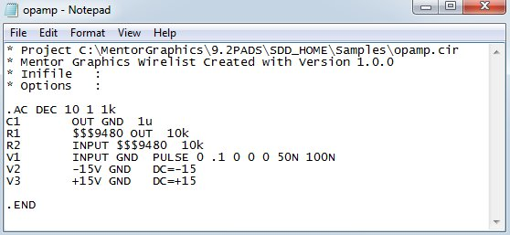
SPICE Netlist
Notes:
It is possible to set up analysis for later simulation. Analysis command will be included in spice netlist.

Slide 26
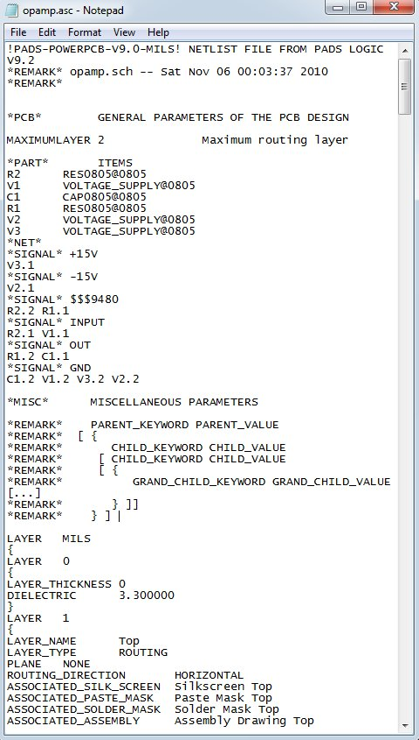
Layout Netlist
The generated netlist is named <schematic_name>.asc.
If errors are found in the netlist, an errors report file (<schematic_name>.err) is generated, and a link to the error file is displayed in the Output Window.
If the Output Window is not enabled, the error report file is displayed in a Notepad window.
No errors file is generated if no errors are found.
The following are reported in the errors report file:
Library issues
Single or zero pin nets
Totally floating connections or subnets
Unnamed dangling connections (one end floating)
Power and Ground symbols used on nets whose name is different from the default name on the symbol
Multiple subnet nets where one or more subnets is missing an off-page symbol
Single subnet nets with an off-page symbol (lonely subnet warning)
User named subnets that have no visible net name label

Slide 27
What is PCB
Printed Circuit Board
Electronic Board that connects circuit components
PCB populated with electronic components is a printed circuit assembly (PCA) or printed circuit board assembly (PCBA)
PCBs are rugged, inexpensive, and can be highly reliable
Mass manufacturing
Professional
Notes:
A printed circuit board, or PCB, is used to mechanically support and electrically connect electronic components using conductive pathways, tracks or signal traces etched from copper sheets laminated onto a non-conductive substrate. It is also referred to as printed wiring board (PWB) or etched wiring board. A PCB populated with electronic components is a printed circuit assembly (PCA), also known as a printed circuit board assembly (PCBA).

Slide 28
What is PCB
Any electronic module is a collection of interconnected electronic components to perform a specific function. At the level of functional design, the future module exists in the form of an electronic scheme containing the symbols of the components used and the connections to be made in order to implement the desired function. However, in order to transform an electronic scheme into a physical module, it is necessary to interconnect the actual components, a function performed by the printed wiring.

Slide 29
What is PCB
In a simplified definition, a printed wiring (PCB = Printed Circuit Board, PWB = Printed Wiring Board) is a passive structure that ensures the interconnection of electronic components in a unitary assembly. Far from being an insignificant component in the whole called "electronic module", as sometimes tends to be considered, printed wiring performs multiple functions, including: mechanical fixing of components, their electrical interconnection, heat dissipation, electromagnetic shielding, interfacing the module with the environment (interface panels or other module), implementing passive circuits with distributed parameters, etc.

Slide 30
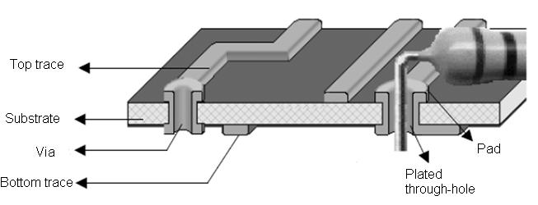
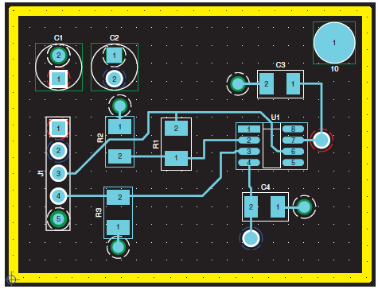
What is PCB
PCB structure
Notes:
A PCB consists of two basic parts: a substrate (the board) and printed wires (the copper traces). The substrate provides a structure that physically holds the circuit components and printed wires in place and provides electrical insulation between conductive parts.
Here is presented a piece of PCB and an layout for PCB

Slide 31
CAM files
A last stage (not exactly unsatisfactory for the designer) to be completed is the transfer of project information to the production hall, which will allow the materialization of his work in the form of an electronic module. This transfer is done in two ways: through printed documents, addressed to operators, and through manufacturing files (or CAM, acronym for Computer Aided Manufacturing), addressed to machines that automatically perform the processing involved in the manufacture of a printed wiring .

Slide 32
CAM files
Gerber files: intended for the photo-plotter, for making the films corresponding to each level.
NC Drill files for coordinate drilling machines
Pick and Place files for automatic component placement robots

