Slide 1
Presentation
Programming for Humanities

Slide 2
Choice of topic
US Election 2020 on twitter
Which days do users tweet?
From which states do users tweet?
Sentiment analysis
Tweets regarding Donald Trump are more valenced
Are democratic states pro-Biden?
What are the sentiment scores in the different states?
Sentiment change as election day approaches

Slide 3
Data
”US Election 2020 Tweets” from Kaggle
https://www.kaggle.com/manchunhui/us-election-2020-tweets
Number of tweets
#DonaldTrump: 970.919
#JoeBiden: 776.886
Columns of interest
[hashtag, tweet, created_at, country, state_code]

Slide 4

Sentiment analysis + preprocessing
Code Walkthrough

Slide 5
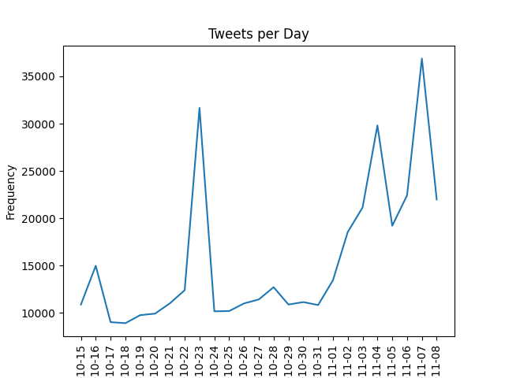
Which days do users tweet?
daily_tweeting = df.groupby(['day_tweeted']).size().reset_index(name='counts') # Making the plot fig, ax = plt.subplots() ax.plot(daily_tweeting['day_tweeted'], daily_tweeting['counts']) ax.set_ylabel('Frequency') ax.set_title('Tweets per Day') plt.xticks(rotation=90) plt.show()

Slide 6
From which states do users tweet?
# Grouping by state code and counting the number of tweets within each state tweets_per_state = df.groupby(['code']).size().reset_index(name='counts’).
sort_values(by=['counts'], ascending=False) # Doing the plotly magic fig = go.Figure(data=go.Choropleth( locations=tweets_per_state['code'], # Spatial coordinates z = tweets_per_state['counts'].astype(float), # Data to be color-coded locationmode = 'USA-states', # set of locations match entries in `locations` colorscale = 'Reds', colorbar_title = "Tweets", )) # Making labels fig.update_layout( title_text = '2020 US Election Number of Tweets per State', geo_scope='usa', # limite map scope to USA ) fig.show()

Slide 7
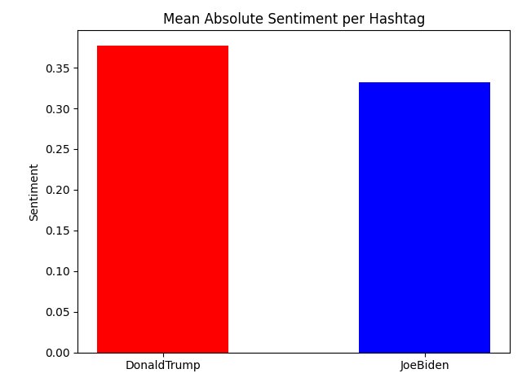
Trump TWEETS are more valenced than biden
# Grouping tweets by hashtag and getting the mean absolute valence grouped_by_hashtag = df.groupby('Hashtag')['abs_sentiment'].mean().reset_index() # Creating the plot ind = np.arange(2) p1 = plt.bar(ind, grouped_by_hashtag['abs_sentiment'], color = ['red', 'blue'], width = 0.5) plt.xticks(ind, grouped_by_hashtag['Hashtag']) plt.ylabel('Sentiment') plt.title('Mean Absolute Sentiment per Hashtag') plt.show()

Slide 8
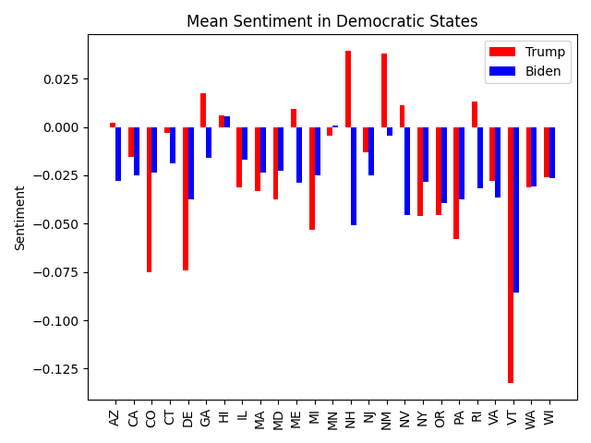
Are democratic states pro-biden?
TOO Heavy code. DO YOU WANNA SEE IT?

Slide 9
What are the sentiment scores in the different states?
# Filtering out all negative tweets df_negative = df.loc[df['sentiment_overall'] == 'Negative'] # Grouping by state code and getting the mean sentiment value abs_sentiment_per_state = df_negative.groupby('code')['sentiment'].mean().reset_index() # Doing the plotly magic fig = go.Figure(data=go.Choropleth( locations=abs_sentiment_per_state['code'], # Spatial coordinates z = abs_sentiment_per_state['sentiment'].astype(float), # Data to be color-coded locationmode = 'USA-states', # set of locations match entries in `locations` colorscale = 'Reds', colorbar_title = "Tweets", )) # Making labels fig.update_layout( title_text = '2020 US Election Negative Sentiment per State', geo_scope='usa', # limite map scope to USA ) fig.show()

Slide 10
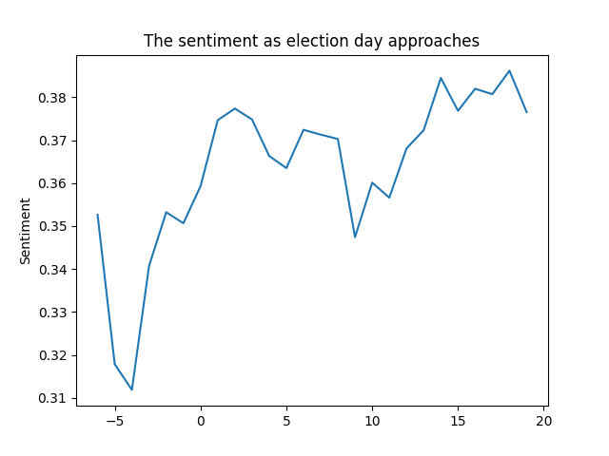
SENTIMENT CHANGE AS ELECTION APPROACHES
# Grouping by days before election days = df.groupby('days_before_election')['abs_sentiment'].mean().reset_index() # Making the plot fig, ax = plt.subplots() ax.plot('days_before_election', 'abs_sentiment', data=days) ax.set_ylabel('Sentiment') ax.set_title('The sentiment as election day approaches') plt.show() plt.savefig("./plots/sentiment_as_election_day_approaches") plt.clf()

Slide 11
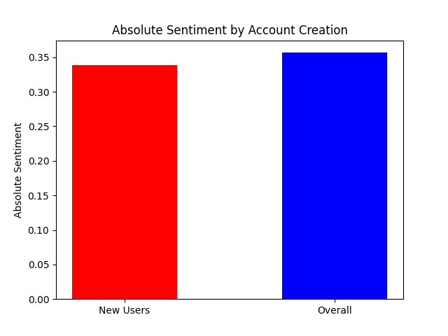
Absolute sentiment by account creation
# filtering tweets created by new accounts new_users =
df.loc[df['days_since_user_creation'] < 1] # plotting the difference means = [new_users['abs_sentiment'].mean(), df['abs_sentiment'].mean()] # Creating the plot ind = np.arange(2) plt.bar(ind, means, color = ['red', 'blue'], width = 0.5) plt.xticks(ind, ['New Users','Overall']) plt.ylabel('Absolute Sentiment') plt.title('Absolute Sentiment by Account Creation') plt.show()

Slide 12
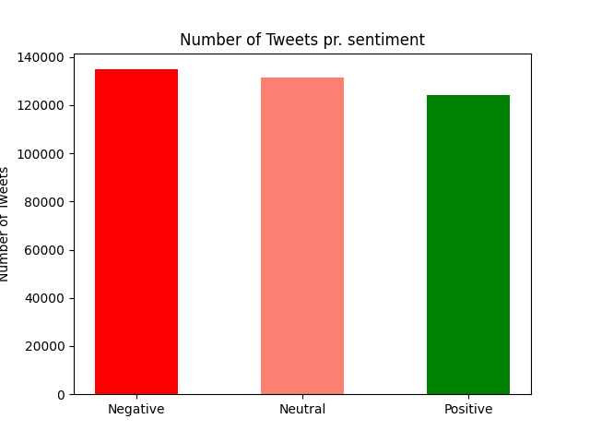
Tweets per sentiment verdict
# Grouping by sentiment label grouped_by_overall_sentiment = df.groupby('sentiment_overall').size().reset_index(name = 'counts').sort_values(by =['counts'], ascending= False) # Creating the indexes for the x axis ind_3 = np.arange(3) # Defining the x and y axis plt.bar(ind_3, grouped_by_overall_sentiment['counts'], color = ['red','salmon','green'], width= 0.5) # Creating the labels for the axis plt.xticks(ind_3, grouped_by_overall_sentiment['sentiment_overall']) plt.ylabel('Number of Tweets') plt.title('Number of Tweets pr. sentiment') plt.show()

Slide 13
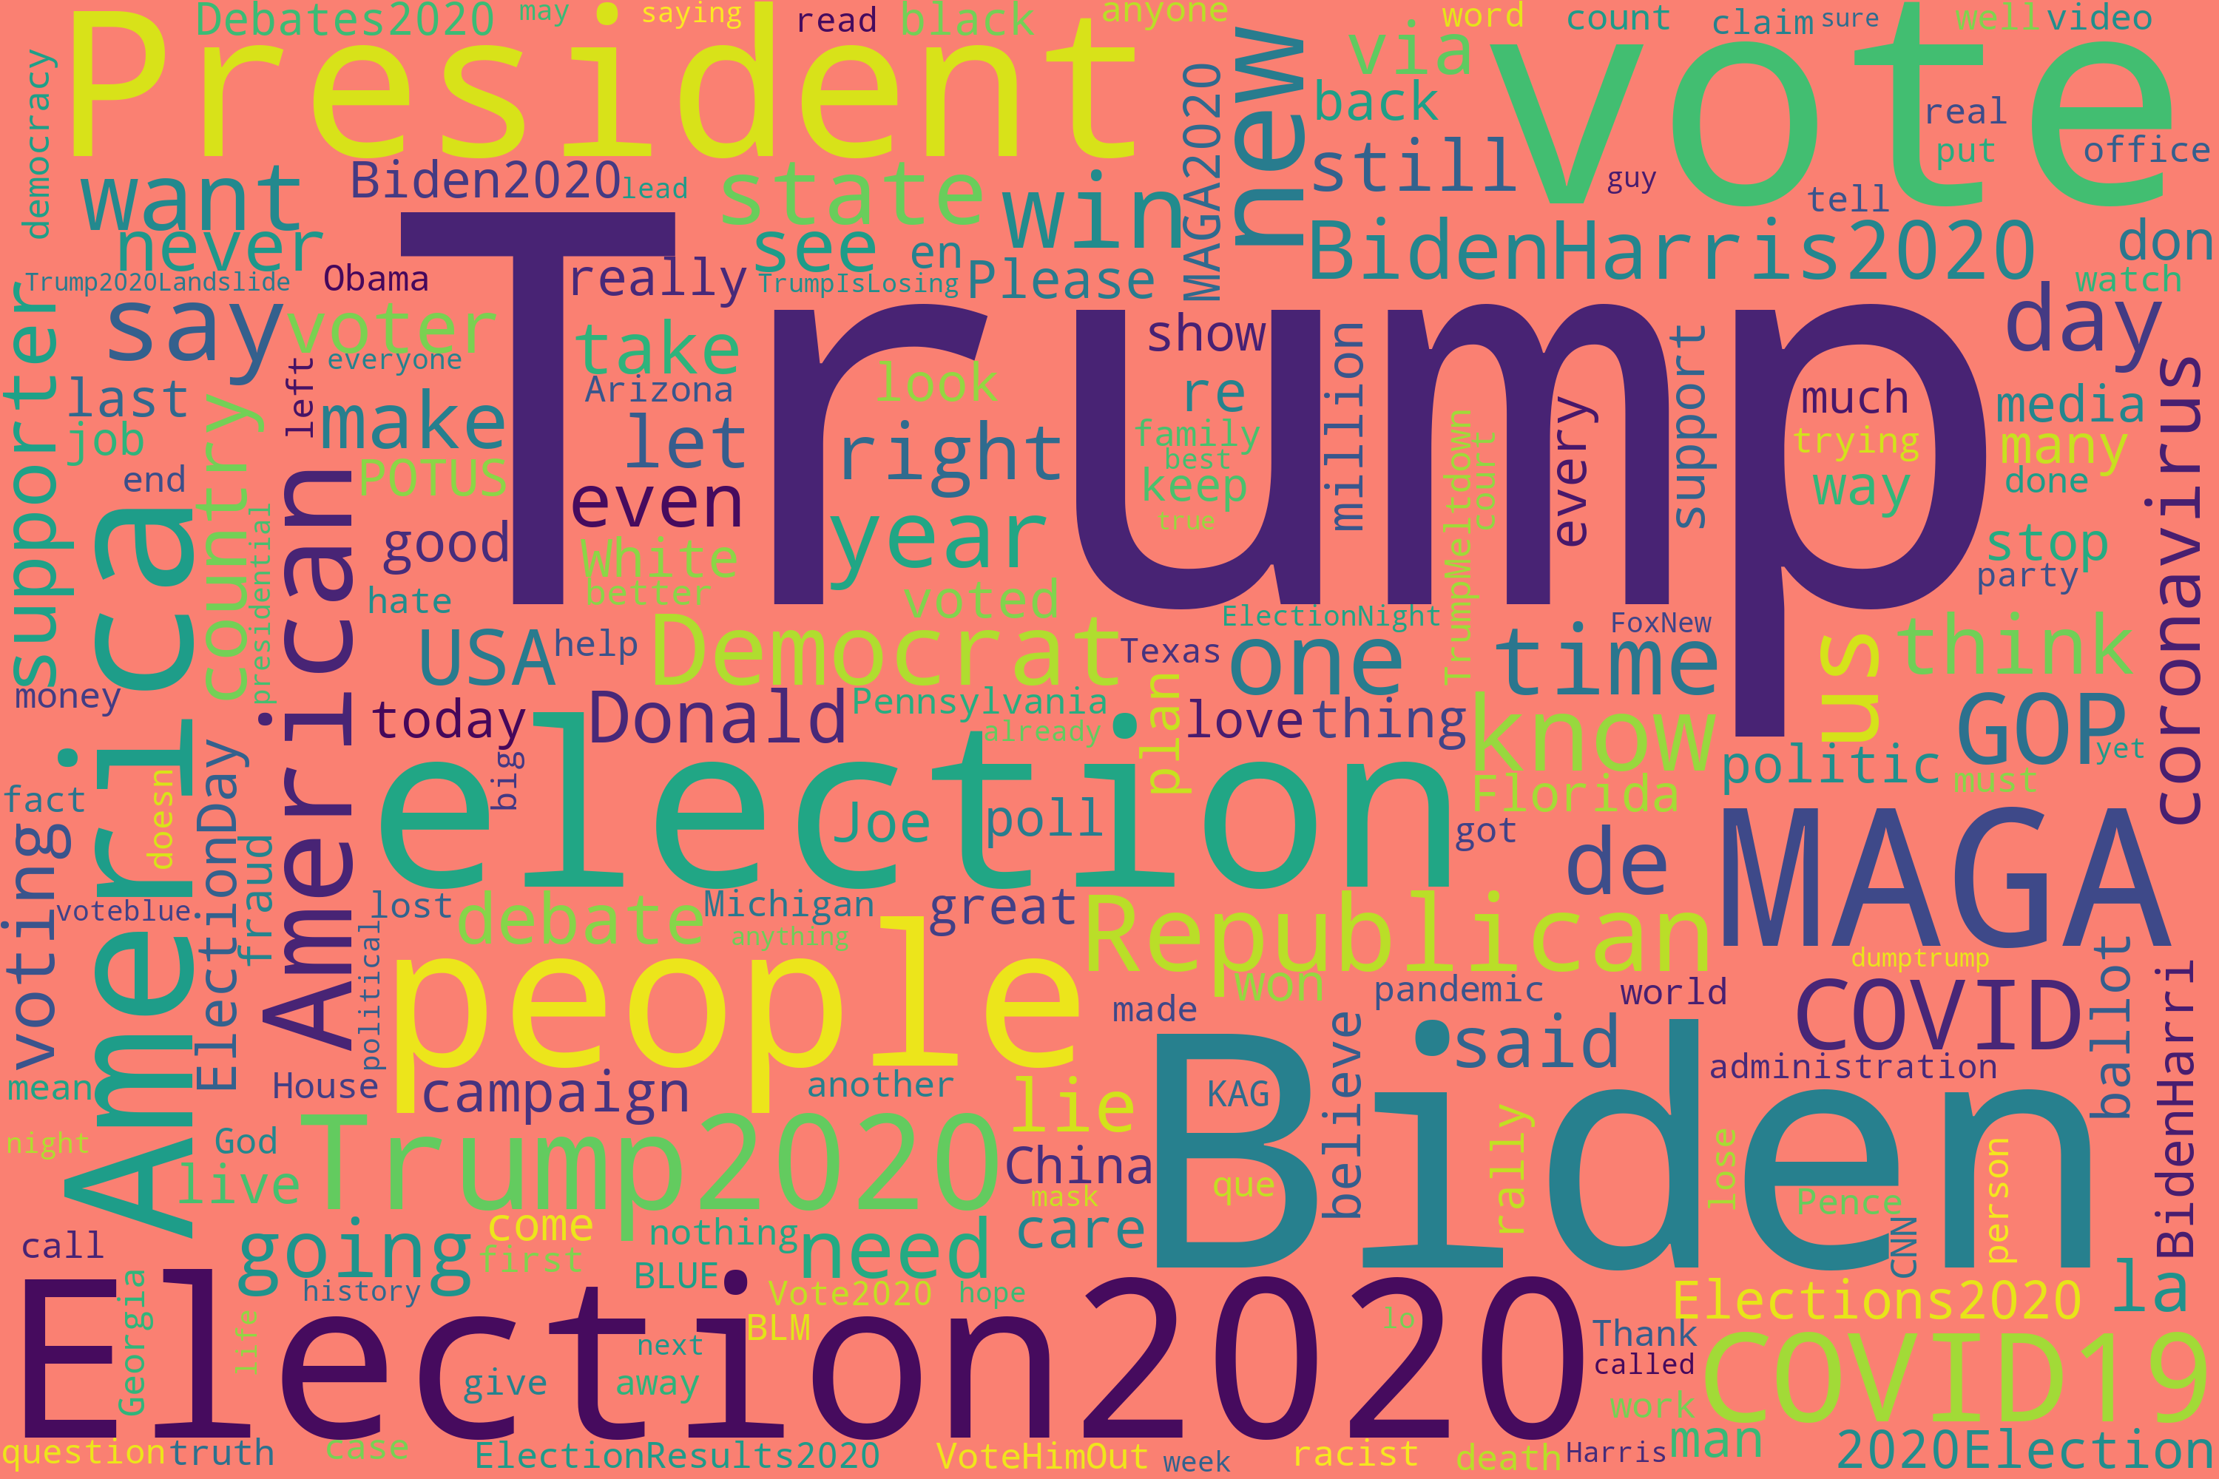
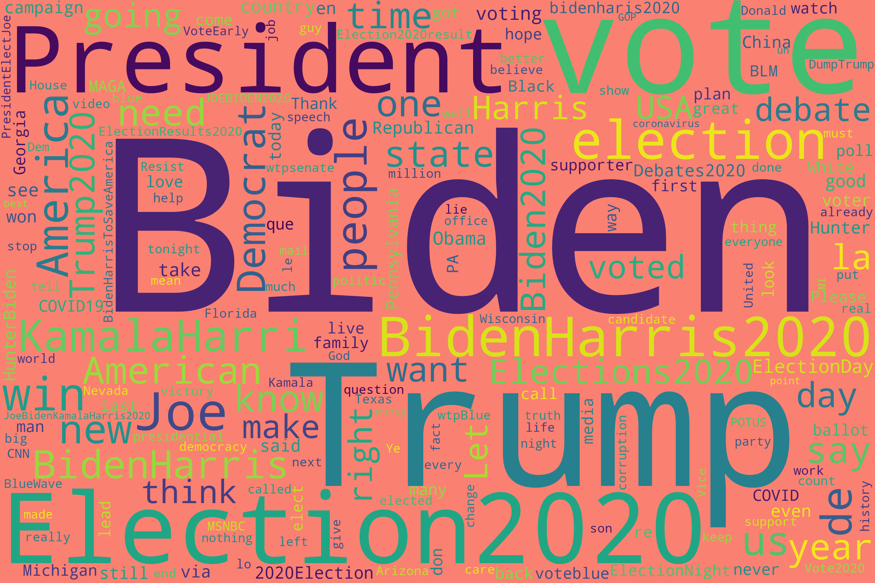
Wordclouds

