Slide 1
Presentation
Programming for Humanities

Slide 2
Choice of topic
US Election 2020 on twitter
From which states do users tweet?
Sentiment analysis
Sentiment change as election day approaches
Tweets regarding Donald Trump are more valenced
Democratic states are more pro-Biden

Slide 3
Data
”US Election 2020 Tweets” from Kaggle
https://www.kaggle.com/manchunhui/us-election-2020-tweets
Number of tweets
#DonaldTrump: 970.919
#JoeBiden: 776.886
Columns of interest
[hashtag, tweet, created_at, country, state_code]

Slide 4

Sentiment analysis + preprocessing
Code Walkthrough

Slide 5
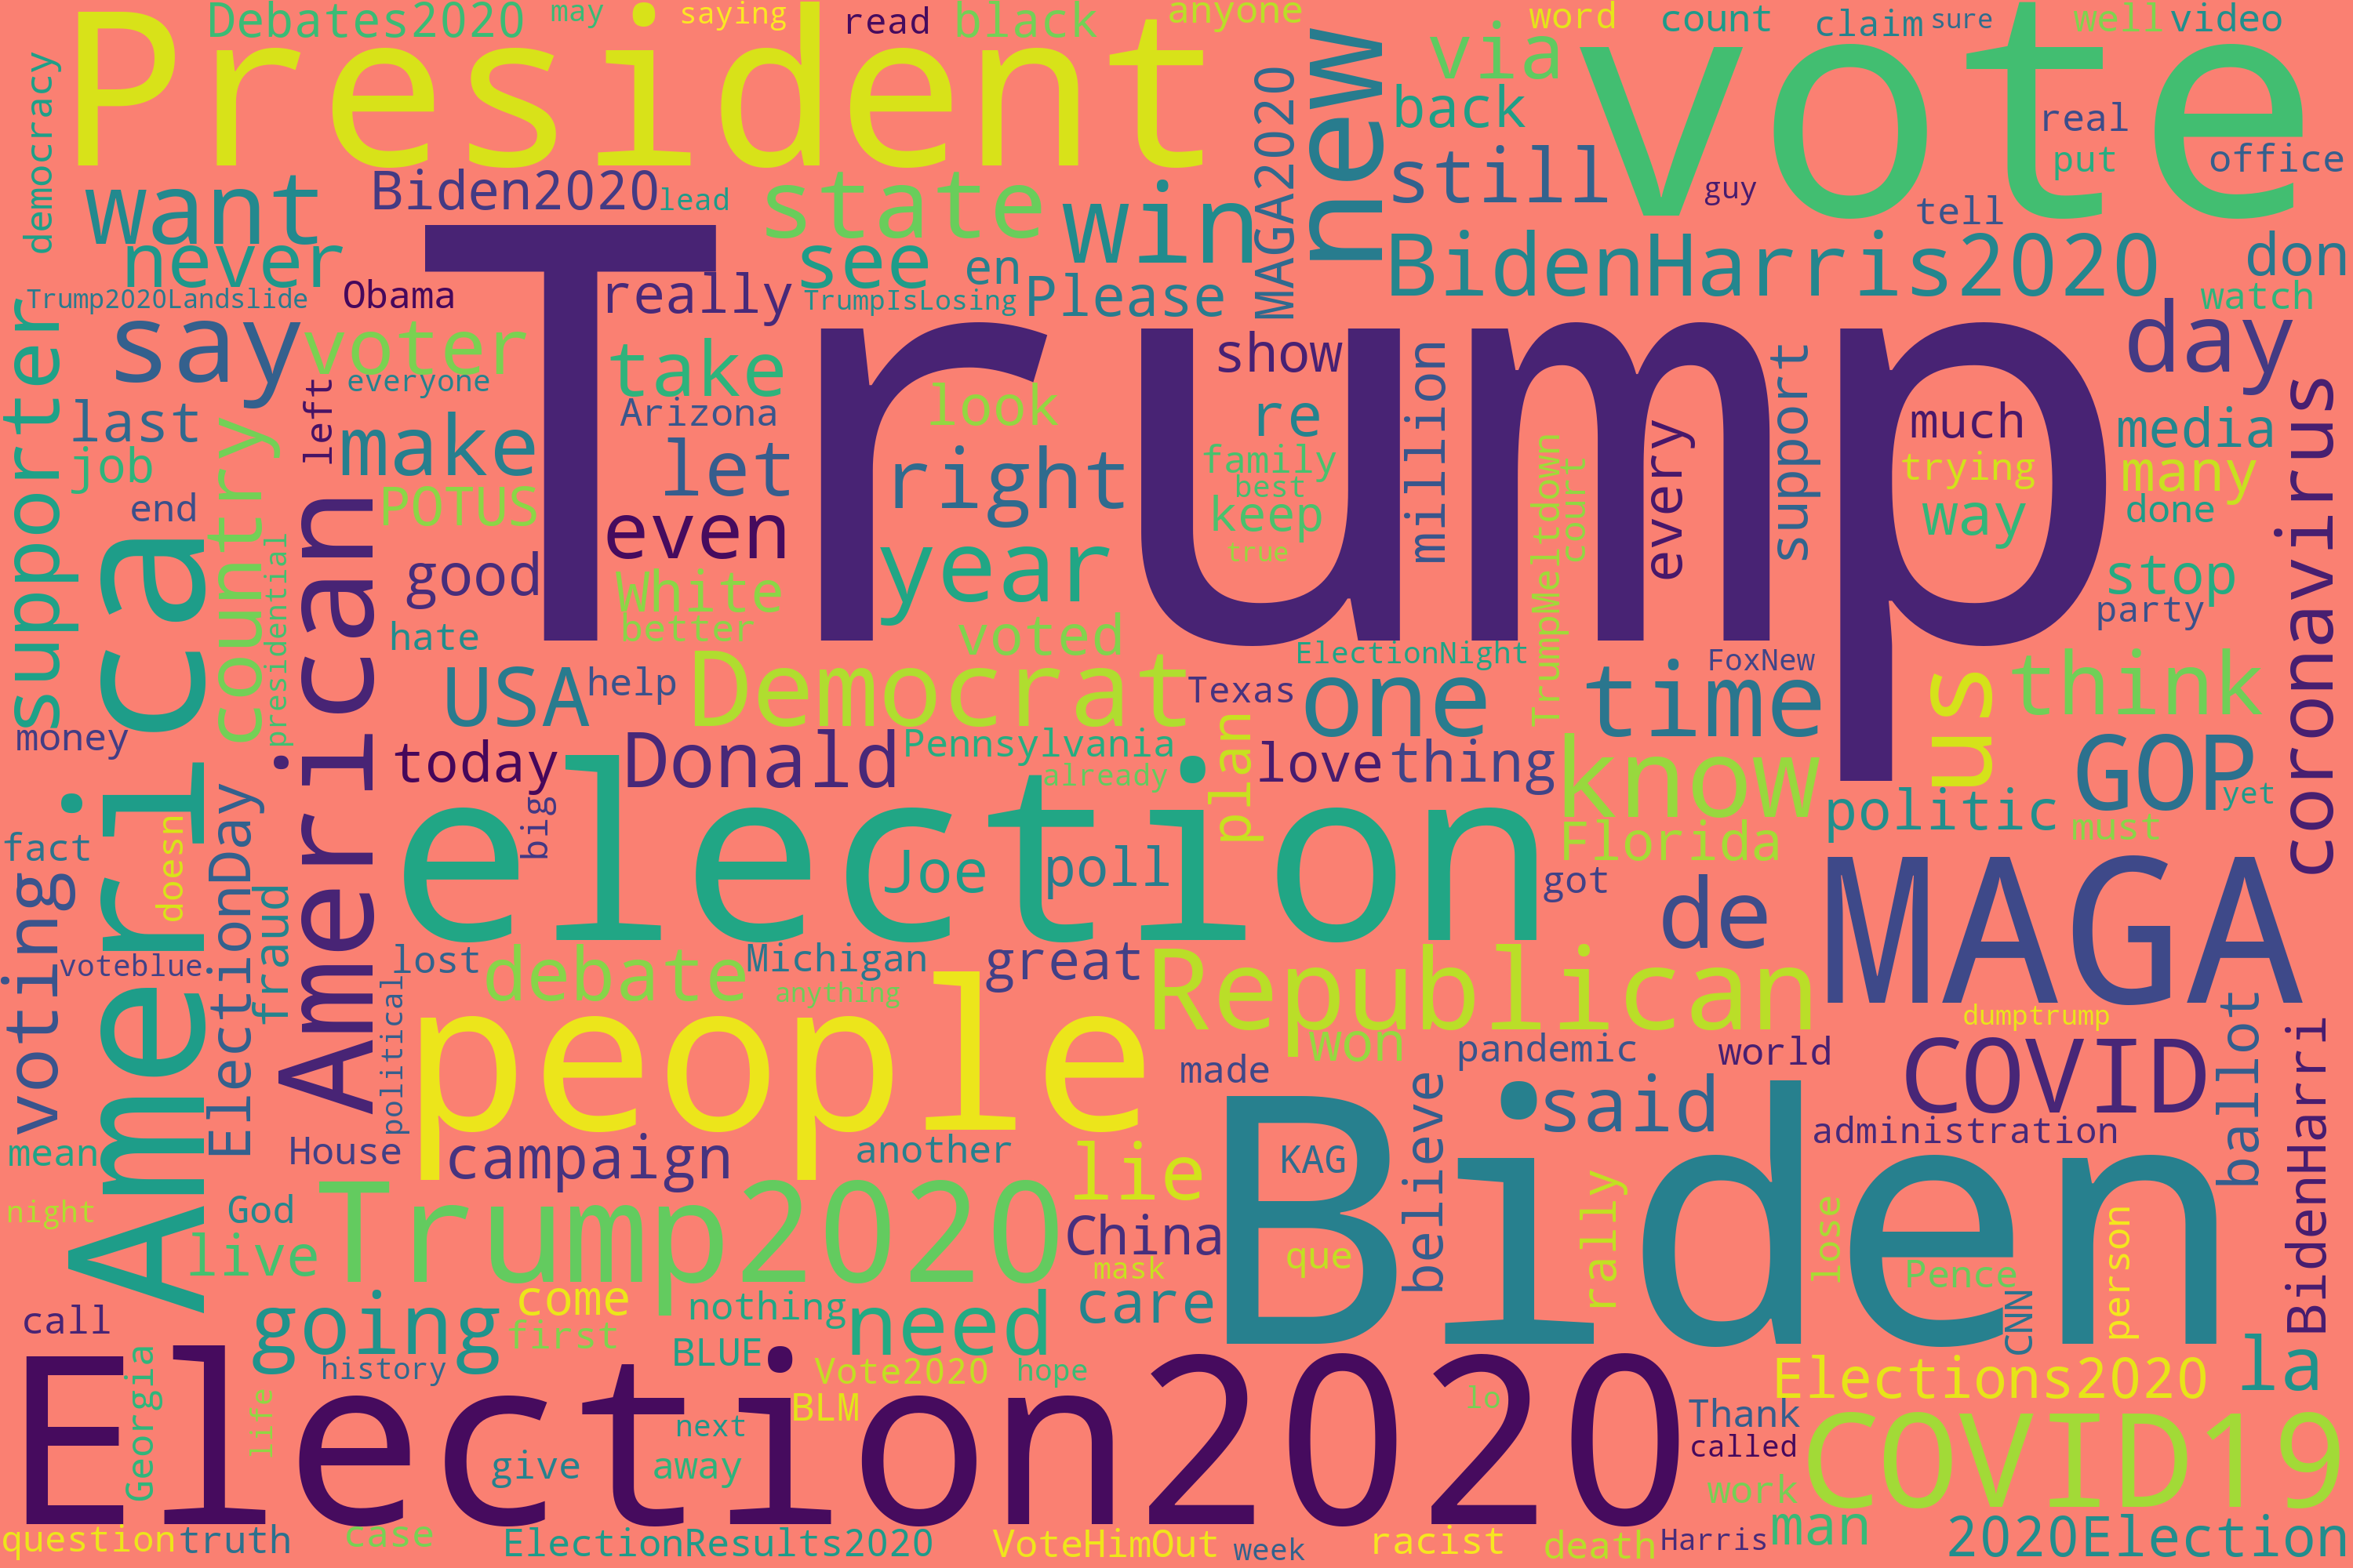
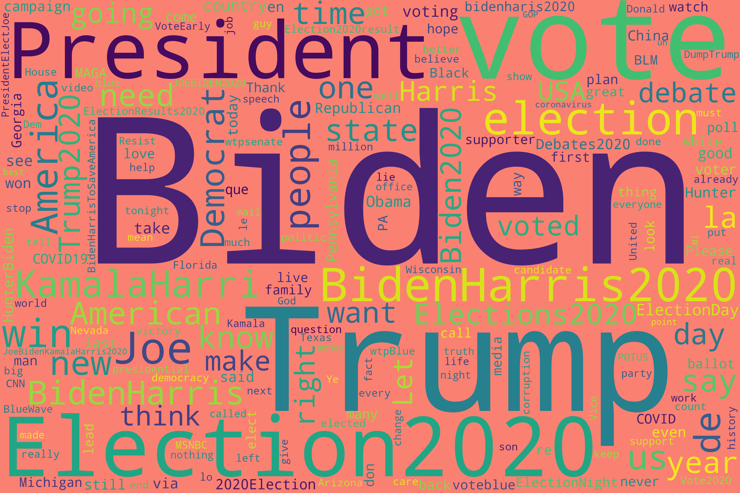
Wordclouds

Slide 6
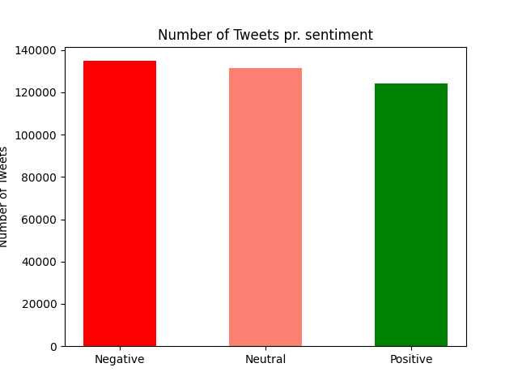
Tweets per sentiment verdict

Slide 7
State graphs
Tweets Per State
Negative Sentiment Per State

Slide 8
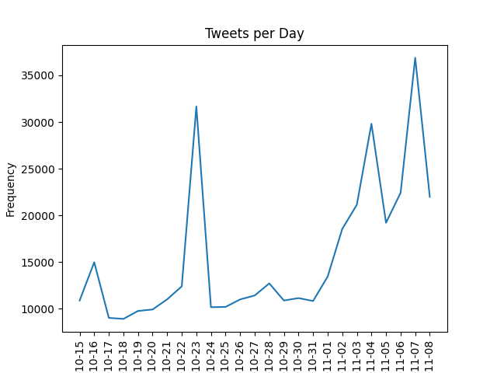
Daily tweeting

Slide 9
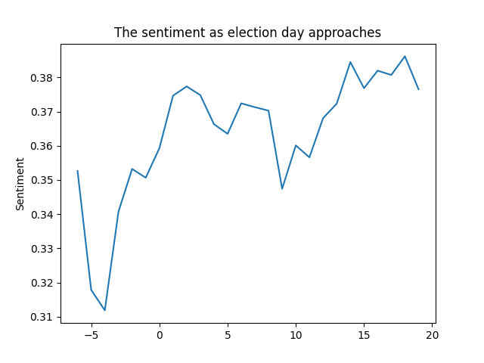
SENTIMENT CHANGE AS ELECTION APPROACHES

Slide 10
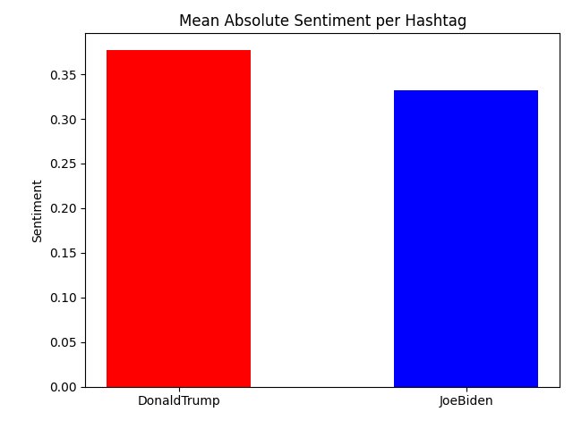
Trump TWEETS are more valenced than biden

Slide 11
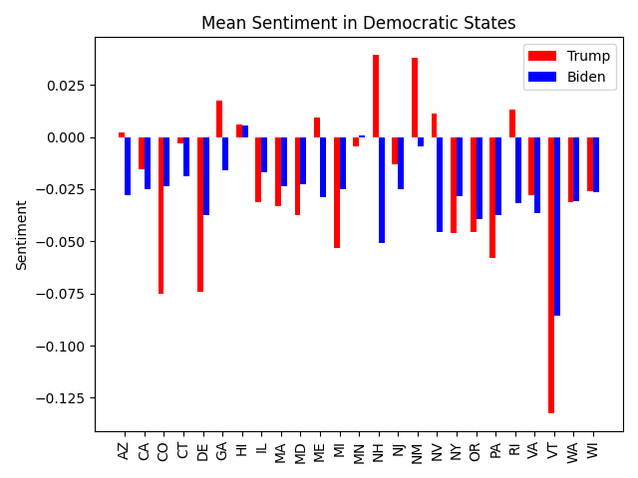
DEMOCRATIC STATES ARE PRO-BIDEN

Slide 12
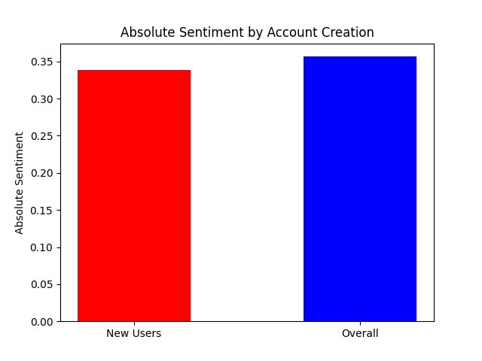
Absolute sentiment by account creation

