Slide 1
divadoxml-gui
Diva XML product description
GHER, University of Liege
31/10/2014

Slide 2
Information to provide
Project: EMODNET Chemistry (in future also SeaDataNet when Sextant template is updated)
Title (default title is extracted from the NetCDF file)
Product code:
<provider>-<area>-<parameter>-<version>-<OBS for collections, ANA for DIVA analysis>
for example:
MUMM-North Sea-Temperature-1.0-ANA

Slide 3
Information to provide
Date of first version: date of version 1.0
Date of update: date of current revision
Version: version number starting from 1.0 (first number: major updates, second number: minor updates)
Abstract: Wikipedia-like syntax may be used for bold, italic underlined, bullets and hyperlinks

Slide 4
Information to provide
Abstract: Wikipedia-like syntax may be used for bold, italic underlined, bullets and hyperlinks. This should include:
a brief description of the DIVA analysis
which data was used
special settings of DIVA (e.g. advection constraint, detrending,...)
EDMO: the EDMO code number of your institution

Slide 5
Information to provide
P35 code: the aggregated parameter code from http://vocab.nerc.ac.uk/collection/P35/current/
Path on OceanBrowser: the path where you will upload the analysis on the machine gher-diva (essentially the domain and possibly subdomain; see the folder structure on http://oceanbrowser.net/emodnet/)

Slide 6
Information to provide
P02 keyword: discovery parameter from the list http://vocab.nerc.ac.uk/collection/P02/current/
Area keywords: area keyword from the list http://vocab.nerc.ac.uk/collection/C19/current/

Slide 7
Start divadoxml
Run with, e.g.
./divadoxml-gui.py --filepath ~/Salinity.19501980.4Danl.nc --varname Salinity --outfile test.xml --divapath /home/abarth/src/diva/JRA4/Climatology
filepath: path of the NetCDF file
varname: the NetCDF variable name
outfile: the XML file to be generated
divapath: path where you have run diva (the script will search for the files yearlist and monthlist), defaults to the current directory

Slide 8
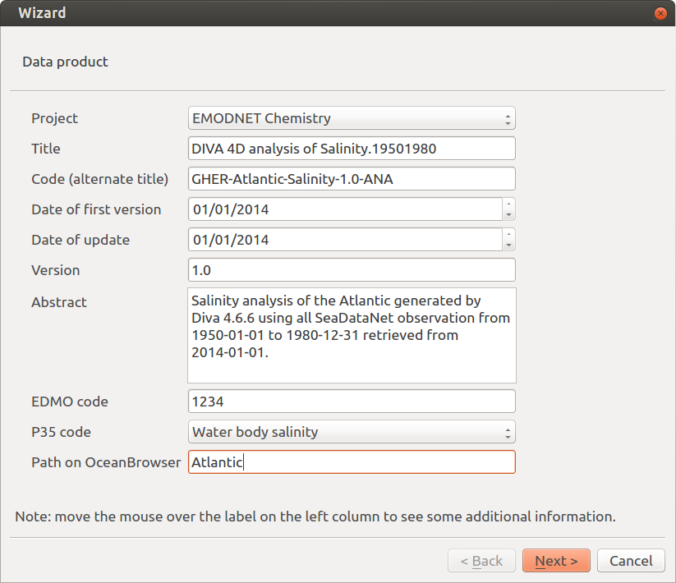
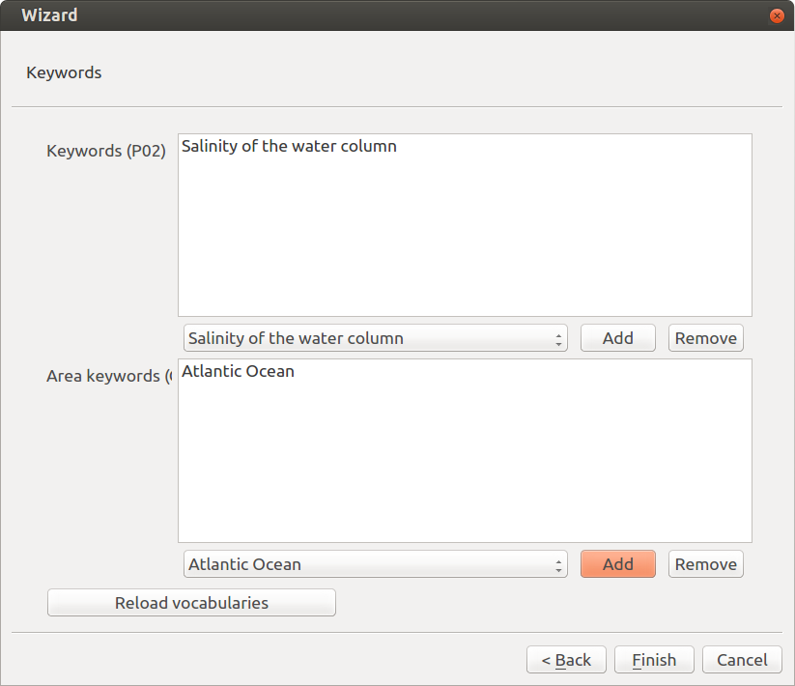
Screenshots

