Slide 1
Advanced Writing for Astronomy
https://gherczeg.github.io/teaching/
Lectures on Tuesdays, Discussion/edits on Fridays
many slides and topics based on a similar course taught by Lynne Hillenbrand: https://sites.astro.caltech.edu/~lah/ay31/

Slide 2
Syllabus
Goal of this course: improve your editing
Two tracks, depending on your time
You will not improve your writing/editing by listening to me lecture
You will (hopefully!) improve as an editor by completing the assignments
If you improve as an editor, you will improve as a scientist
Better able to see strength, weaknesses in logic
Logical gaps lead to papers!

Slide 3
Common Sayings
“Clarity of thought begets clarity of expression.”
“If you haven’t written it, you haven’t done it.”
“If you write it, but no one reads it, then you still haven’t done it.”
“Write for the reader, not just to the reader.”

Slide 4
Writing Considerations
Occasion: why and in what format to write?
Purpose: to inform and/or to persuade?
Audience:
who are they?
what do they know how they will use the document?
how much time do they have to digest the document?
Special Circumstances
context, situation
culture issues
relevant history

Slide 5
Academic Writing
“Success is seen as largely measured by recognition and, in turn, the process of acquiring recognition as dependent on the capacity to write papers that are valued by one’s colleagues.”
[ Ken Hyland; Writing in the Academy]

Slide 6
Structure of oral presentations
Clear statement of the problem
Summary of the state of the art, including assumptions and limitations
Scientific approach
Importance/Uniqueness of problem and approach
Key results
Conclusions
restatement of problem in light of the results
identification of new contribution
generalization / future
A.R. Tanguay; The Art of Scientific Presentations

Slide 7
Structure of written presentations
Written communication is fundamentally different from oral communication
Writing is a Way of Thinking
Technical writing enables self-interrogation
Editing: critically evaluate your own logic
Popular writing: translates abstract to intuitive concepts
Because many scientists dread it, writing often is left to the last minute and thus is not optimally executed

Slide 8
Academic Writing
“Simply, academics who excel in publishing their writing are often appointed to key positions, gain access to economic resources, and occupy major gate-keeping roles. Not only do they achieve social power in their disciplines, but tend to form an elite as they exercise influence in setting standards, directing strategies, and determining what is considered good work or important topics. They may also gain greater influence as spokespeople for their colleagues, and more likely to become members of government committees and granting bodies that decide the fate of funding applications and research contracts.”
[ Ken Hyland; Writing in the Academy]

Slide 9
Purpose: to convey and explain information
Logical approaches
Chronological / narrative
Process / step-by-step
Problem and solution
Compare and contrast
Cause and effect
Definition and classification
Every paper includes these each of these logical steps
Astronomy papers have a specific flow that readers expect
Flow makes following arguments easier
Remember, readers are busy and will be lazy.

Slide 10
Problems with Scientific Writing
Most frequent problems:
dense
boring
obscure
arrogant
difficult to read
often grammatically sloppy
logic is unclear (maybe even to the author!)
Goal: communicate by describing as simply as possible your methods and results
对牛弹琴

Slide 11
How to learn to write?
It’s hard! Practice makes perfect, or at least better
Mostly by emulation (copying) approaches that others take. Sometimes courses like this one.
First step: have a clear focus.
Focus, focus, focus!
Second step: recognize that writing is mostly an art, not an exact science.
Third step: acknowledge that some rules and guidelines apply, and that there is a recommended process.
Practice as a writer and as an editor!

Slide 12
General rules
There are no rules. I will teach you some things that others will disagree with.
Example: avoid almost all acronyms!
(My rule, your advisor may differ; that’s ok, your advisor is correct)
Exceptions: Telescopes/Instruments, ISM, AGN, FRB (but not many more!)
Logical flow is most important
We will also cover grammar, but focus of course is on logic
Approach: outlining
This approach differs from my own writing method
I often “outline” in plot form. Plots tell the story, text explains the plots
EDITING: critical to good writing
When first writing, “throw up on the page”
Don’t try to become a good writer, try to become a good editor.
Tell a story of discovery (but not in chronological order)
Show, don’t tell

Slide 13
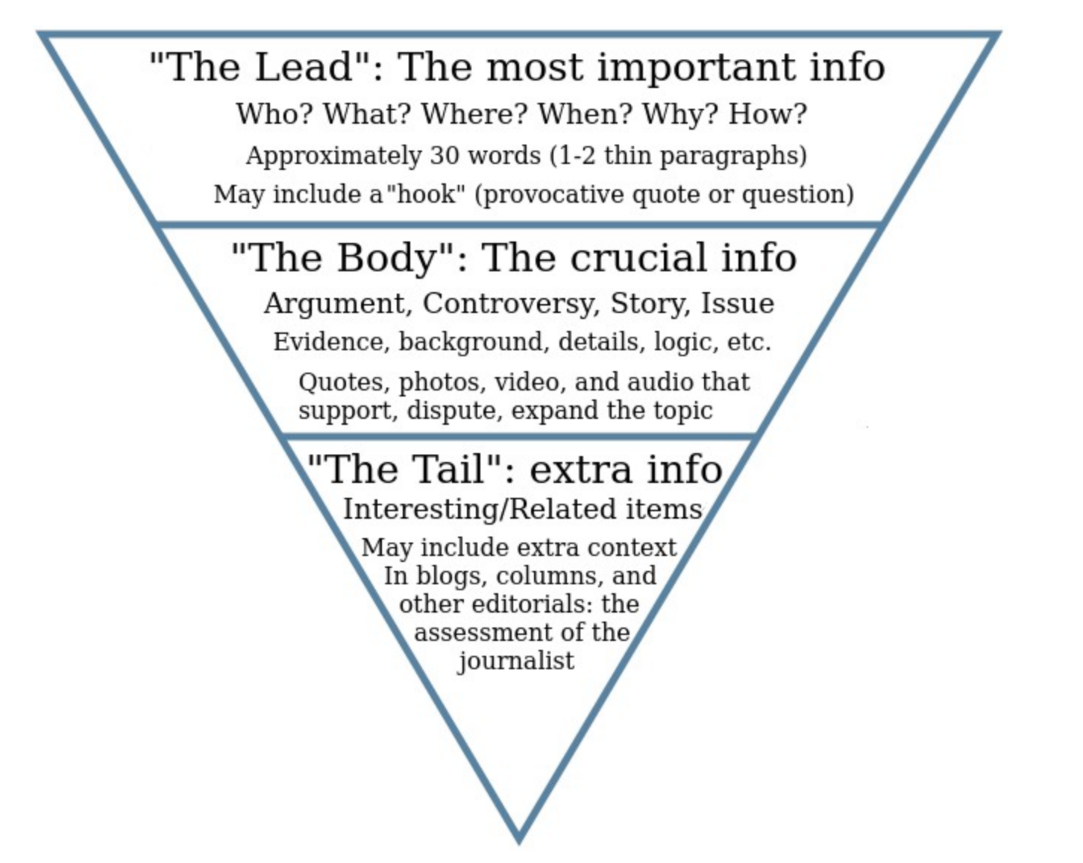
Logic: funnel flow structure
Inverse pyramid:
start big and get smaller
This applies both to the structure of a section and to each paragraph in the structure
DO NOT: build up to a surprising conclusion!
This is not Avengers; conclusions come first

Slide 14
First assignment: Introductions
Often the last section written in a paper (except conclusions)
For us, introductions provide a good place for discussion
Similar logic across papers
Broad enough for non-experts to understand

Slide 15
Resources
https://owl.purdue.edu/owl/general_writing/
https://www.astro.caltech.edu/~lah/ay31/
https://cgi.duke.edu/web/sciwriting/
Alley, The Craft of Scientific Writing
Porush, Short Guide to Writing About Science, 1994
Lindsay, Scientific Writing = Thinking in Words, 2011
Hofmann, Scientific Writing and Communication, 2009

