Slide 1
How to learn to write?
It’s hard! Practice makes perfect, or at least better
Mostly by emulation (copying) approaches that others take. Sometimes courses like this one.
First step: have a clear focus.
Focus, focus, focus!
Second step: recognize that writing is mostly an art, not an exact science.
Third step: acknowledge that some rules and guidelines apply, and that there is a recommended process.
Practice as a writer and as an editor!

Slide 2
Problems with Scientific Writing
Most frequent problems:
dense
boring
obscure
arrogant
difficult to read
often grammatically sloppy
logic is unclear (maybe even to the author!)
Goal: communicate by describing as simply as possible your methods and results
对牛弹琴

Slide 3
General rules
There are no rules. I will teach you some things that others will disagree with.
Example: avoid almost all acronyms! (My rule, your advisor may differ; that’s ok)
Exceptions: Telescopes/instruments, ISM, AGN, FRB
Logical flow is most important
We will also cover grammar, but focus is on logic
Approach: outlining
This approach differs from my own methods
I often “outline” in plot form. Plots tell the story, text explains the plots
EDITING: critical to good writing
When first writing, “throw up on the page”
Don’t try to become a good writer, try to become a good editor.
Tell a story of discovery (but not in chronological order)

Slide 4
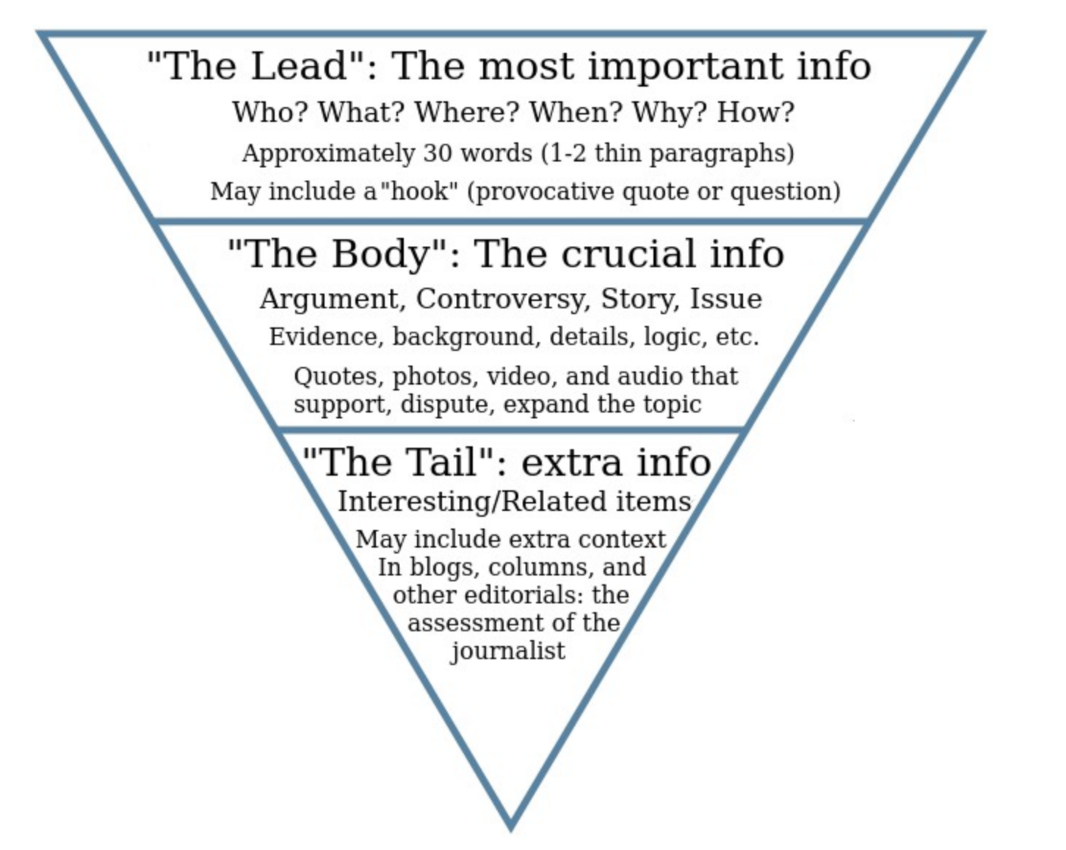
Logic: funnel flow structure
Inverse pyramid: start big and get smaller
This applies both to the structure of a section and to each paragraph in the structure
DO NOT: build up to a surprising conclusion!
This is not Avengers; conclusions come first

Slide 5
Beginning Considerations
Need something to write about!
Topic and details
Expression of content in a single sentence
“thesis sentence”
We will come back to this sentence later, for proposals
“elevator speech”
Specific audience and specific purpose
Format, genre/style, and length (“instructions to authors”)
Think about the who / what / when / where / why
Take the reader’s perspective

Slide 6
Beginning Considerations
Need to know your topic. In fact, own it.
This is not the goal of this class. I cannot help you generate your science, but I can help you communicate it.
It *is* the goal of your PhD.
Collect and study your references and new material
Research Resources:
ads: Astronomy and Astrophysics research literature
Look at highly cited (recent) papers, review papers if you are unfamiliar with an area
Daily astro-ph in your own field
Wikipedia and google searches

Slide 7
Good Advice
Begin from the end, not the beginning.
Tell the story in plots, then explain the plots
It is important to know:
your needs as an author
what are you trying to say?
any requirements for the end-product
the capabilities and needs of the end-user.
Ask yourself
what you would like to see in your paper
who will be reading it
what format is required
Then follow the steps of an academic writing framework.

Slide 8
Generic outline of a research paper
Title: orients reader
Abstract: tells reader what happens
Introduction: prepares reader with context/importance
Observations/methods:
Results: dig into details
Analysis: apply results
Discussion:
Connect analysis back to introduction; why are your results important?
Conclusion: Summarize your results
What are the most important results
Repeat important limitations and caveats

Slide 9
Generic outline of a research paper
Title
Exact
Clear and complete, but succinct
Strong and noticeable or boring
Abstract
Optional: one sentence intro
Key information expressed concisely
Enticing and inspirational
Descriptive
The title and abstract are the two elements
that will attract readers to your work!

Slide 10
Generic outline of a research paper
Introduction: context for your research
Motivation and importance of problem (the “why?”)
Background, history, context, previous literature (the theory)
Current state and unknown/s (the questions)
What and how of current contribution (the hypothesis)
Approach, scope and limitations (the objective)
Layout of presentation (the roadmap)
Note: does not actually begin the argument
The introduction prepares the reader and generally follows a cohesive “funnel flow” or “inverse pyramid” structure.

Slide 11
Generic outline of a research paper
Middle
Observations, simulation setup, equations
Data reduction or equation development
Analysis techniques and figures/narrative, in digestible portions
All of above in enough detail for a trained scientist to repeat work
Findings (results) and interpretation
Discussion of and implications of results; compare to others’
End
Summary, conclusions, future work (nothing new)
Acknowledgments
References

Slide 12
Second assignment: Introductions
Reverse outline the introduction from the good paper
Sentence by sentence
Start your own outline
If already have an outline, reverse outline what you already have

