Slide 1
Writing proposals in astronomy
Observing proposals
Supercomputing proposals
Funding proposals
Fellowship proposals
All proposals: requests to a group of people to provide resources for your work.
Why are your ideas important?
Why are your ideas important to the people evaluating your ideas?
Faculty recruitment: do other people in your field take your ideas seriously? Have you been able to get resources to support yourself (and others)? PI proposals demonstrate that evaluation.

Slide 2
Peer review for competitive proposals
Committee of 6-12 people
100 proposals to read, triage (=ignore) lowest ~30%.
Oversubscriptions can be 10:1 or more; 4:1 is common
Primary/secondary reviewer gives careful read
Sometimes include an outside expert review
Who are those people?
Experts in astronomy? (Fellowship proposals)
Experts in extragalactic/galactic astronomy (observing proposals)
(Avoid jargon and acronyms!!! Sell your ideas to non-experts)

Slide 3
Results of proposal applications
Fellowship: Yes/No
Observing Time: A/B/C/rejection (or something like that) or Yes/No
Comments

Slide 4
Peer review comments
Often written quickly, may not reflect the discussion that was in the room
If triaged, random comments from the primary (with limited input from others)
Learn from the comments, but don’t take them too personally
Identified weaknesses
Sometimes real problem the proposal failed to address
Most often: failure to communicate clearly
Unusual: mistaken reasons or biases

Slide 5
Science
What science do you want to do?
Do you have the resources to do it?
For observers, do you have sufficient modeling on the team?
Co-Is provide resources, technical expertise, and eyes for a critical read of your proposal
Feasibility – can you do your science?
Write the feasibility first
Sample?
Quality of proposal proportional to resources
10 nights of VLT vs 1 hr of LCO photometry
Is this the right resources for the science?

Slide 6
Can you use less expensive resources?
JWST: mid-IR is unique, but are there other ways to do the same science?
Same with HST and UV or high-resolution+wide-field optical imaging
ALMA: Morita (ACA) array – less powerful, but oversubscription is lower
Smaller telescopes
Filler time for bad weather

Slide 7
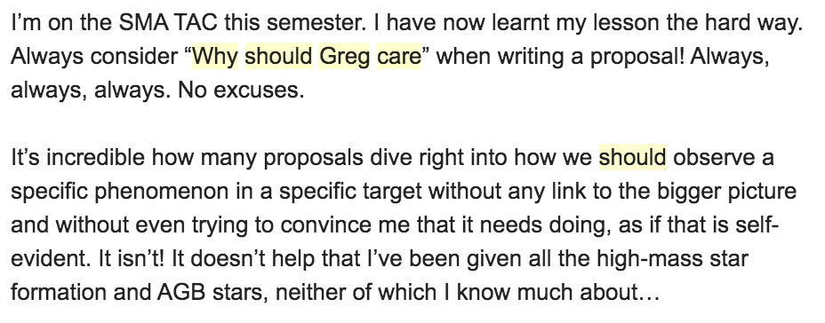
Why should I care about your work?
(literally, me)

Slide 8
Don’t tell me that your science is important, show me why your science is important

Slide 9
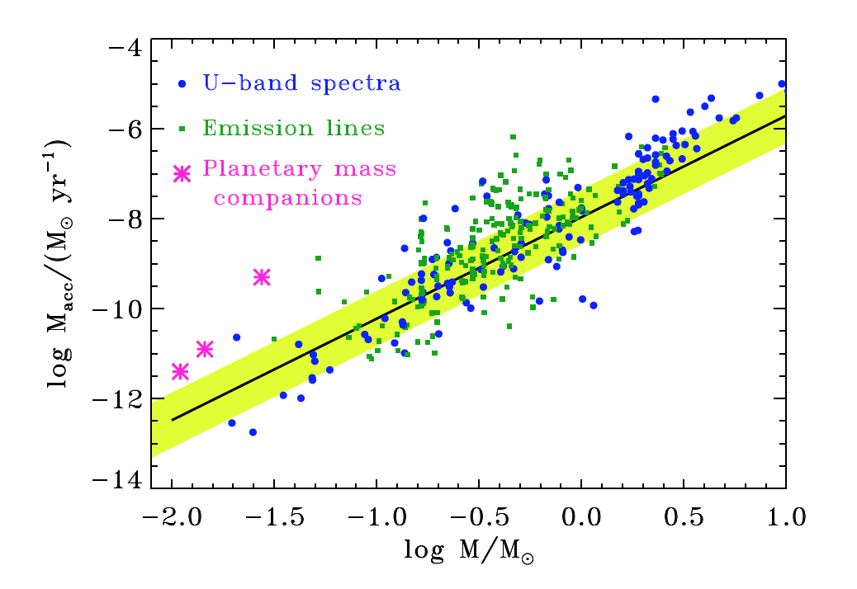
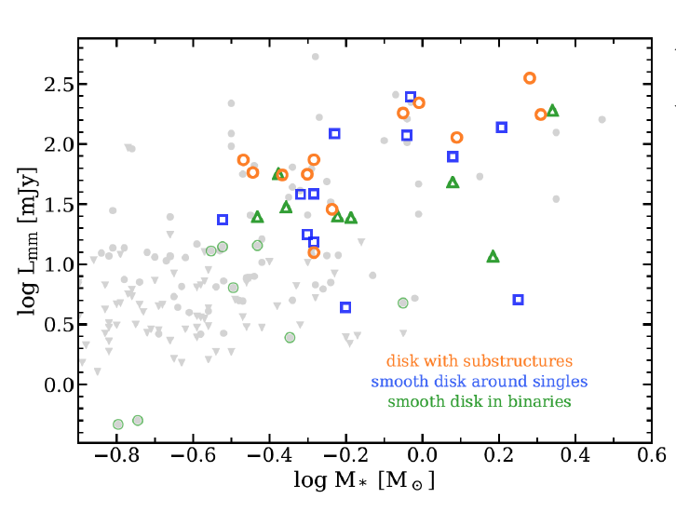
Figures and illustrations: critical
What’s missing in literature?
Sample selection?
Unbiased?
Sufficient but not too much?
SHOW ME!
Case studies
Is your object weird?
SHOW ME
Generalizable?
Is your object normal?
SHOW ME!
Cartoons are good

Slide 10
Format
Length? Forms? Phase IIs or just initial proposal?
Never, ever play games with font size, length, margins, and the rest
Play games by writing concisely
Non-native English speakers are at a disadvantage in ability to maximize information/line
Keep the text+figures readable and legible
Science Justification? Technical Justification?

Slide 11
A proposal is like a condensed introduction
Science Justification
First paragraph: Big Picture
perhaps thesis sentence at end, or perhaps elsewhere
Second paragraph: flow big picture down to problem
Third paragraph: explain problem, what has been done in the past, limitations of past studies
Fourth paragraph: How will you solve this problem?
Ideally, problem has two possible solutions, your observation will discriminate between those solutions
Citations: be broad! Cite your own work, but minimally – make sure that you cite literature from wide range of groups!

Slide 12
The thesis sentence
The thesis sentence is a single sentence that concisely describes:
What problem you will solve
What resources you are asking for to solve
How you will use requested resources to solve the problem
Boldface this sentence! The entire proposal is then built around this sentence:
before this sentence, why is the problem important?
after this sentence, how you will solve the problem
The thesis sentence is usually written early. However, revisions occur until submission. Each revision may require adjustments in the proposal logic.
Sometimes the thesis sentence comes at the end of the first paragraph, sometimes later – depends on how the proposal was written
Thesis sentence must be on first page; similar version in abstract

Slide 13
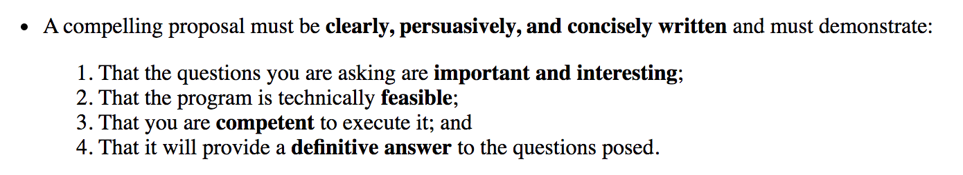
Tips for successful proposals
Put key points up front
(don’t make it hard on the reader)
Be direct, straightforward, and clear
Use illustrations/cartoons to describe your points
Abstract: captures all key points
https://faculty.virginia.edu/rwoclass/astr8500/s16-writing-proposals.html

Slide 14
Editing
Where are weaknesses?
Figure out how to address them!
Are they minor details that nobody else would see?
For a 2-page proposal, write 2.5-3 pages at first
Text can always become more concise
Let others (Co-Is) edit!
Finish draft *early* (not 24 hrs early, but 1-2 weeks)
(and earlier for JWST/galactic ALMA!)
https://faculty.virginia.edu/rwoclass/astr8500/s16-writing-proposals.html

Slide 15
Technical Justification/Feasibility
What is your general goal?
Tie back to big picture
What is your specific observable?
Tie back to general goal
What S/N is required to measure that specific observable to answer your science question?
What tools will you use to analyze the observable to reach your general goal?
Can you do your science?
If you do your feasibility after the science justification, sometimes you realize your science goals are not possible
Usually iterative: adjust feasibility => adjust science => adjust feasibility…
The technical justification is insufficient for funding/support,
but a bad technical justification kills many proposals

Slide 16
Exposure time: why?
Telescope/instrument: right choice?
HST/JWST: why can science not be done from ground?
Sample size and selection
Minimum required to answer science goal
Sufficient to answer science goal
How were they selected? Biases?
What other data exists or will be obtained?
If upper limit is likely, describe why it will be useful
Specify all relevant parameters
Include seeing requirements/assumptions, instrument resolution, etc
Remember overheads!

Slide 17
Proposals are fun!
Imagine what you will do!
Evaluate feasibility
Focus future efforts
Data is always perfect in your proposal mind
Paper is often very different than proposal
Data are flawed (try to avoid)
Deadline!

Slide 18
Fellowship proposals are not fun! (imposter syndrome+long-term planning)
What do you want to do for the next three years?
Sell your ideas and yourself!
CV is built in
Research statement must be strong, easy to read, and concise
3-page research plan (plus past research)
Cartoons and Figures: at least one on every page
Also important for PI positions
https://www.astrobetter.com/blog/2014/08/20/honing-your-hubble-application/

