Slide 1
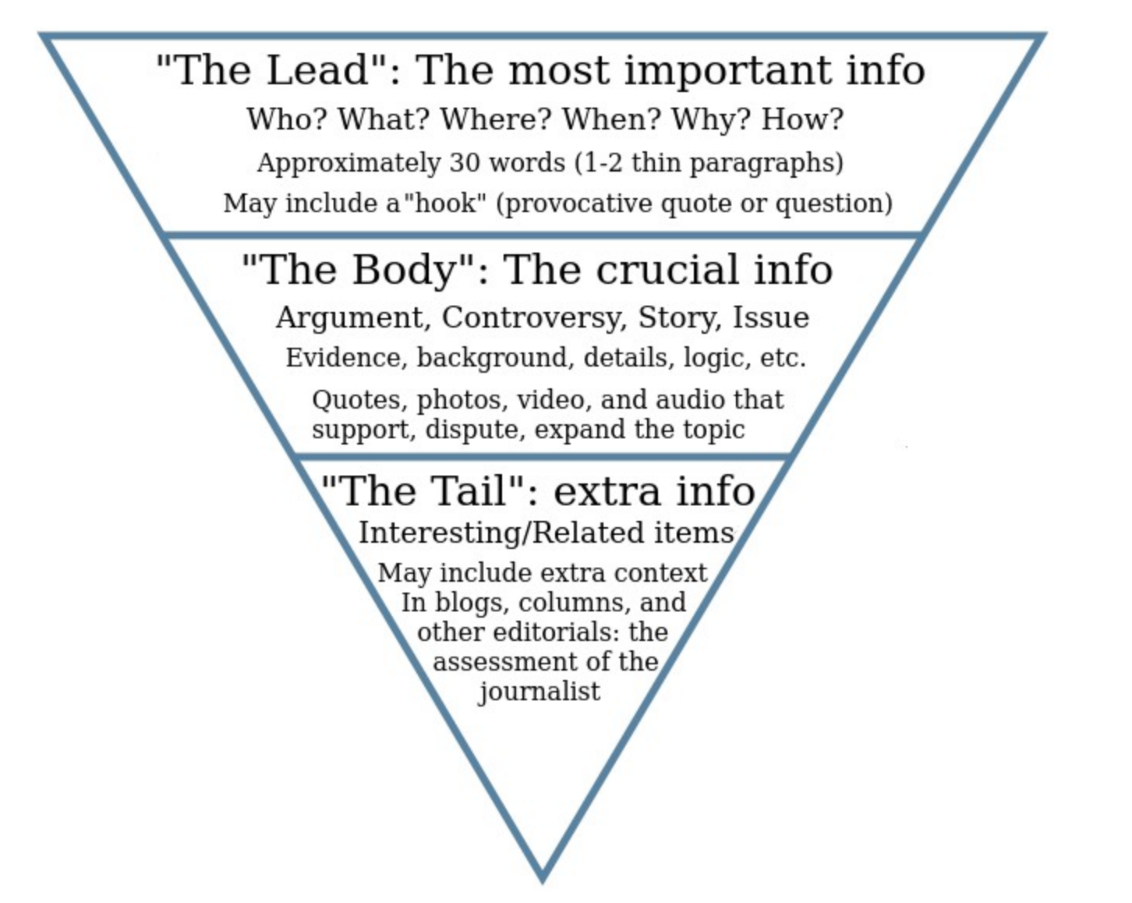
Logic: funnel flow structure
Inverse pyramid: start big and get smaller
This applies both to the structure of a section and to each paragraph in the structure
DO NOT: build up to a surprising conclusion. This is not Avengers; conclusions come first

Slide 2
Generic outline of a research paper
Title
Exact
Clear and complete, but succinct
Strong and noticeable or boring
Abstract
Optional: one sentence intro
Key information expressed concisely
Enticing and inspirational
Descriptive
The title and abstract are the two elements
that will attract readers to your work!

Slide 3
Generic outline of a research paper
Introduction / Context
Motivation and importance of problem (the “why?”)
Background, history, context, previous literature (the theory)
Current state and unknown/s (the questions)
What and how of current contribution (the hypothesis)
Approach, scope and limitations (the objective)
Layout of presentation (the roadmap)
Note: does not actually begin the argument
The introduction prepares the reader and generally follows a cohesive “funnel flow” or “inverse pyramid” structure.

Slide 4
Generic outline of a research paper
Middle
Observations or equations (methods and materials)
Data reduction or equation development
Analysis techniques and figures/narrative, in digestible portions
All of above in enough detail for a trained scientist to repeat work
Findings (results) and interpretation
Discussion of and implications of results; compare to others’
End
Summary, conclusions, future work (nothing new)
Acknowledgements
References

Slide 5
Stages of Writing
Pre-writing - thinking/planning
gather information
generate ideas
plan composition: content, format
consider layout and design
Composing
turn notes into coherent sentences
develop paragraphs
Revising
re-write with vision
develop logical flow
Editing
pay attention to word choice, grammar
engage in creative/convincing phrasing
Submission & Evaluation
Referee comments
Publication / Distribution
Proofing
Production

Slide 6
Stages of Writing
Organize
Procrastinate
Produce draft
Revise
Proofread
Obtain feedback
These stages are not always chronological

Slide 7
Beginning (and Ending) Considerations
Take the reader’s perspective
Be aware that readers are selective and need to be drawn in
Place reader/user needs first
Make communication efficient and accessible
Consider appropriate document mechanics and structure
Set context and convey relevant information
Choose proper tone, voice, rhythm
Use clear language
Lead reader from the familiar to the unfamiliar
Anticipate reactions of readers
Above all, connect ideas

Slide 8
Starting the Document
Start from Outline OR Figures (OR Introduction)
Adjust and refine the outline as you write
Remember that less is more!
Sometimes ideas need to be cut
Focus reader attention on main points and supporting logic
Provide enough detail, but too much gets confusing
Make sure the Title and Abstract
reflect content of paper
draw both people and search engines to your work
I usually write the abstract and finish the title as the last step in the draft

