Slide 1
Document Design
The layout of words and graphics determines the look of a document.
grid pattern, white space, etc.
margins, justification, indentation, spacing, font
headings, paragraph length, bullets, etc.
Goal is to invite a diversity of readers in, guide them through the material, and help them understand and later remember the information.

Slide 2
Section titles and sub-titles
“Results”, “Analysis”, “Discussion”
no information
Descriptive title sections
Invites readers in
Tells readers where information is located
Provides readers an obvious outline
Parallel titles when possible

Slide 3
Parallel arguments
Always keep orders of arguments the same
Try to keep flow parallel
If two competing ideas are presented in Section 4.1 and 4.2, then try to have paragraphs match

Slide 4
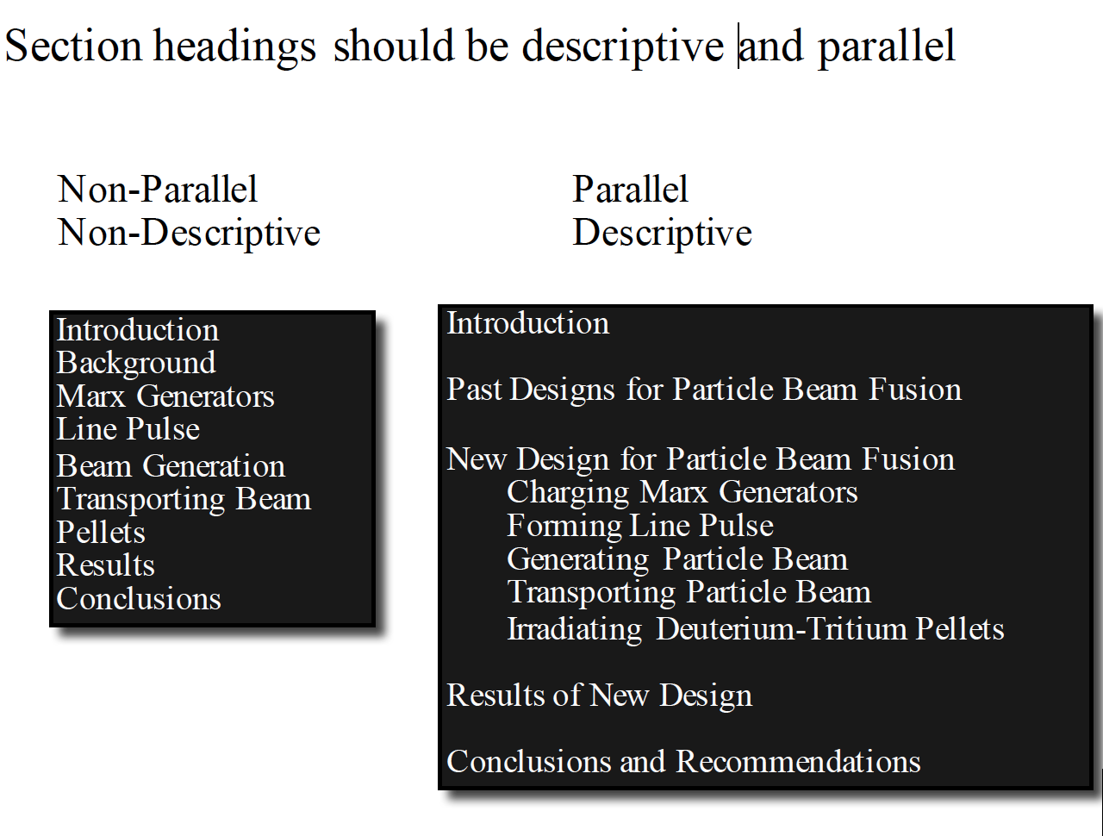
Vague section headings hide meaning

Slide 5
Visuals: Show, don’t tell!
helps reader interpret, remember complex information in simplified form
can show:
how analysis looks or works
how analysis or data are organized or actions are performed
how elements or data are related
visuals should be audience-centered
keep as simple as possible
include explanatory labels, title, caption
use visuals to enhance your story
Should stand on own: can I see story without reading anything?
should use fewest number of plots that tell the story

Slide 6
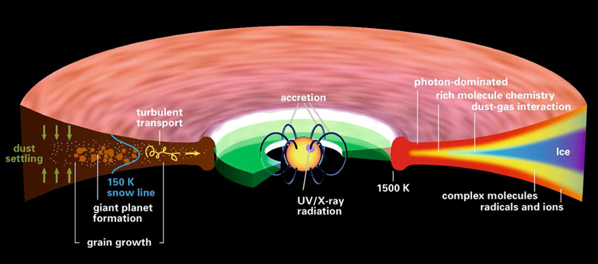
Visuals
Most readers look at visual first
Some exceptions: look at visuals only if logic or results are surprising
Visuals need to tell the story
Story is told in text and in visuals
Not just plots, also illustrations
Spend time on the plots! Make them clean and easy to understand!
Henning & Semenov 2013

Slide 7
Guidelines for Figures
Figures
place independent variable on abscissa (x-axis) and dependent variable on ordinate (y-axis)
ensure figure points, lines, axes, scales are easy to interpret
No “confusograms”
legend/caption should be descriptive of content
Parallel outline (one in text form, one in Figure form)
Not sure if your plot is easy to understand?
Show your friend and do not give them any context!
Figure should explain itself, caption is for details
Outlining: often tell the story through figures
Results/analysis: describes the analysis that goes into the figures
Discussion: interprets the figures

Slide 8
Guidelines for Tables, Equations
Tables
keep table structure simple: how will people use your table?
place familiar content on left and new important information towards right
design table title to identify specific topic
label dependent variables in column headings and independent variables in row headings
Long data catalogs? check with co-authors to make sure they can use it!
Equations
treat equations and formulas as part of text
define variables
state assumptions
Keep as simple as possible
For most papers, leave derivations in the Appendix

Slide 9
Paragraphing
Different types of paragraphs
Introductory: sets stage
Supporting: traditional stand-alone content
Topic is clear
Unity of sentences in developing topic
Coherence of sentences is establishing conclusion
Transitional: brief; provide logical continuity
Concluding: wrap up
Paragraphs should flow together
Look for opportunities for parallel structures
Each paragraph should FOCUS on a single topic
In reverse outlining of the “good” paper you chose (homework),
look back to see how the authors have chosen to structure their paragraphs

Slide 10
Paragraphing
Shape information within paragraphs
Topic sentence (optional) provides overview
Supporting sentences expand, clarify, provide details
Maintain consistent point of view
Maintain consistent verb tense
Usually present tense for work done in paper
Past tense for actions at a specific time in past (“we observed”)
Some differences based on author preferences (but stay consistent)
Repeat key terms:
Continuity
links ideas
Use links within sentences, transitions between sentences to provide logical flow:
therefore, thus, consequently, as a result; however, nevertheless, alternatively, unfortunately, instead, in contrast; in addition; in particular, finally, furthermore, moreover, for example, currently…. [never use ”Besides” without a nounce, ie, “Besides this data”]
Each sentence: what is it about and how does it move the argument along?

Slide 11
Use Reader-centered Strategies
Establish relevance
get the reader’s attention
speak to reader’s goals and interests
explain facts from reader’s perspective
use examples and analogies as appropriate
Make information easy to find
state main points up front
Overview
order information by importance
use clear headings, bulleted lists, etc., effectively
pay attention to details of tables, figures, captions, etc.
eliminate irrelevant information
Sentences longer than 35 words, paragraphs longer than 150 words need surgery.

Slide 12
Tasks during Revision
reorganize information
often move entire paragraphs!
deepen or extend analysis
narrow focus, scope
add data and supporting information
adjust details of argument
eliminate repetition and/or restating the obvious
allocate space to highlight or diminish points
畫蛇添足
huàshétiānzú

