Slide 1
Duke, Exercise 1, Principles:
1. Put actions in verbs
2. Put characters in subjects
3. Keep subjects near verbs

Slide 2
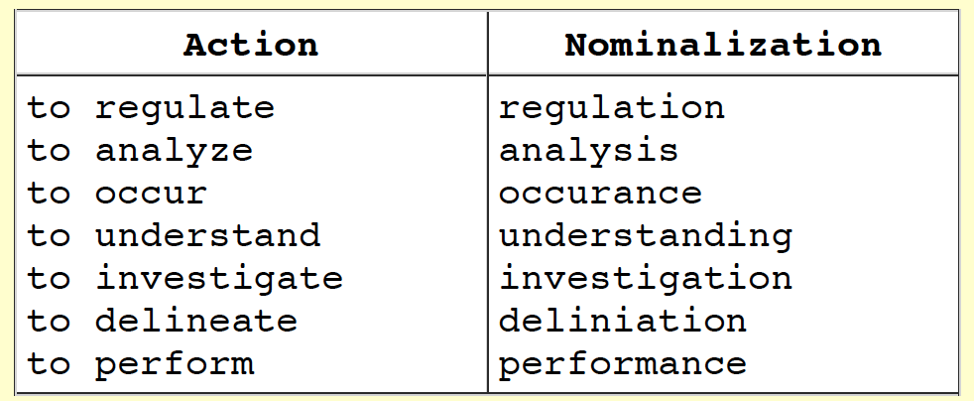
Principle 1: Put actions in verbs
We performed an analysis on the data
We analyzed the data
Verbs should be actions!

Slide 3
Principle 2: Put characters in subjects
You can fulfill reader expectations by maintaining a logical flow of grammatical subjects in a paragraph. There are two primary ways to accomplish this:
1. Maintain a common subject throughout a one-topic paragraph (parallel sentence structure)
2. Shift the subject smoothly according to the story

Slide 4
Principle 3: Keep subjects near verbs
A sentence tells readers: who and what action
The sentence will be straightforward to understand when the subject and verb are close to each other
The ABC database has been subject to different improvements, modifications, and extensions in structure and content over the years.
The ABC database has been improved, modified, and extended in both structure and content over the years. (passive)
The curators have improved the structure and content of the ABC database. (active)

Slide 5
Duke Lesson II: Cohesion, coherence, and emphasis
Principle 1: Put new information last
Principle 2: Use passive voice rarely
Principle 3: Make sure the first and last sentences of a paragraph match
(sometimes? I’m not sure I like this one)
Match the last sentence of the previous paragraph with the first sentence of the next paragraph = more important for smooth transition

Slide 6
Principle 1: Put new information last
Most readers will find your writing more clear if you consistently begin sentences with familiar (old) information and conclude sentences with unfamiliar (new) information
What happens when you begin a sentence with new information? Your reader gets a new idea without any context. He or she may try (incorrectly) to link this information to the previous sentence. After reading the rest of the sentence, the reader may have to revise his or her understanding.
Think of this in the same way as writing your introduction: the very first sentence is something that all of your readers will know
Provides readers with something familiar to start the paper

Slide 7
Principle 1: Put new information last
Revision technique: Read through your manuscript carefully. In each sentence, underline any pieces of new information (unfamiliar to the reader at this point in the manuscript). Make sure your sentences begin with an appropriate backwards link, and not with an unfamiliar concept.
Underlining is a useful tool for many things
Go through manuscript, underline noun/verb to make sure they match

Slide 8
Principle 2: Use passive voice rarely
Active: The dog chased the ball.
Passive: The ball was chased by the dog.
Passive: The ball was chased.
Active: more straightforward. Subject does an action.
US scientists *hate* passive voice. UK scientists rely much more heavily on passive voice.
Also avoid excessive use of “we” (let science be the subject)
Let the science be the subject!
Editing technique: underline all “we”; at most one “we” per paragraph
Underline the noun and verb. Is the verb active? Is the subject noun doing the verb.

Slide 9
When to use passive voice
When you want to say something indirectly
Sometimes it’s more polite
Speculation can be passive

Slide 10
Basic premise: be direct and simple
(almost) always be direct and simple.
Say what you mean

Slide 11
Principle 3: Make sure the first and last sentences of a paragraph match
Match adjacent sentences, especially when moving from one paragraph to another.

Slide 12
Duke Lesson 3: Concision and Simplicity
Omit needless words (excessive hedging, ineffectual phrases)
Prefer simple words
Use simple subjects
Use adjectives/adverbs frugally (=rarely)

Slide 13
Principle 3: Make sure the first and last sentences of a paragraph match
Skipping this one…
Match adjacent sentences, especially when moving from one paragraph to another.

Slide 14
Duke Lesson 3: Concision and Simplicity
Omit needless words (excessive hedging, ineffectual phrases)
Prefer simple words
Use simple subjects
Use adjectives/adverbs frugally

Slide 15
Duke Lesson 3: Concision and Simplicity
Omit needless words (excessive hedging, ineffectual phrases)
Prefer simple words
Use simple subjects
Use adjectives/adverbs frugally (=rarely)

Slide 16
Omit needless words
Phrases to avoid:
Note that
It should be noted that
Respectively
It is important to realize/it is well known
So-called

Slide 17
Omit words that stress how good your analysis is!
”carefully”: is it really?
If you describe details, I understand the care
Figure 3 clearly shows: is it really?
If the Figure is clear, you don’t need to insist
Proven, doubtless
These words are “red flags” for me

Slide 18
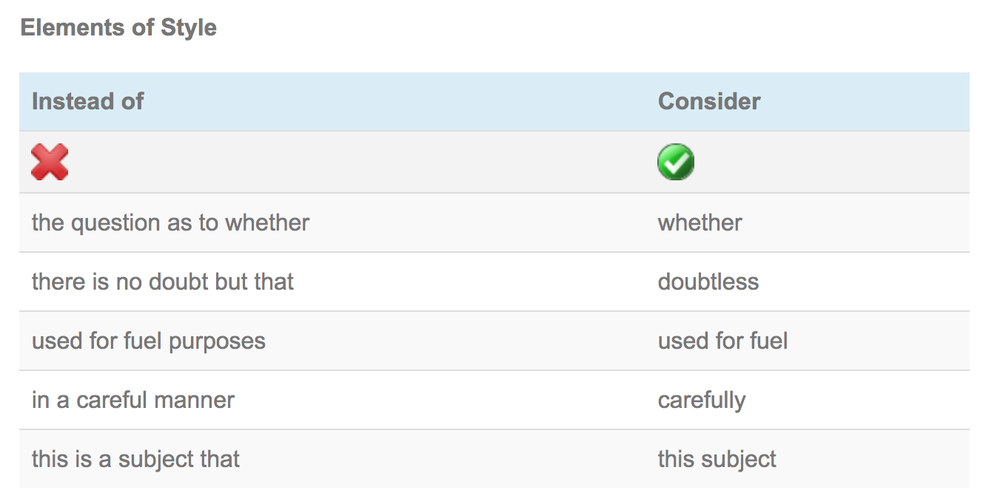

Slide 19
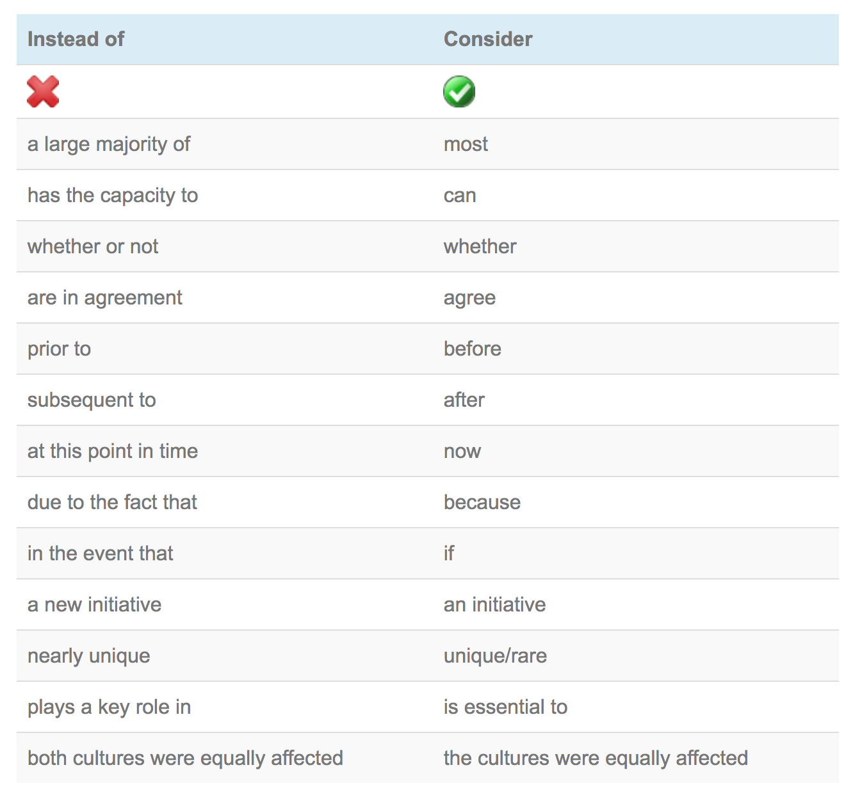

Slide 20
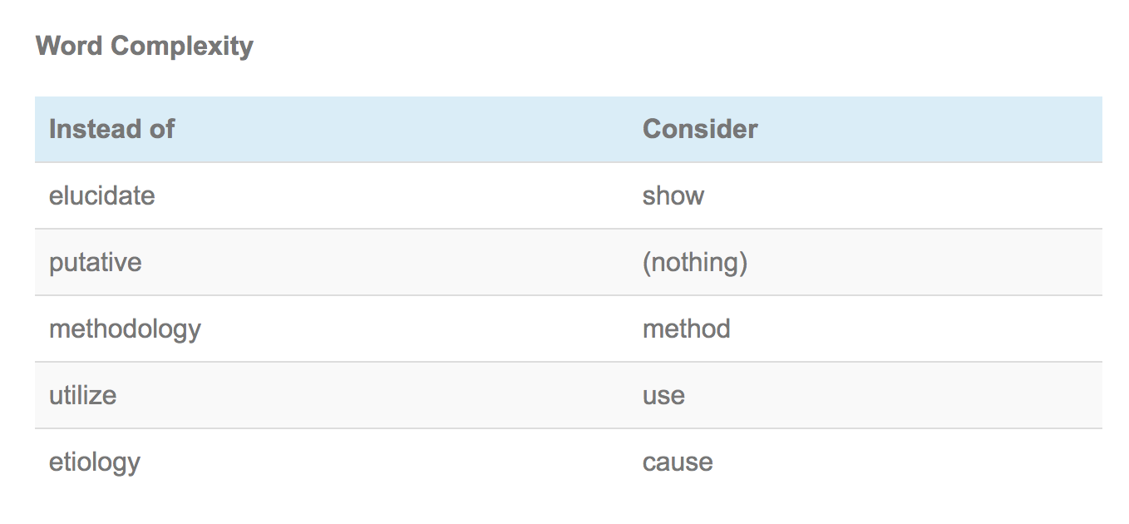
Prefer simple words

Slide 21
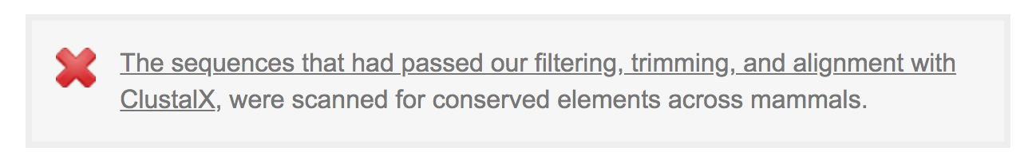
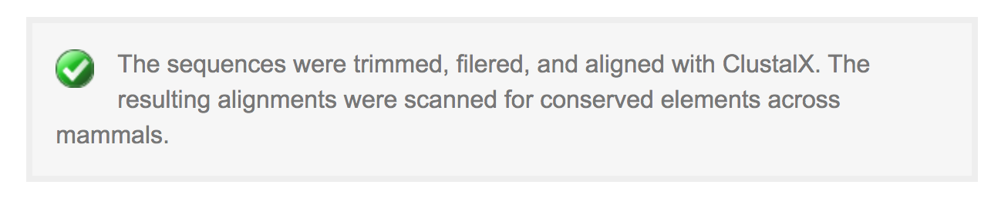
Prefer simple subjects

Slide 22
Use few adjectives/adverbs
“Very” is very overused
Especially for Chinese writers
“very interesting”, “very important”
“extremely”

