Slide 1
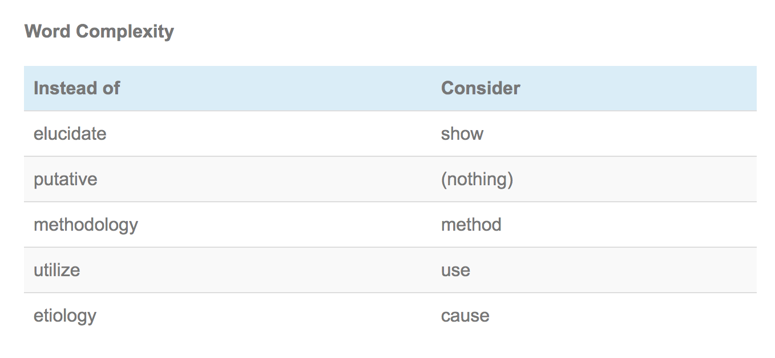
Prefer simple words

Slide 2
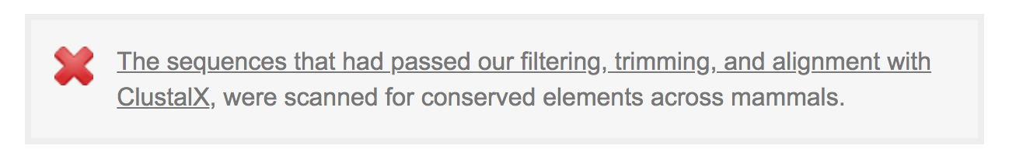
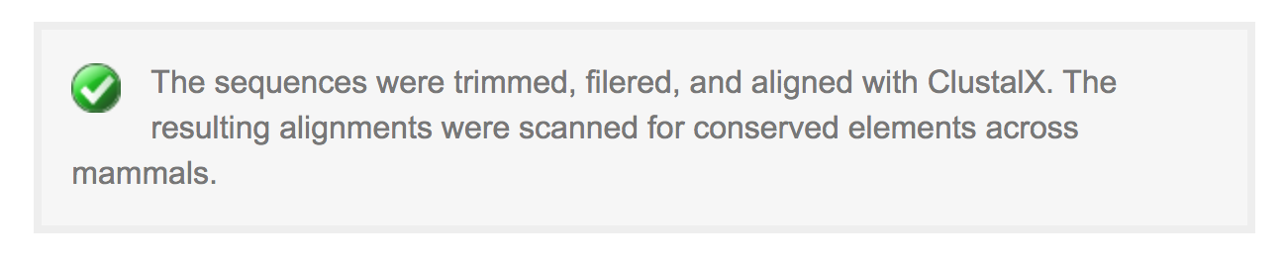
Prefer simple subjects

Slide 3
“important”
Don’t tell the reader that something is important.
Describe to the reader why that thing is important.

Slide 4
Excessive hedging
“Our results suggest that our method may possibly identify highly obscured quasars”
“suggest”, “may”, “possibly”
Some hedging is good, but “may” or “suggest” is sufficient.

Slide 5
Demeaning adverbs
“obviously”, “clearly”, “undoubtedly”
These words are not helpful
Things that are clear to you may not be clear to the reader
Be specific in pointing to results
“Figure 5 clearly shows that…” is a red flag.
Show me, don’t tell me

Slide 6
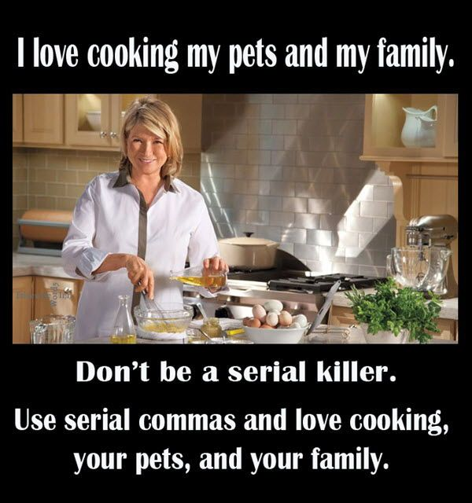
Oxford comma
a, b, and c

Slide 7
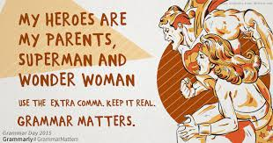
Oxford comma
a, b, and c

Slide 8
When to use “the”
https://owl.purdue.edu/owl/general_writing/grammar/using_articles.html
“The galaxy”: a very specific galaxy
“A galaxy” or “Galaxies”: general term
[still, often not obvious]
Uncountable and unspecific: do not use A/The
”The data provided information needed to identify”
“The data provided the information we needed to identify…”
Also: https://ui.adsabs.harvard.edu/abs/2022NatAs...6.1021K/abstract

Slide 9
Prepositions
At, on, in, etc…

Slide 10
Few/a few: opposites!
“Few students attended class”: negative
”A few students attended class”: positive
(sometimes I hate English)

Slide 11
Only
“only” should be before and as close as possible to the word that it modifies
Only Xinyi completed the homework
Xinyi only completed the homework
Xinyu completed the only homework

Slide 12
Besides…
“Besides,” does not work!
Needs to be followed after a noun
“Besides the one data point”

Slide 13
Language changes: “they”
He/she for singular, they for plural
Gender-inclusive: using “they” for singular
preferred pronoun for some people

Slide 14
Past/present tense in introductions?
Let’s see what papers on astro-ph did today!

Slide 15
Common mistakes
Common Mistakes in Writing Astronomy and Physics Literature in English
https://arxiv.org/abs/1011.5973
Mostly in Chinese

Slide 16
Priorities for sentence construction
1) Complete sentence
2) Not a run-on sentence
3) Sentence and language is simple
4) explaining why something is important
Important that the logic is there, even if the idea needs to be split into two sentences
Show, don’t tell (but ok to split if needed)
5) subject close to the verb

Slide 17
Plagiarism
Avoid plagiarism!
https://owl.purdue.edu/owl/avoiding_plagiarism/index.html
A scientist’s most prized possession is their integrity. Our careers are built off of our reputations, which depend on our integrity. If we commit plagiarism or other severe ethical problem (fraud), our careers are finished
We must always be true to the data

Slide 18
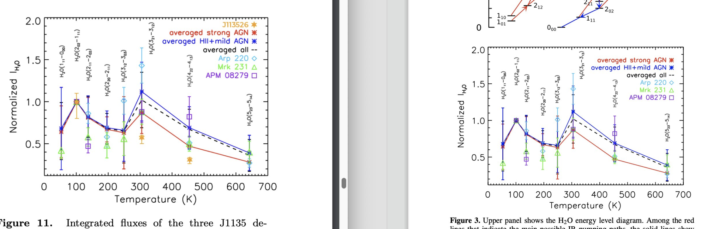
Don’t even come close to plagiarism
One example: ALMA PI program “The Shape of Water,” analysis of that data submitted by a different group as “The Way of Water”
Many plots were *very* similar to plots from previous papers, without sufficient attribution
Example at: https://twitter.com/chentao_yang/status/1648566004258160643

Slide 19
Repeat: Figures and Tables: Guidelines
Tables
keep table structure simple: how will people use your table?
place familiar content on left and new important information towards right
design table title to identify specific topic
label dependent variables in column headings and independent variables in row headings
Units! Footnotes!
Figures
place independent variable on abscissa (x-axis) and dependent variable on ordinate (y-axis)
ensure figure points, lines, axes, scales are easy to interpret
legend/caption should be descriptive of content
Parallel outline (one in text form, one in Figure form)
Units! Good caption!

Slide 20
Visuals: Show, don’t tell!
helps reader interpret, remember complex information in simplified form
can show:
how analysis looks or works
how analysis or data are organized or actions are performed
how elements or data are related
visuals should be audience-centered
keep as simple as possible
include explanatory labels, title, caption
use visuals to enhance your story
Should stand on own: can I see story without reading anything?
should use fewest number of plots that tell the story

Slide 21
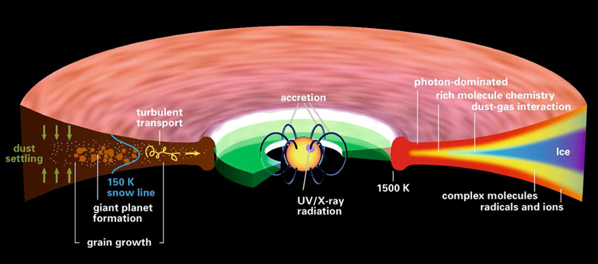
Visuals
Most readers look at visual first
Some exceptions: look at visuals only if logic is surprising
Visuals need to tell the story
Story is told in text and in visuals
Not just plots, also illustrations
Spend time on the plots! Make them clean and easy to understand!
Henning & Semenov 2013

Slide 22
Visuals for color-blind
I avoid green/red close to each other
most common form of color blindness
https://pilestone.com/pages/color-blindness-simulator-1
https://journals.aas.org/graphics-guide/

Slide 23
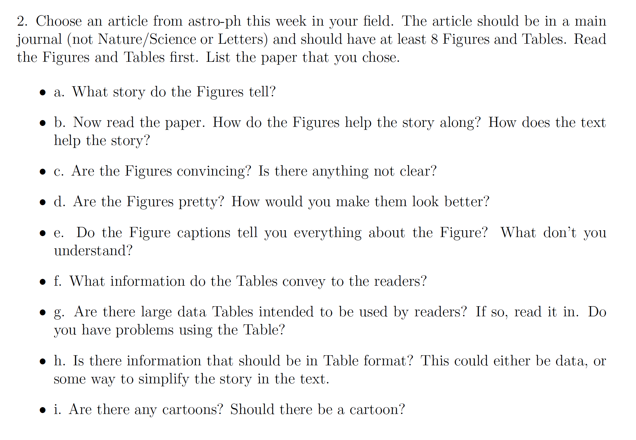
Figures and Tables

