Slide 1
Final writing tips
Should be tailored to the specific class.

Slide 2
Comments and feedback
Feedback request

Slide 3
Some tips (designed for specific class/questions)
vs.: always spell out versus
Noun/verb should go together
Can underline full paper
Combine sentences where it makes sense
Break sentences when they are too long
Single idea/sentence
“It is” ; “There are”: weak sentences, rewrite with science as the subject
Focus paragraphs, often with first sentence as overview
Parallel arguments
locates” => “is located”
Avoid “besides”
Relative terms need a comparison

Slide 4
Tips on tenses
Herczeg approach:
observations+data reduction in past tense, everything else in present tense
Citations to old papers: it depends on how they are being cited
“Galaxies are large”: usually present tense when describing the universe
Early universe: not sure! That was really in the past!
A different approach, from a friend:
What we did (data reduction, analysis) in past tense.
The section of Observation and some parts in the results will be in past tense
if we want to describe our modeling approach, we usually write as “We applied xx model to...")
Description of the results (what we found) is usually in present tense.”

Slide 5
Big picture tips
Be direct
Say what you mean
Don’t be sensationalist, but be interesting
Don’t do everything
Cut papers down to size
nobody reads 20 page papers (and definitely not 30 page papers)
Focus your arguments
use appendices for random tangents and barely relevant details

Slide 6
Resources
Common Mistakes in Writing Astronomy and Physics Literature in English
https://arxiv.org/abs/1011.5973
Mostly in Chinese
Writing Scientific Papers in Astronomy
https://arxiv.org/abs/2110.05503
Writing Centers
https://owl.purdue.edu/
https://sites.duke.edu/scientificwriting
Each other!
Share drafts and proposals!

Slide 7
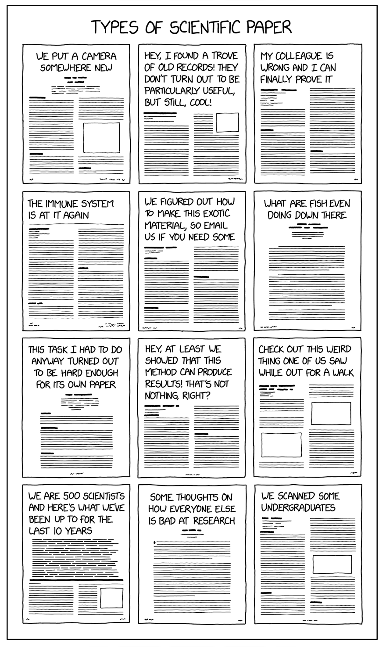
Idea generation and types of papers: https://xkcd.com/2456/
Where do ideas come from?
New capabilities
Creative looks at old ideas
Improving techniques
Parts of paper that don’t fit
Weaknesses in logic
Sources for new ideas include (a) gaps in logic in your work and papers of others, and (b) ideas generated by your paper.
Better editing will improve
your idea generation!

Slide 8
Outline
Outline sections and paragraphs
Outline with plots
Let the reader see the outline
Section/sub-section headings
Introductions to sections/subsections, even paragraphs
Tell a story
Every section, paragraph, and plot has a story
Inverse pyramid
Big concepts come first
Introduce what will come next

Slide 9
Edit!
Edit your own work heavily
Write quickly!
Thesaurus when editing
Spend 10x as much time editing as writing
Logical flow
Grammar
Keep science and grammar edits separate
Figures: spend time editing them!
Large fonts
Clear point that can be seen
Techniques:
Read out loud
Rely on others to edit
Can always share drafts with each other
Underline looking for different things

Slide 10
Time allocation and your future
Write quickly!
Take your time in editing
If you have been at your desk for an hour and have not made progress, move on to something else
This applies to writing and everything else
Your time is precious
Don’t be paralyzed by perfection
Perfect is the enemy of the good
Don’t drive yourself crazy
Focus on logic, not grammar
Work with others, accept criticism and feedback
Other people will strengthen your work
Identify flaws in logic
Add expertise that you lack – you cannot be an expert in everything
Enjoy sharing your discovery with others
Own your PhD topic. It’s yours, know it and love it!
Goal: you are the expert teaching your advisor

