Slide 1
Other forms of writing

Slide 2
Forms of writing
Papers
Proposals (including job applications)
Separate topic for discussion next week
powerpoint
Press Releases/popular articles
Email
Referee reports

Slide 3
Powerpoint
Clean
Don’t have lines that go a single word over the space allocated
Simple
Preferably a single plot
Make sure axes are legible, lines thick enough to see
Title: short or single idea
No complete sentences, but help guide the audience

Slide 4
AAS Nova and Astrobites
Aimed at general public
Other astronomers
Other scientists
Undergraduates
Funding agencies

Slide 5
Press releases/popular short articles
Tell a story
Remember your audience
Aim it at your parents
No acronyms! Simplify terms!
Advertise the importance
Never lie, but enhance the truth
Examples: KIAA website!, Astrobites, AAS Nova, Observatory Newsletters

Slide 6
Keep the logical flow
Start with a way to catch the audience
Describe exciting result (very briefly)
Put into context by describing past results
Describe exciting new results in slightly more detail
Include what facilitated the advance
New instrument or survey?
New insight?
Distribute credit
It never hurts to acknowledge contributions from others
Financial and/or other credit may be necessary
Political considerations (keep others happy)
Direct quotes are fine
Credit to others
Can be more speculative than the rest of the text

Slide 7
Email is not wechat!
Most of your professional communication will be email
Proofread your emails
Be professional
Sometimes formal, “Dear Greg”
Unusual, very formal: “Dear Prof. Herczeg”
Format and structure are important
If long, put important information/structure in body of email, details after your email signature (for me, -greg)
Be careful about your cc list
Write every email like it will appear on Weibo
Be concise and to the point
Be careful! Email can be easily misinterpreted
If nervous or new, can ask your advisor for help
Check your spam (emails from journals, jobs, other announcements)

Slide 8
Email is not wechat!
Examples of problem emails deleted

Slide 9
Submission and referee process
Submit your paper
Editor finds an appropriate referee
Most people first referee in their postdoc
Referee submits a report within 3-4 weeks

Slide 10
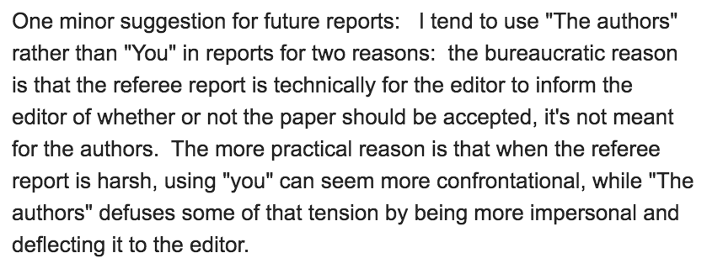
Referee report
Address to the editor, not the authors
Never use “you”: report is to editor
Try to be positive, especially in first paragraphs
Editor decides on acceptance/revision/rejection
Referee report makes recommendations

Slide 11
Referee reports
I usually ask authors to consider my comments
In some cases, I will request changes before the journal considers the paper for publication
Try to find logical flaws, weak points, unclear figures and text, and other problems
What is the main point of the paper?
Why might the authors be wrong (but they are experts and know more, so they are probably right)
Referees are not perfect!
I try to identify all potential problems, let the authors push back
CLARITY OF ARGUMENTS!

Slide 12
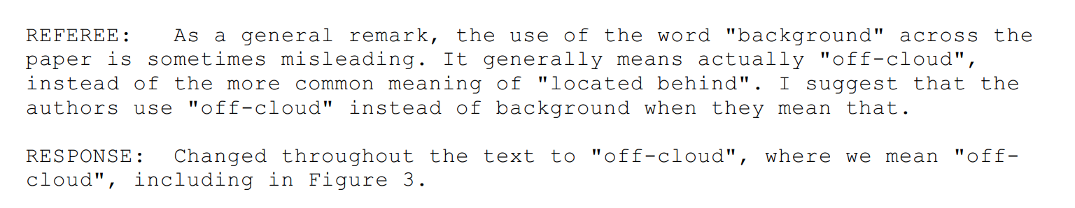
How to respond to referee reports
Clearly!
Point by point!
Separate Referee and Response clearly (color differences and/or in other ways)
Clearly mark the changes! (sometimes I’ll list CHANGES) in addition to REFEREE and RESPONSE
All major changes identified at the start of your response to the referee

Slide 13
How to respond to referee reports
Deep breaths
Read quickly
Send to co-authors
Put aside until tomorrow
Most referee reports help to better explain the results to the readers: this is helpful!
Sometimes referee reports will be more challenging
The authors are writing to the editor, not to the referee
The paper is yours, do not let the referee force you to say something you don’t want to say!
Be pragmatic

Slide 14
Referee process is just one aspect of peer review
Referee process is not perfect!
Most journals have one single referee
Not an expert on everything in your paper!
Some advantages/disadvantages to one referee
How is your work evaluated by the collection of your peers, not a single person
Citations
Outreach to peers: talks, facebook, twitter

