Slide 1
Juan ad. app
Members:
Borja, Gherome
Santiago, TrANZ
ORTEGA, VINCENT
BERSABE, MAC LAURENCE

Slide 2
Group consolidation w/ github
Github pages
Updates
project

Slide 3
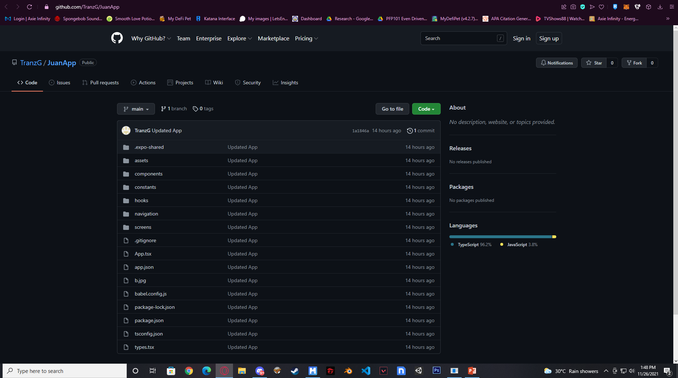

Slide 4
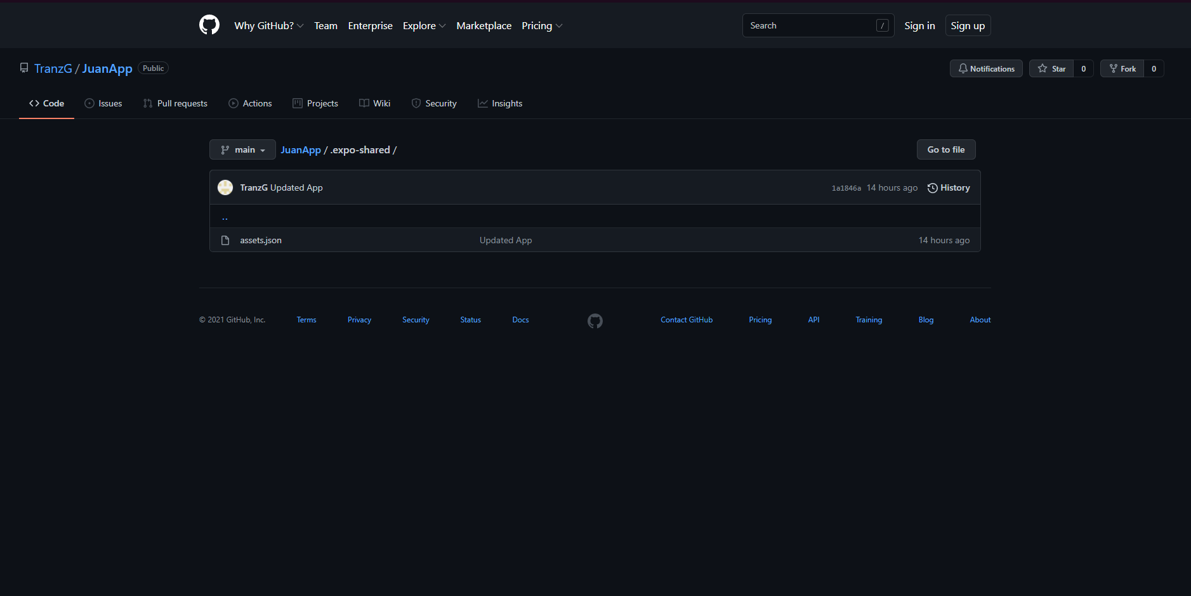

Slide 5
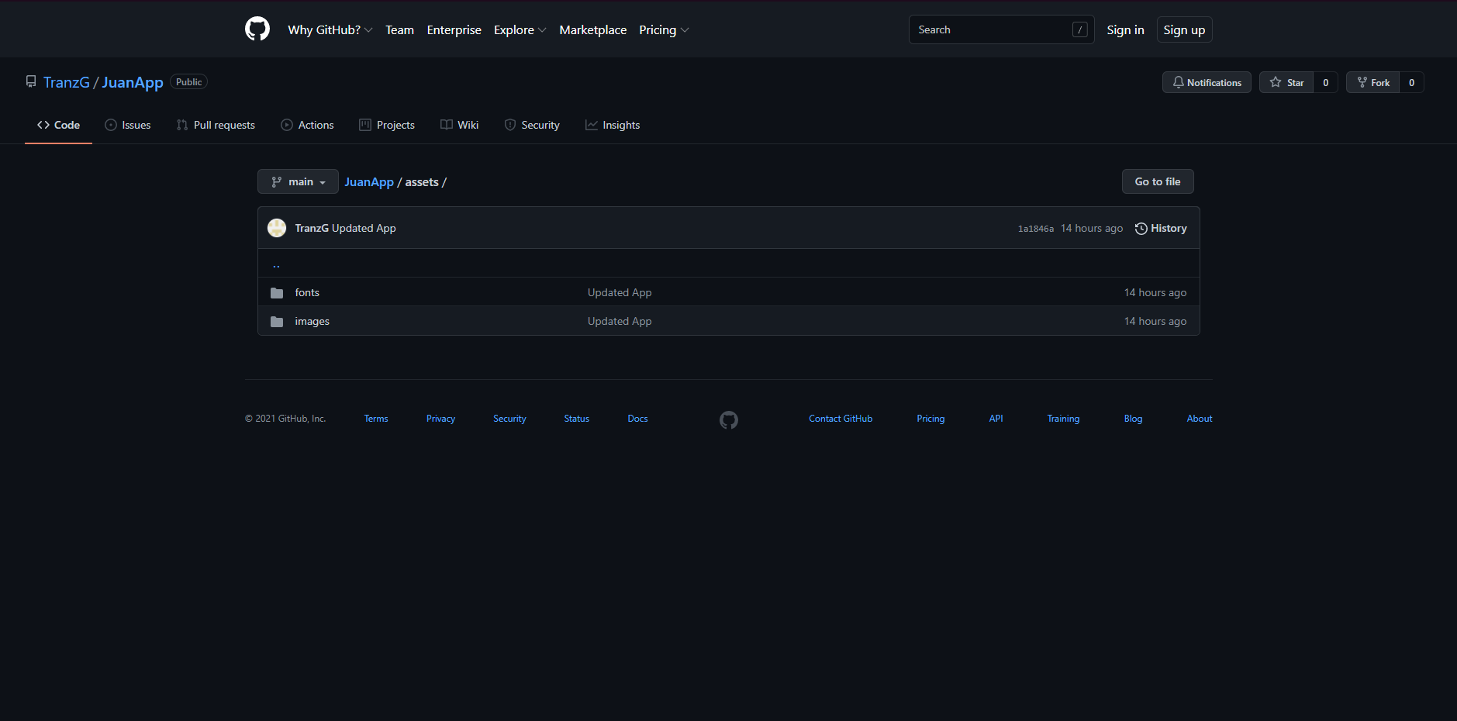

Slide 6
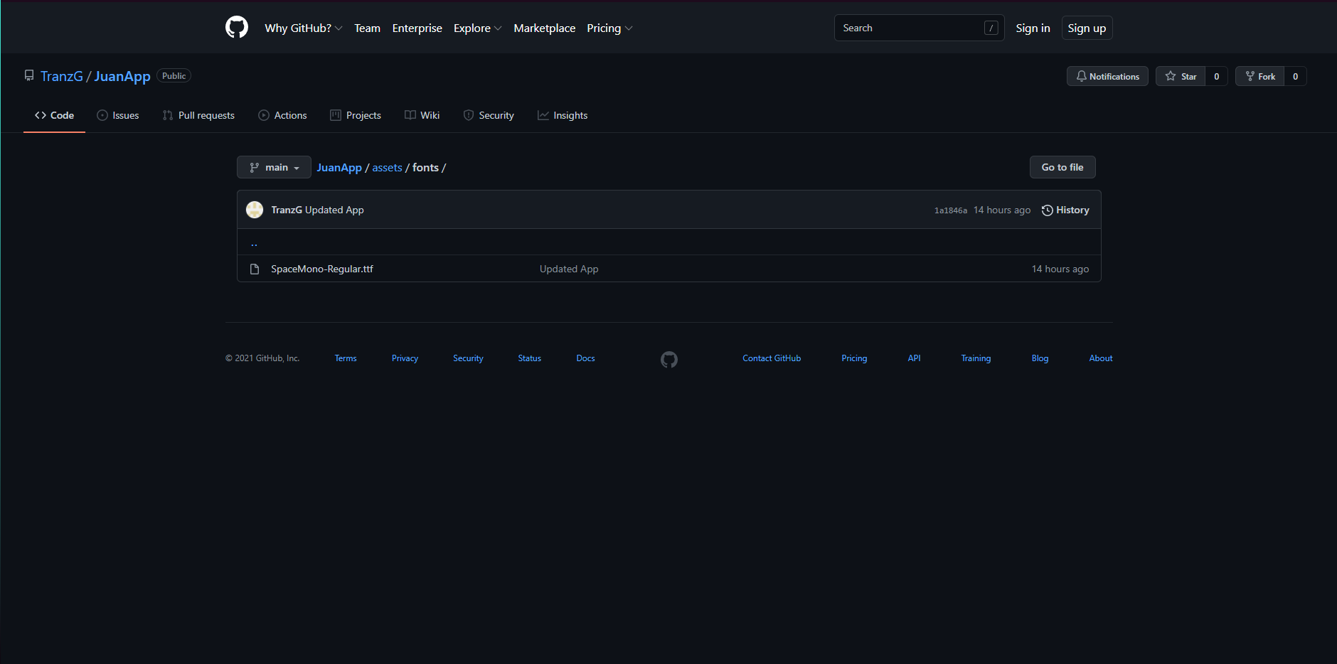

Slide 7
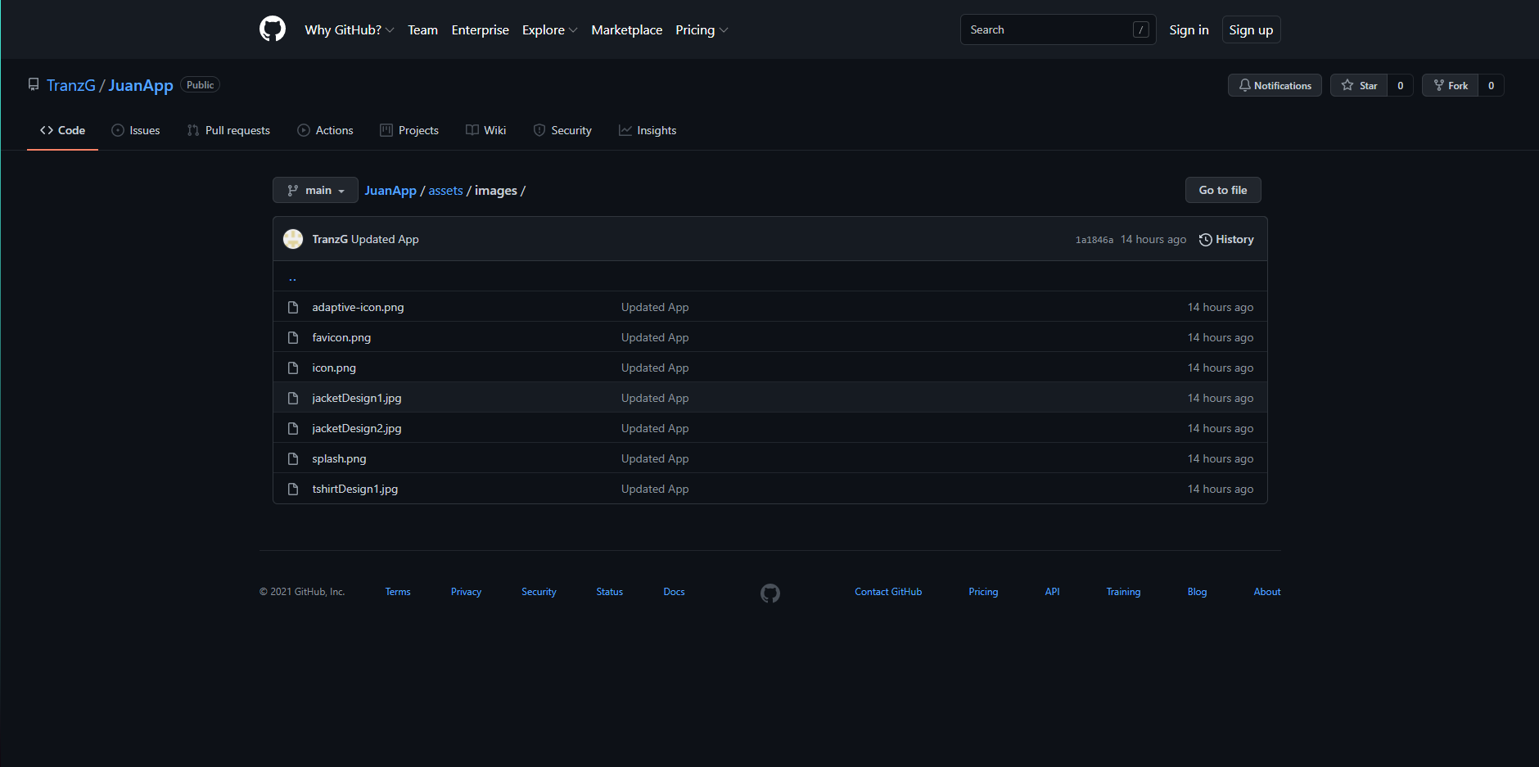

Slide 8
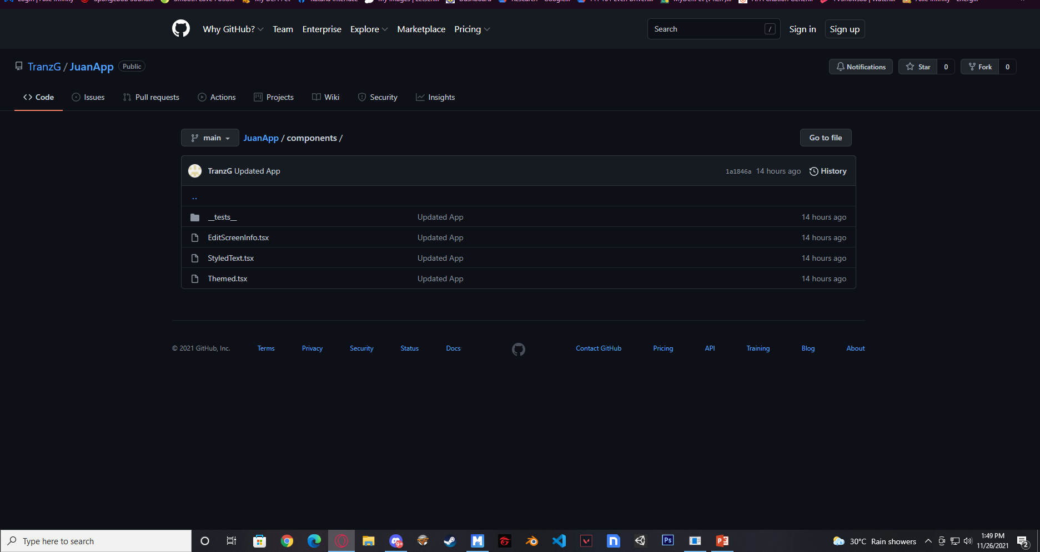

Slide 9
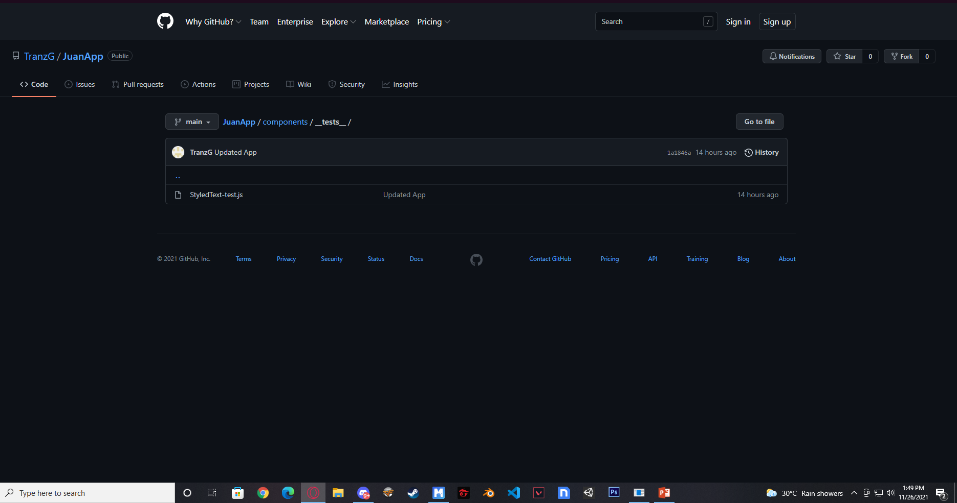

Slide 10
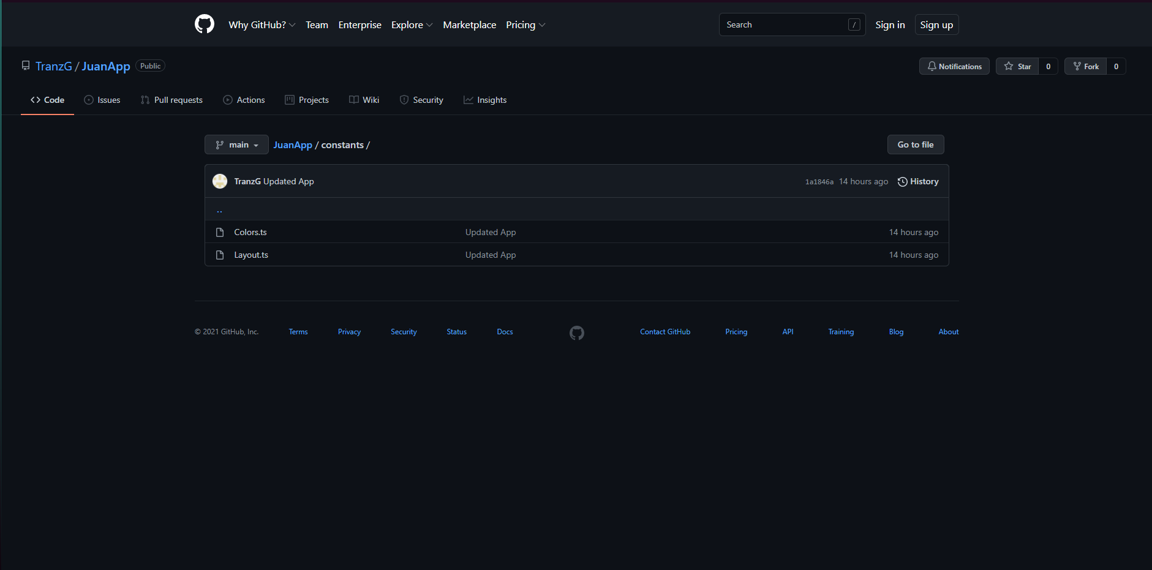

Slide 11
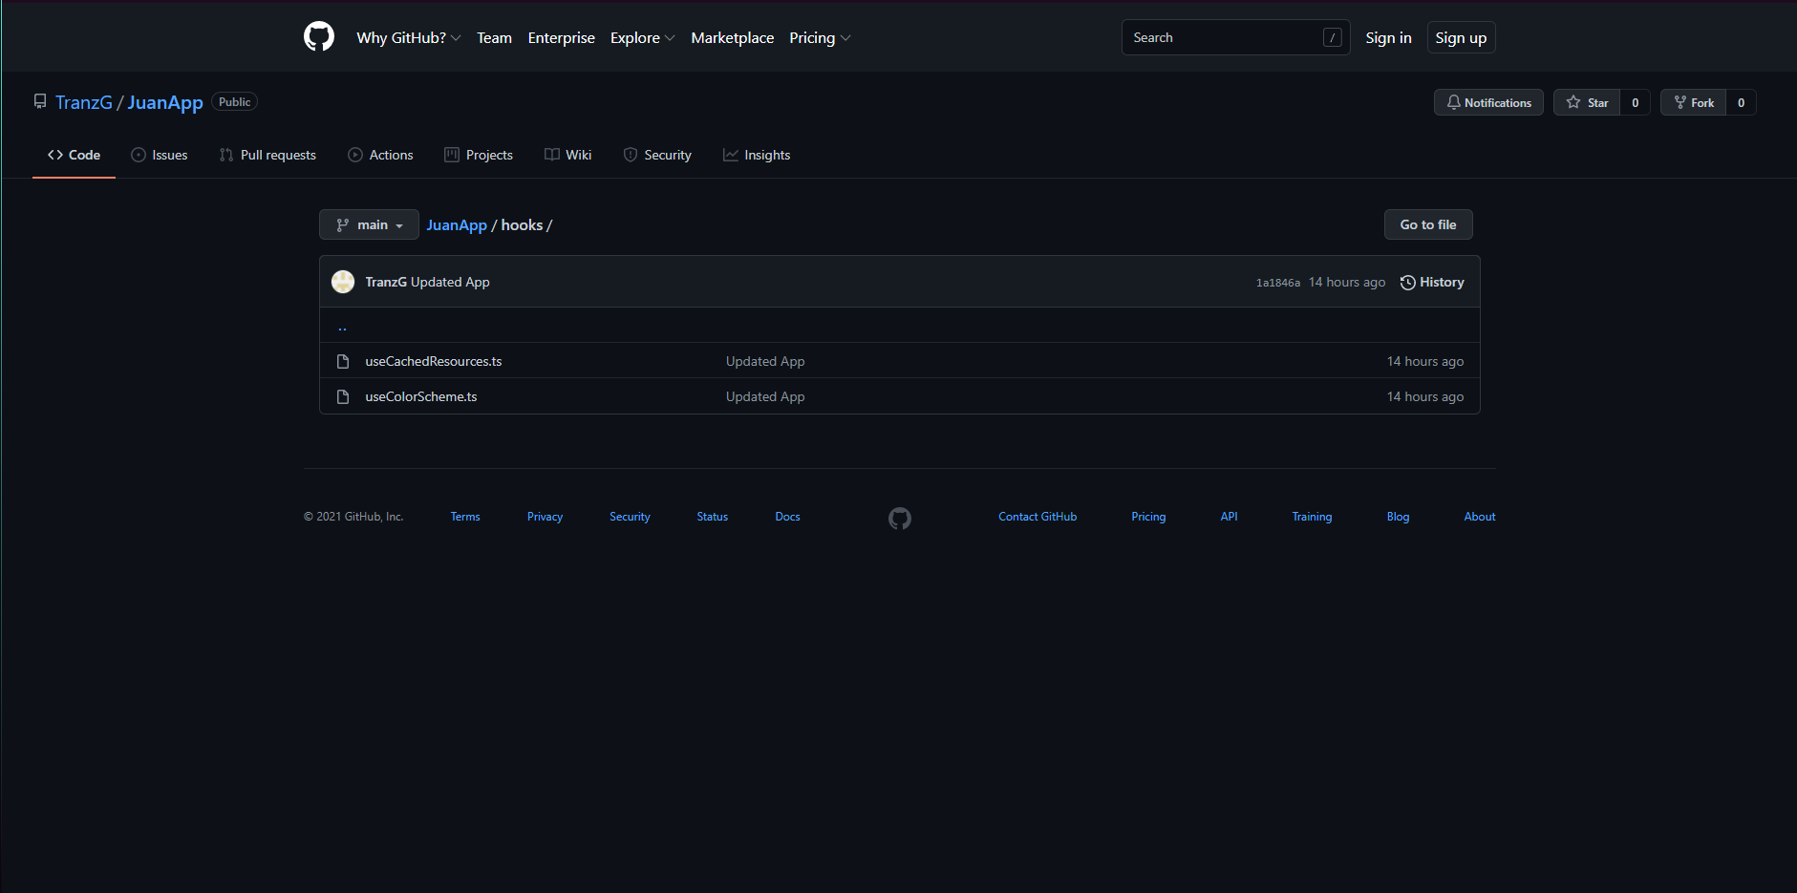

Slide 12


Slide 13
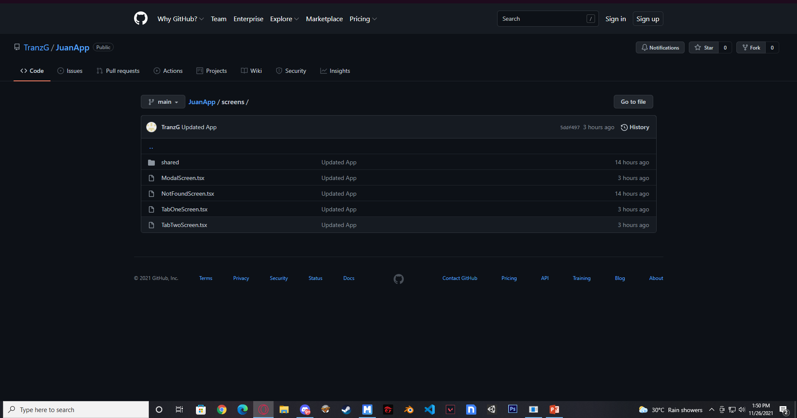

Slide 14


Slide 15
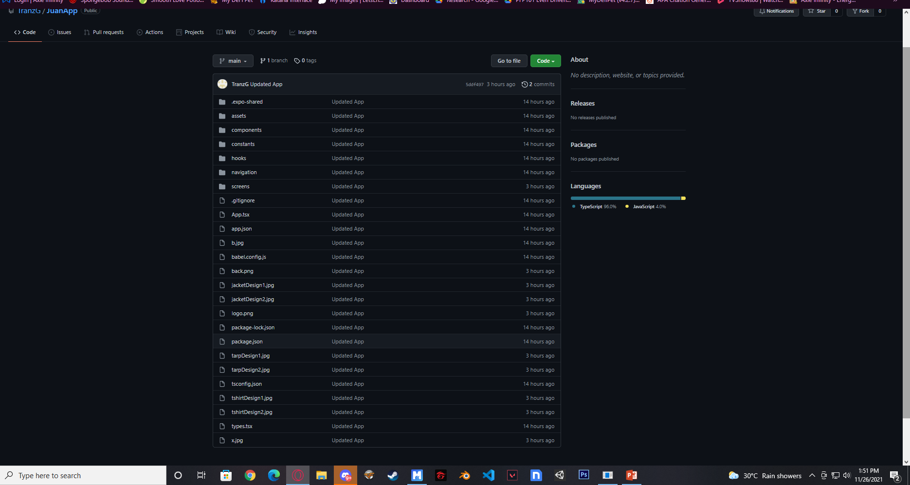

Slide 16
wireframes
Low fidelity designs
Focused on screen navigation and functions

Slide 17
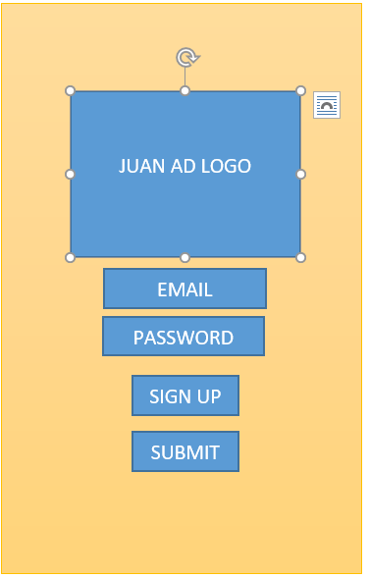
Welcome screen

Slide 18
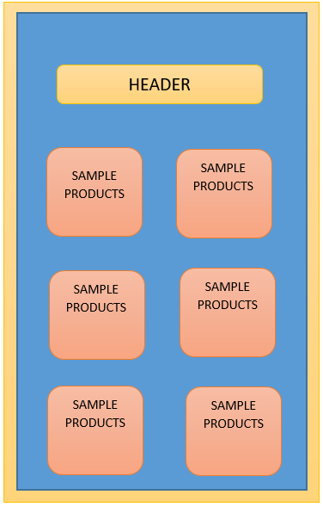
home screen

Slide 19
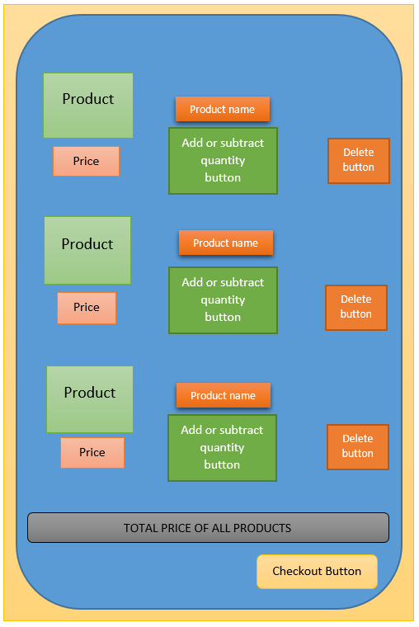
Cart screen

Slide 20
Mock-up designs
Juan ad. Concept app future designs

Slide 21
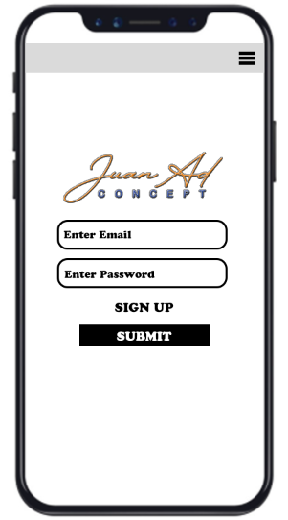
Log in screen

Slide 22
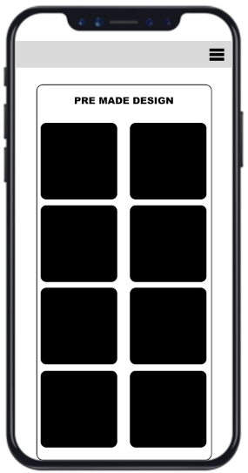
Main screen

Slide 23
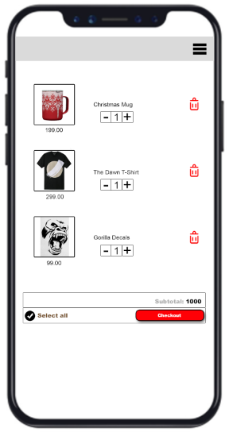
Cart screen

Slide 24
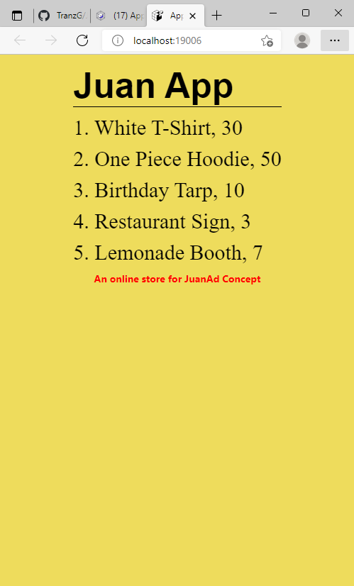
API

