Slide 1
ML-Base Research Tools for the Research Process
Part III: Reading academic resources
October 10, 2023

Slide 2
Agenda
A brief introduction to the summary generation.
Pre-assessment discussion.
Research tools.
Post-assessment discussion.
What is Next

Slide 3

You have a few papers to read.
Don’t have enough time.
Need to have a summary of each paper.
Want to know if it is worth reading it thoroughly?

Slide 4


Slide 5

Lets talk about this
What is your strategy for reading papers?
What are the challenges you have?

Slide 6

Have you ever think of:
A tool that can help me summarize the papers quickly?
Find the important information faster.

Slide 7


Slide 8

Scholarcy
Is an AI-powered summarizing tool that can help researchers and students to quickly assess the importance of research articles, reports, and book chapters.
Can read these documents in seconds and break them down into bite-sized sections, identifying key information such as study participants, data analyses, main findings, and limitations.
Can create a summary flashcard of any article, report, or document in Word or PDF format, extracting the key facts, figures, and references in seconds.

Slide 9

Notes:
+ Ask for search term.

Slide 10
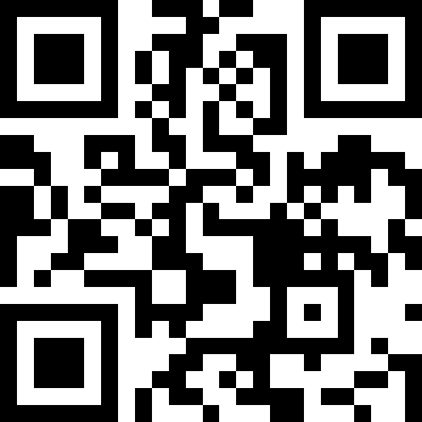
https://www.scholarcy.com

Slide 11
How do you feel about using scholarcy?
How much ethical it is to use such a tool?

Slide 12

Homework:
Open an account in https://elicit.org/.
Do a comparison between two software:
What are:
Similarities?
Differences?
What is your preference and why?
Submit the assignment to the dropbox in the A2L.

Slide 13


