Slide 1
ML-Base Research Tools for the Research Process
Part II: Literature Review
Septmenber 21th, 2023

Slide 2
Agenda
A brief introduction to the Literature Review.
Pre-assessment discussion.
Research tools.
Post-assessment discussion.
What is Next

Slide 3

Literature Review (LIT):
How to start searching?
What should we read first and last?
Where we should stop?

Slide 4
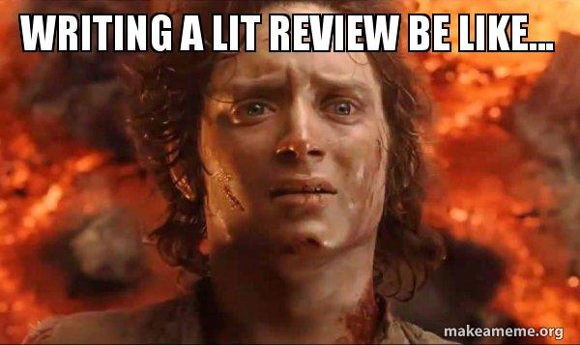

Slide 5

Lets talk about this
How do you work on the research background?

Slide 6

Have you ever think of:
A tool that can help me summarize the papers quickly?
Find the important information faster.

Slide 7


Slide 8
Connected Papers
Get a visual overview of a new academic field.
Enter a typical paper and build a graph of similar papers in the field.
Discover the most relevant prior and derivative works.
Create the bibliography for your thesis.
Make sure you haven’t missed an important paper.
Explore and build more graphs for interesting papers that you find.

Slide 9

Notes:
+ Ask for search term.

Slide 10
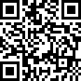
https://www.connectedpapers.com

Slide 11
How do you feel about using connected papers?
How you can use it in your research?

Slide 12

Assignment:
Open an account at https://www.researchrabbit.ai/.
Do a comparison between two software:
What are:
similarities?
differences?
What is your preference and why?
Submit the assignment to the dropbox in the A2L

Slide 13


