Slide 1
ECE401 Final RC statistics
Zimeng Mao

Slide 2


Overview
A
Comparison of Two Variances
Non-Parametric Comparisons
Paired Tests and correlations
Categorical Data

Slide 3

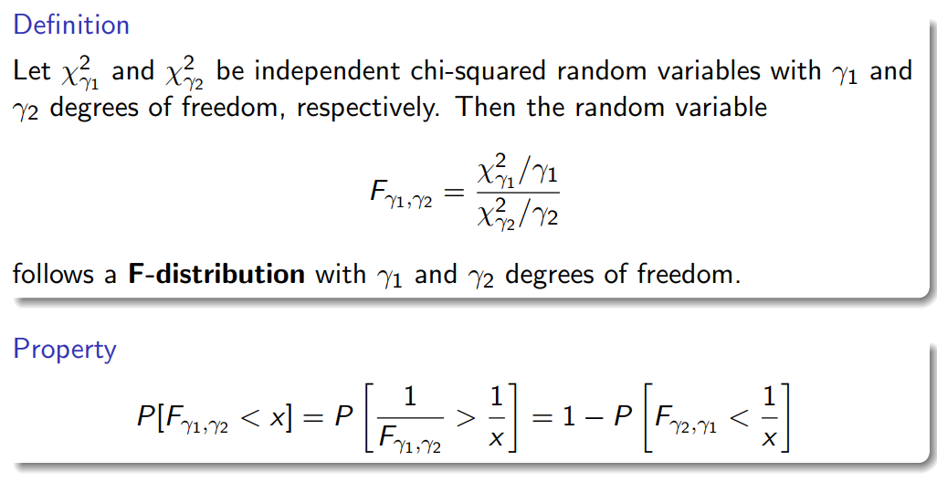

Slide 4
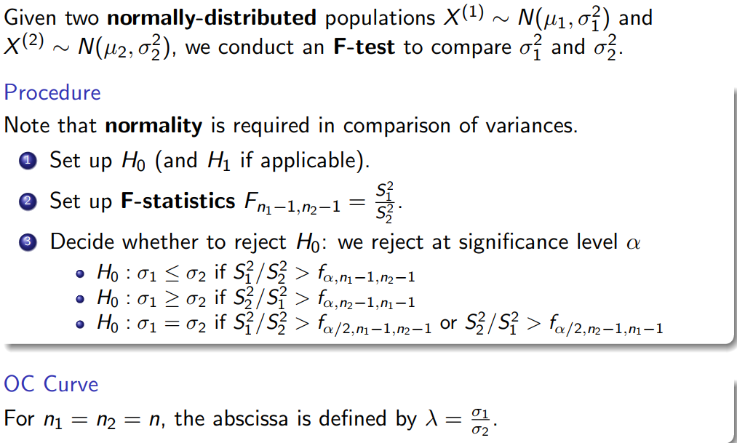
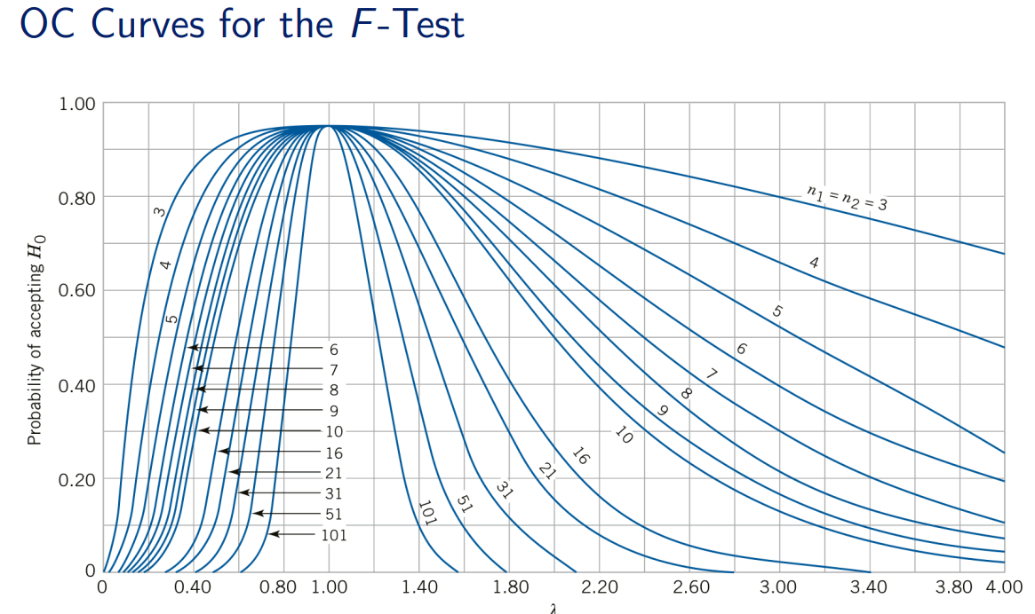

Slide 5
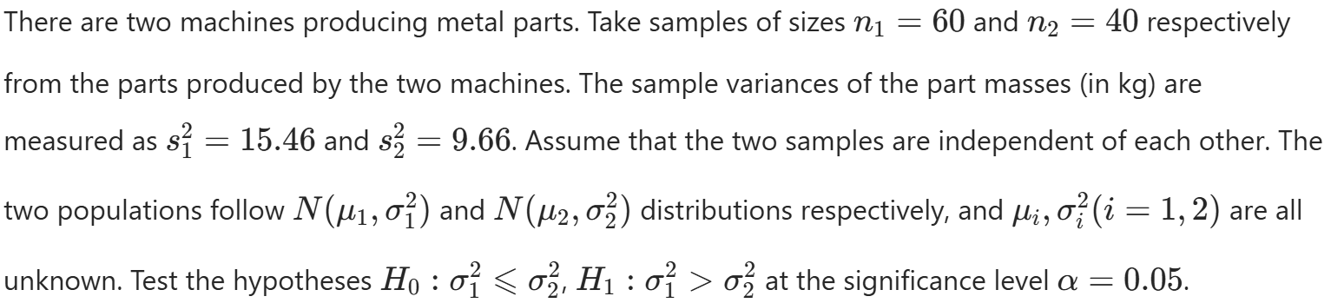

Slide 6
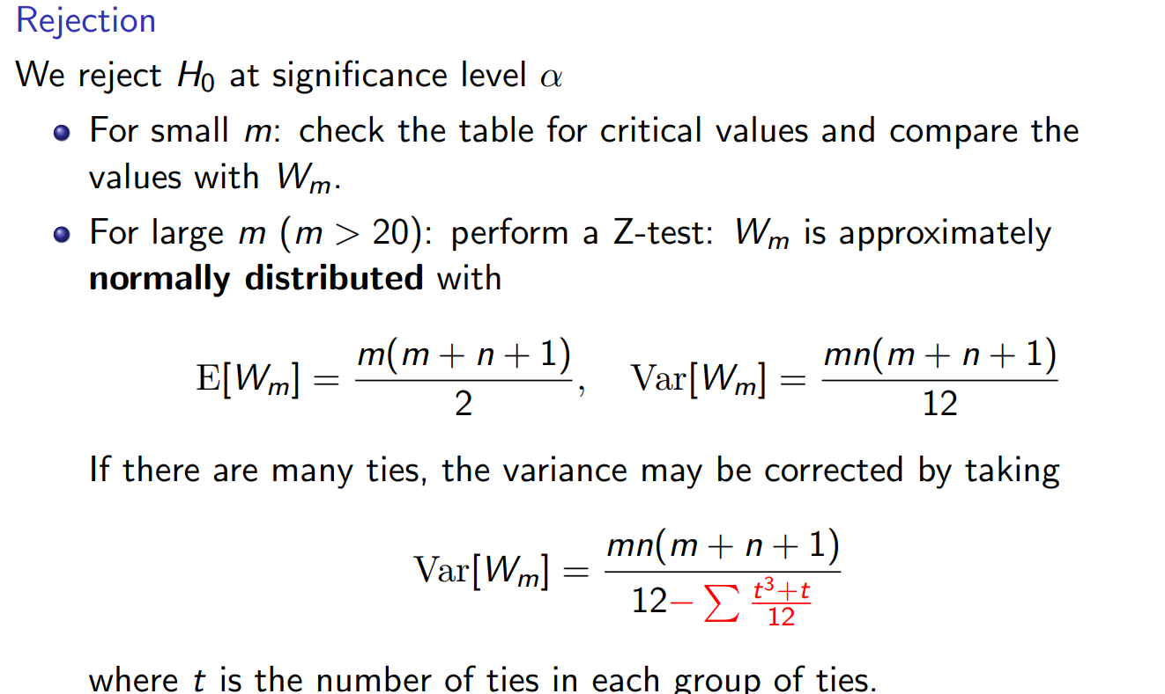
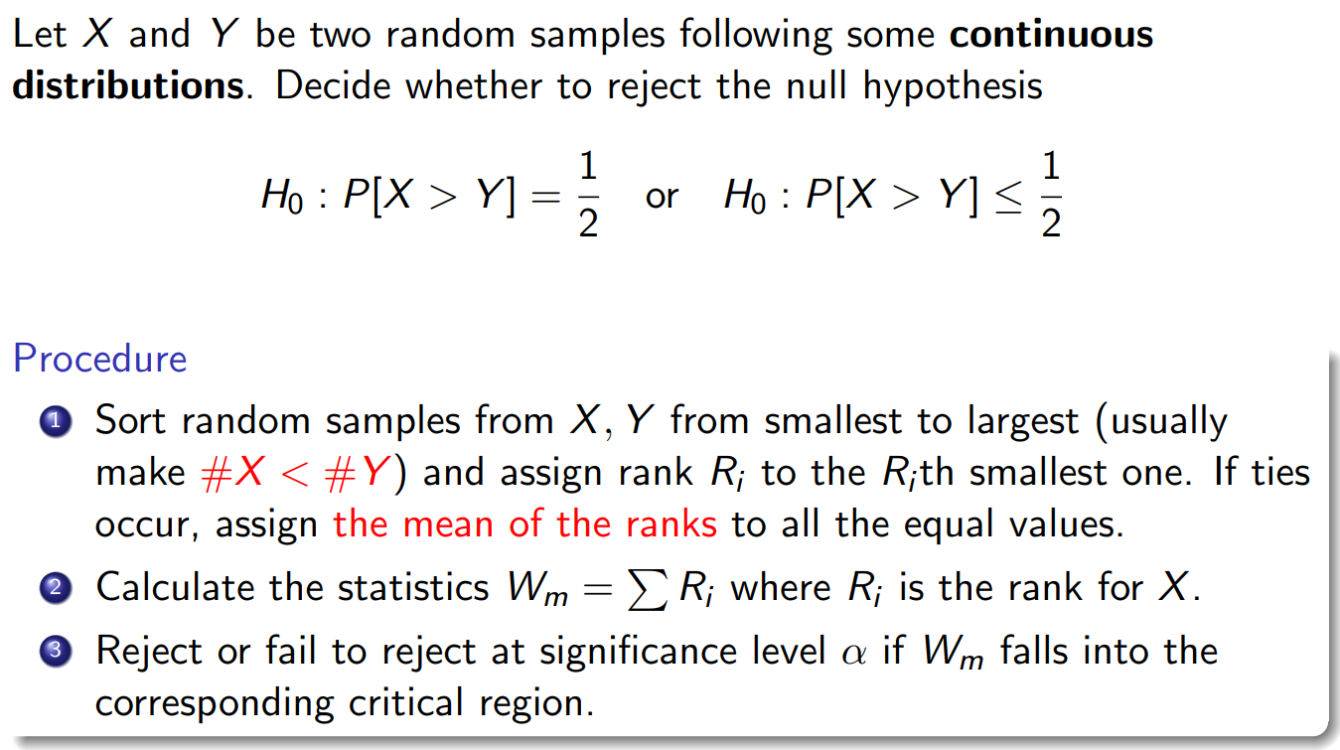

Slide 7
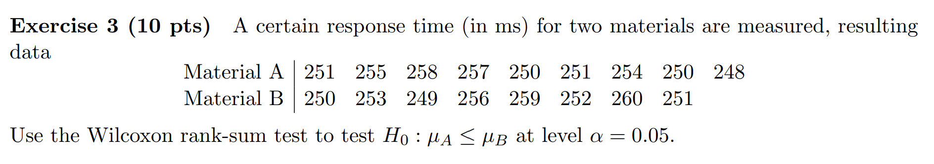

Slide 8

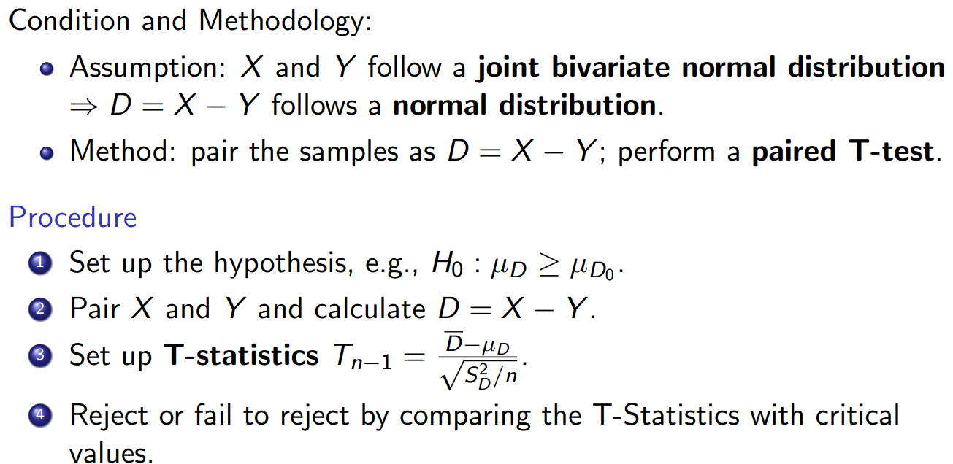
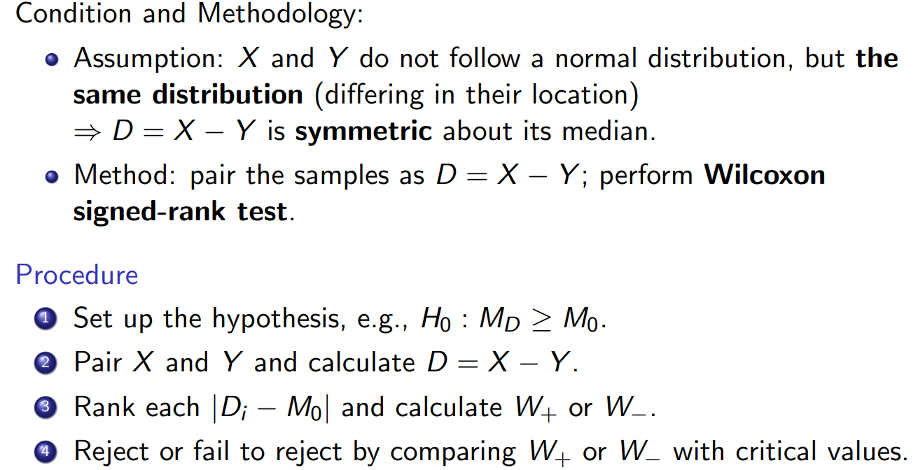

Slide 9
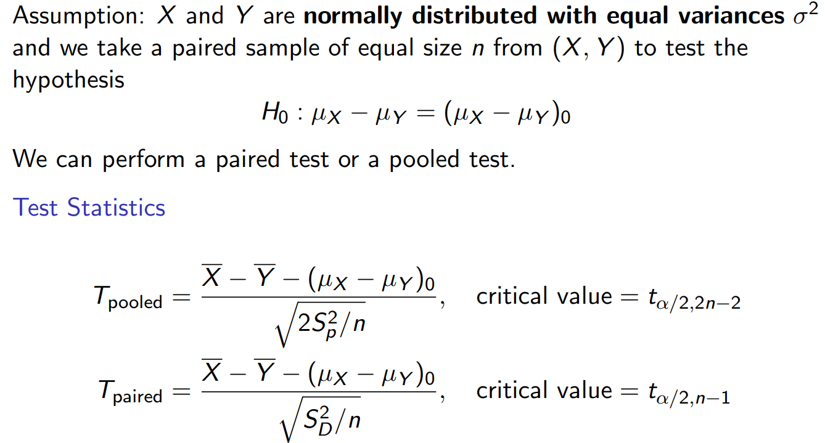
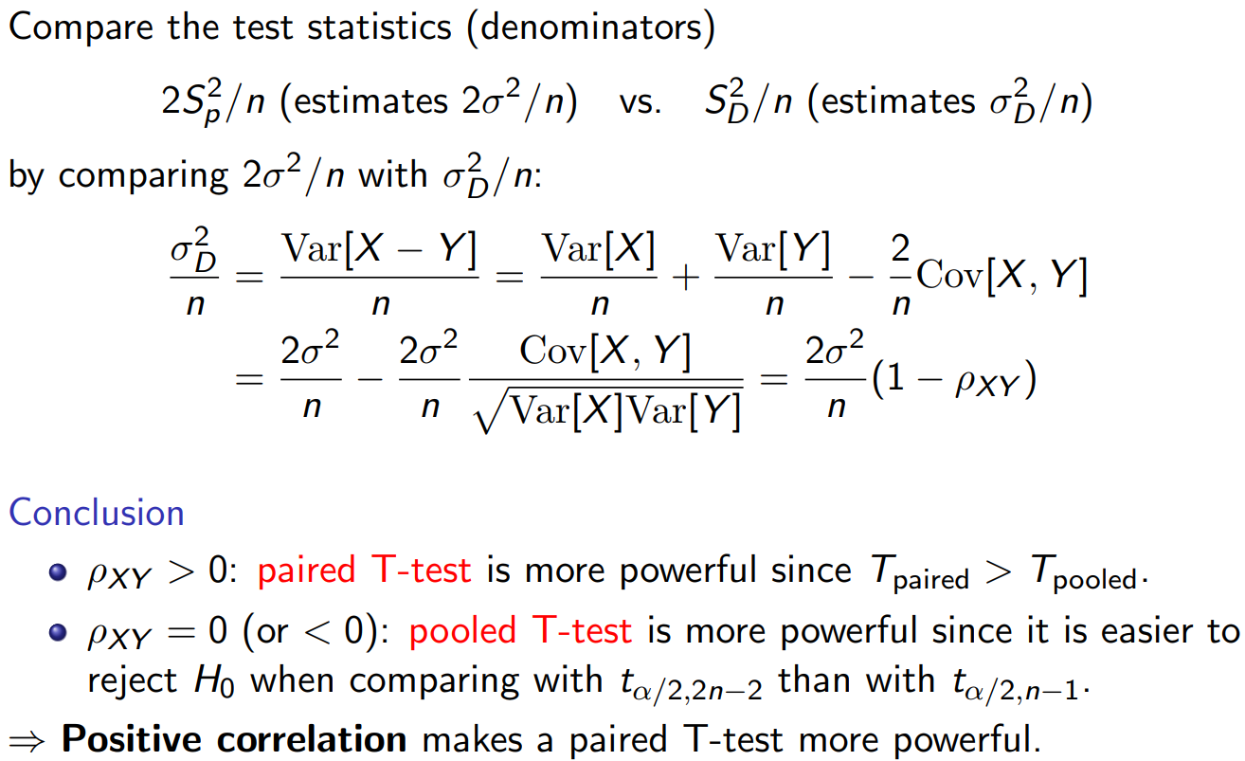

Slide 10
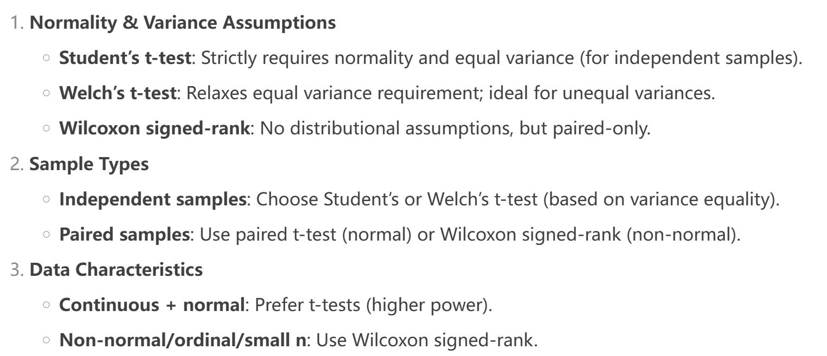

Slide 11
Sample Type | Data Distribution | Variance Assumption | Recommended Test | Also Known As
Independent | Normal (or approx.) | Equal (homogeneous) | Student’s t-test | Pooled t-test (pooled variance)
Independent | Normal (or approx.) | Unequal (heterogeneous) | Welch’s t-test | Satterthwaite t-test (unpooled variance)
Independent | Non‑normal / Skewed / Small n / Ordinal | Not required | Wilcoxon Rank-Sum Test | Mann‑Whitney U test
Paired | Differences normal (or approx.) | Not applicable (paired design) | Paired t-test | Dependent t-test
Paired | Differences non‑normal / Skewed / Small n | Not applicable | Wilcoxon Signed‑Rank Test | Paired signed‑rank test

Slide 12
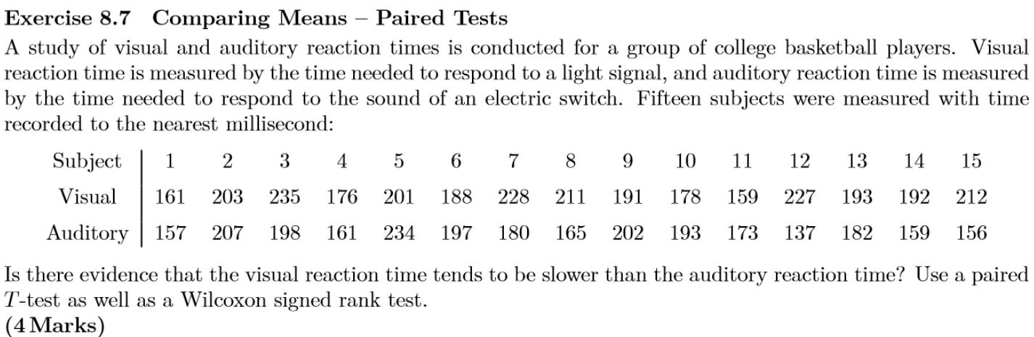

Slide 13

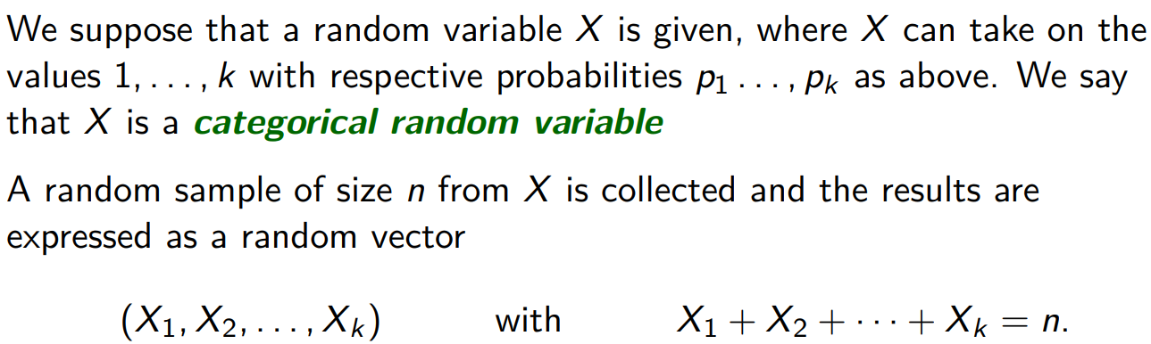
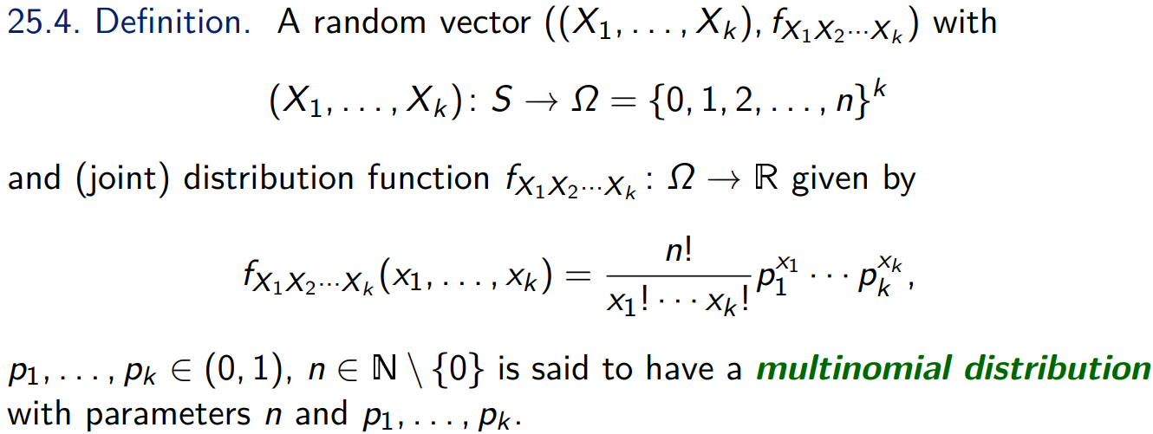
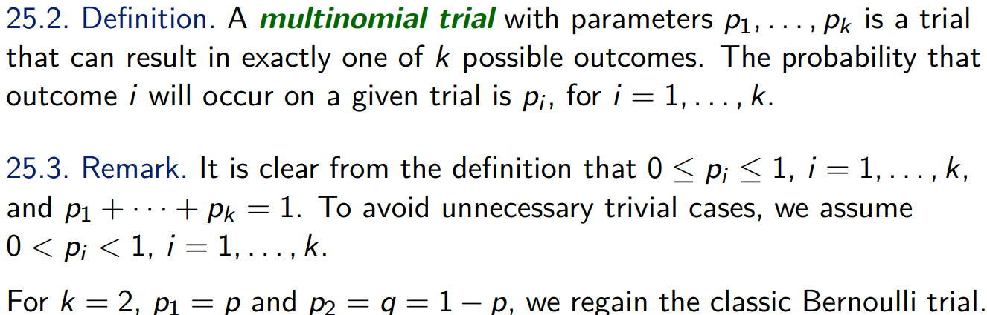
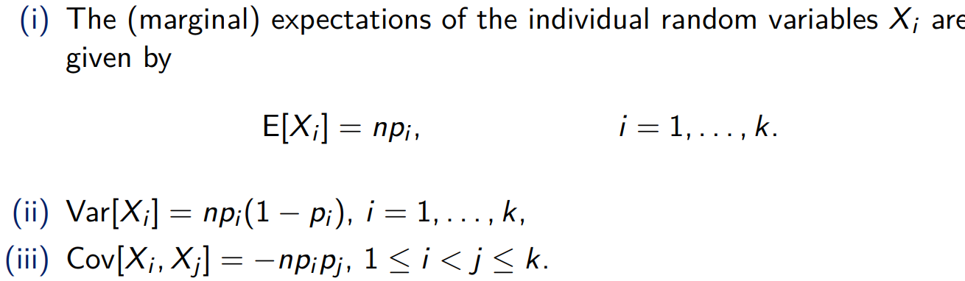

Slide 14
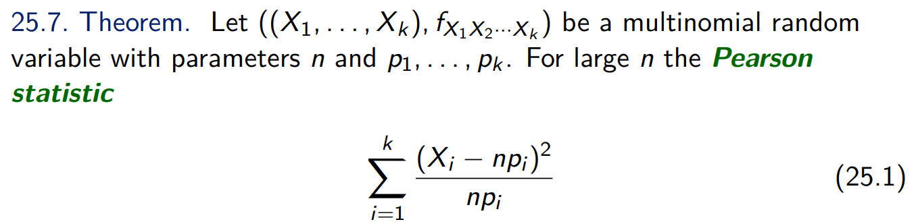
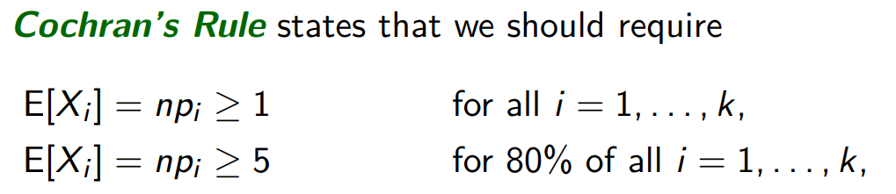
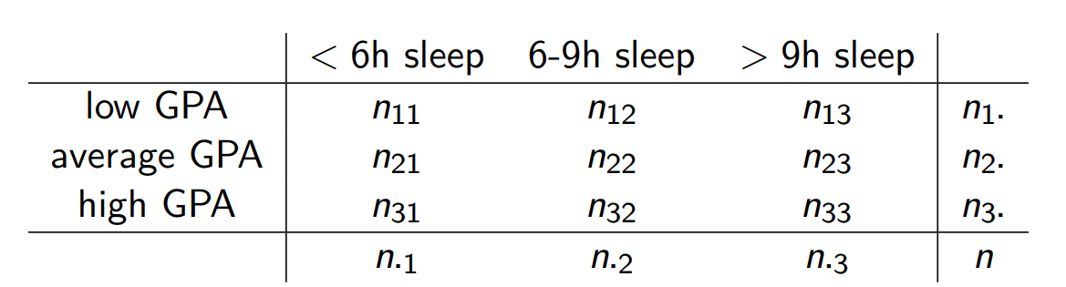
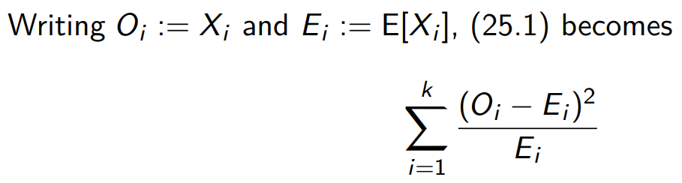
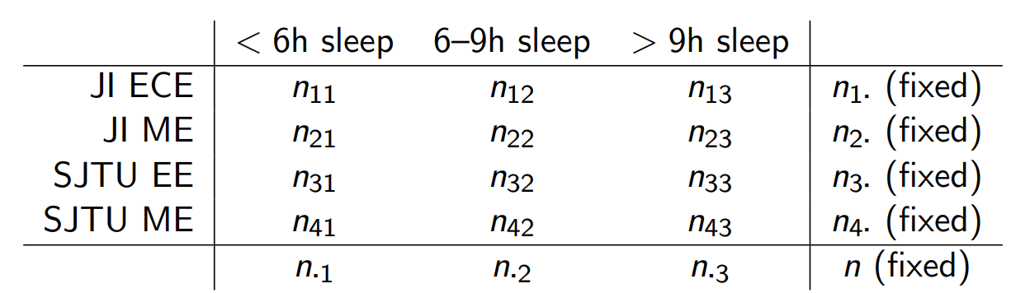


Slide 15
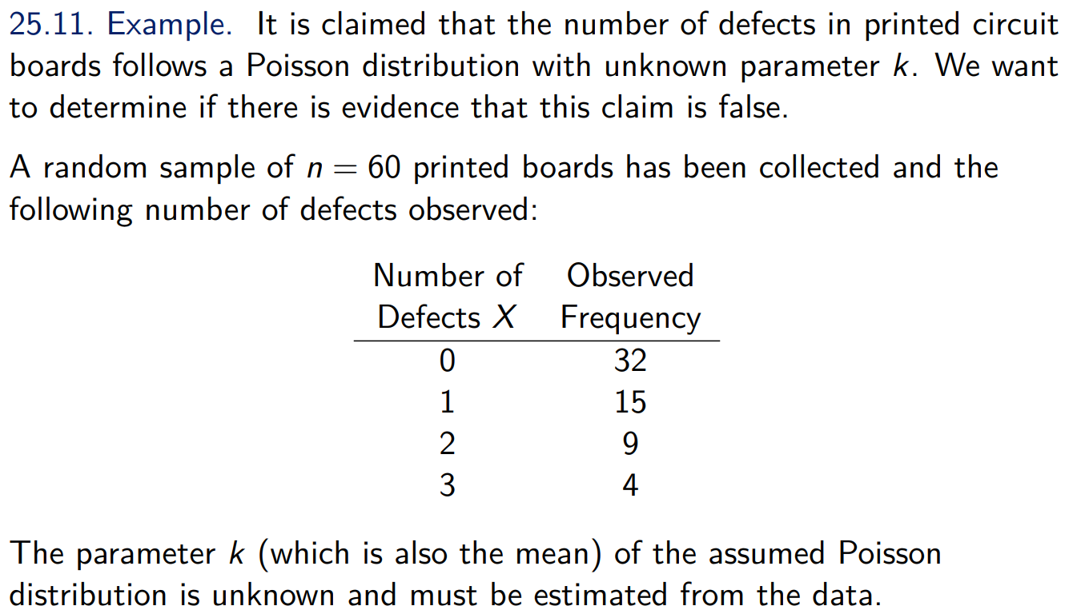
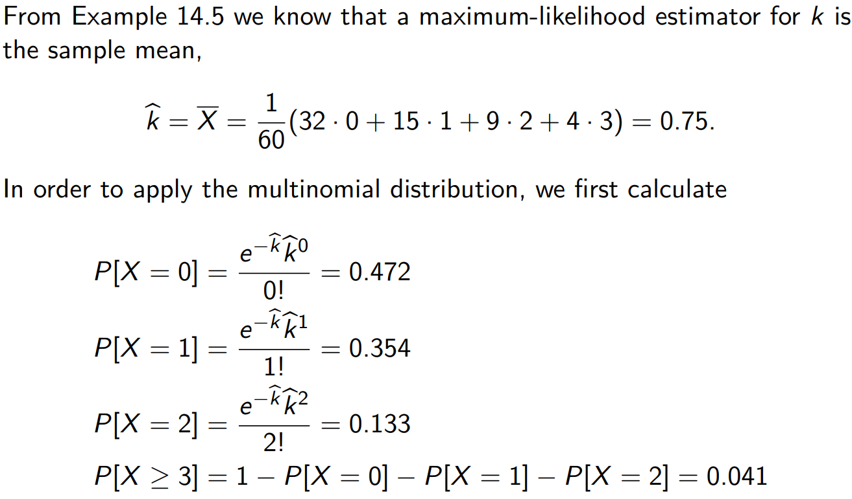
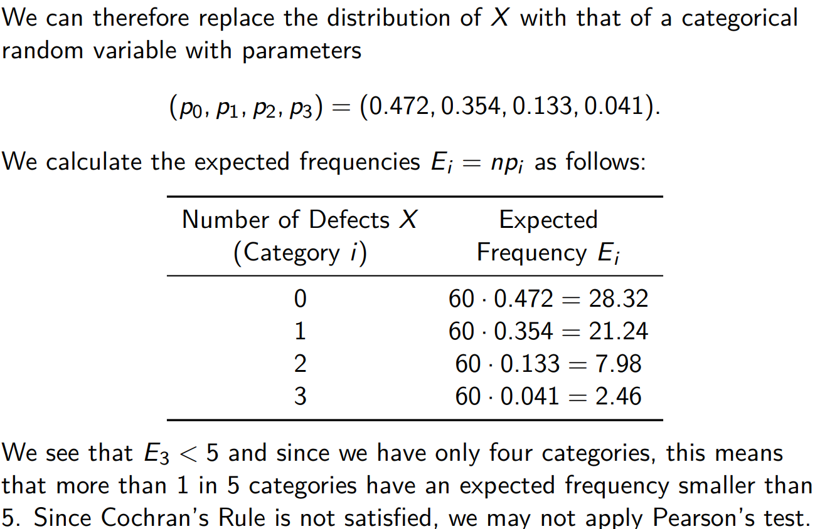
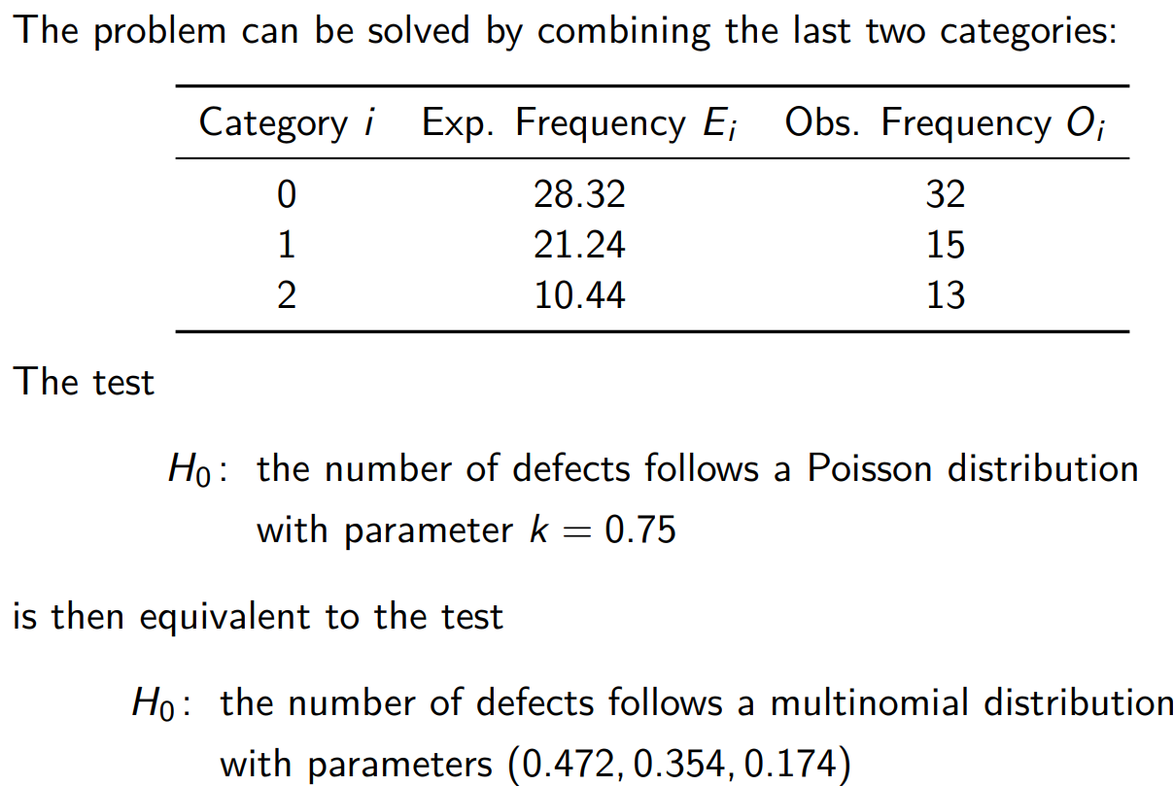

Slide 16
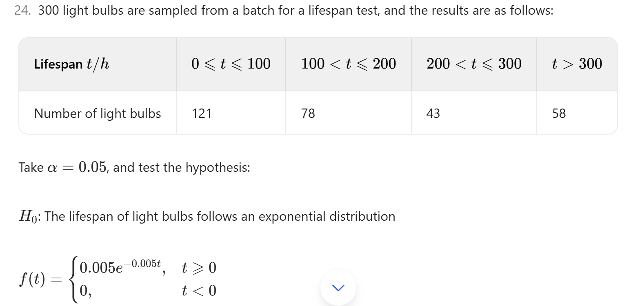

Slide 17
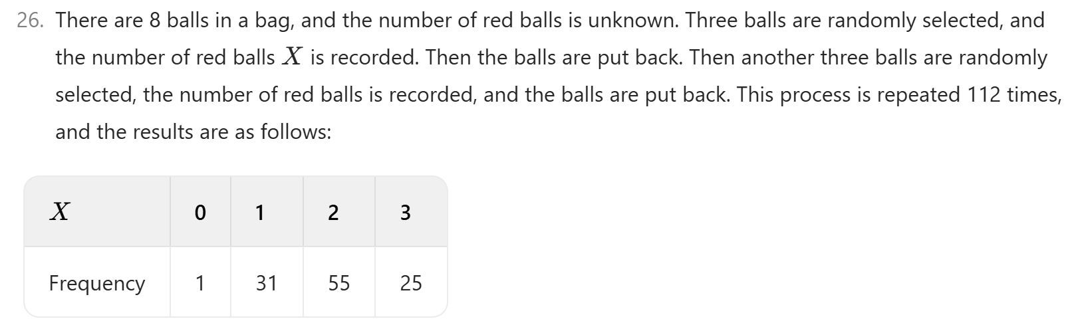
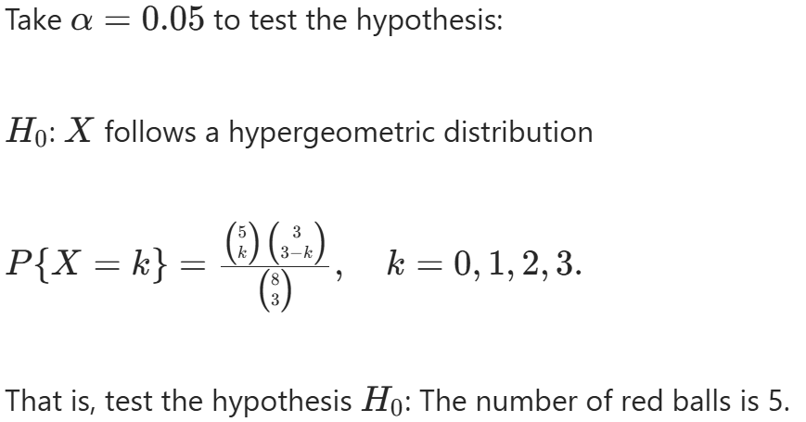

Slide 18
Reference
F
VE401 Slide, Horst
Final_RC_Part2, Tianyi Jiang
Final_part3_Linda, Linda Wei
VE401_RC_topics_2021, Horst
Sheng, Z., Xie, S., & Pan, C. (2018). Probability Theory and Mathematical Statistics (5th ed.). Zhejiang University Press.

