Slide 1
Game Streamers Summary
Ghifari Umar Noorman

Slide 2
01
TABLE OF CONTENTS
Finding Things
02
Summary
03
Improvement

Slide 3
Problem Statement
At MainGames we are committed to help streamers increase their revenues by leveraging the rich source of streaming data to provide actionable insights. In this problem, we want to learn whether certain features of streamers will make them more or less likely to receive stars from their audience, in this case PaidStarPerWatchedHour is our dependent variable

Slide 4
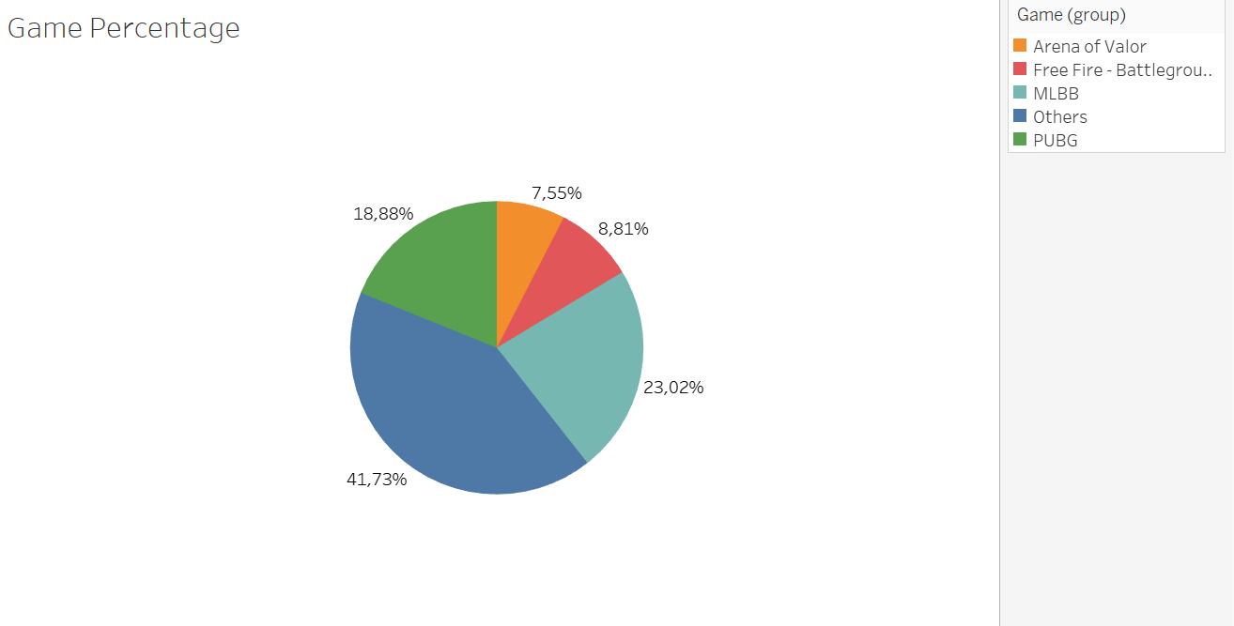
Finding Things Game Streamed by Percentage
With toal 64 games recorder. Most Streamers play MLBB (Moblie Legend) with 23%, follow by PUBG with 19%, Free Fire with 8,81%, Arena of Valor with 7,55% and 41,7% shared by other games

Slide 5
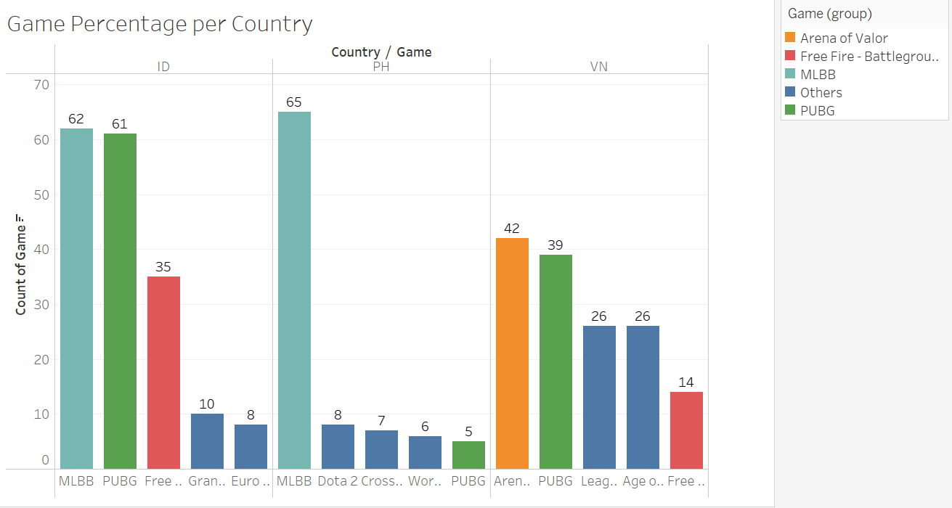
Finding Things Game Streamed in Every Country by Total
From three countries recorded Indonesia, Philippines, Vietnam. In Indonesia Most Streamers play MLBB and PUBG. In Philippines most Streamers play MLBB. While in Vietnam most streamers play Arena of Valor follow by PUBG.

Slide 6
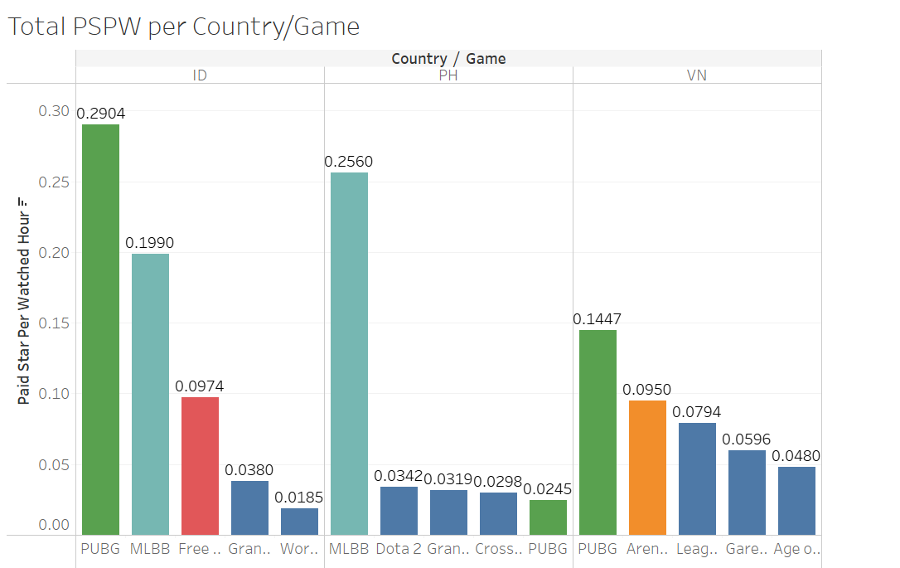
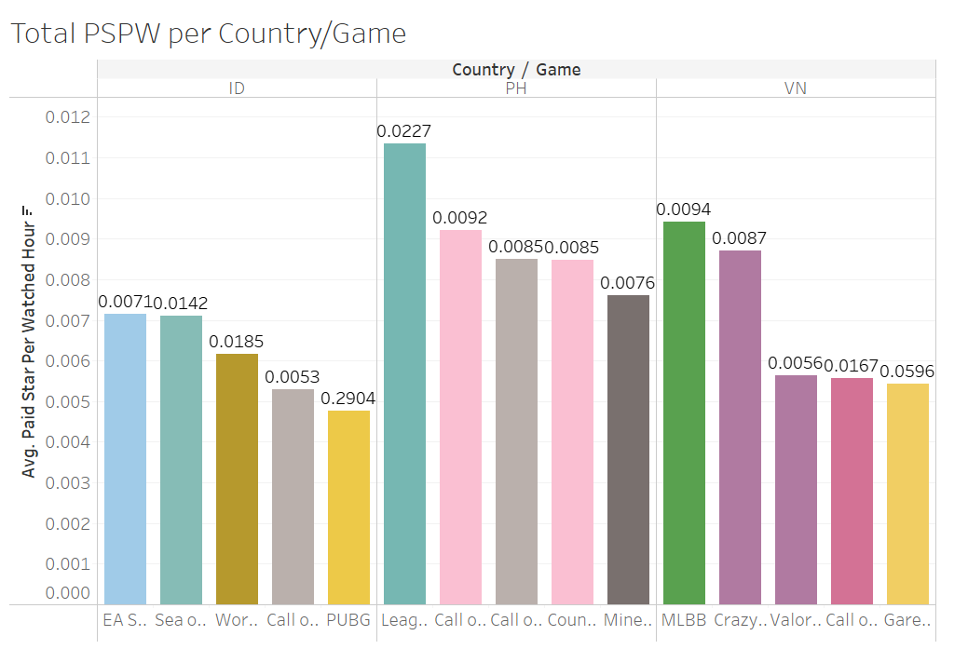
Finding Things PSPW in per Country and Game by Percentage
Total Paid Star per Watched Hour in Indonesia lead by PUBG, in Philippines lead by MLBB while in Vietnam lead by PUBG.
But in average Paid Star per Watched Hour in Indonesia lead by UFC 3, in Philippines lead by League of Legends, while in Vietnam lead by MLBB

Slide 7
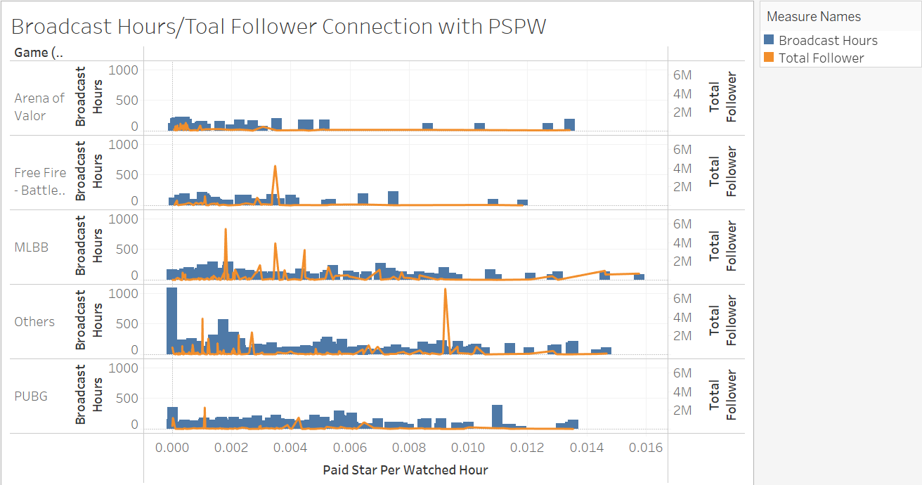
Finding Things Broadcast Hours/Total Follwer Connection with PSPW
Having a lot followers and having a long time broadcast hour doesn’t rise the Paid Star per Watched Hour significantly.

Slide 8
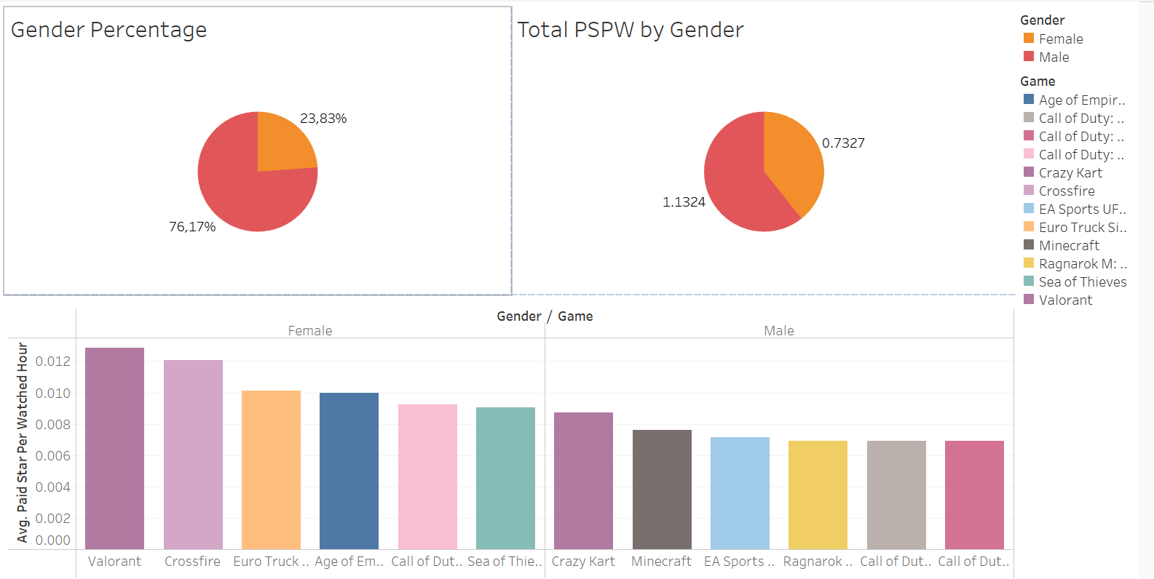
Finding Things Gender
There are more male streamer than female streamer. But female streamer average Paid Star Per Watched Hour is higher than male streamer

Slide 9
Summary
 |  | Indonesia | Philippines | Vietnam
Most Game Played |  | 1. MLBB | 1.MLBB | 1. Arena of Valor
 |  | 2. PUBG | 2. Dota 2 | 2. PUBG
 |  | 3. Free Fire | 3. Crossfire | 3. League of Legends
Paid Star per Watched Hour | Total | 1.PUBG | 1.MLBB | 1.PUBG
 |  | 2. MLBB | 2. Dota 2 | 2.Arena of Valor
 |  | 3. Free Fire | 3. Cross Fire | 3. League of Legends
 | Average | 1.UFC 3 | 1.League of Legends | 1.MLBB
 |  | 2. Sea of Thieves | 2. Call of Duty : Warzone | 2. Crazy Kart
 |  | 3. Wormate.io | 3. Call of Duty Mobile | 3. Valorant
The amount of Paid Star per Watched Hour is high because the game mostly played by streamers. But the game doesn’t have a high average of Paid Star per Watched Hour.
Means the amount of Paid Star per Watched Hour is not based on the most game played.

Slide 10
Summary
There are more male streamers than female streamers. It affect the total of Paid Star per Watched Hour, but in average Female Streamers gain more Paid Star per Watched Hours than male streamers

Slide 11
Improvements
For new streamers they can stream game with the highest game played to improve their exposure and gain more quantity in watchers. Play such as MLBB, PUBG or Free Fire
For experienced streamer we should encourage them to play game with high average paid star per watched hour such as UFC 3 in Indonesia, League of Legends in Philippines and MLBB in Vietnam. Because they already have their own followers so they need more the quality not the quantity.
As the system paid more star for female streamers, the company should find more talents for female streamers than male streamers

Slide 12
THANK YOU

