Slide 1

Data Analyst Presentation
Ghiffary Naufal
25/8/2026

Slide 2



OUTLINE
Executive Summary
Introduction
Methodology
Results
Visualization – Charts
Dashboard
Discussion
Findings & Implications
Conclusion
Appendix

Slide 3

EXECUTIVE SUMMARY
• JavaScript, SQL and HTML/CSS are among the most widely used technologies in the survey.
• Full-stack and back-end roles are prominent in the developer survey and job data.
• Full-stack development is the most frequently reported developer type in the survey.
• Job postings show substantial representation across technology-related role categories.
• Programming languages differ in adoption, future interest, salary and learning difficulty.
• Remote and hybrid work arrangements are common among respondents.
• Career preparation should combine in-demand technical skills with practical project experience.

Slide 4

INTRODUCTION
Purpose of the report, Target Audience & Value of the analysis
Analyze developer survey data, job-market information, and programming-language data to identify important trends in the technology industry.
Aspiring developers, students, and career changers who want to understand which technologies and career areas are relevant to the current developer market.
Provides data-driven insights that can help learners prioritize technologies and make more informed career and learning decisions.
Programming-language popularity, developer roles, job opportunities, salary information, and workplace trends.

Slide 5

METHODOLOGY
Data sources, Data collection & Data wrangling steps
Used the provided developer survey datase
Programming-language information was collected from the IBM Skills Network Programming Languages dataset.
Checked the data for missing or inconsistent values before performing analysis.
Organized and transformed the relevant data so that comparisons and visualizations could be created.
Grouped and summarized relevant categories to identify patterns and trends.
Prepared the cleaned data for visualization and dashboard presentation, allowing key findings to be communicated clearly to the target audience.

Slide 6
Results
<Please present your results in the following slides.>

Slide 7
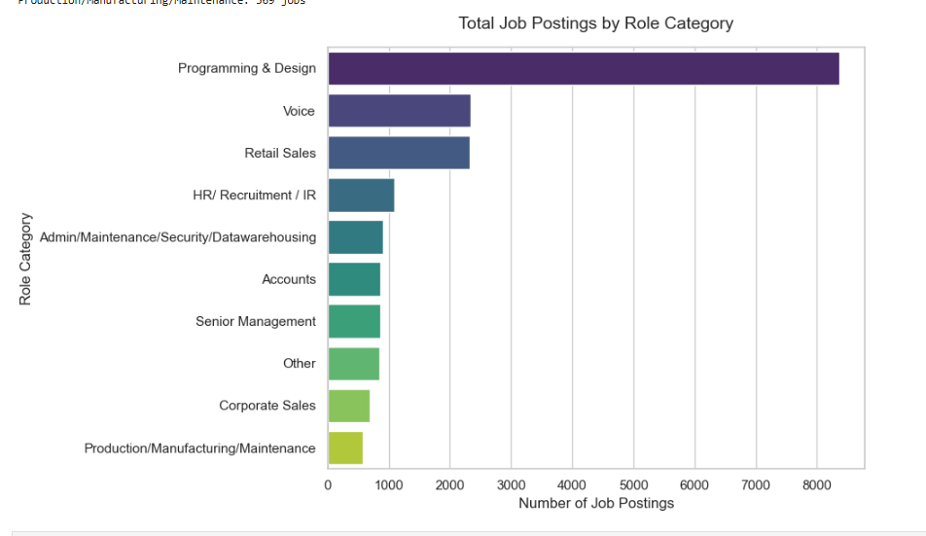
JOB POSTINGS

Slide 8
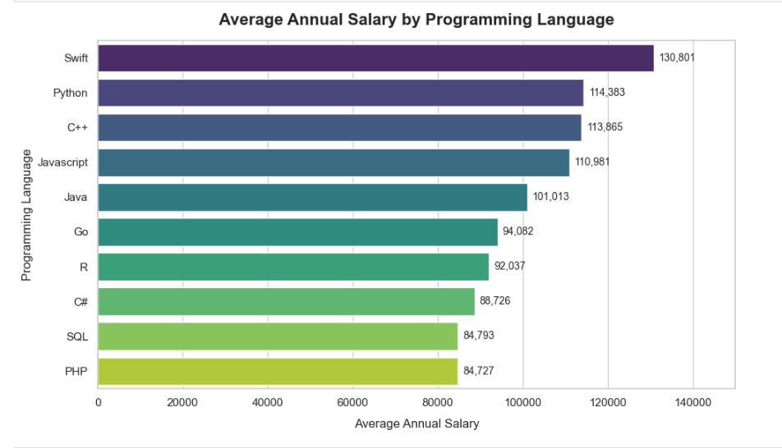
POPULAR LANGUAGES

Slide 9
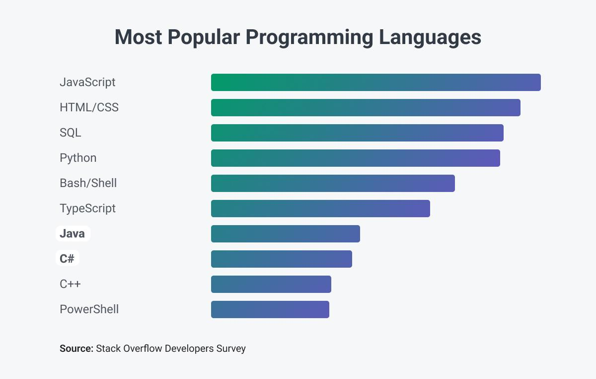
PROGRAMMING LANGUAGE TRENDS
Current Year
Next Year

Slide 10
PROGRAMMING LANGUAGE TRENDS - FINDINGS & IMPLICATIONS
Findings
JavaScript is the most widely used programming language in the survey data, with 14,943 respondents reporting experience with it.
SQL follows with 12,602 respondents, while HTML/CSS has 12,410.
TypeScript and Python are also highly represented, with 10,709 and 9,590 respondents respectively.
Implications
The results suggest that learners seeking broad relevance in the developer market should consider prioritizing JavaScript, SQL, TypeScript, and Python.
JavaScript is particularly important for web development, while SQL provides valuable database skills that apply across many data and software roles.
Python's strong representation also supports its value for areas such as data analysis, automation, and backend development.

Slide 11
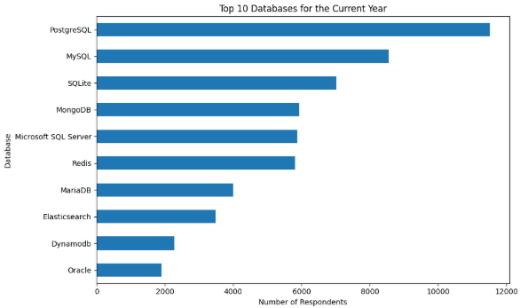
DATABASE TRENDS
PostgreSQL leads current database usage.
PostgreSQL is the leading future-interest database.
Relational databases remain prominent, while MongoDB and other NoSQL options retain strong interest.
Current Year
Next Year

Slide 12
DATABASE TRENDS - FINDINGS & IMPLICATIONS
Findings
• MySQL is the most commonly reported database technology, followed by PostgreSQL and SQLite.
• MongoDB, Microsoft SQL Server and Redis also have notable usage.
Implications
• Learners can prioritize MySQL and PostgreSQL for strong foundational database skills.
• SQL plus relational-database skills transfer well to backend development, data analysis and data engineering.

Slide 13

DASHBOARD
<Please present your dashboard in the following slides.>

Slide 14
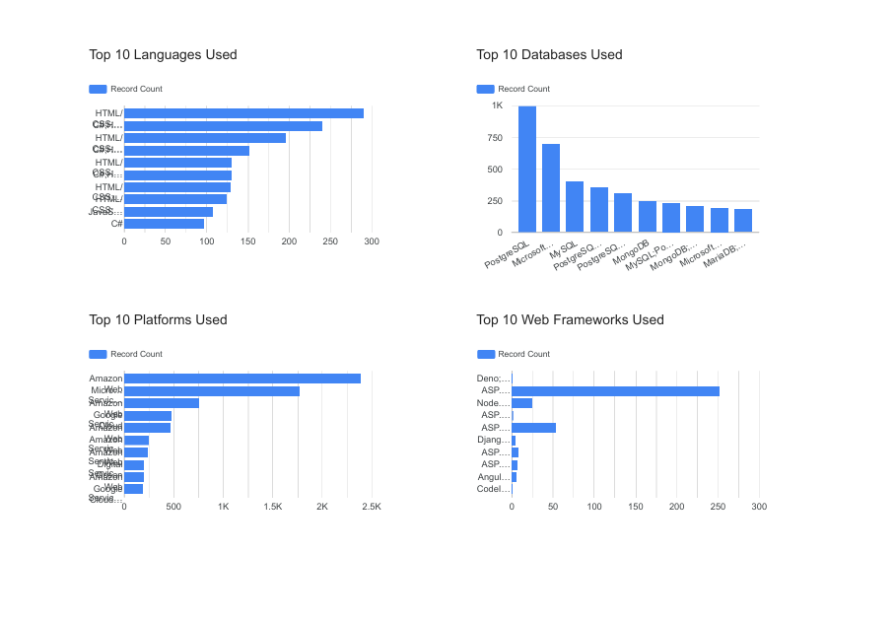
DASHBOARD TAB 1: Current Technology Usage

Slide 15
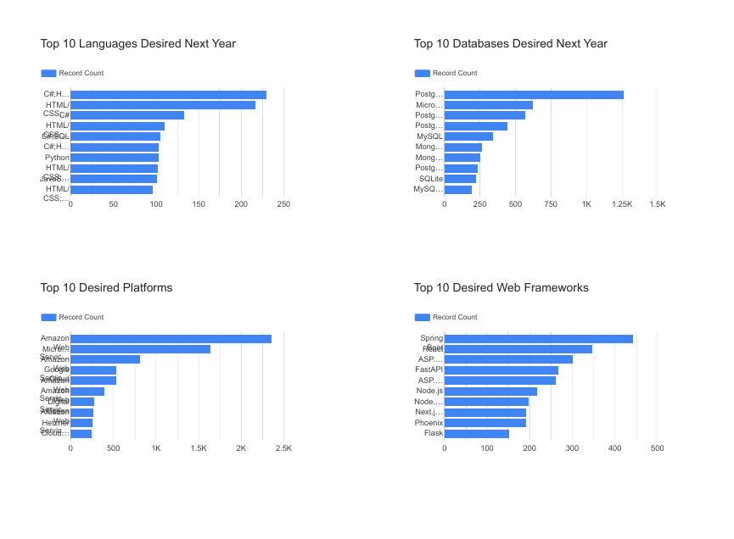
DASHBOARD TAB 2: Future Technology Trends

Slide 16
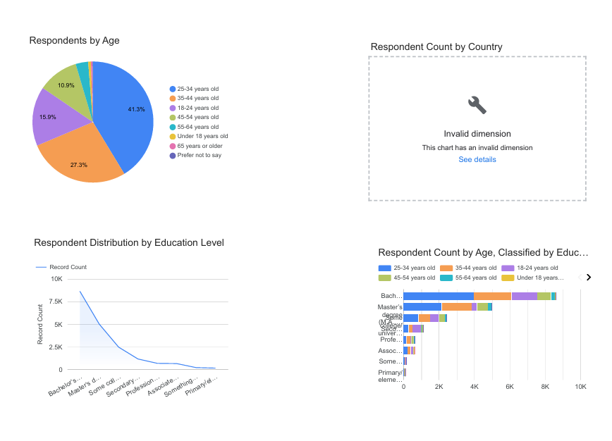
DASHBOARD TAB 3: Demographics

Slide 17
DISCUSSION
• Current usage is led by JavaScript, while JavaScript leads future interest.
• PostgreSQL leads current database use, while PostgreSQL has the strongest future interest.
• The dashboards show that technology choices vary by role and experience, with remote/hybrid work common among respondents.
• The findings support learning a strong combination of programming, SQL/database and practical development skills.

Slide 18
OVERALL FINDINGS & IMPLICATIONS
• JavaScript, SQL and HTML/CSS have strong current adoption.
• MySQL and PostgreSQL are major database technologies.
• Future-interest data shows continued demand for widely used languages and databases.
• Prioritize transferable skills such as JavaScript, Python and SQL.
• Build practical projects using relational and modern database technologies.
• Combine technical learning with job-market awareness and hands-on experience.

Slide 19

CONCLUSION
• The survey shows strong adoption of JavaScript, SQL, HTML/CSS and Python.
• Database skills, especially SQL and relational databases, remain important.
• Future-interest patterns can guide learners toward technologies with sustained relevance.
• Successful career preparation should combine technical skills, practical projects and awareness of industry needs.

Slide 20

APPENDIX
Additional charts are included in the Results and Dashboard sections.

