Slide 1

AI Quant Assistant Ghiffary Rifqialdi Batch December 2022
G2 Academy Bootcamp
Web and Mobile Development

Slide 2
Outline
Business Understanding
Features
Technology Stacks
Architecture
Use Case Diagram
Entity Relationship Diagram
Activity Diagram
Timeline Project

Slide 3

Business Understanding

Slide 4
Why
To commercialize AI system focusing on quantitative analysis.
How
Producing the working API including web and mobile client if time-possible.
What
Product called AI Quant Assistant.

Slide 5
Features

Slide 6
Features
REST API
CI/CD
JWT authentication
Password recovery
Error handling
Cookie based visitor's shopping cart
Persistent customer's shopping cart
Cart and order management
Checkout
Catalogue
Order management
Subscription management
Pagination

Slide 7
Technology Stacks

Slide 8
Technology Stacks: Backend Forecast
Python 3.10
Gunicorn WSGI HTTP Server
Flask
Numpy
Pandas
Scikit-learn
Pytorch
Yahoo Finance
AutoTS
FBProphet
Neural Prophet

Slide 9
Technology Stacks: Backend Store
Java 11
Spring Boot 2.4
Spring Security
JWT Authentication
Spring Data JPA
Hibernate
Maven
Spring Validation

Slide 10
Technology Stacks: Database
MySQL
Firebase

Slide 11
Technology Stacks: DevOps
Docker
Docker Compose

Slide 12
Technology Stacks: FrontEnd Web
Javascript
Node.JS
React 18.2
React Router
Bootstrap
SCSS
Redux
Axios
NGINX

Slide 13
Technology Stacks: FrontEnd Android and iOS
Javascript
Node.JS
React Native 0.71
Expo 48
React Navigation
React Native Paper
React Native Reanimated
React Native Gesture Handler
Redux
Redux-Thunk
Axios

Slide 14
Architecture

Slide 15




Architecture
Legend
Depends on
Access to
BackEnd Forecast
FrontEnd Android
FrontEnd iOS
BackEnd Store
FrontEnd Web

Slide 16
Use Case Diagram

Slide 17
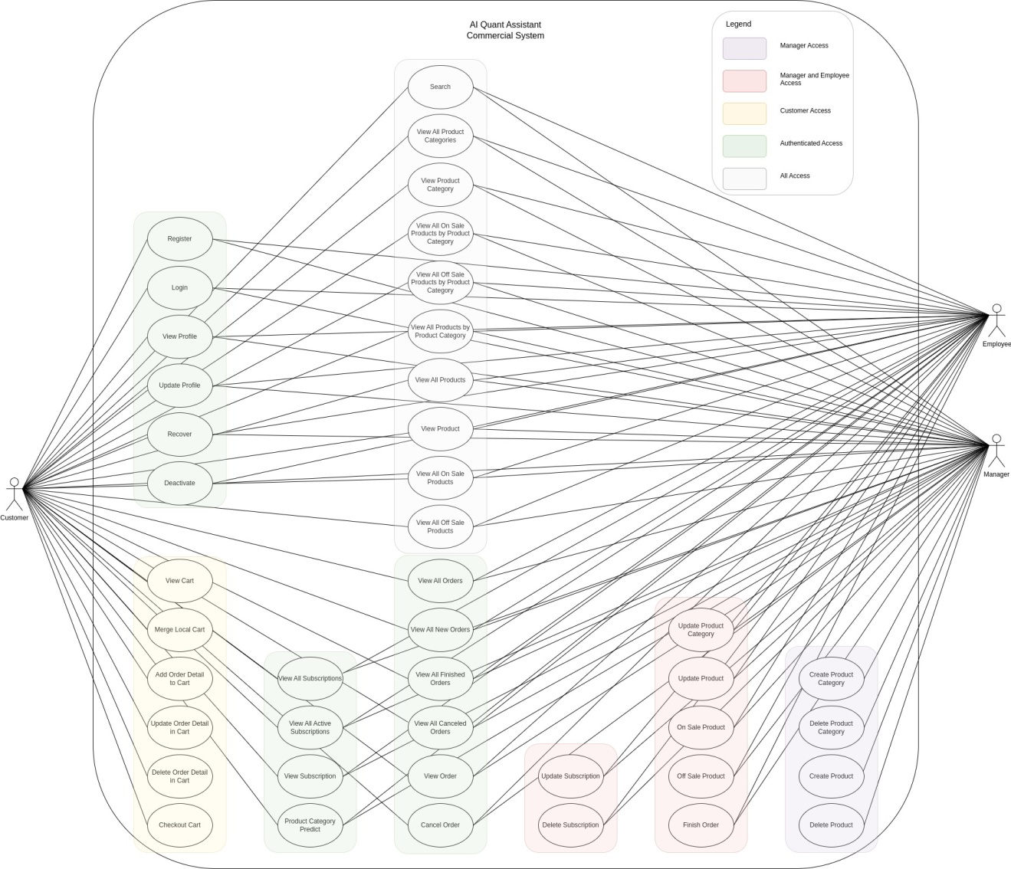
Use Case Diagram

Slide 18
Entity Relationship Diagram

Slide 19
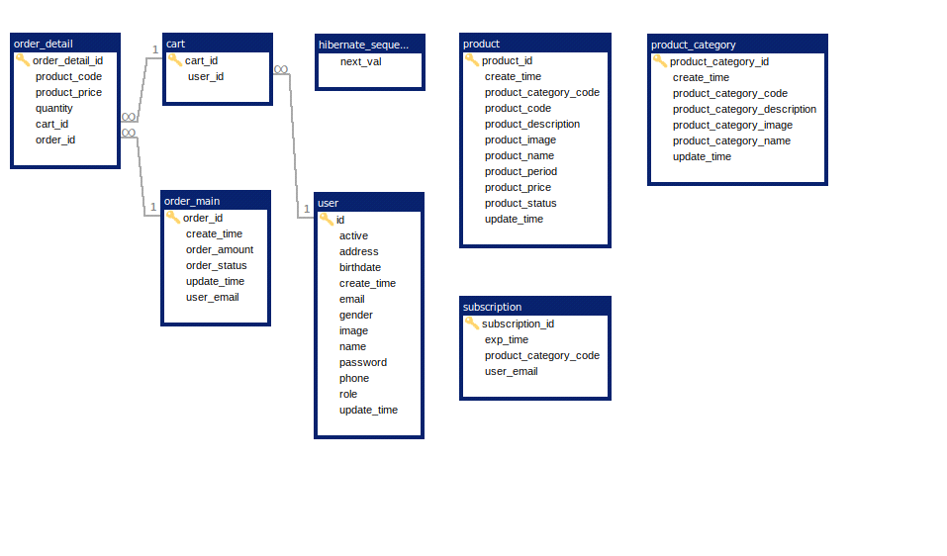
Entity Relationship Diagram

Slide 20
Activity Diagram

Slide 21
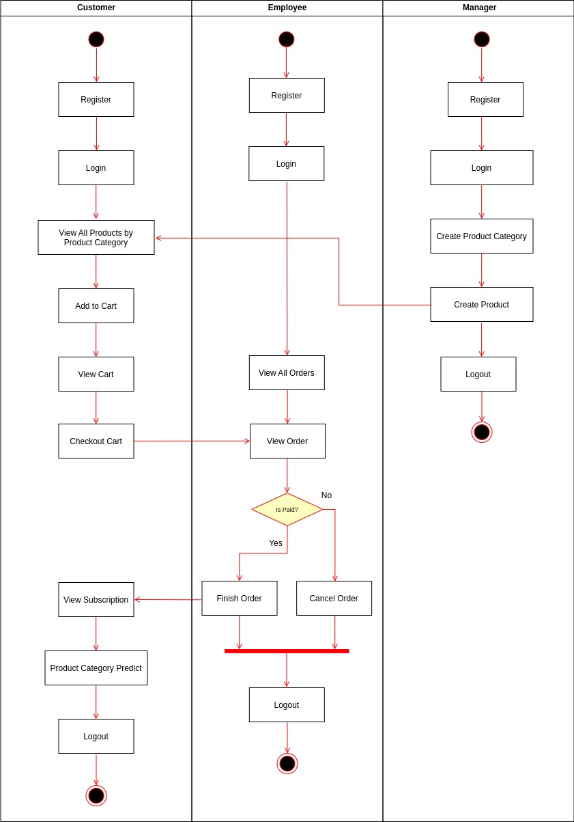
Activity Diagram

Slide 22
Timeline Project

Slide 23
Timeline Project
21 - 23 April 2023
Prepare and Concept Design
28 - 30 April 2023
Test and Debug
2 May 2023 - Future
Continuous Development
24 - 27 April 2023
Building Program
31 April - 2 May 2023
Prepare Presentation

Slide 24

Thank You

Slide 25
Source
https://github.com/ghiffaryr/AIQuantAssistant

Slide 26
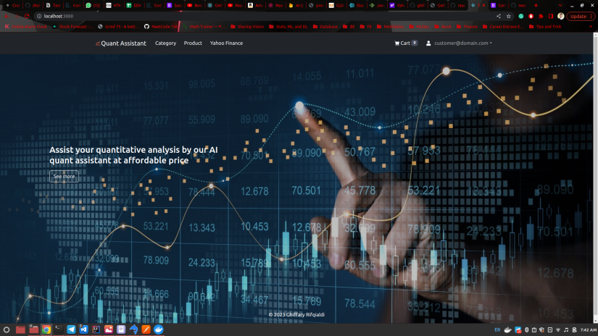
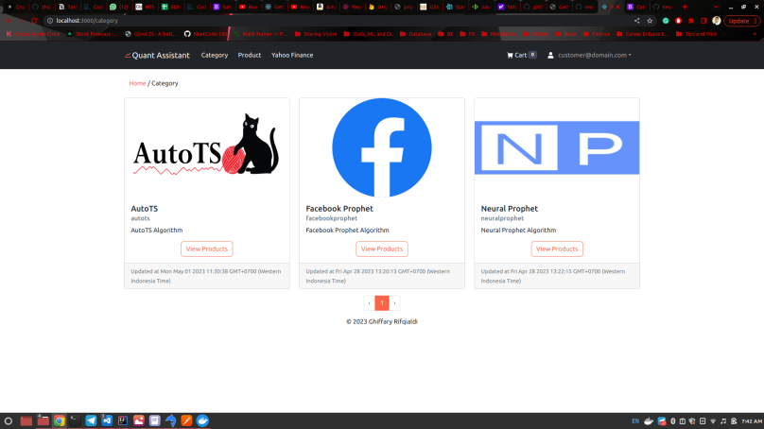
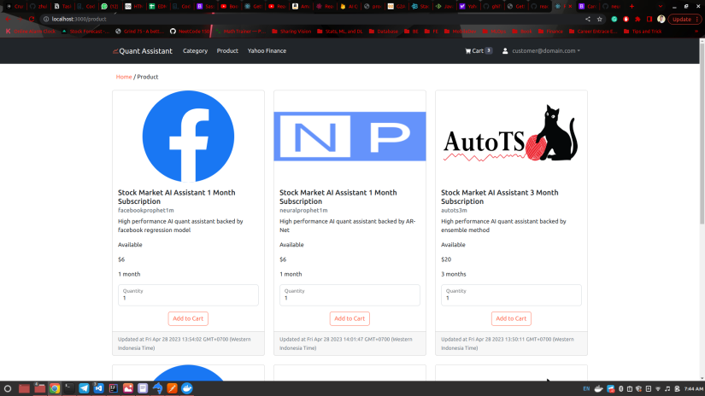
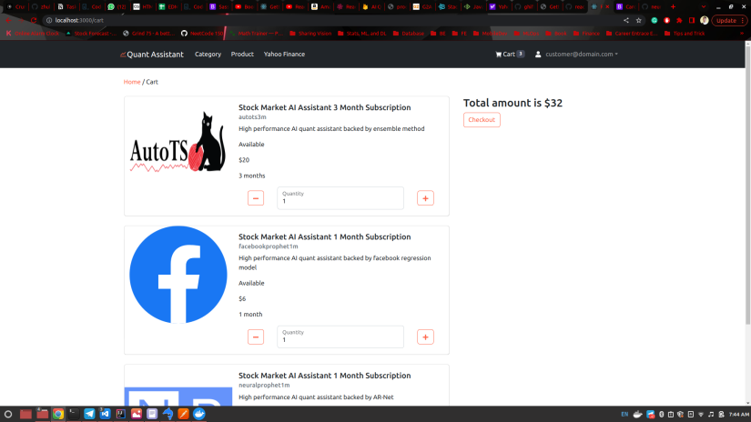
Gallery

Slide 27
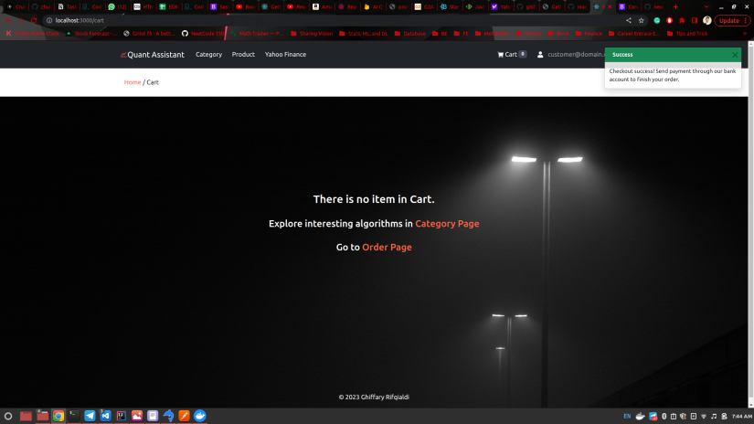
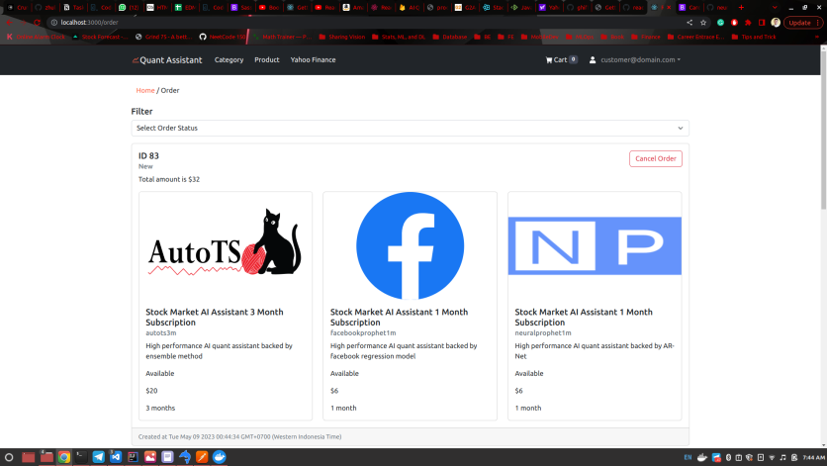
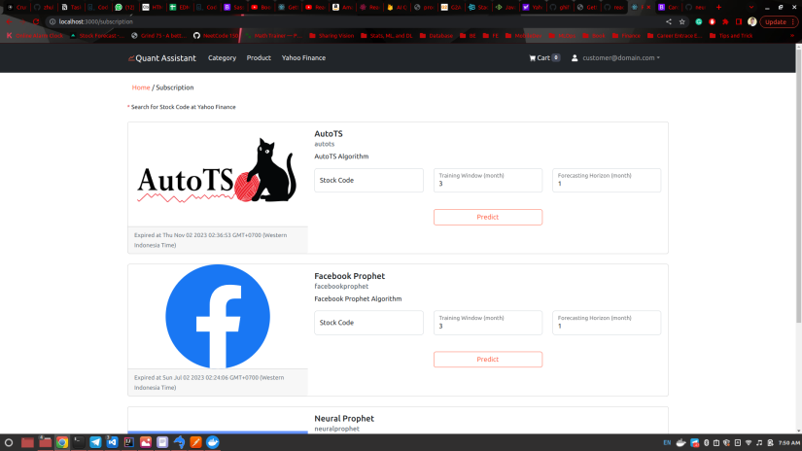
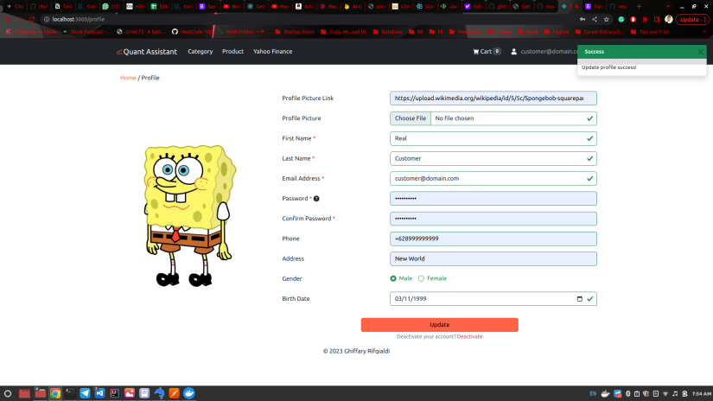
Gallery

