Slide 1
AI-Driven SOC Platform
Commercial Architecture & Value Proposition

Slide 2
Executive Summary
This document outlines the commercial architecture, enabling MSSPs to transform their business model from "hours-based" to "outcome-based" security services.
---

Slide 3
1. The Business Value Proposition
🚀 For the MSSP (The Provider)
  **Infinite Scalability**: The multi-tenant architecture allows you to onboard hundreds of clients without linearly increasing headcount.
  **Higher Margins**: Automate Tier 1 and Tier 2 analysis (90% of workload), reducing operational costs by up to 70%.
  **New Revenue Streams**: Sell "AI-Agent-as-a-Service" and premium "Autonomous Response" capabilities.
  **Future-Proofing**: Built on MCP (Model Context Protocol), enabling seamless integration with future AI tools and LLMs.
🛡️ For the Client (The End User)
  **Mean Time to Respond (MTTR) in Seconds**: AI agents detect and contain threats instantly, 24/7.
  **Transparency**: Real-time dashboards show exactly what the AI is doing, building trust.
  **Cost-Effective**: Enterprise-grade security at a fraction of the cost of building an internal SOC.
---

Slide 4
2. Commercial Architecture
The platform is architected to support a multi-tiered service model.
Tier 1: "Essential" (Automated Detection)
  **Features**:
* Event Ingestion via API.
* ADA (Anomaly Detection Agent) scanning.
* Basic Email Alerts.
  **Target**: SMEs needing compliance and basic monitoring.
  **Tech Stack**: BigQuery + ADA Service.
Tier 2: "Professional" (AI Analysis)
  **Features**:
* All Tier 1 features.
* **TAA (Triage & Analysis Agent)**: AI investigates alerts, reducing false positives.
* **MCP Integration**: AI queries external threat intel (VirusTotal, AbuseIPDB) automatically.
* Interactive Customer Portal.
  **Target**: Mid-market companies requiring active defense.
  **Tech Stack**: ADA + TAA + MCP Server.
Tier 3: "Enterprise" (Autonomous Response)
  **Features**:
* All Tier 2 features.
* **CRA (Containment Response Agent)**: Automated blocking of IPs, isolation of hosts.
* **CLA (Continuous Learning Agent)**: Custom model training on client data.
* Dedicated Tenant Resources.
  **Target**: Large enterprises with critical infrastructure.
  **Tech Stack**: Full Multi-Agent Swarm (ADA, TAA, CRA, CLA).
---

Slide 5
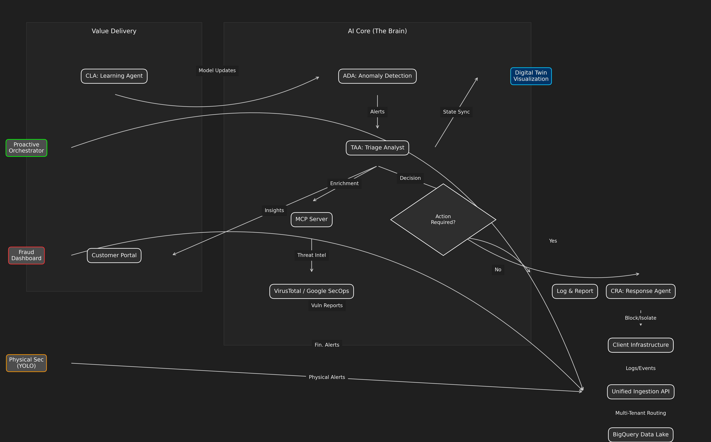
3. Technical Architecture for Sales

Slide 6
4. Monetization Strategy
API-First Integration
The **MSSP Platform Server** exposes a clean REST API (`/api/v1/events`, `/api/v1/tenants`).
  **Sell Integration**: Charge setup fees to integrate with client's existing IT stack.
  **Volume Pricing**: Charge per GB of ingested logs or per EPS (Events Per Second).
Agentic Add-Ons
  **"Investigate with AI" Button**: Charge per on-demand deep investigation triggered by the client.
  **Custom Compliance Reports**: AI-generated reports for GDPR/SOC2, sold as a monthly add-on.
---

Slide 7
5. Advanced Ecosystem Integrations
Expand your service portfolio with our cutting-edge ecosystem modules:
🌐 Digital Twin SOC (Situational Awareness)
  **What it is**: A real-time 3D visualization of your client's entire network and security posture.
  **Value**: Transforms abstract logs into a visual "War Room" experience. Instantly spot compromised nodes and attack paths in a 3D space.
  **Reference**: [Digital Twin Showcase](https://github.com/ghifiardi/digital_twin_SOC_sowcase)
🛡️ Proactive Security Orchestrator (DevSecOps)
  **What it is**: A "Shift-Left" engine that integrates directly into the client's development pipeline (CI/CD).
  **Value**: Stops vulnerabilities *before* they reach production. Uses **Semgrep** and **Gitleaks** to audit code and secrets automatically.
  **Reference**: [Proactive Orchestrator](https://github.com/ghifiardi/proactive-security-orchestrator)
👁️ Unified Cyber-Physical Defense (YOLO)
  **What it is**: AI-powered computer vision integration for physical security feeds (CCTV) and customer touchpoints.
  **Use Case**: **Fraud & Social Engineering Defense** (Telco/Banking).
  **Key Capabilities**:
* **Face Spoofing & Liveness Detection**: Prevents identity fraud using photo/video replay or masks.
* **Device Presence Detection**: Detects unauthorized recording devices (phones/cameras) pointing at agent screens, a key indicator of **SIM Swap Fraud** or coercion.
* **Contextual Risk Signals**: Correlates physical behaviors with KYC data to flag high-risk interactions in real-time.
  **Value**: Bridges the gap between cyber and physical worlds. Detects unauthorized physical access or security breaches that could precede a cyber attack.
  **Reference**: [YOLO Integration](https://github.com/ghifiardi/YOLO)
🏦 AI Fraud Modelling Dashboard (Banking & Fintech)
  **What it is**: A specialized module for real-time transaction monitoring and fraud detection.
  **Use Case**: **Financial Crime Prevention & Blockchain Analytics**.
  **Key Capabilities**:
* **Multi-Agent Intelligence Network**: Connects with regional agents (Jakarta Bank Consortium, Singapore Regional Agent) to share fraud patterns like BI-FAST abuse and money laundering.
* **Real-Time Risk Scoring**: Uses ensemble models (Random Forest, Isolation Forest) to score transactions in milliseconds.
* **Blockchain Integration**: Capable of monitoring crypto-asset flows and correlating them with fiat transactions for comprehensive AML (Anti-Money Laundering).
  **Value**: Reduces false positives in transaction monitoring and enables collaborative defense against global financial fraud rings.
  **Reference**: [Fraud Modelling Dashboard](https://github.com/ghifiardi/fraud_modelling_dashboard)
---

Slide 8
6. Conclusion

