Slide 1
AI-Driven SOC Platform
Commercial Architecture & Value Proposition

Slide 2
Executive Summary
This document outlines the commercial architecture, enabling MSSPs to transform their business model from "hours-based" to "outcome-based" security services.

Slide 3
1. The Business Value Proposition
🚀 For the MSSP (The Provider)
  Infinite Scalability: The multi-tenant architecture allows you to onboard hundreds of clients without linearly increasing headcount.
  Higher Margins: Automate Tier 1 and Tier 2 analysis (90% of workload), reducing operational costs by up to 70%.
  New Revenue Streams: Sell "AI-Agent-as-a-Service" and premium "Autonomous Response" capabilities.
  Future-Proofing: Built on MCP (Model Context Protocol), enabling seamless integration with future AI tools and LLMs.
🛡️ For the Client (The End User)
  Mean Time to Respond (MTTR) in Seconds: AI agents detect and contain threats instantly, 24/7.
  Transparency: Real-time dashboards show exactly what the AI is doing, building trust.
  Cost-Effective: Enterprise-grade security at a fraction of the cost of building an internal SOC.

Slide 4
2. Commercial Architecture
The platform is architected to support a multi-tiered service model.
Tier 1: "Essential" (Automated Detection)
  Features:
Event Ingestion via API.
ADA (Anomaly Detection Agent) scanning.
Basic Email Alerts.
  Target: SMEs needing compliance and basic monitoring.
  Tech Stack: BigQuery + ADA Service.
Tier 2: "Professional" (AI Analysis)
  Features:
All Tier 1 features.
TAA (Triage & Analysis Agent): AI investigates alerts, reducing false positives.
MCP Integration: AI queries external threat intel (VirusTotal, AbuseIPDB) automatically.
Interactive Customer Portal.
  Target: Mid-market companies requiring active defense.
  Tech Stack: ADA + TAA + MCP Server.
Tier 3: "Enterprise" (Autonomous Response)
  Features:
All Tier 2 features.
CRA (Containment Response Agent): Automated blocking of IPs, isolation of hosts.
CLA (Continuous Learning Agent): Custom model training on client data.
Dedicated Tenant Resources.
  Target: Large enterprises with critical infrastructure.
  Tech Stack: Full Multi-Agent Swarm (ADA, TAA, CRA, CLA).

Slide 5
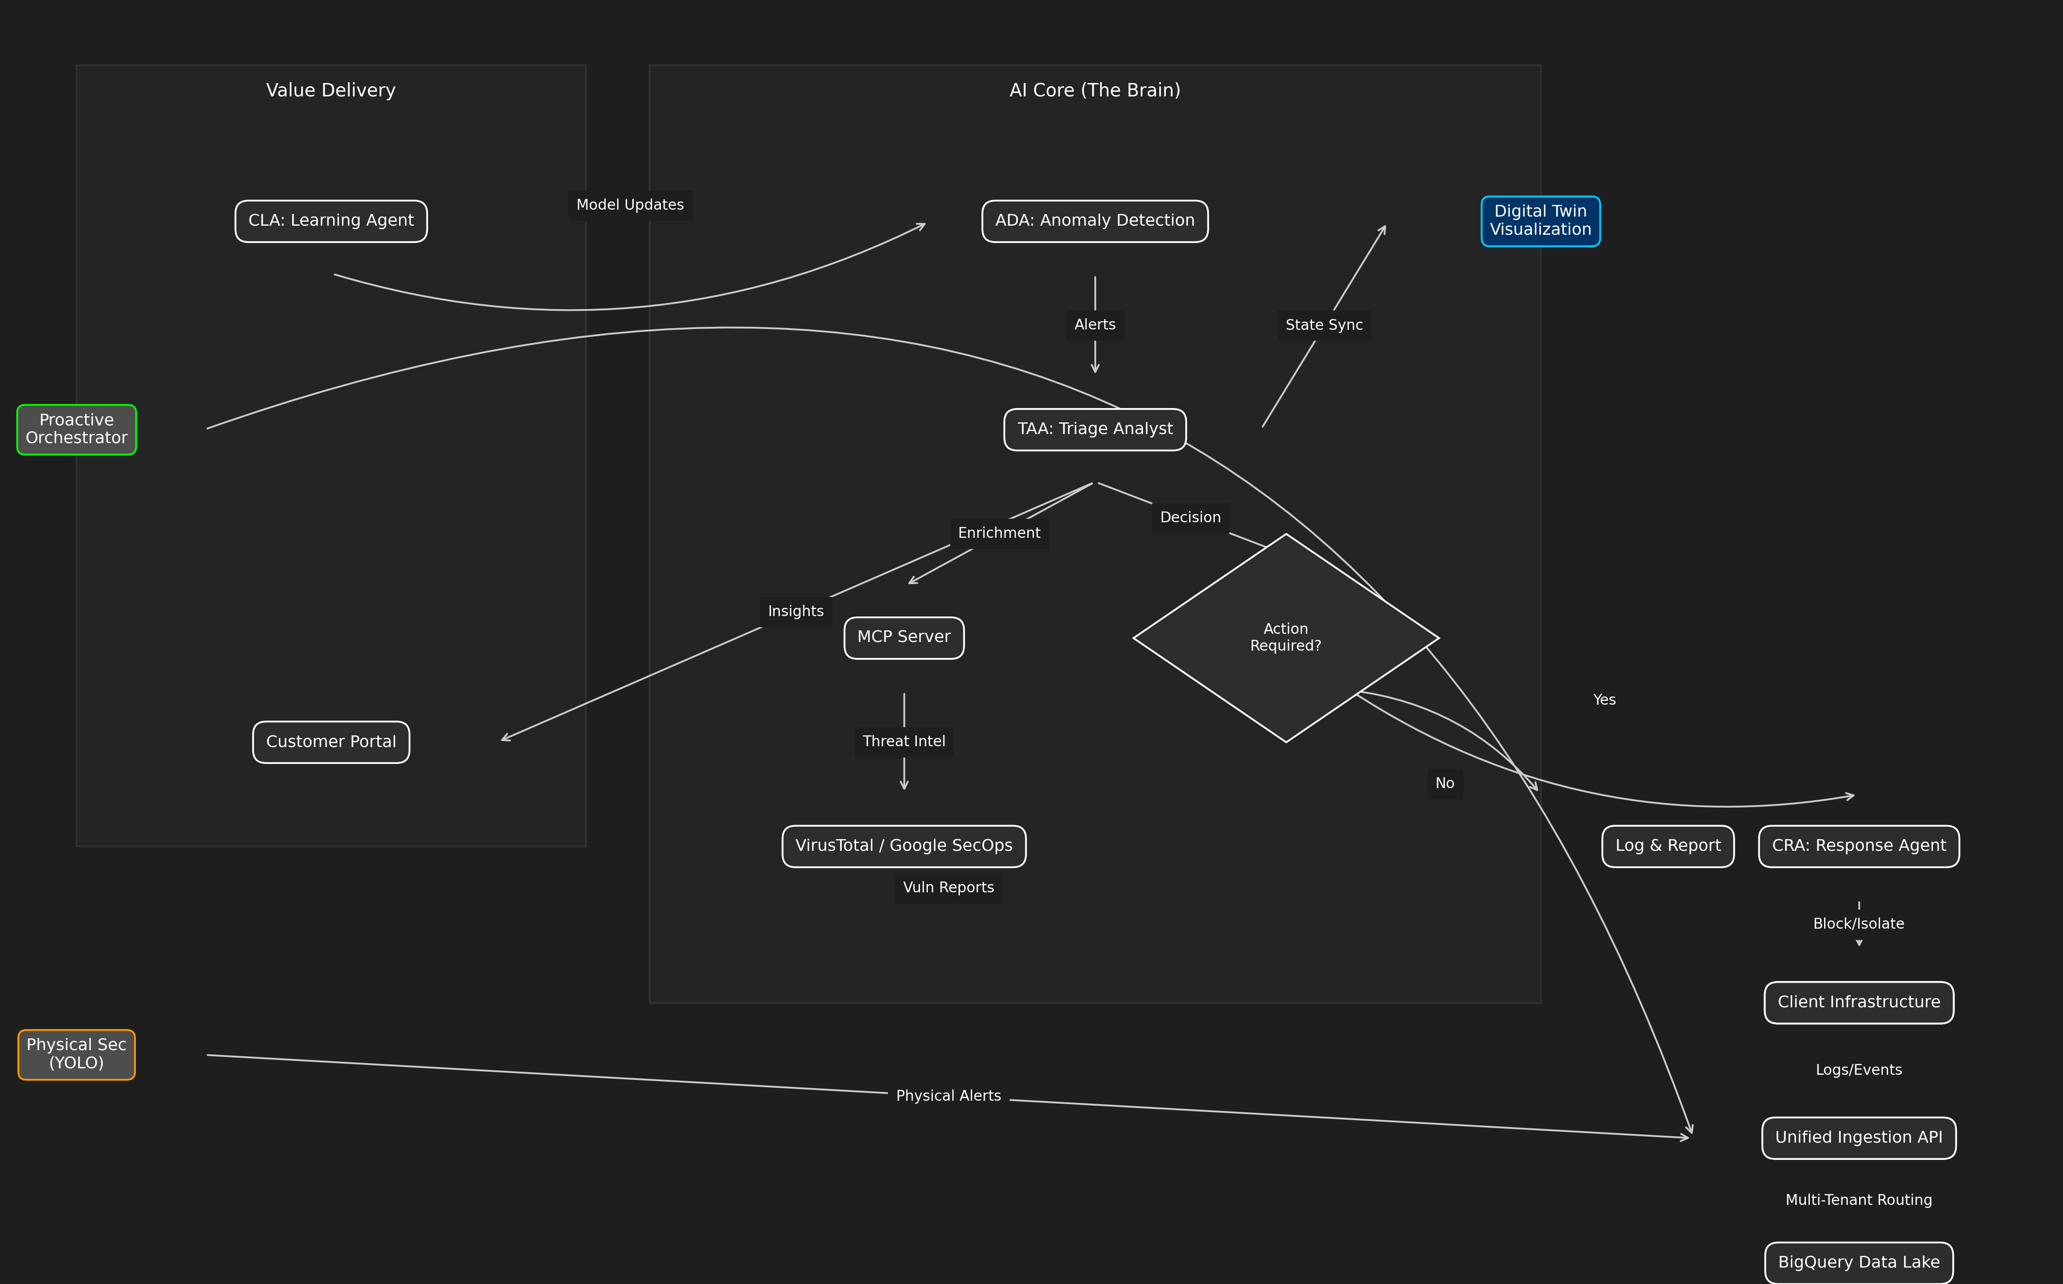
3. Technical Architecture for Sales

Slide 6
4. Monetization Strategy
API-First Integration
The MSSP Platform Server exposes a clean REST API (`/api/v1/events`, `/api/v1/tenants`).
  Sell Integration: Charge setup fees to integrate with client's existing IT stack.
  Volume Pricing: Charge per GB of ingested logs or per EPS (Events Per Second).
Agentic Add-Ons
  "Investigate with AI" Button: Charge per on-demand deep investigation triggered by the client.
  Custom Compliance Reports: AI-generated reports for GDPR/SOC2, sold as a monthly add-on.

Slide 7
5. Advanced Ecosystem Integrations
Expand your service portfolio with our cutting-edge ecosystem modules:
🌐 Digital Twin SOC (Situational Awareness)
  What it is: A real-time 3D visualization of your client's entire network and security posture.
  Value: Transforms abstract logs into a visual "War Room" experience. Instantly spot compromised nodes and attack paths in a 3D space.
  Reference: [Digital Twin Showcase](https://github.com/ghifiardi/digital_twin_SOC_sowcase)
🛡️ Proactive Security Orchestrator (DevSecOps)
  What it is: A "Shift-Left" engine that integrates directly into the client's development pipeline (CI/CD).
  Value: Stops vulnerabilities *before* they reach production. Uses Semgrep and Gitleaks to audit code and secrets automatically.
  Reference: [Proactive Orchestrator](https://github.com/ghifiardi/proactive-security-orchestrator)
👁️ Unified Cyber-Physical Defense (YOLO)
  What it is: AI-powered computer vision integration for physical security feeds (CCTV) customer touchpoints
  Key Capabilities:
    Face Spoofing & Liveness Detection: Prevents identity fraud using photo/video replay or masks.
    Device Presence Detection: Detects unauthorized recording devices (phones/cameras) pointing at agent screens, a key indicator of **SIM Swap Fraud** or coercion.
    Contextual Risk Signals: Correlates physical behaviors with KYC data to flag high-risk interactions in real-time..
  Value: Bridges the gap between cyber and physical worlds. Detects unauthorized physical access or security breaches that could precede a cyber attack.
  Reference: [YOLO Integration](https://github.com/ghifiardi/YOLO)

Slide 8
6. Conclusion

