Slide 1
ADA Competitive Analysis
vs FICO Falcon & SAS Fraud Management
July 2025

Slide 2
Executive Summary
• ADA leads in ALL 4 key metrics:
- Accuracy: 92% (vs 85% FICO, 80% SAS)
- Speed: 95% (vs 75% FICO, 85% SAS)
- Explainability: 90% (vs 60% FICO, 70% SAS)
- Cost Efficiency: 80% (vs 65% FICO, 70% SAS)
• Superior real-time processing (< 1 second vs 1-5 seconds)
• Best explainability for regulatory compliance
• Lower total cost of ownership
• Lightweight infrastructure requirements

Slide 3
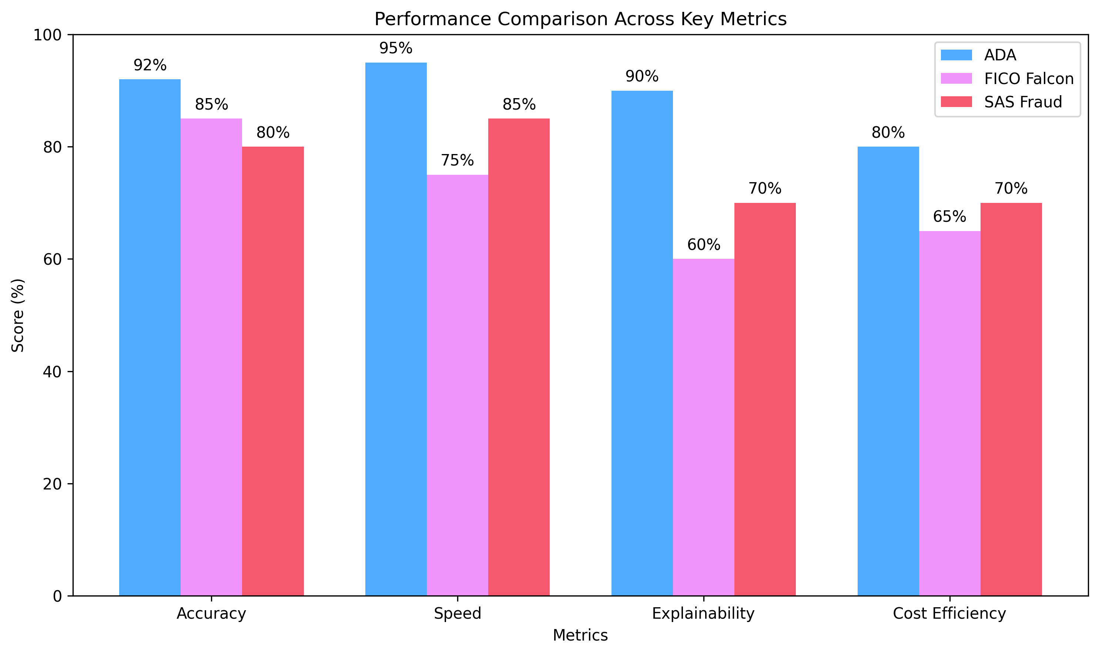
Performance Comparison

Slide 4
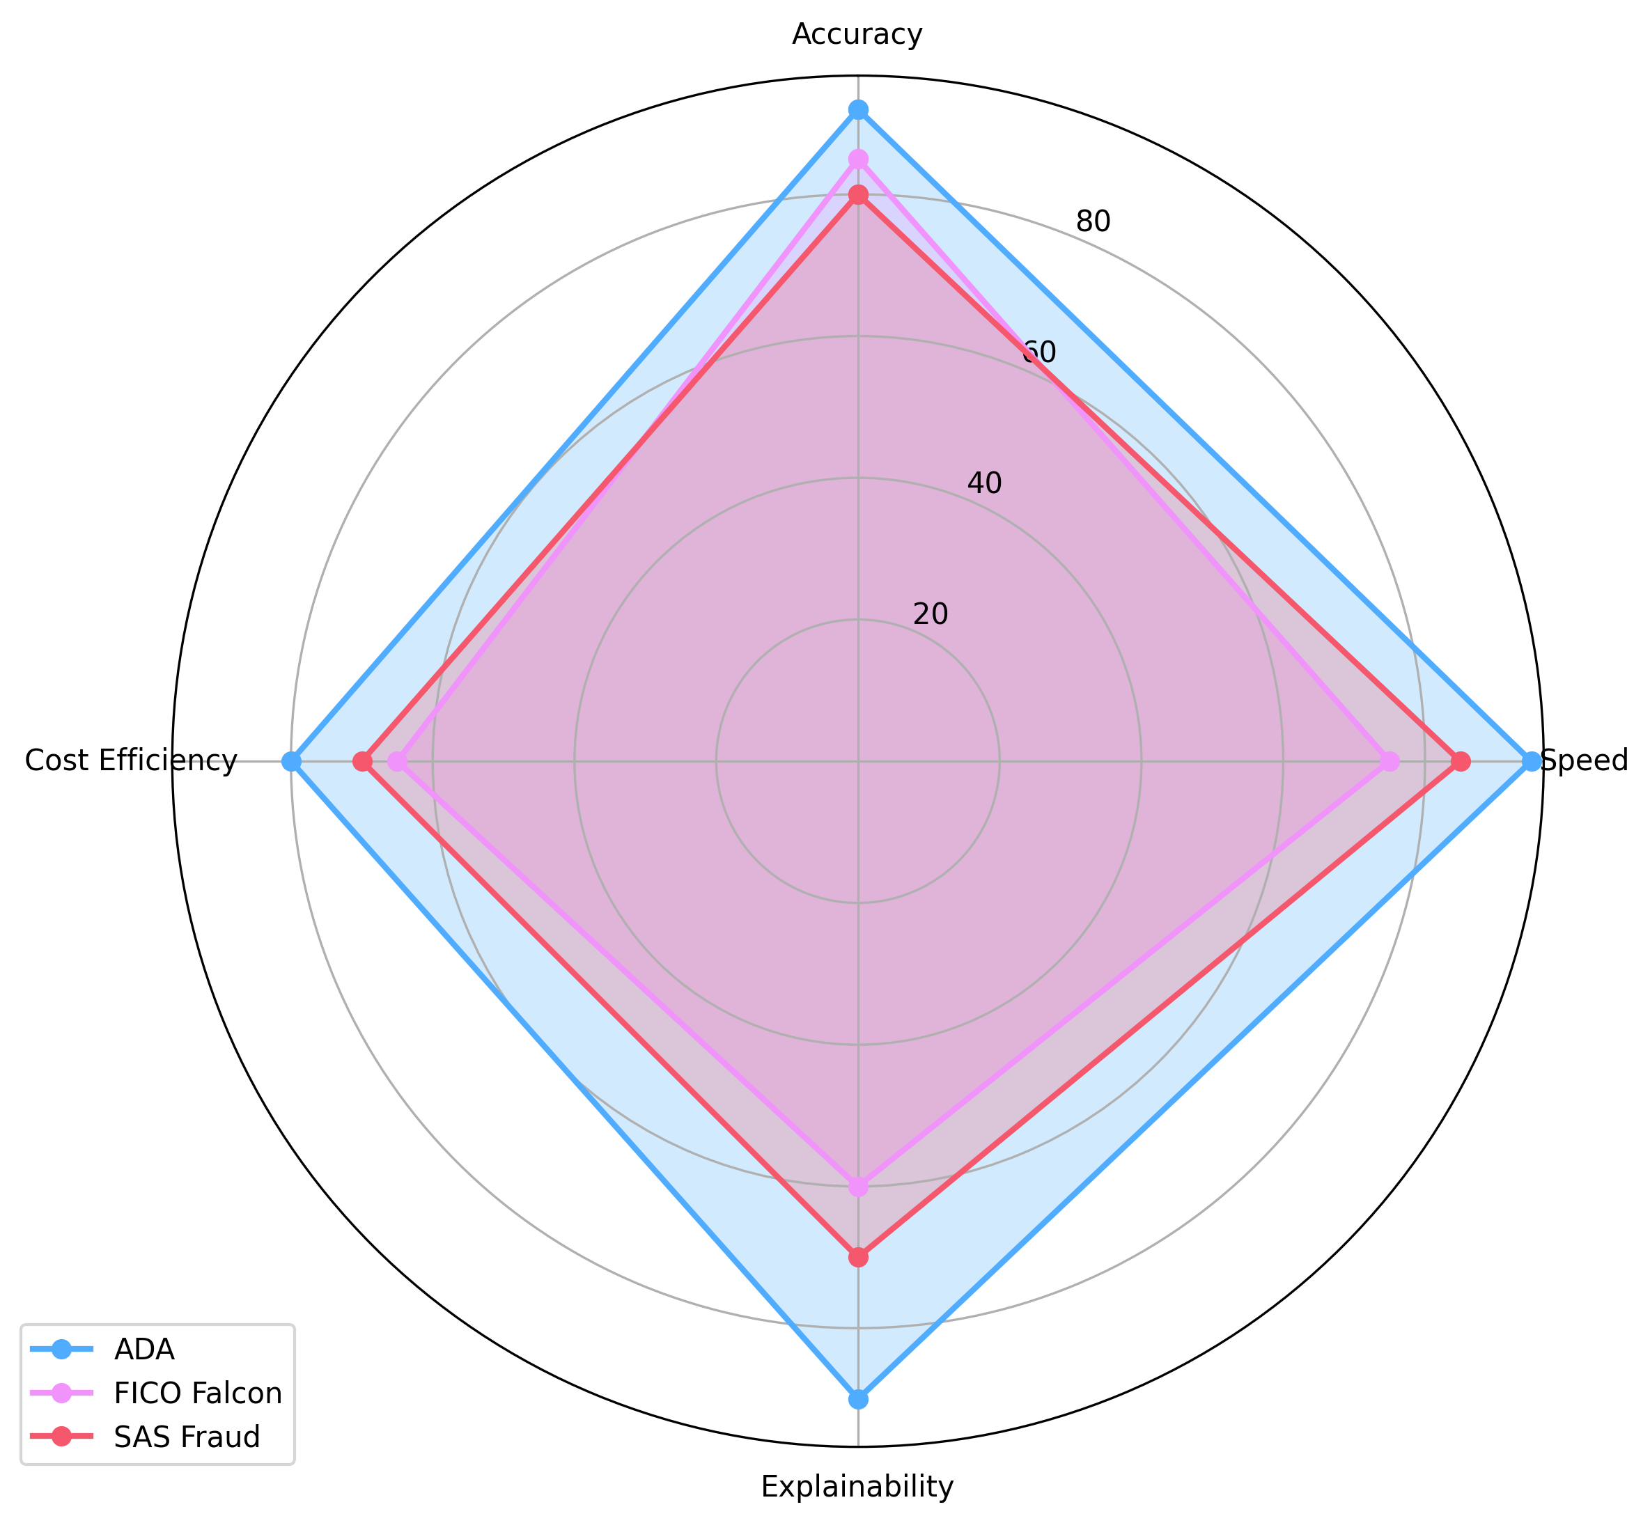
Radar Chart Analysis

Slide 5
Feature Comparison
Feature | ADA | FICO Falcon | SAS Fraud
Detection Accuracy | 92% | 85% | 80%
Processing Speed | 95% | 75% | 85%
Real-time Processing | < 1 second | 3-5 seconds | 1-2 seconds
Explainability | 90% | 60% | 70%
Cost Efficiency | 80% | 65% | 70%
Infrastructure Requirements | Lightweight | Heavy | Moderate
Integration Complexity | Low | High | Medium
Customization | High | Moderate | High
Scalability | Excellent | Good | Good
Support & Maintenance | Low | High | Medium

Slide 6
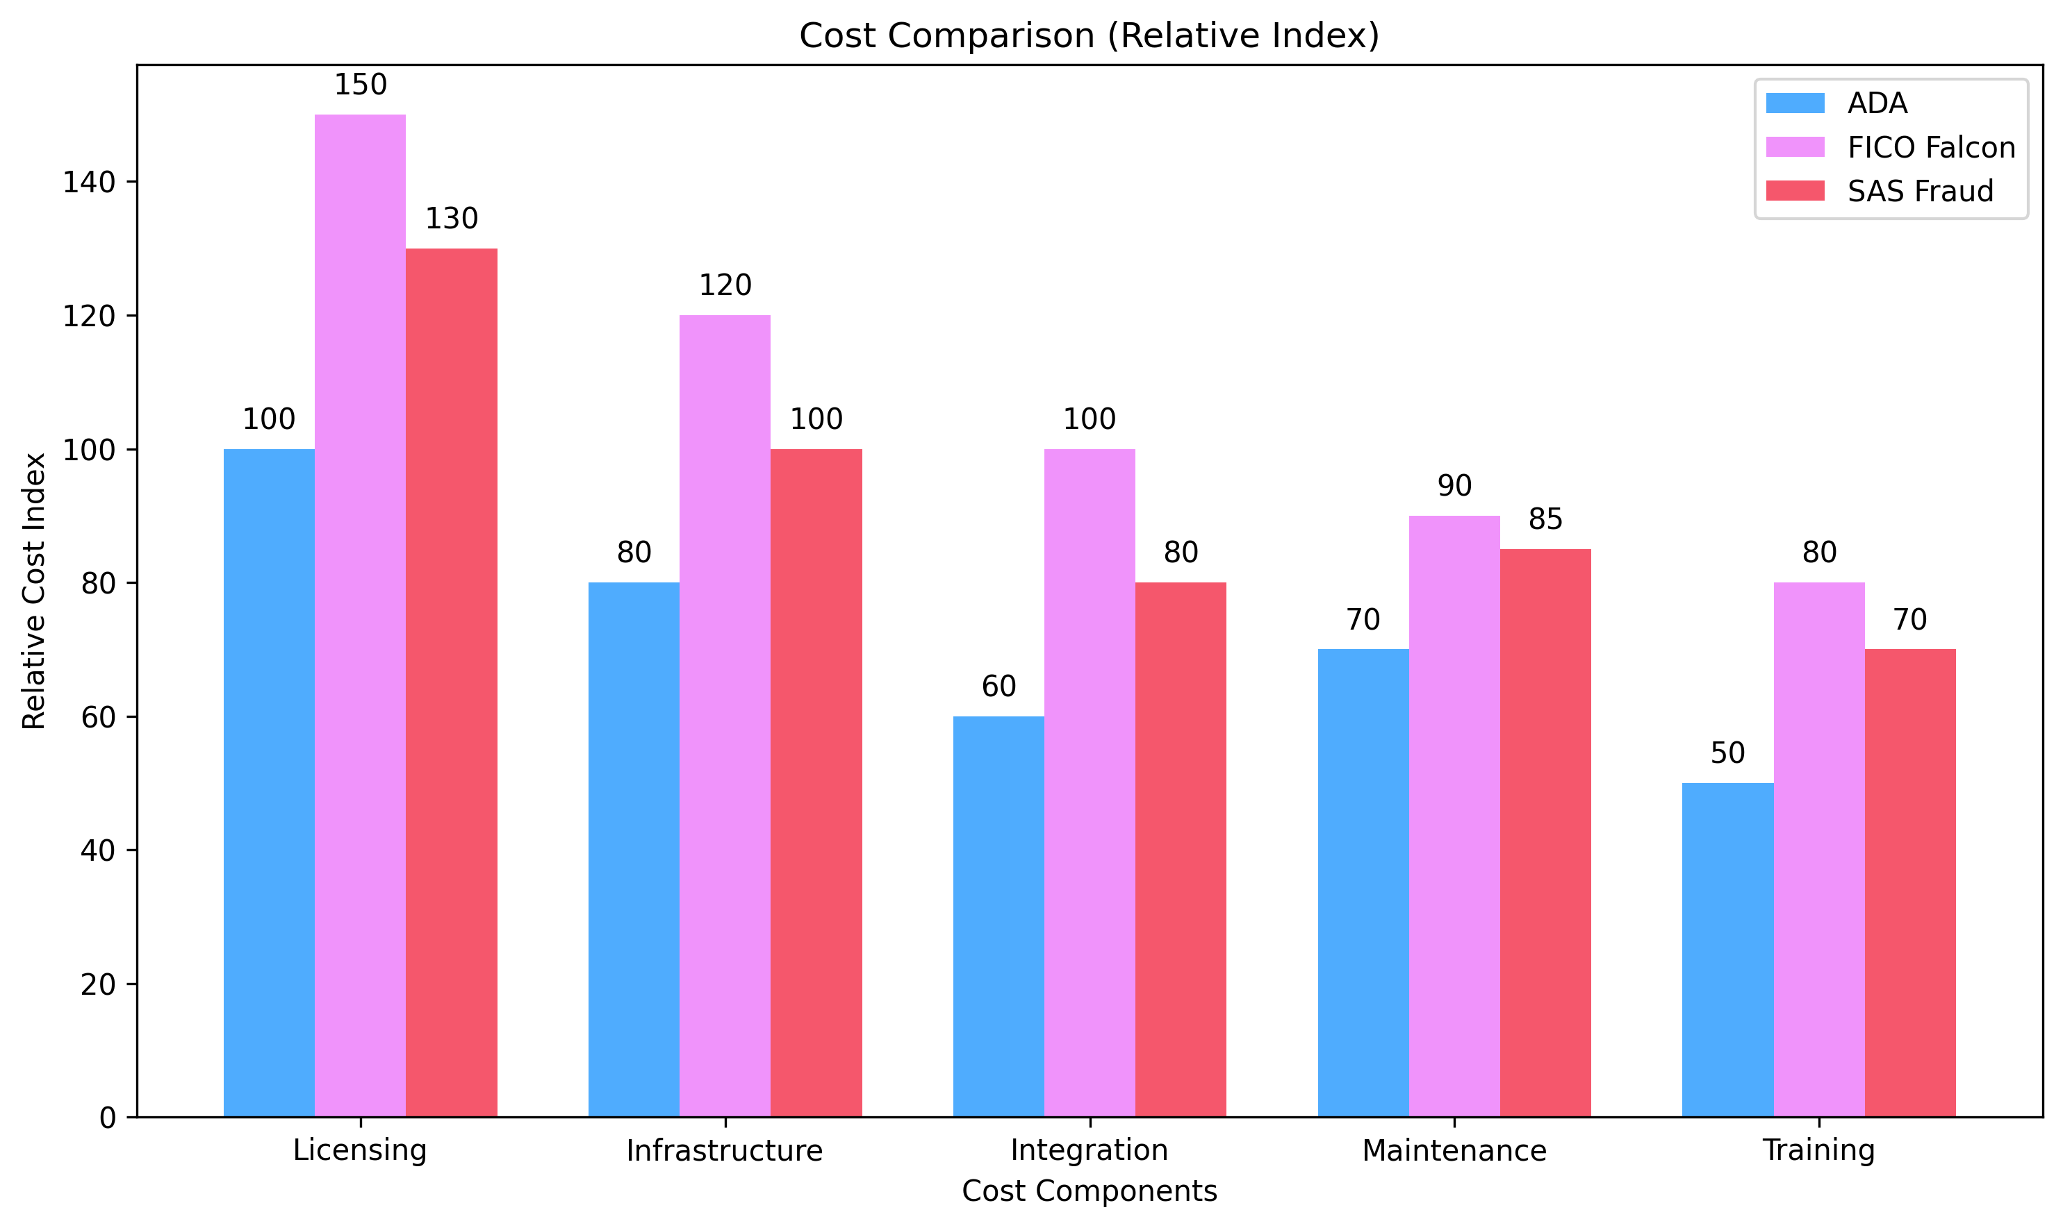
Cost Analysis

Slide 7
ADA Competitive Advantages
⚡ Speed & Performance:
• < 1 second processing time (vs 1-5 seconds)
• 500+ TPS throughput
• Real-time fraud detection
• Low latency architecture
🧠 AI & Explainability:
• 90% explainability score
• XAI integration
• Regulatory compliance
• Transparent decisions
💰 Cost Efficiency:
• Lower TCO than competitors
• Lightweight infrastructure
• Easy integration
• Reduced maintenance
🎯 Accuracy & Reliability:
• 92% accuracy rate
• Advanced ML models
• Continuous learning
• Adaptive algorithms

Slide 8
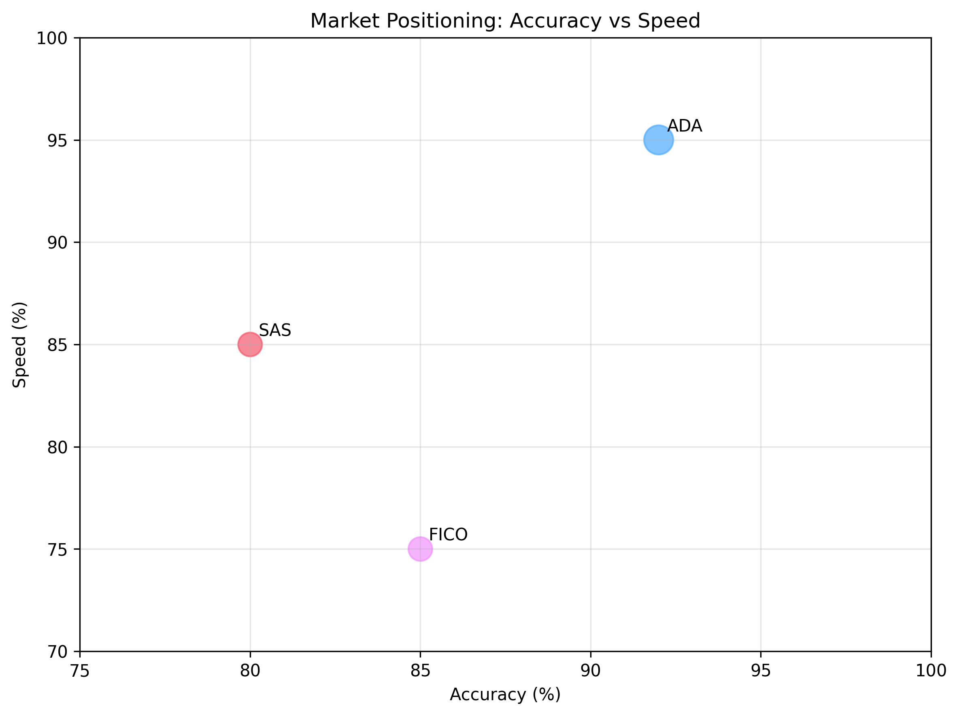
Market Positioning

Slide 9
Strategic Recommendations
🚀 Go-to-Market Strategy:
1. Target High-Value Segments:
• Financial institutions requiring real-time processing
• E-commerce platforms with high transaction volumes
• Regulated industries needing explainability
2. Competitive Messaging:
• Emphasize speed advantage (5x faster than FICO)
• Highlight cost savings (33% vs FICO, 23% vs SAS)
• Showcase explainability for compliance
📈 Growth Opportunities:
3. Market Expansion:
• Target mid-market companies priced out by FICO/SAS
• Focus on emerging markets with cost sensitivity
• Leverage cloud-native architecture advantage
4. Product Development:
• Continue improving accuracy beyond 92%
• Enhance explainability features
• Develop industry-specific solutions
🎯 Key Recommendation:
Position ADA as the 'Next-Generation Fraud Detection Platform' with superior performance across all metrics, modern cloud-native architecture, lower TCO, and better regulatory compliance.

