Slide 1
Virtual Trip
05/11/2018

Slide 2

V-Trip

Slide 3
problematic
For many reasons not everyone can go on a trip, some people are afraid of taking the plane, others don't have enough money to pay for airline tickets and hotel rooms …
It's even harder for people with reduced mobility or seniors.
In addition the organization of the trip takes time and requires a lot of efforts.
So for all these people we want to create an application based on virtual reality that will allow them to travel all over the world staying comfortably in their houses.

Slide 4
Our Solution
It's no longer necessary to go through a travel agency to travel all over the world.
Our company "V-Trip" will aim to create a mobile application that uses virtual reality to simulate a ride in any touristic place in the world and make the experience as realistic as possible.
Anyone who does not have the means or the time to travel, virtual reality remains the best way to explore the world in detail.
The most beautiful places in the world will be well accessible to everyone, all we need is a virtual reality headset and download the application.

Slide 5
Competition
There are some similar applications that use virtual reality.
The best known are:
Google earth VR.
The application only works with a limited number of virtual reality headsets.
Use satellite images which remove all realism from the experience.
There are also Ascape and Discovery VR.
To compete with these applications we will:

Slide 6
Create a community around the world so that everyone can share his experiences and the places he has visited.
Larger the community will be, more content there will be, so our app will offer more video choices than our competitors.
There will be new videos every day.
Videos on the platform of the application will be free.
The application will be compatible with all virtual reality headsets on the market.

Slide 7
Customers
The prices of this service are much lower than a real trip, that allow us to reach a large customer base in particular
people with reduced mobility ,
seniors,
and even in schools to show children historical sites located in distant countries .

Slide 8
Marketing
To promote our application we mainly rely on social networks,
create a Facebook page to present the application and relay it.
Put advertising video on YouTube and Twitter.
We also use more traditional means such as posters on the streets and bus stations.

Slide 9
Advertissement | Type | Cost
social networks and media | Facebook Instagram Twitter YouTube | 50 € 200 € 150 € 5 € /day (2160€/year )
poster to paste | Billboard (10) Post on the wall (10000) | 25000€ + (240€ for printing) 20000€( either 2 € each)
TOTAL | 2 560€+ 27 240€ + 20 000€ = 49 800 €

Slide 10
Sources of revenue
In order to make a profit with the application we will collect the data and extract relevant information allowing the travel agencies to better understand the customers' desires.
The customer will pay to download the application.

Slide 11
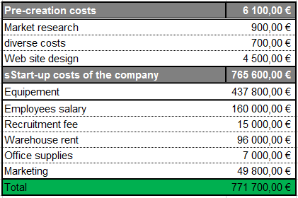
Financial analysis

Slide 12
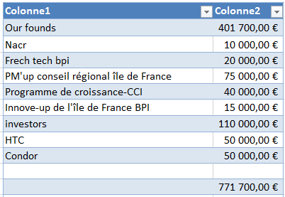
Funding

