Slide 1
﻿Assessing the potential for deep learning and computer vision to identify bumble bee species from images
Adarsh Ghimire
100058927
18 April 2021

Slide 2
Problem Statement
Pollinators population is declining
Conservation of pollinators is a necessity
﻿Number of species and population size in an area can only be assessed when they are accurately identified
Species level identification is :
Expensive
Time Consuming
Requires taxonomic training
Solution
The problem is specifically a multi-class classification problem
Many deep learning architectures exist to solve this problem
Thus, using deep learning and computer vision for automating the identification of bees is an appropriate approach.

Slide 3
Paper Scope of work
Four deep learning architectures has been tested:
Resnet
Wide Resnet
InceptionV3
MnasNet
Developed an automatic bee species identification web application
Best Identifier is based on InceptionV3 architecture
The system identifies bees from their image
System can identify bee with an accuracy of 91.6% and at 3.34ms.

Slide 4
Machine Learning Problem
36 species of North American bumble bees needs to be identified
With varying lighting conditions in images
With varying background in the images
Varying orientation of image
Partially obscured image
Solution
Applying Convolutional Neural Network Architecture for learning the features from the images

Slide 5
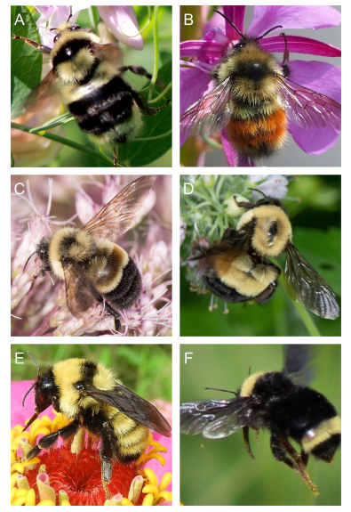
Raw Dataset
Verified Images of bumble bees were first collected from : ﻿Bumble Bee Watch, iNaturalist, and BugGuide
Total Images → 120,000
Original Total target → 42
Dataset Processing
Original Images were cropped tightly to target using an object detection algorithm
﻿Detection algorithm errors included false positives which were discarded manually
Relabeled mis-labelled data
Discarded images less than 200x200 pixels
At least 150 images per bee species was required
6 species did not meet criteria
Final target size → 36
Training Size → 89,776

Slide 6
Deep learning architecture design considerations
﻿Deep neural networks suffers from vanishing gradient problem
Prevents the adjustment of model weights during the training process
Making hard to improve model performance before ﻿information passes through the end of the network
﻿ResNet-101 addressed this problem by using skip connections that allow useful layer output to pass over groups of layers (or residual blocks) and thus penetrate much further into deep networks.
Wide-ResNet-101 is wider but shallower than ResNet-101. This difference in architecture allows information to more easily pass through the network while providing a greater number of channels to maintain performance.
InceptionV3 has fewer layers but achieves greater computational efficiency by using factorized convolution, which breaks down channels into simpler linear sequences while maintaining spatial context within the image.
MnasNet-A1 was designed to be faster for mobile devices and thus has the fewest layers then other models.

Slide 7
Model Training
Image size :
224x224 pixel for ResNet, Wide-ResNet, and, MnasNet.
299x299 pixel for Inception
Train test split ratio → 80:20
Use of pre-trained models → pretrained on ImageNet Database
Retraining of pretrained models
Image augmentation strategies applied :
Increase generalizability
Reduce Overfitting
Augmentation strategies:
Rotation < 100 degree
Crop < 10%
Sheer < 30%
Horizontal flip
To overcome class imbalance, class weights were given during training

Slide 8
Model Training
Optimizer – Stochastic Gradient Descent (SGD)
Batch normalization applied on network layers
Initial Learning rate → 0.01 for all networks except MnasNet which was set to 0.1
Learning rate reduction factor 10, after each 30 epochs
Total epochs used → 150
Loss → Categorical Crossentropy

Slide 9
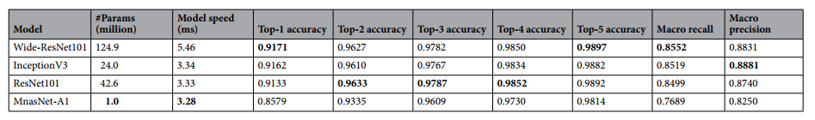
Performance Metrics
Precision
Recall
Speed of prediction
Macro precision → ﻿ the mean of species-level precision scores
Macro recall → ﻿mean of species-level recall scores

Slide 10
Major improvement that can be done on current study
The applied deep learning architectures are not designed with attention
These architecture learns the global feature of the image
Different variants of bees differs from each other based on some specific feature on them
Attention mechanism can be a powerful tool for this task.
Attention network such as transformer network, convolutional block attention module can be applied for finding region of attention or feature on bee
Finding such specific attentive pattern can be a useful feature for accurate classification task
Use Grad-CAM visualization figuring out where the network is giving attention

Slide 11
Major Improvements that can be done on current study
Using Siamese Network for class agnostic classification
This can be better solution for identification of bees with less data
Siamese network trained with triplet-loss can help to identify bees very accurately
Since, they are capable of performing classification on face recognition task with 99.78+% accuracy
Class specific bees feature vector can be developed and saved, for later one-shot classification of bees on future images
Using of Generative Adversarial Network for generating synthetic images

