Slide 1
Project Defense on
Pharmacy Inventory & Billing System
Supervisor:
Susan Sunuwar
11 March, 2025
BCA Department:
Swastik College
Presented by:
Anuradha Dulal
Niru Prajapati

Slide 2
Outlines
Introduction
Problem Statement
Objectives
Scope
Literature Review
Requirement Analysis
Feasibility Analysis
8. Project Timeline
9. Results
10. Test Cases
11. Limitation
12. Recommendation
13. Conclusion

Slide 3

Introduction
Pharmacy Inventory and Billing System aims to help in maintaining and managing the records for a pharmaceutical store by improving efficiency, accuracy and security.
Using the Pharmacy Management System, one can:
User Registration and Login
Inventory Management
Billing and Invoicing
Product and Service Management
Sales and Transaction History
Expiry and Stock Alerts
Financial Tracking and Reporting
Multi- User Access with Role Management

Slide 4
Problem Statement
Inefficient Inventory Tracking
Manual Billing Errors
Time Consuming Transaction Processing

Slide 5
Objectives
User-Friendly Interface
Automated Inventory & Billing Processes
Provides fast searching capabilities
Resource Optimization through Digitalization
Generate alerts and reports as required on sales and medicines.

Slide 6
Scope
This system can be used in various establishments, such as retail pharmacies, clinics, and small medical stores, which require efficient management of inventory and streamlined billing processes.
Manage Inventory
Handle Billing and Sales
Supplier and Purchase Management
Customer and Prescription Records
Employee Management
Generate Reports

Slide 7
Literature Review
[1] Stock management, billing, and prescriptions, leading to errors and inefficiencies. Digital inventory and billing systems address these issues by automating stock management, tracking expiry dates, and ensuring faster, more accurate billing. This improves efficiency, reduces waste, and enhances customer service.
[2] Pharmahands.com let us know about the interfaces and the features to add on our system which includes invoicing , accounting, stock management etc.
[3] From an operational perspective, effective inventory management plays a crucial role in ensuring that customer and patient demands are consistently met. Proper inventory control minimizes shortages and overstocking, thereby improving service quality and operational efficiency.

Slide 8
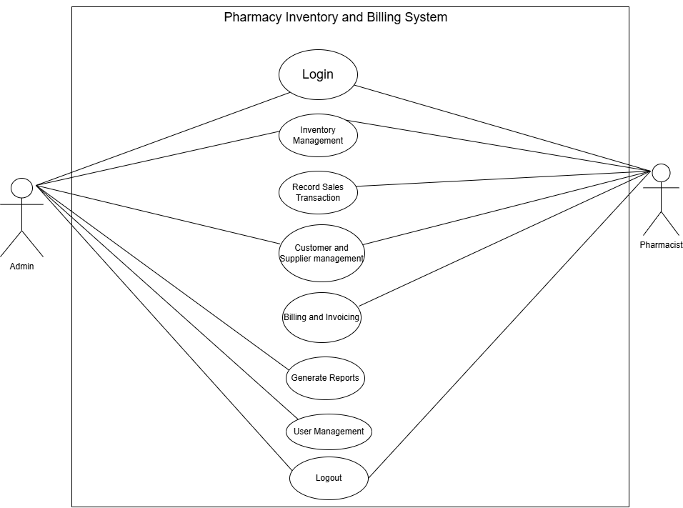
Requirement Analysis
Functional Requirement
Role Authentication
Stock Control
Report Generation
Fig: Use Case Diagram

Slide 9
Requirement Analysis
Non- Functional Requirement:
Efficiency
Maintainability
Reliability
Security
Accessibility

Slide 10
Feasibility Analysis
Technical Feasibility
Economical Feasibility
Operational Feasibility
Schedule Feasibility

Slide 11
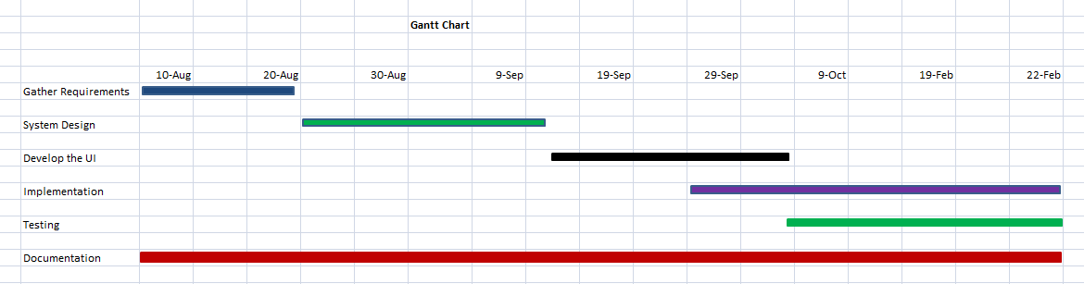
Project Timeline(Gantt Chart):
Figure: Gantt Chart

Slide 12
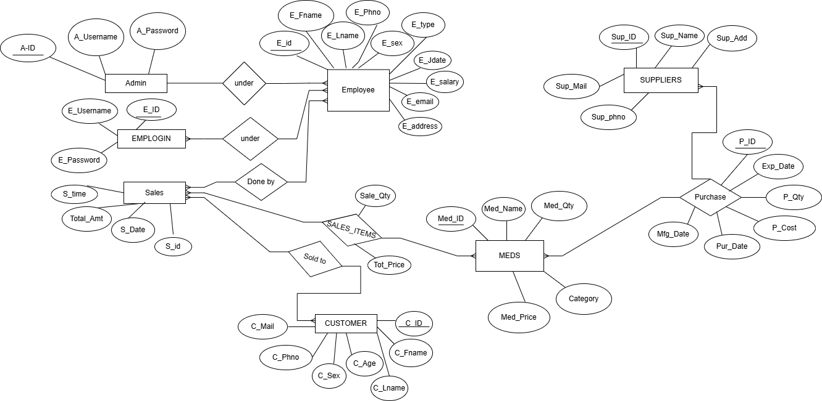
ER Diagram
Figure: E-R Diagram

Slide 13
Implementation & Testing
I. Frontend Tools
HTML
JavaScript
CSS
III. Design Tools
Draw.io
II. Backend Tools
IV. Database Tools
PHP
MYSQL

Slide 14
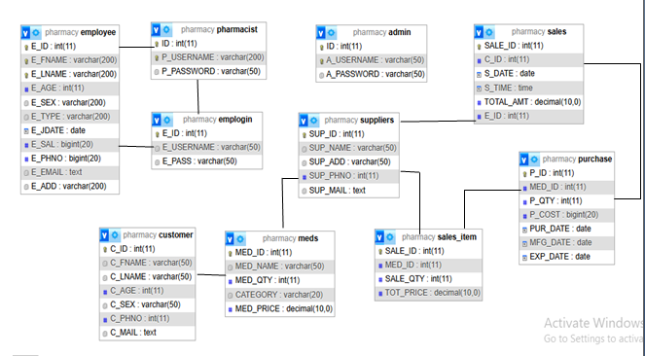
Database Schema Diagram

Slide 15
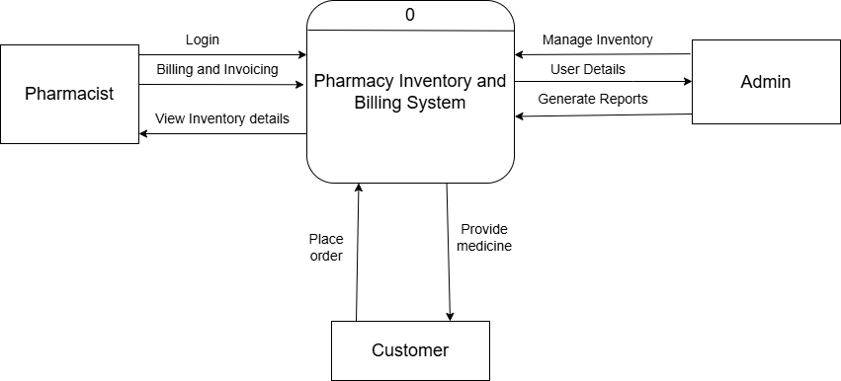
DFD(Level 0)

Slide 16
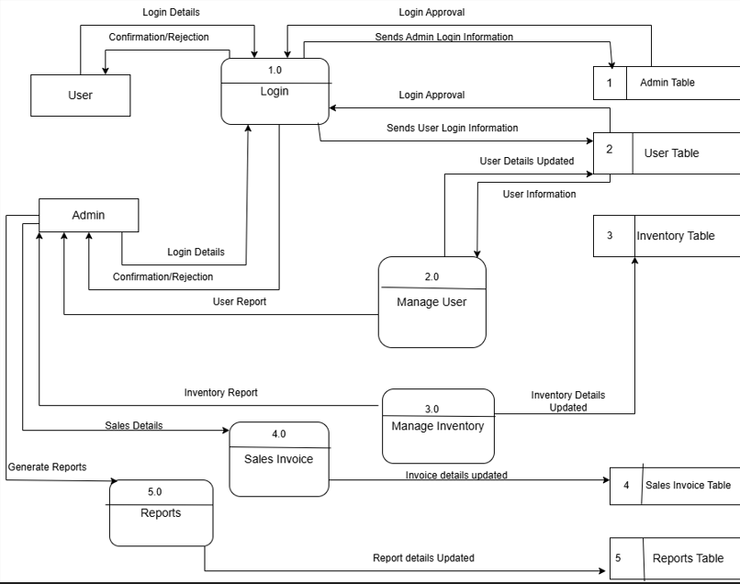
DFD(Level 1)

Slide 17
Test Cases
Test cases for admin login of the Pharmacy Inventory and Billing System
Test Cases ID | Test Name | Test Case Details | Expected result | Test result | Status
1 | Login functionality test | Wrong username and password | Login unsuccessful | Login unsuccessful | Pass
2 | Login functionality test | Correct username and password | Login successful | Login successful | Pass

Slide 18
Test Cases
Test cases for logging out of the Pharmacy Inventory and Billing System
Test Cases ID | Test Name | Test Case Details | Expected result | Test result | Status
1 | Logout functionality test | Click on logout Button | Get into Login form page | Get into login form page | Pass

Slide 19
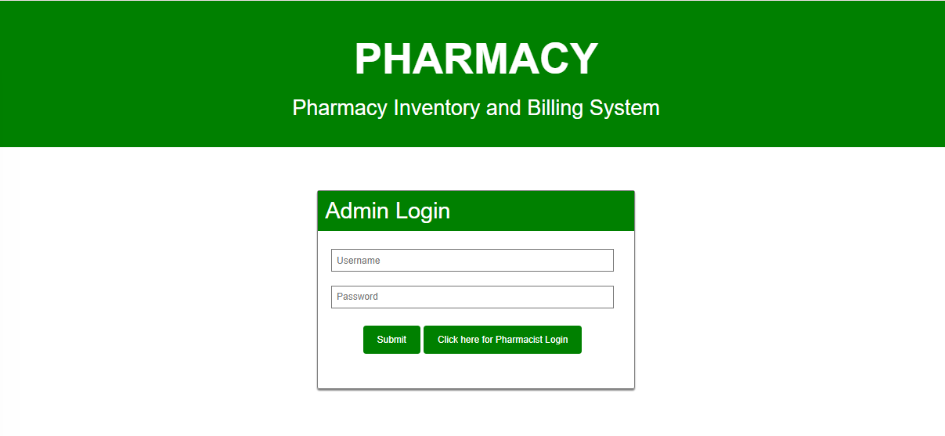
Result

Slide 20
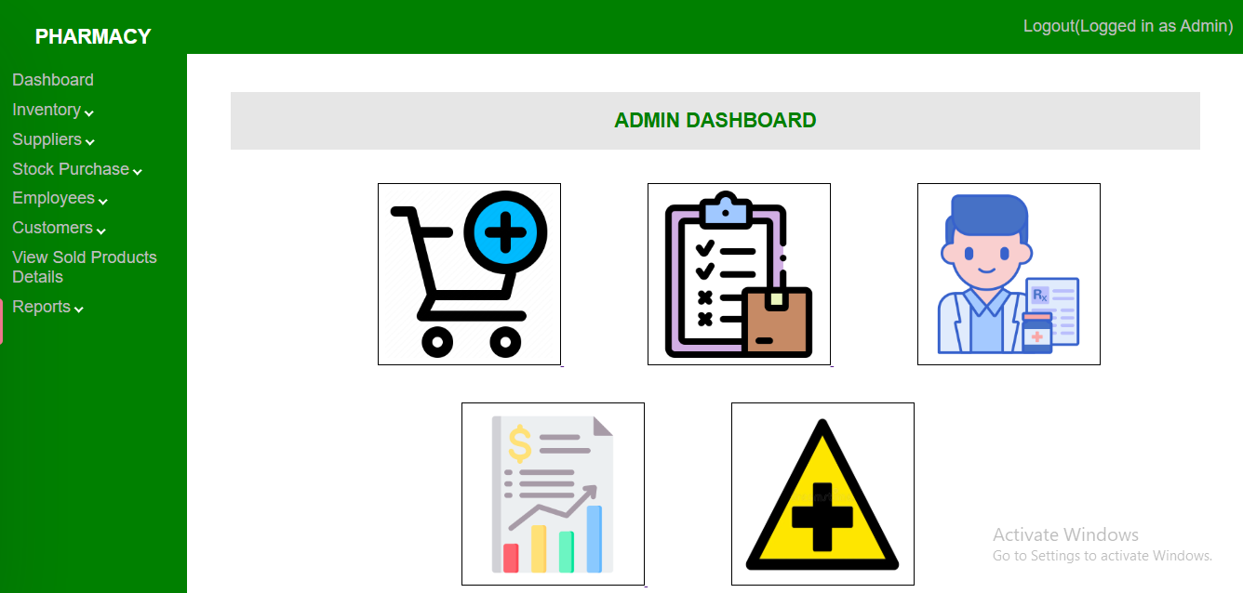
Continue..

Slide 21
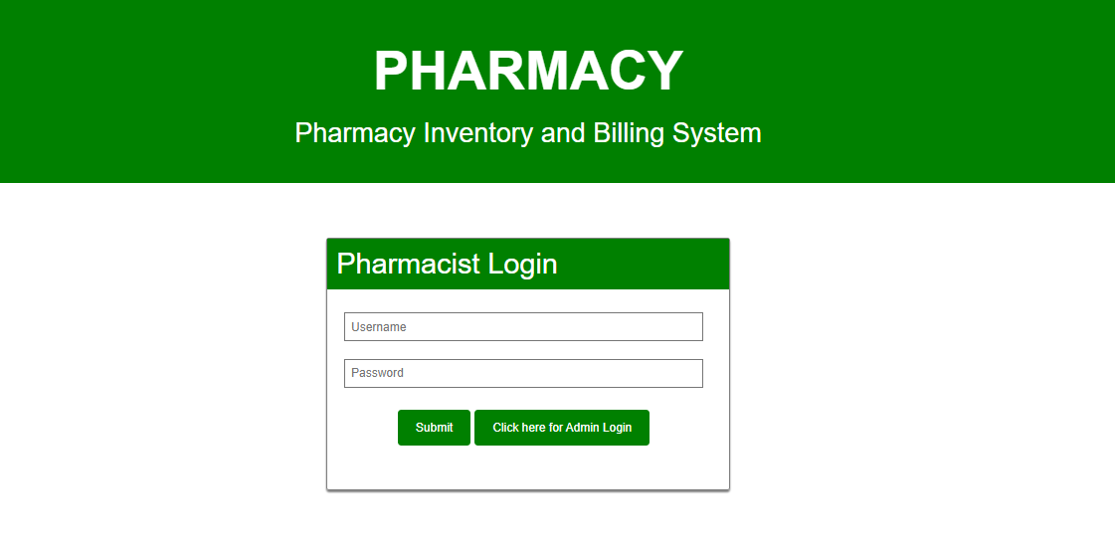
Continue..

Slide 22
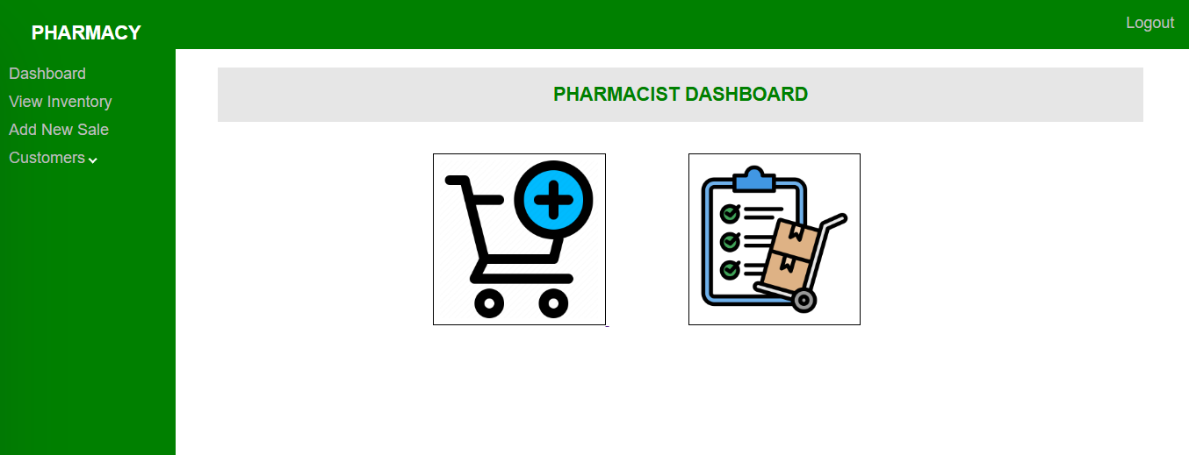
Continue.

Slide 23
Limitation
It is best suited for Small to Medium -Sized Pharmacies Only.
It has limited offline functionalities.
It has basic Analytics and Reporting.

Slide 24
Recommendation
Improve User Interface Design
Add Barcode Scanning Integration
Implement Advanced Search and Filter Options
Develop Mobile App Access

Slide 25
Conclusion
In summary, the Pharmacy Inventory Management and Billing System meets the needs of small to medium-sized pharmacies by providing an easy-to-use platform for managing inventory, billing, and transactions. It improves accuracy, keeps stock information up-to-date, and ensures secure financial handling, making pharmacy operations smoother and more reliable.

Slide 26
References
1. Library Management System. Sharma, Shourabh, et al., et al. s.l. : IJRASET, 05 08, 2022, Ijraset Journal For Research in Applied Science and Engineering Technology.
2. Pharmacy Inventory Managemnet System: A comprehensive Guide. PARMANANDANI, NIHA. s.l. : Openxcell, 2024.
3. Harrington, Thomas C. Implementing an effective inventory managemnet system. International Journal of physical distribution and logistics management. [Online] pp.17-23.

Slide 27


Slide 28


