Slide 1

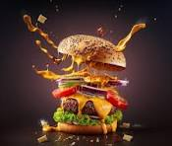
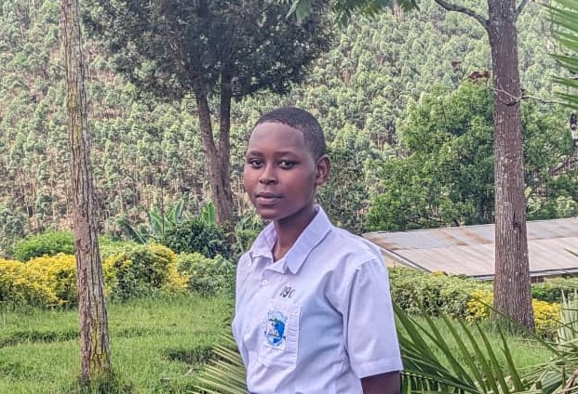
IAP
FROM 18/04/2024 23/05

Slide 2
DAY 1
INSTATRFGYHWYTWI45.RYFE3,JRGVRJVSEAGJK.4EJG3RUJHKJHFGRVKJ4RTKU.RFGKRT5R4TG
RFTRHKREAGRJLEAAAAAAAAAAAAARG
TYUYFJHGF

Slide 3
Day 2
Yytfcfytjhgfdtyhigfytgfrfgbhg
Hgtrghvbmj
Uy
Vfgc6vvbu
Fgfrtxcvbuygtfd
Zxcvyhgt
Frrrduyhkjhg
6tgu7kjjhygy
ynhbhjjnbbh

Slide 4
DAY3
UYHVFUJGH
IJHUYHVBJKLNOBN
YJHJ.,HIKVNH
VBNOKJBNJHU
BKJNBCNHJVBNL
KJNNBJ
,LN;KMBIJBGFNOPNKBJHG

Slide 5
Day5
IO9UYH7VJK
OI9UJCJY
TGF
D
GHKL
OGIJU
Y
T
D

Slide 6
day4
Tchnfviu8bnbjmnh
7ubnkimvbj
Gtghkmn,
Kjvnhbnm
P;mnkjjguui
Ioih
Kgvbh
Nio
Ioopp
[

Slide 7
DAY 1
INSTATRFGYHWYTWI45.RYFE3,JRGVRJVSEAGJK.4EJG3RUJHKJHFGRVKJ4RTKU.RFGKRT5R4TG
RFTRHKREAGRJLEAAAAAAAAAAAAARG
TYUYFJHGF

