Slide 1
Database
Unit 4 - Database Design & Development
14/6/2023
GHIYATH AL MOSHMOSH
202202037
RC77789
cgalmoshmosh@std.axcelacademy.co.uk

Slide 2
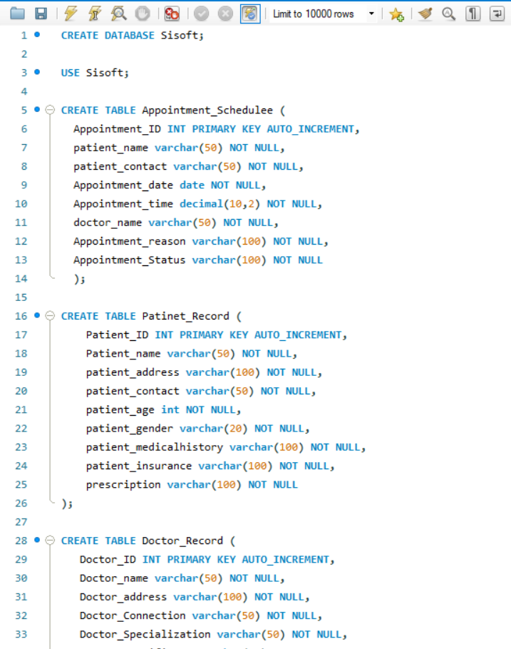
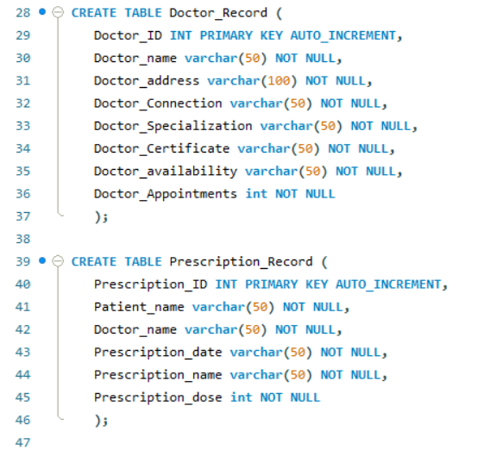
MySQL Database

Slide 3
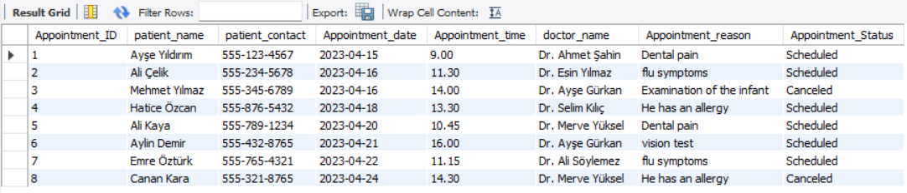
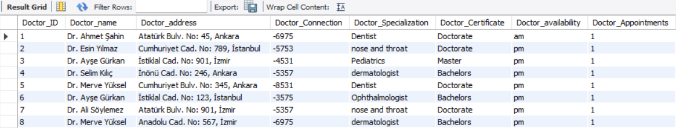
MySQL Database

Slide 4
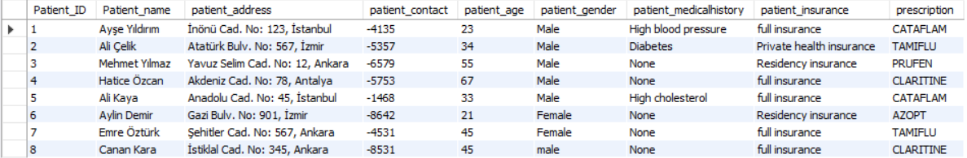
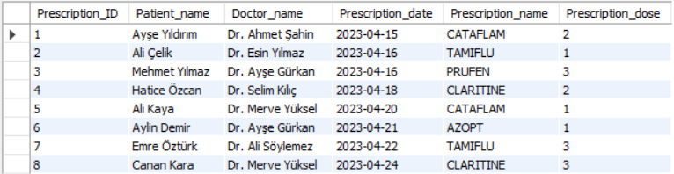
MySQL Database

Slide 5
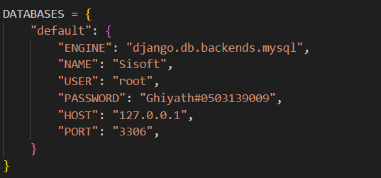
Set up the Database

Slide 6
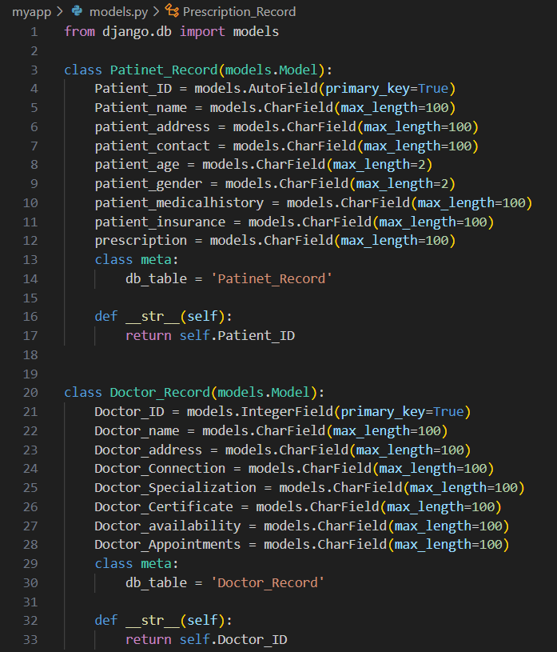
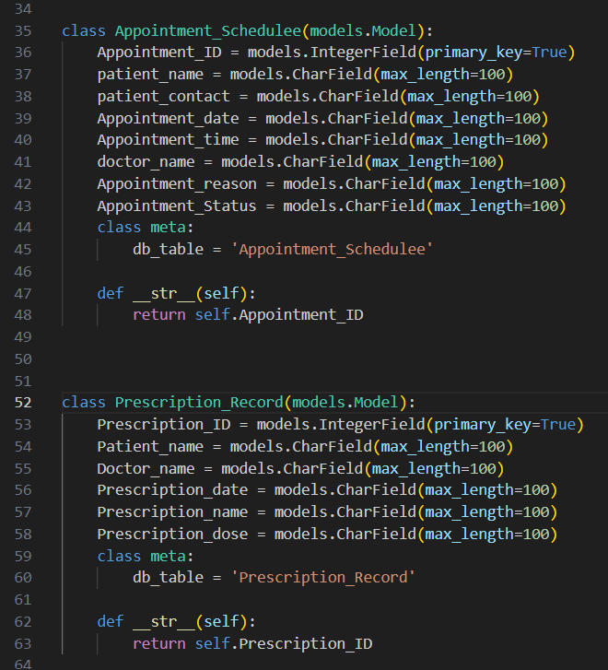
Models
Notes:
I designed models.py to define models and its help interact with the database

Slide 7
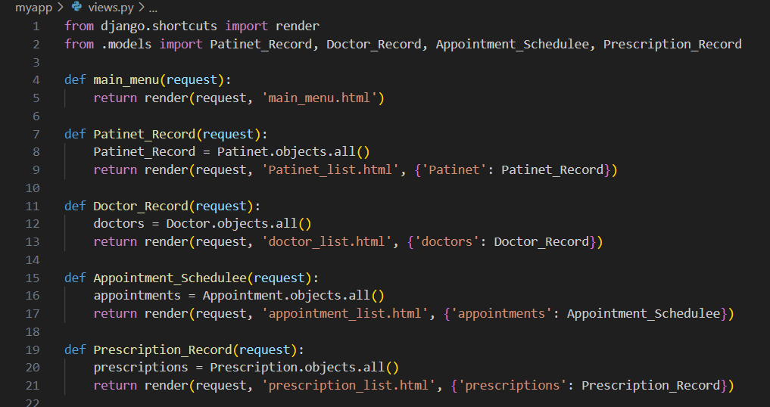
View

Slide 8
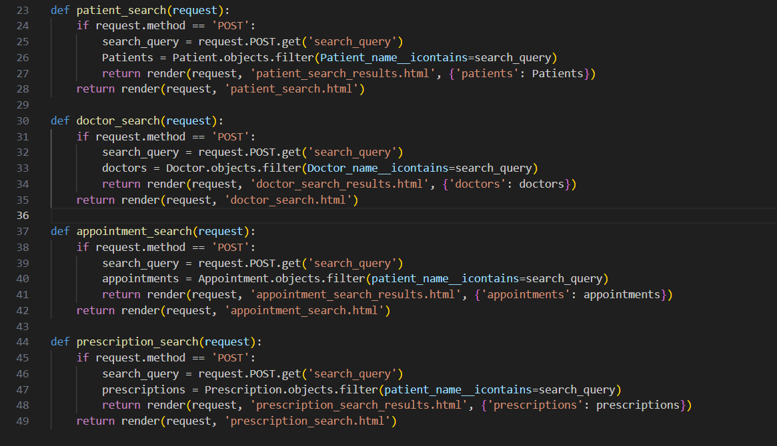
View
Notes:
patient_search (request) = it processes the (POST) and retrievesريتريفز a search query from a request, then if the search is compatible with a form, the results are passed to patient_search_results.html to display

Slide 9
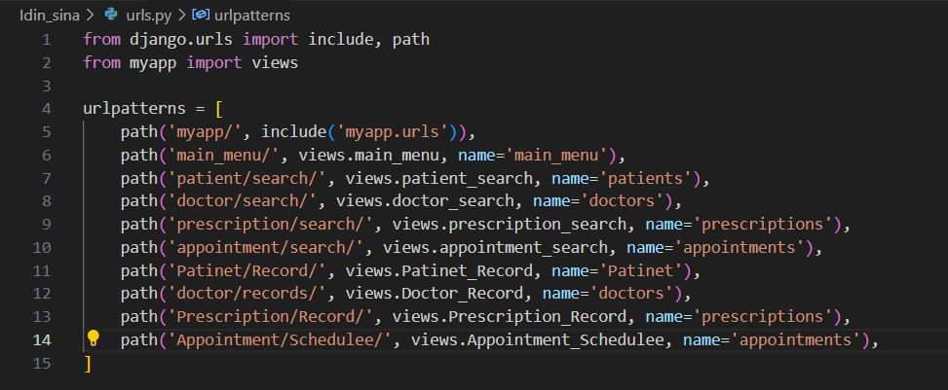
URLs

Slide 10
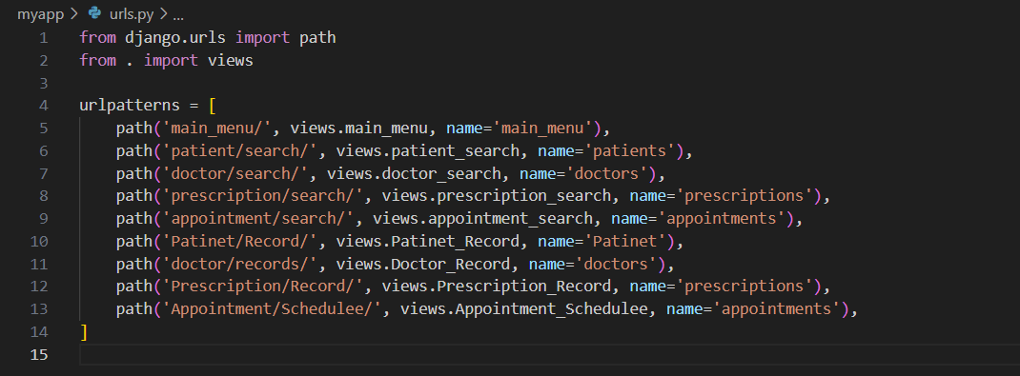
URLs
Notes:
When the user visits /doctor/search/URL, the doctor_search function will be called to display the doctor's search template or process the search query.
When the user visits /Patinet/Record/URL, the Patinet_Record function will be called to retrieveريتريف the patient records and provide the patient list template.

Slide 11
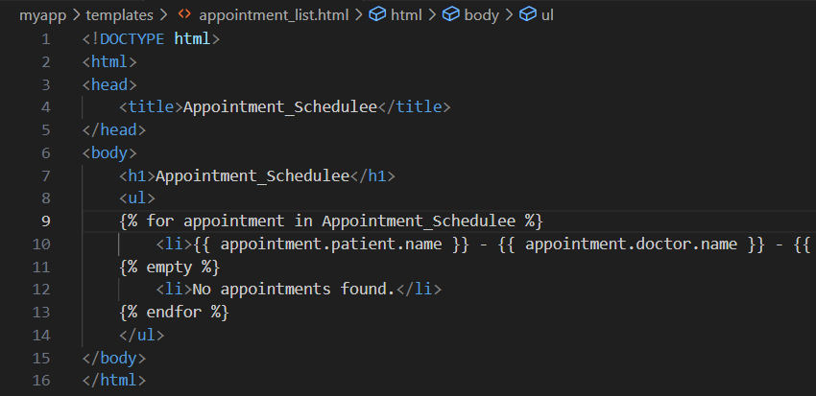
Templates of the HTML

Slide 12
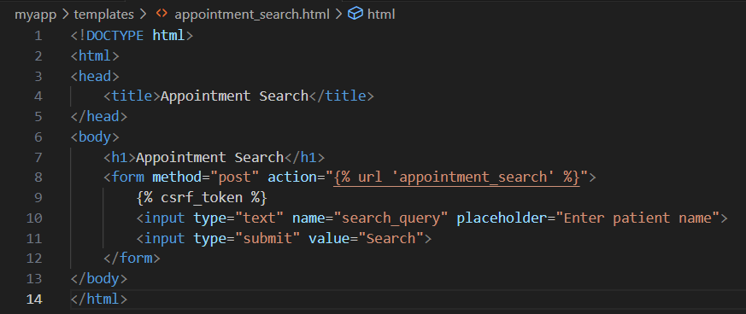
Templates of the HTML
Notes:
<form method="post" action="{%url ‘appointment_search'%}">=
By defining that "post" should be used and then sending the data to the URL pattern named "appointment_search"
{%csrf_token%} = This is for increased security during form submission which is done by Django as it generates a CSRF token
<input type="text" name="search_query" placeholder=here a space appears to enter the name the user wants to search for
<input type="submit" value="Search">= this line creates a submission with a search header next to the input space so they can submit the form

Slide 13
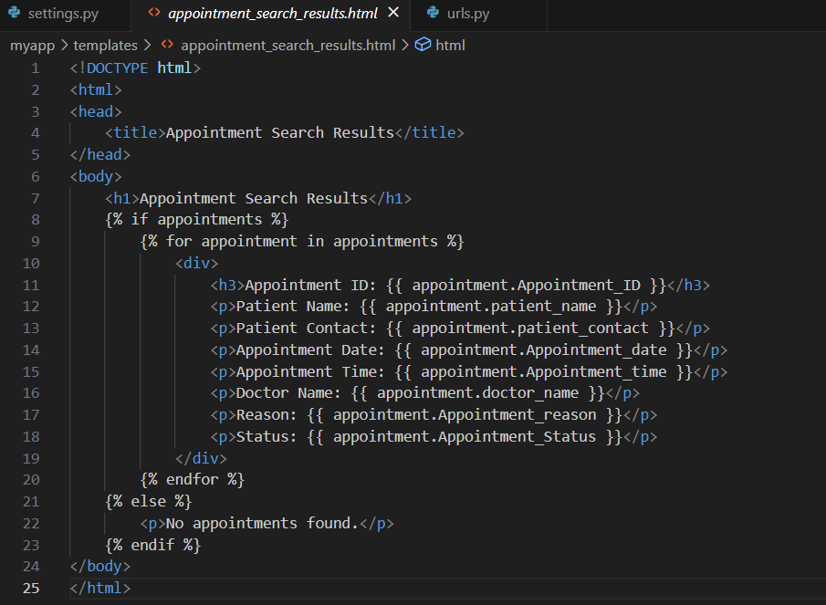

Slide 14
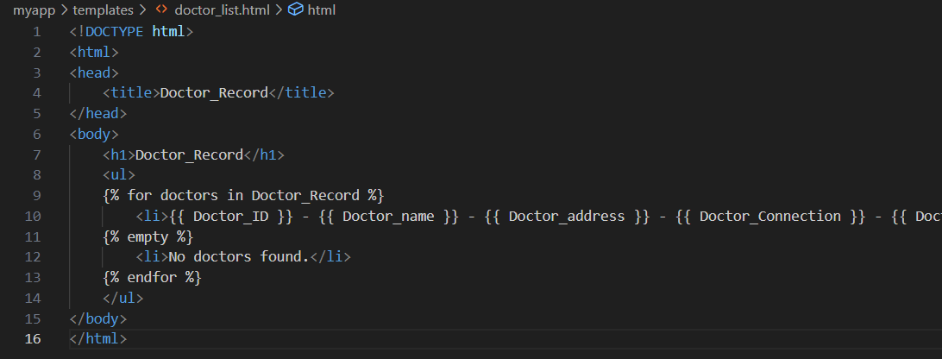
Templates of the HTML
Notes:
<! DOCTYPE html>= identifies the document as HTML
<html> = the start
<head> = Contains attributes such as the title that the web will display
<h1>doctor_Schedule</h1> = This is to show the doctor_Schedulee title first.
<li> {{000}} - {{.0000}} - {{0000}} - {{0000}} </li> = used to display all data in the Appointment_Schedulee
</ul>: means to close the unordered list.
</body>: This tag indicates the end of the body of the HTML document.
</html>: This closing tag means the end of the HTML document.

Slide 15
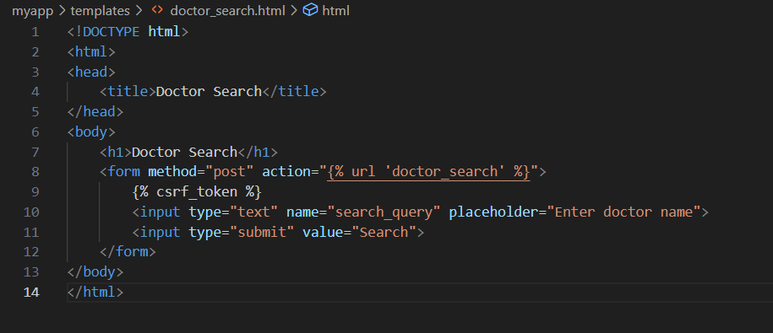
Templates of the HTML

Slide 16
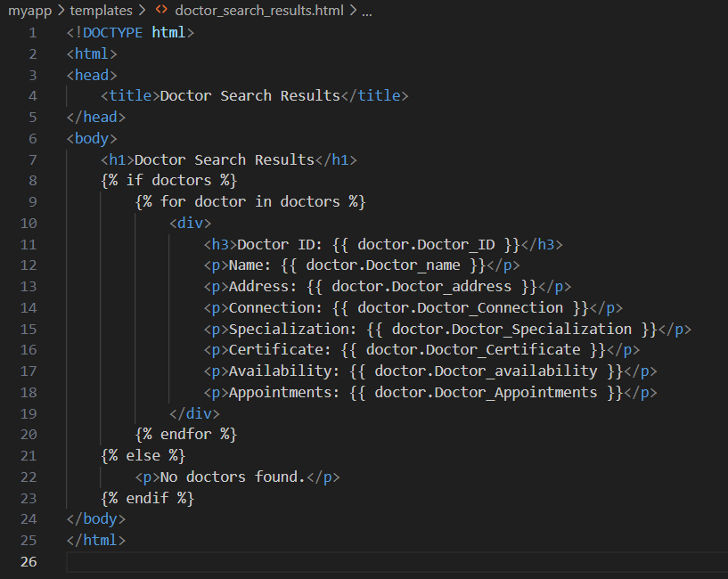
Templates of the HTML

Slide 17
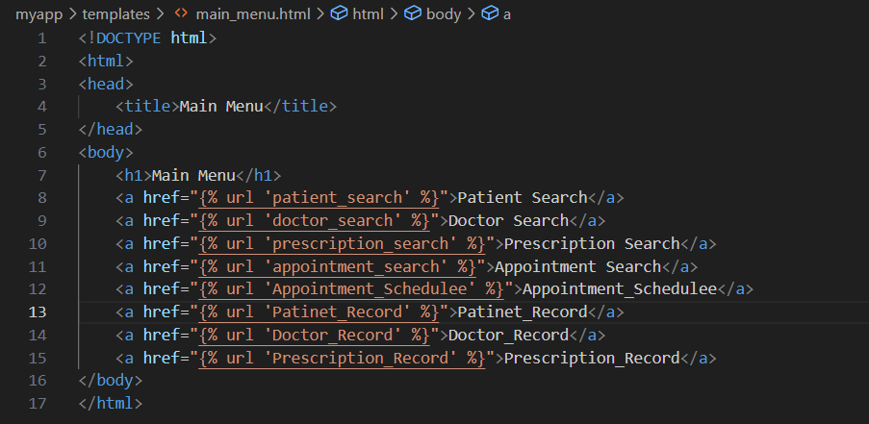
Templates of the HTML

Slide 18
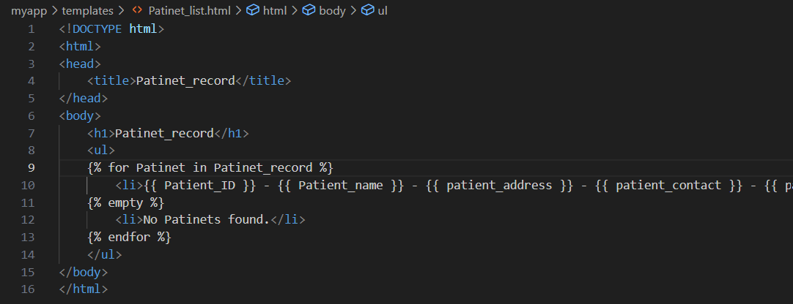
Templates of the HTML

Slide 19
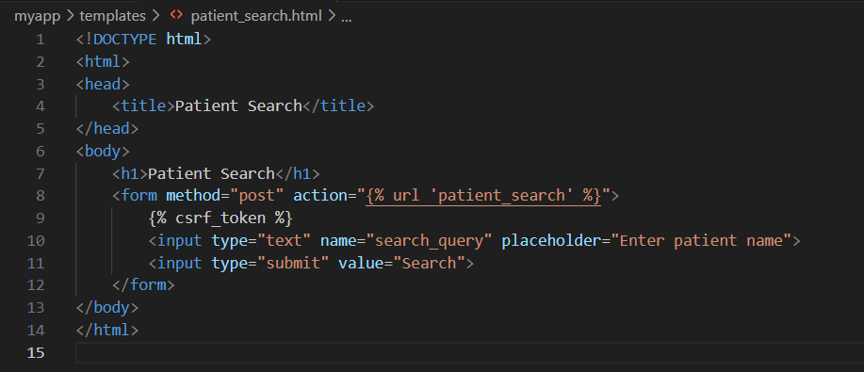
Templates of the HTML

Slide 20
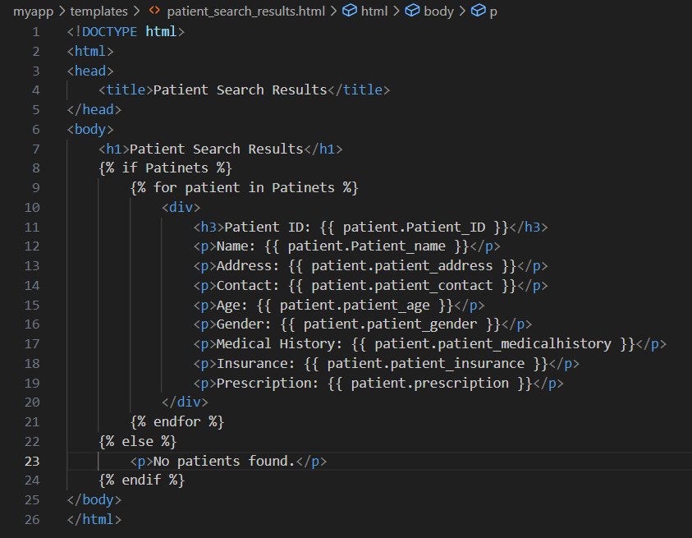
Templates of the HTML

Slide 21
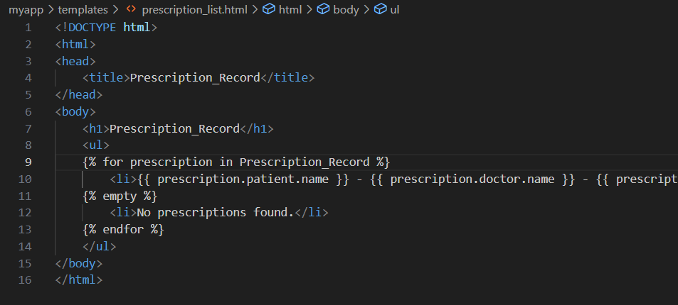
Templates of the HTML

Slide 22
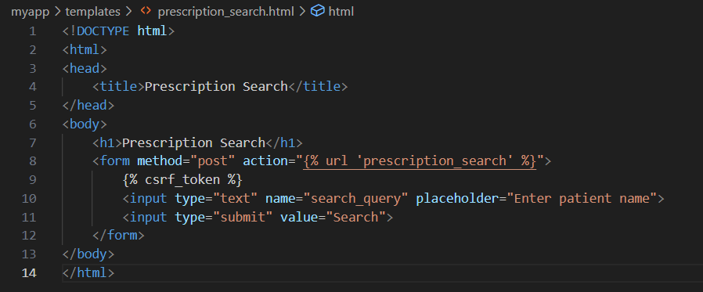
Templates of the HTML
Notes:
<form method="post" action="{%url 'doctor_search'%}">=
By defining that "post" should be used and then sending the data to the URL pattern named "doctor_search"
{%csrf_token%} = This is for increased security during form submission which is done by Django as it generates a CSRF token
<input type="text" name="search_query" placeholder=here a space appears to enter the name the user wants to search for
<input type="submit" value="Search">= this line creates a submission with a search header next to the input space so they can submit the form

Slide 23
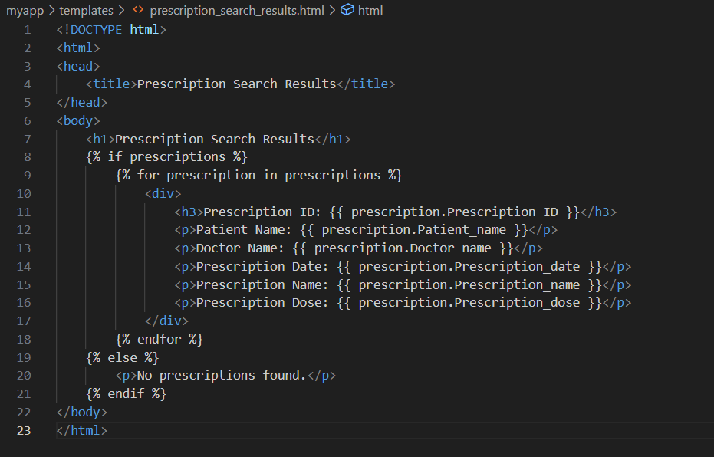
Templates of the HTML

Slide 24
Link of the (githud.com)
ghiyathii/code-application-database (github.com)

