Slide 1
Root Cause Analysis
Apollo Methodology
根本原因分析 阿波罗法

Slide 2
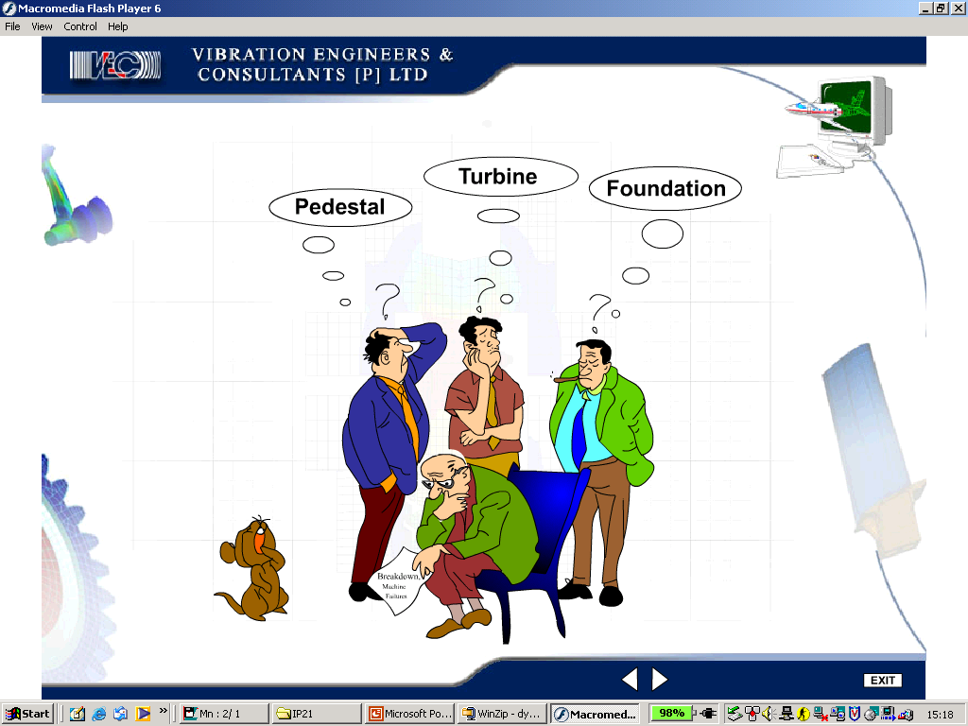
Why RCA ?????……..Prevailing most common
industrial situation
为何RCA？？？？？………广泛适用

Slide 3

WHY RCA ??…为何应用RCA？？…
To implement a process and culture for improving and sustaining the maintenance performances of our assets.
实施一种流程和文化，改善并维护我们的资产运营。
Am I responsible ??..我有责任吗？？
Every member of our production and manufacturing teams is responsible for reliability improvement.
对于提高可靠性，所有生产制造团队成员匹夫有责。

Slide 4

Why RCA … Contd.. ? RCA为何环环相扣？
TIMELY PROCUREMENT
购买及时
SKILL/TRAINING & MOTIVATION技巧/培训和激励
CULTURE文化
QUALITY OPERATION
质量操作
SYSTEMS系统
QUALITY SPARE PARTS品质部件
Important link in reliability chain可靠性链上的重要环节
RCA
PLANNED PREVENTIVE MAINTENANCE计划预防性维护
LUBRICATION
润滑剂
CBM
RELIABILITY
可靠性

Slide 5

TWO TYPE OF PROBLEMS两种问题
A PROBLEM RECOGNISED (DEFINED) IS A PROBLEM HALF SOLVED
发现问题是解决问题的一半
Rule-Based Problems规则性问题
Based on a convention or set of rules which dictate a single
right answer.基于某种惯例或规则，且答案唯一。
- If you run a red light, the rule says you can be fined根据规则，运行红灯将被罚款。
- Written procedures demand compliance.遵守已成文之规定。
Event-Based Problems突发性事件问题
Based on the law of cause and effect where there are many
possible solutions.基于因果关系法则，发现多种解决方案。
- Why did the pump fail?泵为何停止工作？
- How do I prevent accidents?怎样避免事故？

Slide 6
IN-EFFECTIVE PROBLEM SOLVING
无效解决方式
Ignore problem definition忽略问题定义
- solution Oriented偏重解决方案
- belief Problem is obvious认为问题显而易见
Fill out report forms填写汇报表
- Problem is solved when we :
Check the boxes ; Fill in the blanks ; categorize当我们做了标记，填完空格，分类之后，问题就解决了。
Tell stories叙述
  - Sequence of events事情进展
  - Focused on the actions注重行为
  - Categorical thinking绝对性思维

Slide 7
ROOT CAUSE ANALYSIS根本原因分析
EFFECTIVE PROBLEM SOLVING DEFINED
有效问题解决方式
Appreciative understanding有价值的理解
- Diversity of thought is valuable多样性思维最具价值
- Abandon right answer mind set改变一味追求正确答案的思维模式
Create a common reality
- Use cause & effect chart使用因果关系表
- Avoid categorical thinking避免绝对化思维
Solution based on known cause & effect relationship在已知因果关系的基础上寻找解决方案

Slide 8
PROBLEM SOLVING问题的解决
A SIMPLE, EFFECTIVE METHODOLOGY
一种简单有效的方法
A simple methodology一种简单方法
Used by anyone and everyone任何人均可使用
Applies to all event-based problems适用于所有突发性事件问题
Does not require forms or checklists无须表格或清单
Minimize story telling叙述问题言简意赅
Creates a common reality建立一般事实
Encourages a questioning attitude鼓励提问
Uncover creative solutions发现创新的解决方案

Slide 9
ROOT CAUSE ANALYSIS根本原因分析
EFFECTIVE PROBLEM SOLVING
有效问题解决方式
PROBLEM问题
CAUSE & EFFECT RELATIONSHIP因果关系
SOLUTIONS解决方案

Slide 10
ROOT CAUSE ANALYSIS (RCA)根本原因分析
THE FOUR STEP PROCESS四步走
Step 1. Define the Problem
第一步：明确问题
Step 2. Create a Cause & Effect Chart第二步：创建因果关系表
Step 3. Identify Effective Solutions
第三步：找到有效解决方案
Step 4. Implement the Best Solutions第四步：实施最佳方案

Slide 11
ROOT CAUSE ANALYSIS根本原因分析
FOUR CHARACTERISTICS OF THE CAUSE & EFFECT PRINCIPLE因果原则的四个特点
1st - Causes & Effects are the same thing因果同体
^{2nd} - Causes & Effects are part of an infinite continuum因果是无限连续统一体的一部分
^{3rd} - Each effect has at least two causes in the form of actions and conditions，一果至少两因，分别以行为和条件形式存在。
^{4th} - An effect exist only if its causes exist at the same point in time and space果只有在其多个因存在于时间和空间的同一点时才能产生。

Slide 12
ROOT CAUSE ANALYSIS根本原因分析
FIRST CHARACTERISTIC特点一
Causes & Effects Are The Same Thing因果同体
Injury受伤
Effect果
Fall摔倒
Cause Effect因果
Wet surface表面湿滑
Cause Effect因果
Leaky valve管道漏水
Cause Effect因果
No Maintenance维护不到位
Cause Effect因果
Seal Failure密封不好
Cause Effect因果
An Effect is the consequence of a cause果源于因
When we ask why of a cause it becomes an effect因又有因，则因亦为果
Perspective determines the starting point视角决定起点

Slide 13
ROOT CAUSE ANALYSIS根本原因分析
SECOND CHARACTERISTIC特点二
Causes & Effects Are An Infinite Continuum
因果同为一个无限连续统一体的一部分
No matter where we start asking why, we are always in middle of a chain of causes无论我们从何处开始产生疑问， 我们往往处于某个因的环节。
Causes are like pieces of jigsaw puzzle这些因就像智力拼图的碎片
- they connect in several ways它们都有多个连接处
- they are part of a bigger picture它们都是整体 的一部分
- the more connections the better the picture连接越多拼图越完整
- Individually they can be the beginning or the end单个碎片可能是头也可能是尾
Definition定义 :
The Primary Effect is the effect we want to prevent初级结果是指我们要避免的结果
The Phrase “Caused By” is the key to connecting the causes
”由。。。引起“这一说法是连接所有因的关键
The first effect we choose to start with is the Primary Effect 我们选择的第一个结果叫做初级结果

Slide 14
ROOT CAUSE ANALYSIS 根本原因分析
THIRD CHARACTERISTIC特点三
Each Effect has at least two Causes in the form of Actions and Conditions一果至少两因，分别以行为和条件形式存在
Action行为
Cause因
Everything that happens is the result of causes set in motion所有事件都是一系列因连续作用的结果
Effect果
Caused
By
Condition条件
Each time we ask why, look for Actions & Conditions to identify causes每次产生疑问时，从行为和条件两方面去发现原因
Cause因

Slide 15
ROOT CAUSE ANALYSIS根本原因分析
FOURTH CHARACTERISTIC特点四
Action行为
An Effect exist only
If its causes exist at
The same point in time
And space
Match Strike划火柴
Example : Actions & Conditions例：行为和条件
Fire Triangle火的原理三角图
Condition条件
Actions are momentary causes that bring conditions together to cause an effect行为属瞬间因，它综合所有条件最终产生结果
Ignition Source火源
Heat热
Fuel燃料
Open Fire明火
Caused
Condition条件
By
Combustible Material 可燃材料
Conditions are causes that exist over time条件是一直存在的因
Oxygen氧气
Condition条件
Oxygen氧气

Slide 16
ROOT CAUSE ANALYSIS根本原因分析
OVERCOMING THE LIMITATIONS克服局限
Lack of Knowledge !缺乏知识
When you don’t know, admit it不知为不知
Go outside the group for specific knowledge专业知识寻求外援
Use a “?” it identify what you don’t know不懂得地方标记“？”
Lack of interest !!缺乏兴趣
Identify all obvious causes, then work on the ones you can
control找到所有显性的因，并处理可控 之因
If these do not provide effective solutions, look deeper into the
other causes如仍无法找到有效解决方案，深入挖掘其他因
Lack of time !!时间紧迫
Establish priorities明确重点
Clearly define the problem before you solve it解决问题之前明确问题所在

Slide 17
Continued..续…
ROOT CAUSE ANALYSIS根本原因分析
OVERCOMING THE LIMITATIONS克服局限
Favorite Solution Mindset !!最中意之解决方案！！
Establish a common reality with a C&E Chart.利用因果关系表建立一般事实
Look for actions and conditions at every “WHY?”针对每一个“为什么”，寻找行为和条件
Challenge everything质疑每一个环节
Go outside yourself and your group for answers寻求外援
Limitations of the Mind !!思维局限
Use a Cause and Effect chart.利用因果关系表

Slide 18
ROOT CAUSE ANALYSIS根本原因分析
A PROBLEM RECOGNISED (DEFINED) IS A PROBLEM HALF SOLVED
发现问题是解决问题的一半
PROBLEM DEFINITION定义问题

Slide 19
ROOT CAUSE ANALYSIS根本原因分析
DEFINING THE PROBLEM定义问题
People can look at the same event and see “the Problem” differently.对同一个问题的看法因人而异

Slide 20
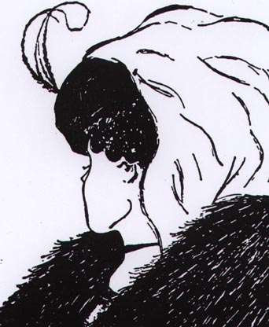

Slide 21
ROOT CAUSE ANALYSIS根本原因分析
DEFINING THE PROBLEM
Write Down the following列出以下各项
WHAT – What is the problem?什么——问题是什么？
WHEN – When did it happen?何时——何时发生的？
WHERE – Where did it happen?何地——发生在何地？
SIGNIFICANCE – What is the significance?影响——有何影响？
The problem definition does not contain定义问题不包括
WHO – The focus in on Prevention not Blame谁——重要的是解决问题，不是摊派责任
WHY – Detracts from defining the problem为什么——分散注意力
- Example, “who knows why widgets breaks?例如：”谁知道这个东西为什么坏了？“

Slide 22
THE RCA PROCESS RCA流程
FIX THE CAUSES, NOT THE BLAME
消除因，避免无谓谴责
1. Define the Problem定义问题
Write down the following :列出以下各项：
What – The Primary Effect – The thing you want to prevent from occurring什么——初级结果——需要避免发生的事情
When- Date? Time? Status?何时——日期？时间？情形？
Where- Physical location? Process Location?何地——地点？进展到哪个步骤？
Significance影响
Safety :安全： Injuries? Potential?受伤？ 潜在影响？
Environment :环境： Regulations? Spills? Potential?规章？潜在问题？
Production :生产： MT? Rates? Delay? Hours? Quality? Peso?MT ?误工？质量？
Service:服务： Delay? Customer Satisfaction?延误？客户满意度？
Maintenance :维护： Materials? Labor? Hours? Peso?材料？劳动力？任务单？
Frequency :频率： Occurrence? Timeframe?发生频率？时限？

Slide 23
CAUSE and EFFECT ANALYSIS因果分析

Slide 24
ROOT CAUSE ANALYSIS根本原因分析
CAUSE and EFFECT CHART因果关系表
The Cause & Effect Charting Concept因果关系表概念
1 This is to where we
begin to ask why?疑问产生之始
Condition条件
3 Look for causes in
Actions & Conditions
在行为和条件中寻找因
Cause因
Primary
Effect初级结果
Evidence依据
Caused
By
Action行为
Cause因
2 Think “Caused by”
思考“由…引起”
4 Support causes with
Evidence or
Use a “?”寻找因的依据或标记“？”
Evidence依据

Slide 25
ROOT CAUSE ANALYSIS根本原因分析
LOOK FOR CAUSES IN ACTIONS AND CONDITIONS在行为和条件中寻找因
Actions and Conditions are both Causes行为和条件同为因
Each time you ask “Why?” look for Actions and Conditions寻找每一个疑问背后的行为和条件
An Action combines with Conditions to create an Effect行为与条件结合产生果
Typically there is one Action, and several Conditions一般来说，存在一个行为，多个条件

Slide 26
ROOT CAUSE ANALYSIS根本原因分析
LOOK FOR CAUSES IN ACTIONS AND CONDITIONS
在行为和条件中寻找因
We tend to see Actions and ignore Conditions我们往往只见行为，不见条件
The best solutions are often attached to Conditions最佳解决方案常常与条件密不可分
Actions usually involve people行为通常与人有关
Placing blame focuses on people’s Actions谴责的焦点常常是人的行为
  - Don’t fall into this trap, it rarely prevents recurrence请勿陷入此误区，因为这样无法解决问题
Conditions are usually easier to control than Actions条件通常比行为更加容易控制
Actions can become Conditions and Conditions can become Actions.行为和条件可相互转化

Slide 27
ROOT CAUSE ANALYSIS根本原因分析
WHAT IS EVIDENCE ??什么是依据？？
Evidence : Data that supports a conclusion依据：推导出结论的数据
Evidence should be added to all cause blocks.
所有因都应该具备依据

Slide 28
ROOT CAUSE ANALYSIS根本原因分析
Machine Running机器运行
Primary Effect初级结果
Connecting rod breakage连接杆折断
Log sheet日志表
Axial Load connect rod轴向载荷连接杆
connecting rod motion not synchronized连接杆移动不同步
stop
Excess force 承力过大
Observation: Axial load观察：轴向载荷
Measurement测量
Channel weak线路弱
Movable frame Misalignment可移动框架连接错误
System design ??系统设计？？
Observation: Log sheet 观察：日志表
Cross head shaft channel mis-aligned线路错误
Channel failed线路故障
Alignment reading
Alignment reading
Inspection检查
Cyclic load high循环荷载过高
System design系统设计

Slide 29
ROOT CAUSE ANALYSIS根本原因分析
“Not the root causes we seek for effective solutions”
”不是针对有效方案所寻找的根本原因“

Slide 30
SOLUTIONS CRITERIA解决方案的标准
Prevent recurrence防止问题再次发生
Within your control尽在掌控
Meets goals and objectives达到目标

Slide 31
ROOT CAUSE ANALYSIS根本原因分析
THE SOLUTIONS PROCESS解决流程
HOW TO FIND EFFECTIVE SOLUTIONS
怎样找到有效解决方案
Cause/ Effect因/果
Cause/ Effect因/果
Caused
Caused
By
By
Solution 1方案1
Solution 2方案2
Solution 3方案3
Cause/ Effect因/果
PRIMARY EFFECT
初级结果
Caused
Solution 1方案1
Solution 2方案2
By
Cause/ Effect因/果
Solution 1方案1
Solution 2方案2
Solution 3方案3
Cause/ Effect因/果
Caused
Caused
By
By
Solution 1方案1
Solution 2方案2
Solution 3方案3
Solution 4方案4
Solution 1方案1
Solution 2方案2

Slide 32
ROOT CAUSE ANALYSIS根本原因分析
THE SOLUTION PROCESS解决流程
1. Challenge each and every cause质疑每一个因
- Start on the right side从正确的一面着手
Ask what can be done to change, control or prevent this one
cause from acting想一想怎样改变，控制或防止这个因
2. Offer possible solutions for each cause针对每一个因，找到可能的解决方案
Focus on one cause at a time. Don’t worry about solving the
entire problem.一次处理一个因，不要顾虑整个问题。
- Be creative. Don’t judge it as “right” or “wrong” at this stage.运用创造力。请勿盲目判断正确或错误
- Solutions control specific causes.解决方案控制具体的因。
3. Evaluate possible solutions using criteria guidelines.运用标准原则评估每一个可能的解决方案

Slide 33
Nine Dots九点阵
Without lifting your pen or pencil or retracing any lines connect all nine dots with four straight lines. You may cross lines.请用四条线将下列九个点连接起来，勿断笔或回笔，连线可以交叉。

Slide 34
Nine Dots九点阵
Without lifting your pen or pencil or retracing any lines connect all nine dots with four straight lines. You may cross lines.请用四条线将下列九个点连接起来，勿断笔或回笔，连线可以交叉。
1 Line第一笔

Slide 35
Nine Dots九点阵
Without lifting your pen or pencil or retracing any lines connect all nine dots with four straight lines. You may cross lines.请用四条线将下列九个点连接起来，勿断笔或回笔，连线可以交叉。
2 Lines第二笔

Slide 36
Nine Dots九点阵
Without lifting your pen or pencil or retracing any lines connect all nine dots with four straight lines. You may cross lines.请用四条线将下列九个点连接起来，勿断笔或回笔，连线可以交叉。
2 Lines

Slide 37
Nine Dots九点阵
Without lifting your pen or pencil or retracing any lines connect all nine dots with four straight lines. You may cross lines.请用四条线将下列九个点连接起来，勿断笔或回笔，连线可以交叉。
3 Lines第三笔

Slide 38
Nine Dots九点阵
Without lifting your pen or pencil or retracing any lines connect all nine dots with four straight lines. You may cross lines.请用四条线将下列九个点连接起来，勿断笔或回笔，连线可以交叉。
The Lesson:教训：
Think Outside the Box.跳出图外思考。
It’s counterintuitive, but there may be solutions there.虽然违反直觉，但找到解决方案并不是不可能的。
4 Lines第四笔

Slide 39
Beware !! RCA SOLUTION KILLERS
注意：RCA解决方案的拦路虎
It will never work here.在这儿绝对行不通。
We’re too busy to do that.我们忙得不可开交，没时间。
No one will buy it!没有人会买这玩意儿。
We already tried that once.我们已经尝试过了。
That’s not our policy here.这不符合我们的制度。
It isn’t in the budget.预算里没有这一项。
Good thought, but impractical想法很好，但不实际。
Top Management will never go for it.高层管理者不会理睬这个的。
No one else is doing it that way.没有人这样做。
Wrong!这是错的。
We’ve always done it that way我们一直是那样做的。
Good idea, I’ll get back to you.好想法，以后再说吧。
Etc., etc.,etc.等等。

Slide 40
ROOT CAUSE ANALYSIS根本原因分析
Insanity
“Doing the same thing over & over again and expecting a different result””永远重复同一件事，却幻想不同的结果“
“If you do what you have always done you will get what you always got””机械重复只能带来相同的结果“

Slide 41
“Keep questioning : It has created miracle !! and brought human civilization from stone age to where we are”
”不断提出质疑：奇迹就是这样产生的，而人类文明也是这样由石器时代发展至今的“
Thank You
谢谢

