Slide 1
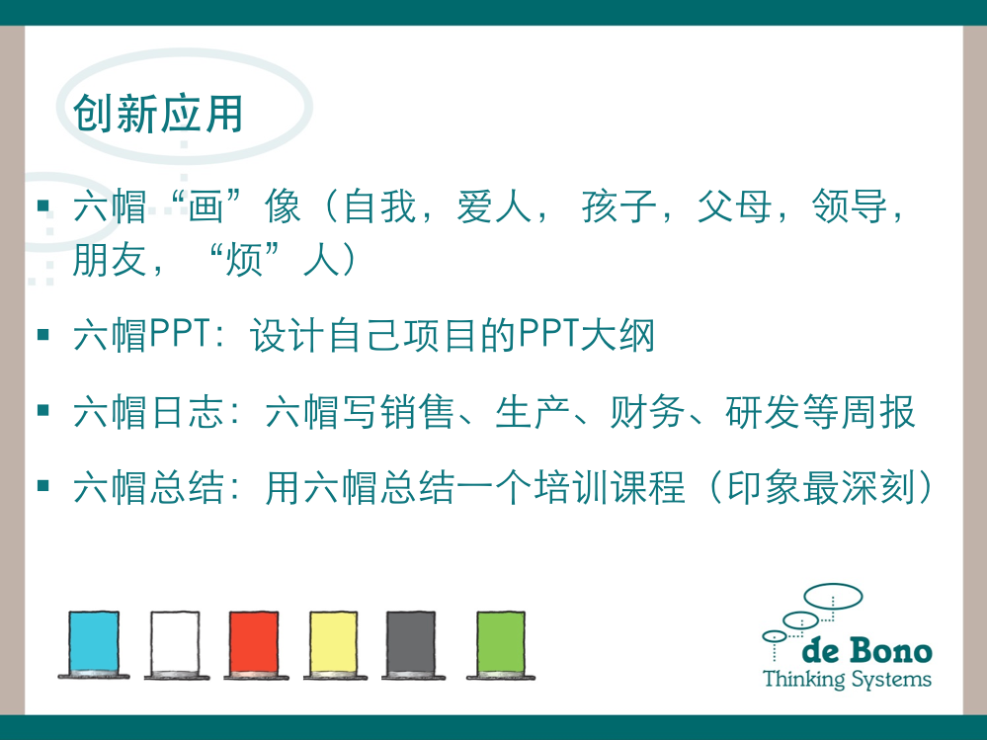
焦点： 汇报人： 时间：
Six Thinking Hats应用模版

Slide 2
焦点： 汇报人： 时间：
Six Thinking Hats应用模版

Slide 3







焦点：
3’
时间
6‘
3’
3’
10’
30“
4’

Slide 4


焦点：（创新思维备忘单）
题目：（澄清题目）

Slide 5

焦点：
已知 | 所需／未知
O.P.V. | 渠道

Slide 6

焦点：
核心价值
利益
可行性
价值主张

Slide 7

焦点：
问题
困难
潜在风险
需要警惕的提醒

Slide 8

焦点：
创新工具：
随机输入／概念提取
多样性
创新性

Slide 9

焦点
感觉
直觉判断
筛选优先选项：M.V.P./最小可行化产品

Slide 10
焦点：
Who does what when

Slide 11








Blue hat P. 16
Managing the Thinking
“Control” hat
Organizes the thinking
Sets the focus and agenda
Summarizes and concludes
Ensures that the rules are observed

Slide 12






White Hat P. 19
Information
Information we know
Information we need
How are we going to get that information?
WH
Determines accuracy and relevance
Looks at Other People’s View (O.P.V.)

Slide 13






Red Hat P. 21
Feelings, Intuition, Gut Instinct
Permission to express feelings
No need to justify
Represents feelings right now
RH
Keep it short
A key ingredient in decision making

Slide 14






Yellow Hat P. 24
Benefits and Feasibility
The optimistic view
Reasons must be given
Needs more effort than the black hat
YH
Finds the benefits and values
Considers both short-and long-term perspectives

Slide 15
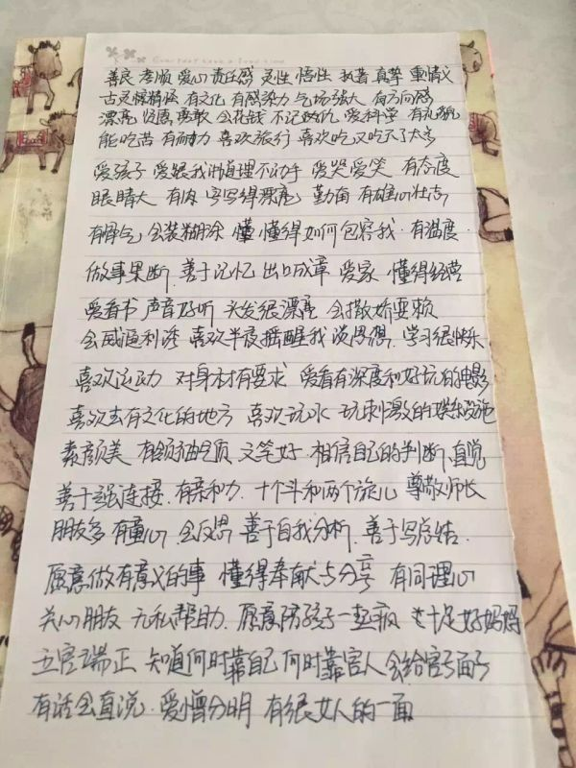
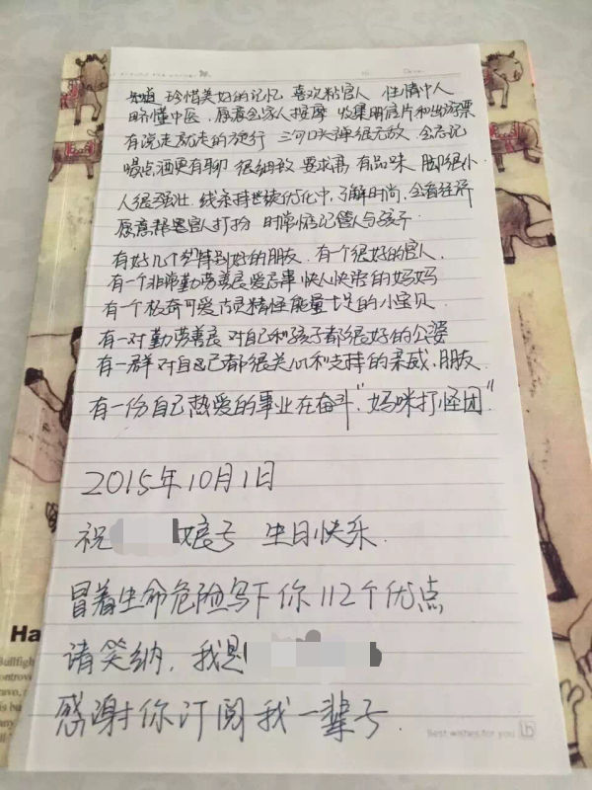

Slide 16






Black Hat P. 26
Risks, Difficulties and Problems
The skeptical view
Reasons must be given
Points out thinking that does not fit the facts, experience, regula-tions, strategy, values
BH
Points out potential problems

Slide 17


Green hat P. 28
Green Hat
growth
creativity
alternatives
ideas

Slide 18





Hats Sequences 帽子序列
Strategic Planning

Slide 19

Sequencing the Hats
Performance Review

Slide 20

Hats Sequences
OPV
P41

Slide 21

Hats Sequences

Slide 22

Hats Sequences
Idea Generation

