Slide 1
Introduction to Boosted Trees
Tianqi Chen Oct. 22 2014

Slide 2
Outline
Review of key concepts of supervised learning
Regression Tree and Ensemble (What are we Learning)
Gradient Boosting (How do we Learn)
Summary

Slide 3






Elements in Supervised Learning
Notations: i-th training example
Model: how to make prediction given
Linear model:
The prediction score depending on the task
Linear regression:
Logistic regression:
(include linear/logistic regression) can have different interpretations
is the predicted score
is predicted the probability
of the instance being positive
Others… for example in ranking can be the rank score
Parameters: the things we need to learn from data
Linear model:

Slide 4




Elements continued: Objective Function
Objective function that is everywhere
Training Loss measures how well model fit on training data
Regularization, measures complexity of model
Loss on training data:
Square loss:
Logistic loss:
Regularization: how complicated the model is?
L2 norm:
L1 norm (lasso):

Slide 5
Putting known knowledge into context
Ridge regression:
Linear model, square loss, L2 regularization
Lasso:
Linear model, square loss, L1 regularization
Logistic regression:
Linear model, logistic loss, L2 regularization
The conceptual separation between model, parameter, objective also gives you engineering benefits.
Think of how you can implement SGD for both ridge regression and logistic regression

Slide 6
Objective and Bias Variance Trade-off
Training Loss measures how well model fit on training data
Regularization, measures complexity of model
Why do we want to contain two component in the objective?
Optimizing training loss encourages predictive models
Fitting well in training data at least get you close to training data which is hopefully close to the underlying distribution
Optimizing regularization encourages simple models
Simpler models tends to have smaller variance in future predictions, making prediction stable

Slide 7
Outline
Review of key concepts of supervised learning
Regression Tree and Ensemble (What are we Learning)
Gradient Boosting (How do we Learn)
Summary

Slide 8





Regression Tree (CART)
regression tree (also known as classification and regression tree):
Decision rules same as in decision tree
Contains one score in each leaf value
Input: age, gender, occupation, …
Does the person like computer games
age < 15
Y
N
is male?
Y
N
prediction score in each leaf
+2
+0.1
-1

Slide 9

Regression Tree Ensemble
tree1
tree2
Use Computer Daily
age < 15
Y
N
Y
N
is male?
Y
N
+2
+0.1
-1
+0.9
-0.9
f( ) = 2 + 0.9= 2.9 f( )= -1 - 0.9= -1.9
Prediction of is sum of scores predicted by each of the tree

Slide 10
Tree Ensemble methods
Very widely used, look for GBM, random forest…
Almost half of data mining competition are won by using some variants of tree ensemble methods
Invariant to scaling of inputs, so you do not need to do careful features normalization.
Learn higher order interaction between features.
Can be scalable, and are used in Industry

Slide 11
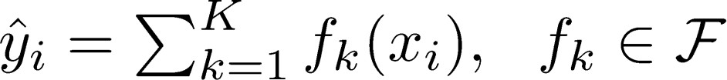


Put into context: Model and Parameters
Model: assuming we have K trees
Space of functions containing all Regression trees
Think: regression tree is a function that maps the attributes to the score
Parameters
Including structure of each tree, and the score in the leaf
Or simply use function as parameters
Instead learning weights in
, we are learning functions(trees)

Slide 12
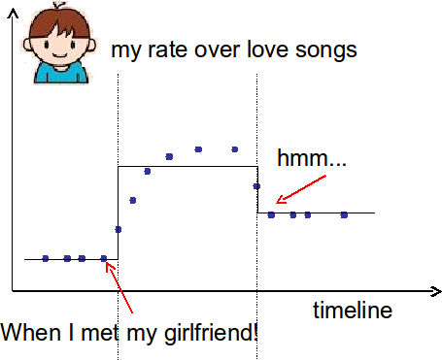
Learning a tree on single variable
How can we learn functions?
Define objective (loss, regularization), and optimize it!!
Example:
Consider regression tree on single input t (time)
I want to predict whether I like romantic music at time t
The model is regression tree that splits on time
Piecewise step function over time
t < 2011/03/01
Y
N
Equivalently
t < 2010/03/20 Y
1.0
N
1.2
0.2

Slide 13
Learning a step function
Things we need to learn
Splitting Positions
The Height in each segment
Objective for single variable regression tree(step functions)
Training Loss: How will the function fit on the points?
Regularization: How do we define complexity of the function?
Number of splitting points, l2 norm of the height in each segment?

Slide 14
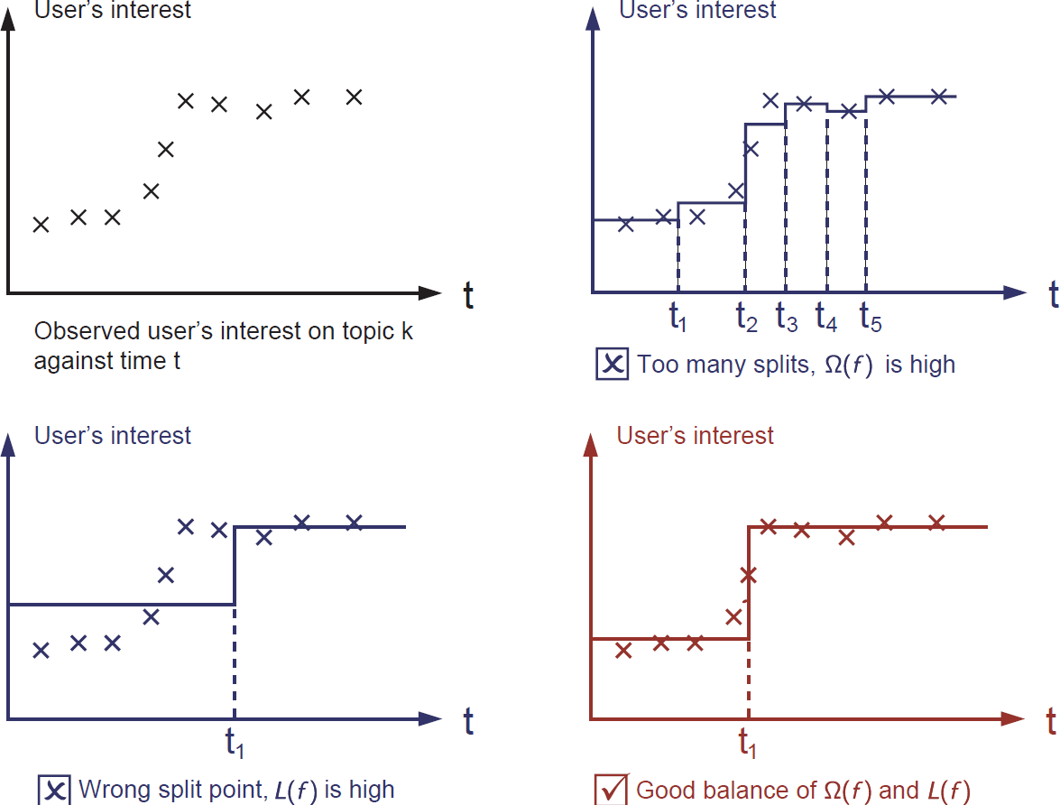
Learning step function (visually)

Slide 15

Coming back: Objective for Tree Ensemble
Model: assuming we have K trees
Objective
Training loss
Complexity of the Trees
Possible ways to define ?
Number of nodes in the tree, depth
L2 norm of the leaf weights
… detailed later

Slide 16
Objective vs Heuristic
When you talk about (decision) trees, it is usually heuristics
Split by information gain
Prune the tree
Maximum depth
Smooth the leaf values
Most heuristics maps well to objectives, taking the formal (objective) view let us know what we are learning
Information gain -> training loss
Pruning -> regularization defined by #nodes
Max depth -> constraint on the function space
Smoothing leaf values -> L2 regularization on leaf weights

Slide 17
Regression Tree is not just for regression!
Regression tree ensemble defines how you make the prediction score, it can be used for
Classification, Regression, Ranking….
….
It all depends on how you define the objective function!
So far we have learned:
Using Square loss
Will results in common gradient boosted machine
Using Logistic loss
Will results in LogitBoost

Slide 18
Outline
Review of key concepts of supervised learning
Regression Tree and Ensemble (What are we Learning)
Gradient Boosting (How do we Learn)
Summary

Slide 19
Take Home Message for this section
Bias-variance tradeoff is everywhere
The loss + regularization objective pattern applies for regression tree learning (function learning)
We want predictive and simple functions
This defines what we want to learn (objective, model).
But how do we learn it?
Next section

Slide 20
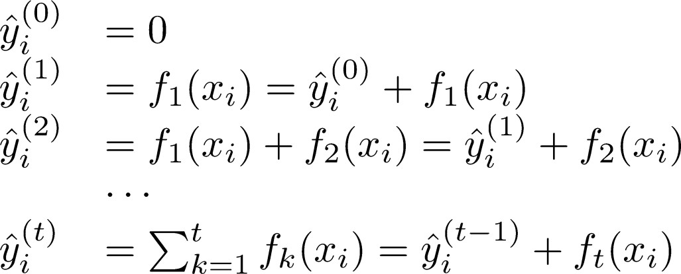
So How do we Learn?
Objective:
We can not use methods such as SGD, to find f (since they are trees, instead of just numerical vectors)
Solution: Additive Training (Boosting)
Start from constant prediction, add a new function each time
New function
Model at training round t
Keep functions added in previous round

Slide 21

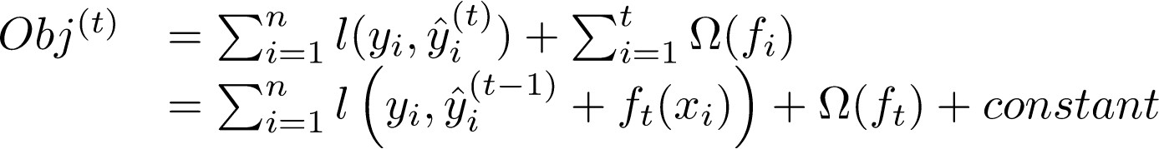

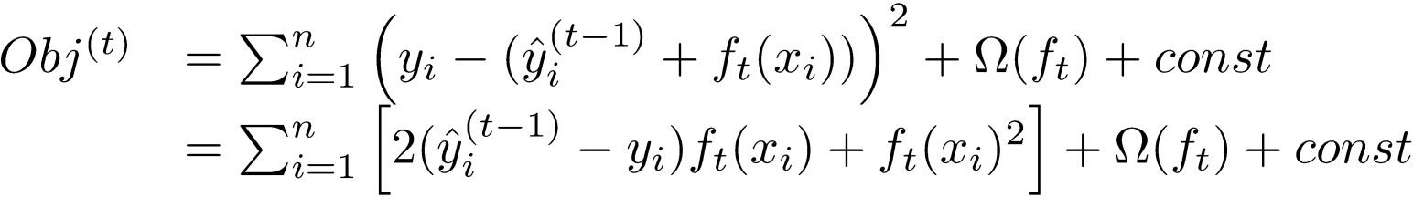
Additive Training
How do we decide which f to add?
Optimize the objective!!
The prediction at round t is
This is what we need to decide in round t
Goal: find
to minimize this
Consider square loss
This is usually called residual from previous round

Slide 22

Taylor Expansion Approximation of Loss
Goal
Seems still complicated except for the case of square loss
Take Taylor expansion of the objective
Recall
Define
If you are not comfortable with this, think of square loss
Compare what we get to previous slide

Slide 23


Our New Goal
Objective, with constants removed
where
Why spending s much efforts to derive the objective, why not just grow trees …
Theoretical benefit: know what we are learning, convergence
Engineering benefit, recall the elements of supervised learning
and comes from definition of loss function
The learning of function only depend on the objective via and
Think of how you can separate modules of your code when you are asked to implement boosted tree for both square loss and logistic loss

Slide 24
Refine the definition of tree
We define tree by a vector of scores in leafs, and a leaf index mapping function that maps an instance to a leaf
The structure of the tree
age < 15
Y
N
The leaf weight of the tree
is male?
Y
N
q(
) = 1
Leaf 3
q(
) = 3
Leaf 1
Leaf 2
w1=+2
w2=0.1
w3=-1

Slide 25
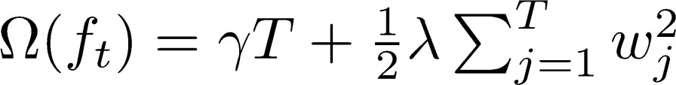

Define Complexity of a Tree (cont’)
Define complexity as (this is not the only possible definition)
Number of leaves
L2 norm of leaf scores
age < 15
Y
N
is male?
Y
N
Leaf 1
Leaf 2
Leaf 3
w1=+2
w2=0.1
w3=-1

Slide 26

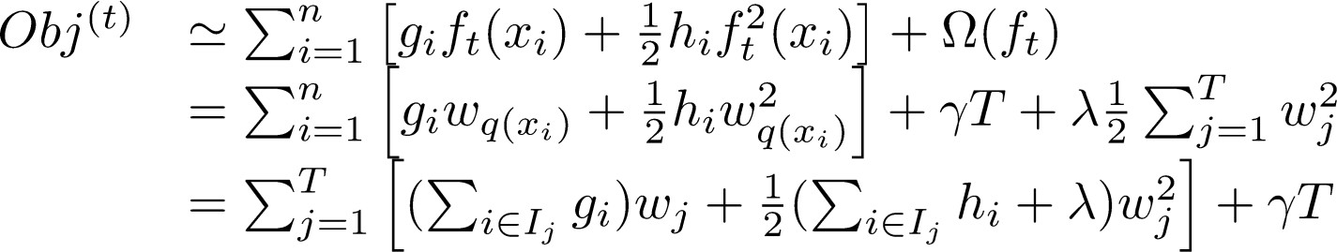
Revisit the Objectives
Define the instance set in leaf j as
Regroup the objective by each leaf
This is sum of T independent quadratic functions

Slide 27



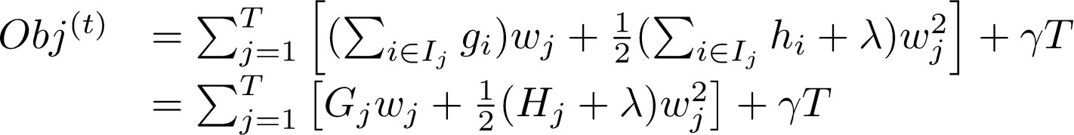
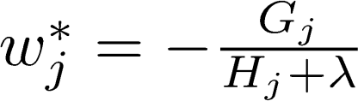
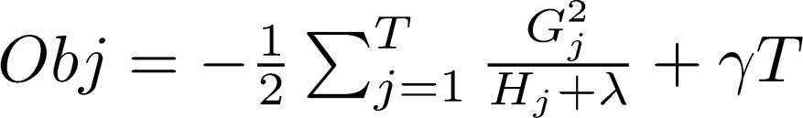
The Structure Score
Two facts about single variable quadratic function
Let us define
Assume the structure of tree ( q(x) ) is fixed, the optimal weight in each leaf, and the resulting objective value are
This measures how good a tree structure is!

Slide 28










The Structure Score Calculation
Instance index
gradient statistics
age < 15
1
g1, h1
Y
N
is male?
2
g2, h2
Y
N
3
g3, h3
4
g4, h4
5
g5, h5
The smaller the score is, the better the structure is

Slide 29
Searching Algorithm for Single Tree
Enumerate the possible tree structures q
Calculate the structure score for the q, using the scoring eq.
Find the best tree structure, and use the optimal leaf weight
But… there can be infinite possible tree structures..

Slide 30
Greedy Learning of the Tree
In practice, we grow the tree greedily
Start from tree with depth 0
For each leaf node of the tree, try to add a split. The change of
objective after adding the split is
The complexity cost by introducing additional leaf
the score of left child the score of if we do not split the score of right child
Remaining question: how do we find the best split?

Slide 31




Efficient Finding of the Best Split
What is the gain of a split rule ? Say is age
a
g1, h1
g4, h4
g2, h2
g5, h5
g3, h3
All we need is sum of g and h in each side, and calculate
Left to right linear scan over sorted instance is enough to decide the best split along the feature

Slide 32
An Algorithm for Split Finding
For each node, enumerate over all features
For each feature, sorted the instances by feature value
Use a linear scan to decide the best split along that feature
Take the best split solution along all the features
Time Complexity growing a tree of depth K
It is O(n d K log n): or each level, need O(n log n) time to sort There are d features, and we need to do it for K level
This can be further optimized (e.g. use approximation or caching the sorted features)
Can scale to very large dataset

Slide 33
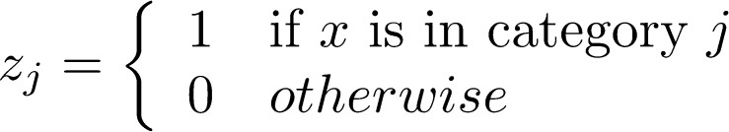
What about Categorical Variables?
Some tree learning algorithm handles categorical variable and continuous variable separately
We can easily use the scoring formula we derived to score split based on categorical variables.
Actually it is not necessary to handle categorical separately.
We can encode the categorical variables into numerical vector using one-hot encoding. Allocate a #categorical length vector
The vector will be sparse if there are lots of categories, the learning algorithm is preferred to handle sparse data

Slide 34
Pruning and Regularization
Recall the gain of split, it can be negative!
When the training loss reduction is smaller than regularization
Trade-off between simplicity and predictivness
Pre-stopping
Stop split if the best split have negative gain
But maybe a split can benefit future splits..
Post-Prunning
Grow a tree to maximum depth, recursively prune all the leaf splits with negative gain

Slide 35



Recap: Boosted Tree Algorithm
Add a new tree in each iteration
Beginning of each iteration, calculate
Use the statistics to greedily grow a tree
Add to the model
Usually, instead we do
is called step-size or shrinkage, usually set around 0.1
This means we do not do full optimization in each step and reserve chance for future rounds, it helps prevent overfitting

Slide 36
Outline
Review of key concepts of supervised learning
Regression Tree and Ensemble (What are we Learning)
Gradient Boosting (How do we Learn)
Summary

Slide 37
Questions to check if you really get it
How can we build a boosted tree classifier to do weighted regression problem, such that each instance have a importance weight?
Back to the time series problem, if I want to learn step functions over time. Is there other ways to learn the time splits, other than the top down split approach?

Slide 38




Questions to check if you really get it
How can we build a boosted tree classifier to do weighted regression problem, such that each instance have a importance weight?
Define objective, calculate , feed it to the old tree learning algorithm we have for un-weighted version
Again think of separation of model and objective, how does the theory can help better organizing the machine learning toolkit

Slide 39
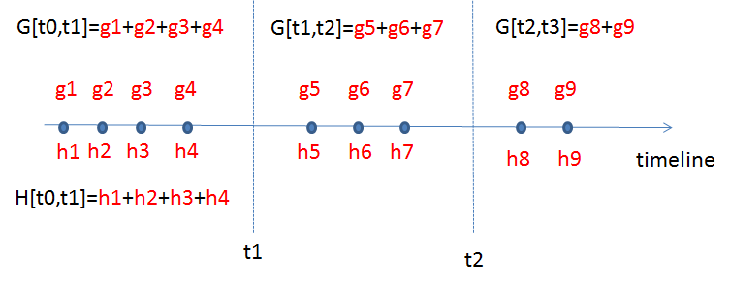
Questions to check if you really get it
Time series problem
All that is important is the structure score of the splits
Top-down greedy, same as trees
Bottom-up greedy, start from individual points as each group, greedily merge neighbors
Dynamic programming, can find optimal solution for this case

Slide 40
Summary
The separation between model, objective, parameters can be helpful for us to understand and customize learning models
The bias-variance trade-off applies everywhere, including learning in functional space
We can be formal about what we learn and how we learn. Clear understanding of theory can be used to guide cleaner implementation.

Slide 41
Reference
Greedy function approximation a gradient boosting machine. J.H. Friedman
First paper about gradient boosting
Stochastic Gradient Boosting. J.H. Friedman
Introducing bagging trick to gradient boosting
Elements of Statistical Learning. T. Hastie, R. Tibshirani and J.H. Friedman
Contains a chapter about gradient boosted boosting
Additive logistic regression a statistical view of boosting. J.H. Friedman T. Hastie R. Tibshirani
Uses second-order statistics for tree splitting, which is closer to the view presented in this slide
Learning Nonlinear Functions Using Regularized Greedy Forest. R. Johnson and T. Zhang
Proposes to do fully corrective step, as well as regularizing the tree complexity. The regularizing trick is closed related to the view present in this slide
Software implementing the model described in this slide: https://github.com/tqchen/xgboost

