Slide 1



Beam test characterization of CMS Pixel detectors for the Phase I upgrade
Armin Burgmeier, Somnath Choudhury, Ganna Dolinska,
Malte Hoffmann, Ievgen Korol, Hanno Perrey, Daniel Pitzl,
Valentina Sola, Simon Spannagel
DESY and Uni HH
RESMDD, 10.10.2014
on behalf of the CMS collaboration
CMS Pixel upgrade
irradiation
beam test
results

Slide 2
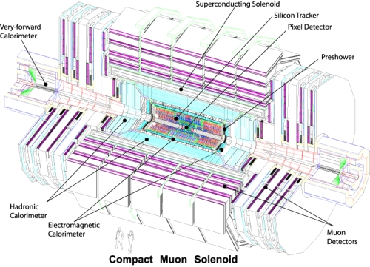
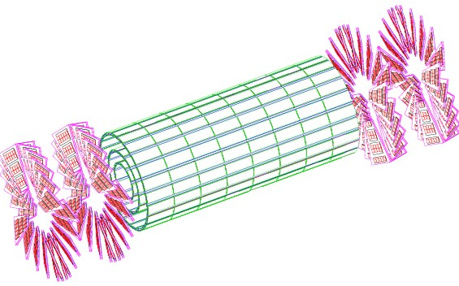
CMS and its pixel detector
The present CMS pixel detector was designed for
  L = 10³⁴/cm²/s
  25 ns bunch spacing
It operated very successfully in Run I
For higher luminosity it needs an upgrade:
  extended data buffering to maintain efficiency
The technology is the same:
  250 nm CMOS
  n-in-n sensors
Explore radiation effects
The present CMS detector
The CMS Pixel Detector
53 cm
93 cm

Slide 3
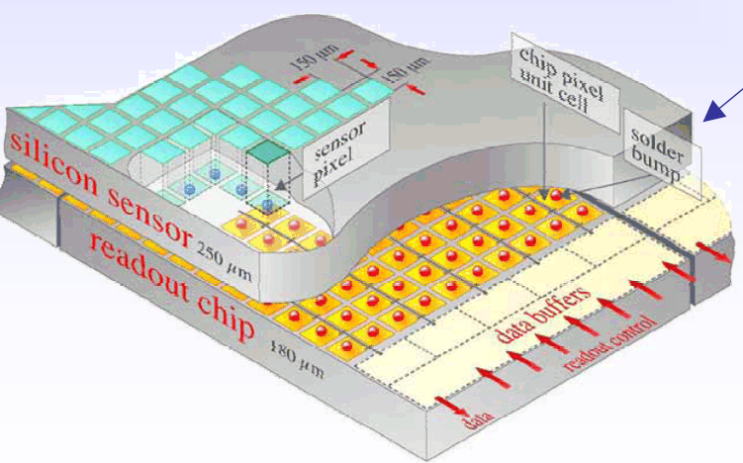
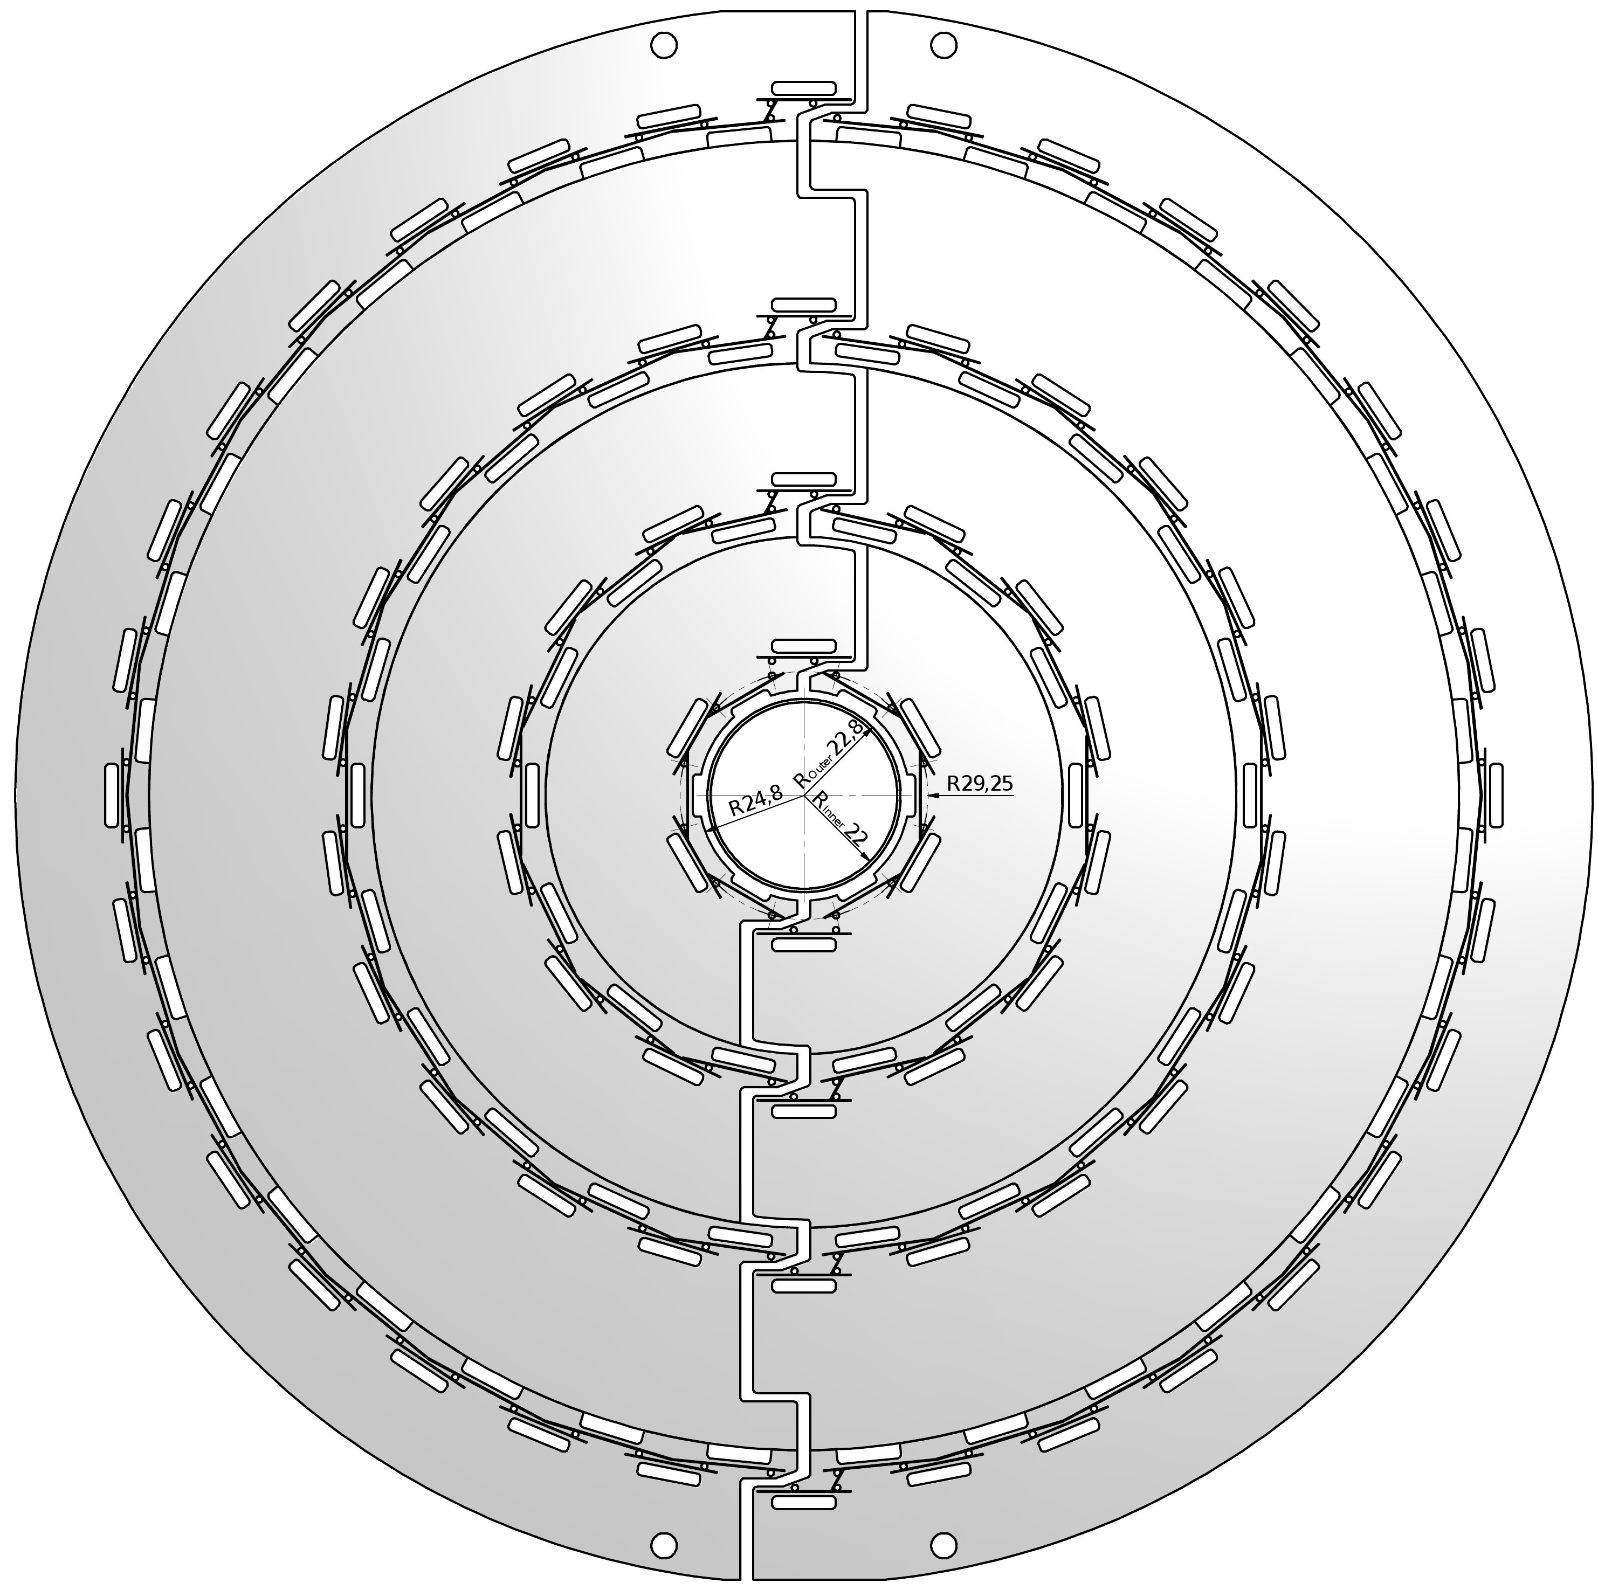
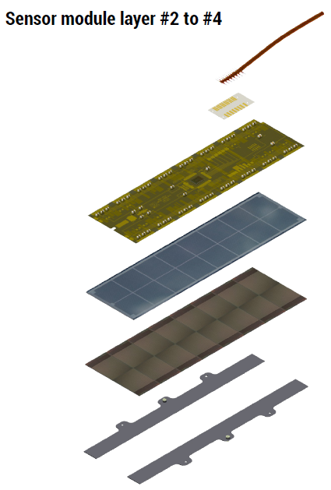
Barrel pixel upgrade
Hybrid pixel
detector with
bump bonding
micro twisted pair cable
Flex print
Si sensor
sensor
16 CMOS
readout chips
4 layers (now 3)
inner layer at 30 mm (now 44)
less material in tracking volume
new readout chip for 2·10³⁴/cm²/s
readout
Si3N4 base strips
Notes:
In frames of CMS update , pixel detector will be modified.
The fourth barrel layer will be added using less material
in tracking volume.
Also new digital readout chips are developed for the upgrade.
It is planned to produce 350 pixel modules at DESY with Uni
Hamburg. It is also planned to do own bump bonding onside.

Slide 4
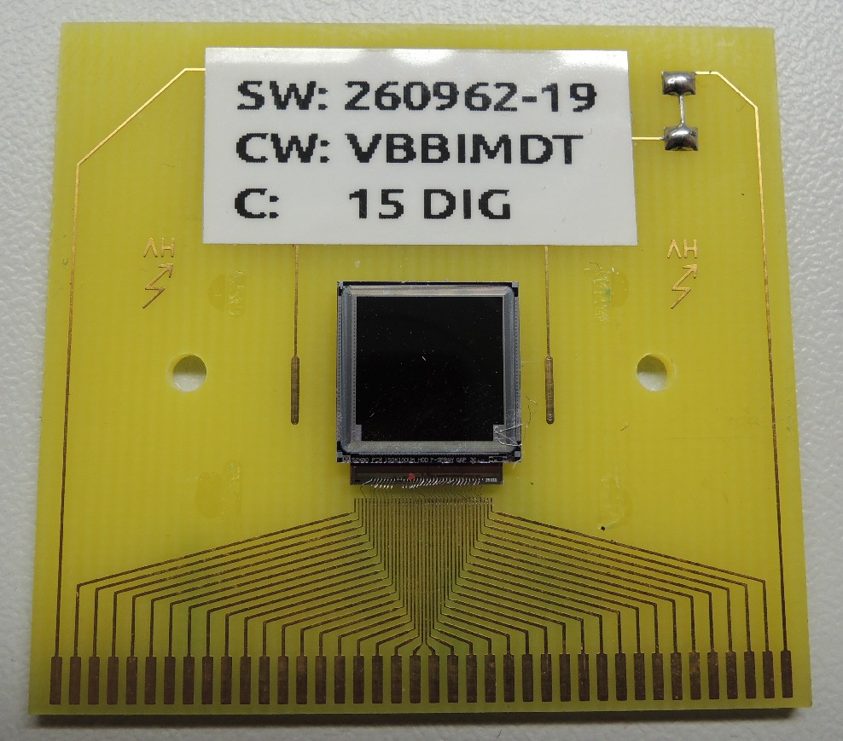
CMS pixel single chip module
Two sensors irradiated at CERN PS
1/16 of the module
  Si: 10×10 mm², 4160 pixels
  Glued and wire bonded to carrier printed circuit board
3.8 10¹⁴ p/cm² and 0.9 10¹⁴ p/cm²
Layer 1: 3.6 10¹⁵/cm²
Layer 2: 1.8 10¹⁵/cm²
Layer 3: 0.6 10¹⁵/cm²
Layer 4: 0.39 10¹⁵/cm²
expected for 500 fb⁻¹

Slide 5
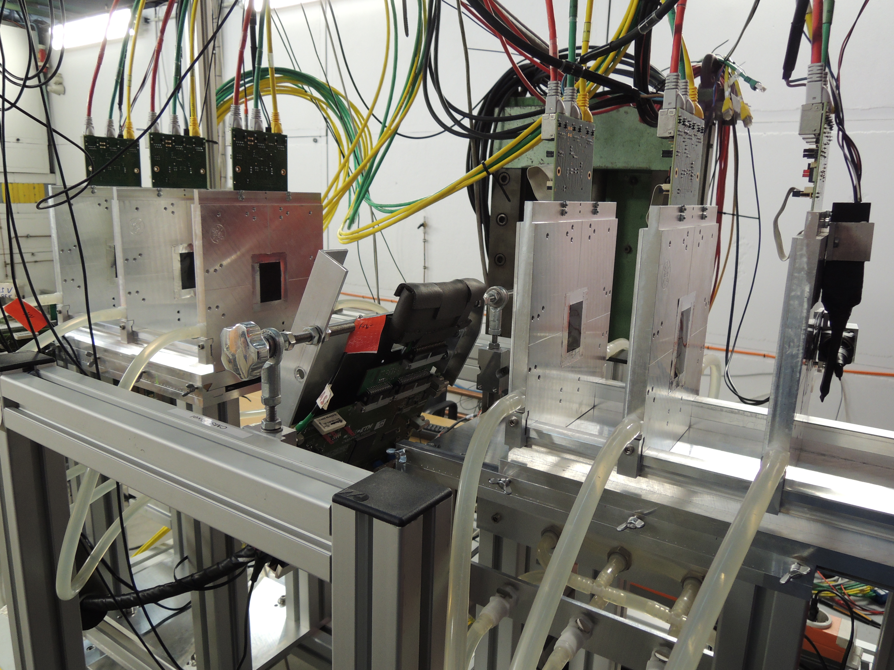
DESY telescope and test device
2 trigger
scintilators
2 trigger
scintilators
CMS Pixel
tilted 0-30º
3 planes
downstream
1-6 GeV
positrons
1 kHz/cm²
Ethanol chiller
-15ºC
3 planes
Mimosa MAPS
3.3 µm resolution

Slide 6
efficiency definition
5.5
GeV
150 mm
150 mm
~80
mm
30
mm
90
mm
90
mm
REF
scint
trig
downstream arm
DUT
upstream
arm
scint
trig
DUT hit linked to isolated telescope track with link to REF hit
eff =
isolated telescope track with link to REF hit
telescope track: tight matching cut 0.1 mm in x and y
isolation: no other telescope track within 0.3 mm at REF
REF link: tight cut 0.15 mm in x and y
DUT link: loose cut 0.5 mm in x and y

Slide 7
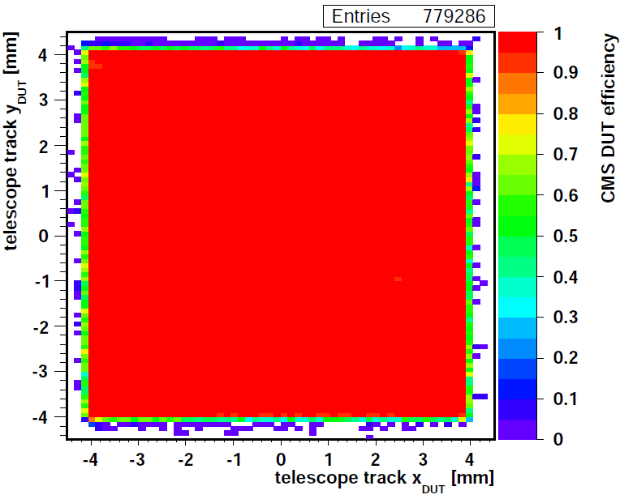
efficiency map
eff = (DUT linked clusters) / (telescope tracks with REF cluster)
3.8·10¹⁴ p/cm²
tilted, cooled
bias -200 V
threshold 1.8 ke
99.8% efficiency

Slide 8
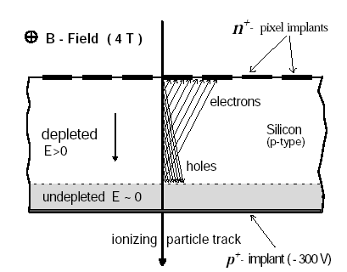
partially depleted irradiated sensor
Vbias > Vdepletion
full depletion:
used for alignment
Vbias = 0.25 Vdepletion
n⁺ pixel design
irradiated:
type inversion,
depletion starts
from pixel side
partial depletion:
less charge,
cluster more narrow
and shifted

Slide 9
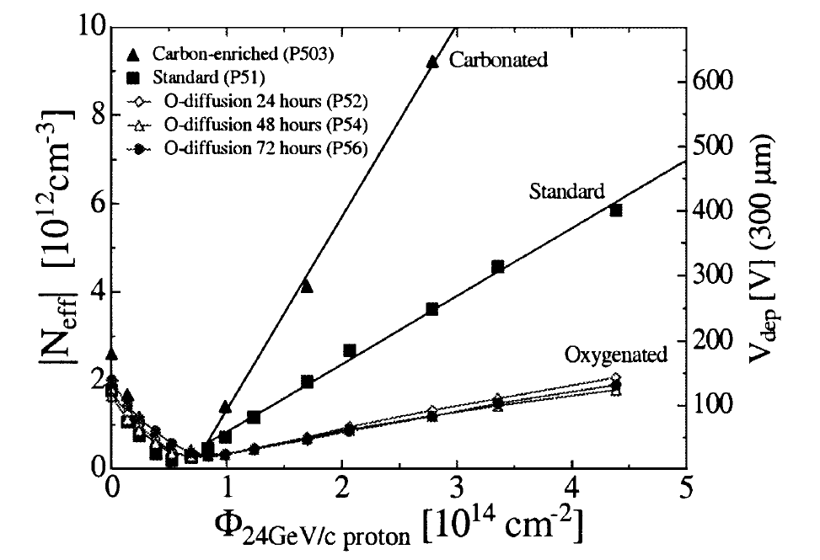
silicon depletion voltage vs p fluence
●
3.8·10¹⁴ p/cm²
G. Lindstroem NIM A 512 (2003) 30

Slide 10
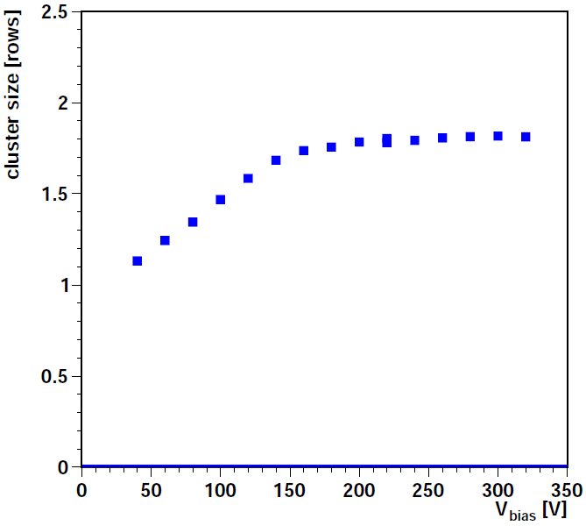
cluster size vs bias voltage
3.8 · 10¹⁴ p/cm²
tilt 19º, no turn
threshold 1.8 ke
psi46dig chip 203:
  3.8 · 10¹⁴ p/cm²
  chiller -15ºC
  threshold 1.8 ke
  19º tilt, no turn
  expect 1.8 pixels per cluster
full depletion around 150 V

Slide 11
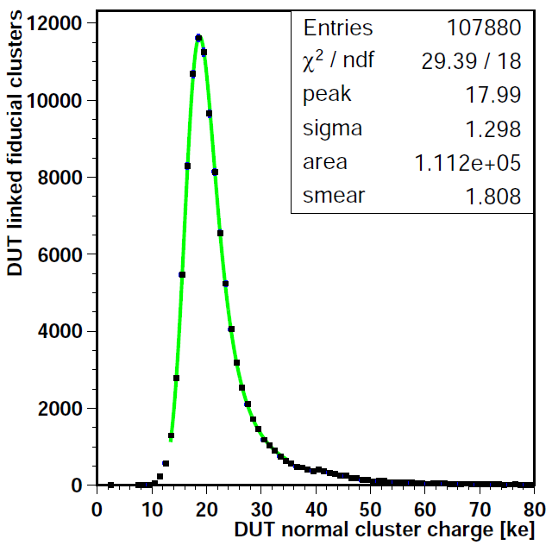
cluster charge distribution
PSI46dig 203:
  3.8 · 10¹⁴ p/cm²
  threshold 1.8 ke
  bias -250V, cooled
  tilt 22º, no turn
  normalized to vertical incidence
Cluster charge distribution fit by Landau ⊗ Gauss:
  peak at 18 ke
  was 22 ke before
PSI46dig 203
3.8·10¹⁴ p/cm²
tilt 22º, no turn
threshold 1.8 ke
bias -250V
cooled

Slide 12
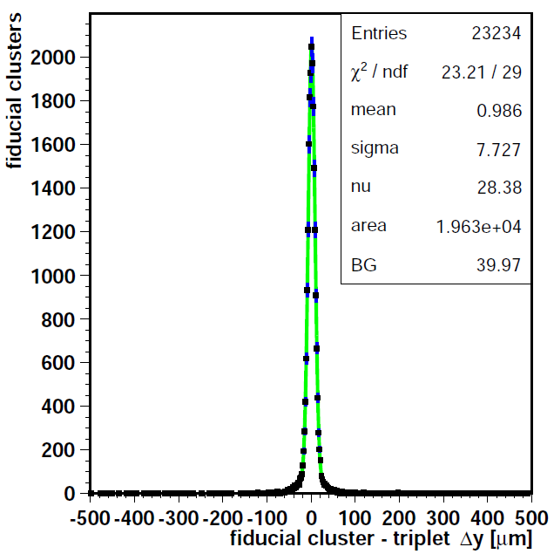
resolution
PSI46dig 203
3.8·10¹⁴ p/cm²
tilt 19º, no turn
threshold 1.8 ke
bias -320V
cooled
PSI46dig 203:
  3.8 · 10¹⁴ p/cm²
  threshold 1.8 ke
  bias -320 V, cooled
  tilt 19º, no turn
  Landau peak
residual to track:
  sigma 7.7 µm
  subtract telescope contribution 4.3 µm
  resolution 6.4 µm
  fresh: 5.5 µm

Slide 13
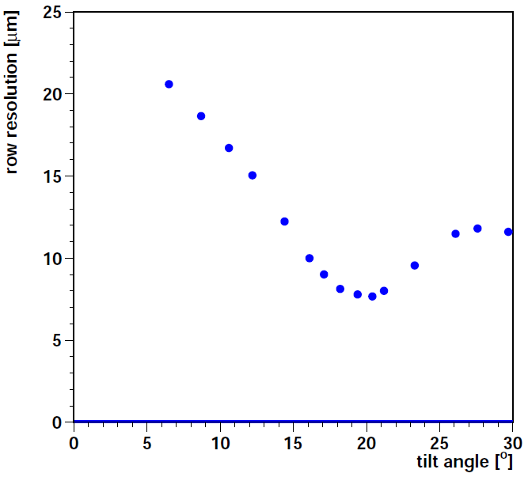
resolution vs track angle
runs 11269-11289
α
PSI46dig 203
3.8·10¹⁴ p/cm²
bias -200 V
threshold 1.8 ke
chiller +5ºC
psi46dig 203:
  3.8 · 10¹⁴ p/cm²
  threshold 1.8 ke
  bias -200 V
  chiller +5ºC
best resolution for 2-pixel sharing:
100 µm pitch
285 µm thick
19.3º

Slide 14
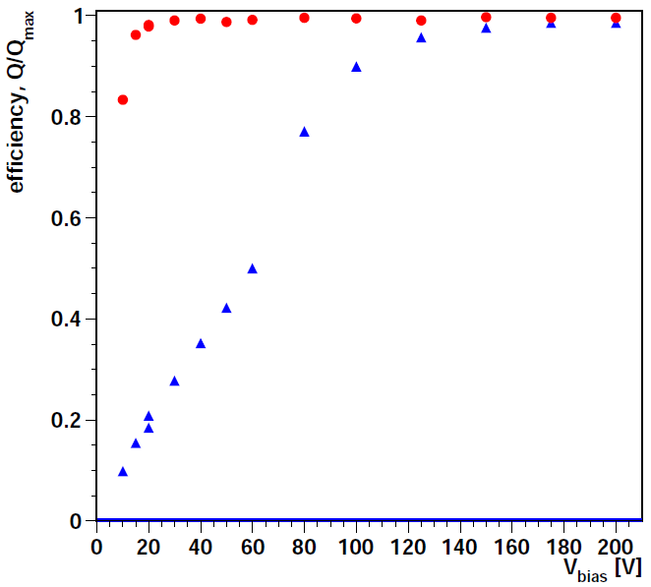
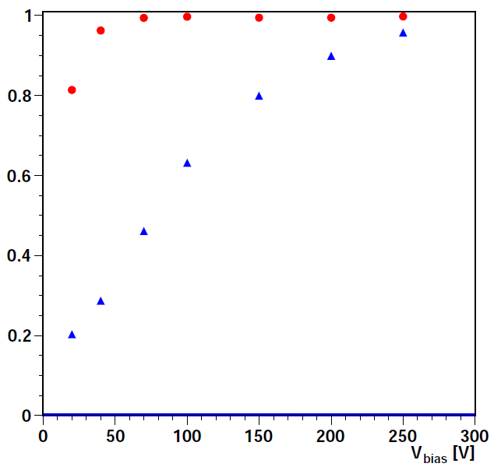
efficiency vs bias voltage
⚫ efficiency
⚫ efficiency
▴ charge / Qmax
▴ charge / Qmax
0.9 · 10¹⁴ p/cm²
3.8 · 10¹⁴ p/cm²
tilt 19º
threshold 1.8 ke
>98% efficient down to 30 V
1/3 charge is enough
tilt 23º, turn 29º
threshold 2 ke
>98% efficient down to 70 V:
1/2 charge is enough

Slide 15
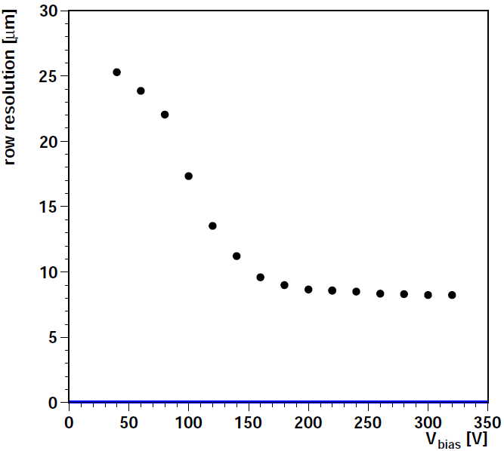
resolution vs bias voltage
3.8 · 10¹⁴ p/cm²
threshold 1.8 ke
19º tilt, no turn
chiller -15ºC
resolution degrades when operating below full depletion

Slide 16
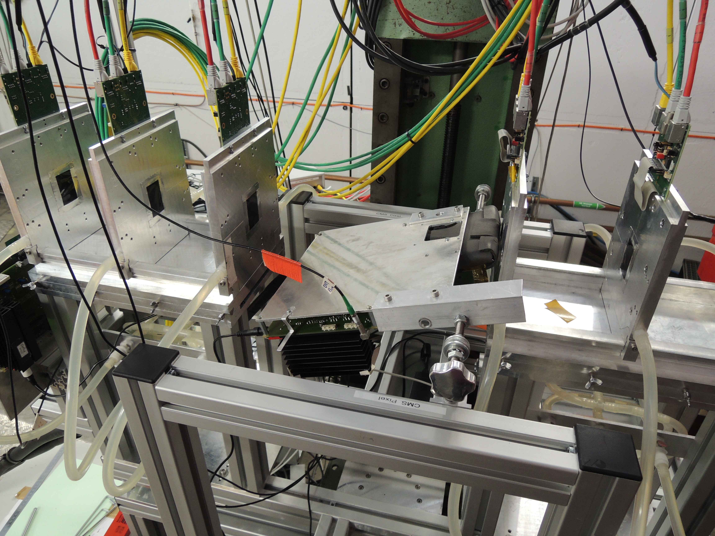
DUT large tilt angle in the telescope
DUT
72º tilt

Slide 17
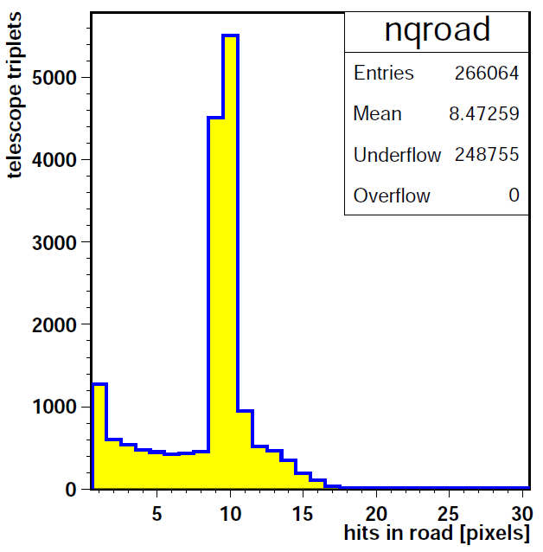
Shallow incidence
5.6
GeV
950
800
650
300
150
0
z [mm]
time
ref
scint
trig
DUT
72º tilt
scint
trig
w = d tanβ = 880 μm
d = 285 μm
track path length:
d / cosβ = 920 μm

Slide 18
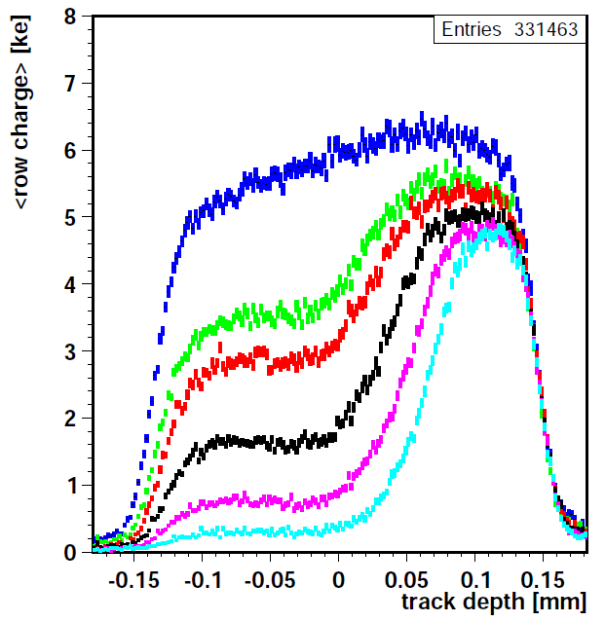
charge depth profile vs bias
200 V
150 V
3.9 · 10¹⁴ p/cm²
tilt 72.4º, no turn
vary bias voltage from full to partial depletion
charge per pixel as function of track depth
  zero = mid-sensor
collect deep charge at reduced bias voltage
  explained by double junction models
120 V
100 V
80 V
60 V

Slide 19
summary
The upgraded CMS pixel detector will use well-established technology:
  n-in-n sensors, 250 nm CMOS with radiation hard design rules
Modules with the upgrade readout chip have been irradiated to 3.8 · 10¹⁴ p/cm² and operated in a beam test:
  depletion voltage about 150 V
  fully efficient above 70 V (with low threshold)
  resolution only slightly degraded: 6.4 µm compared to 5.5 µm
  observe deep charge collection at partial depletion voltage
next:
  add simulation
  irradiated to higher fluences: 3 · 10¹⁵ p/cm²

Slide 20
Back up

Slide 21
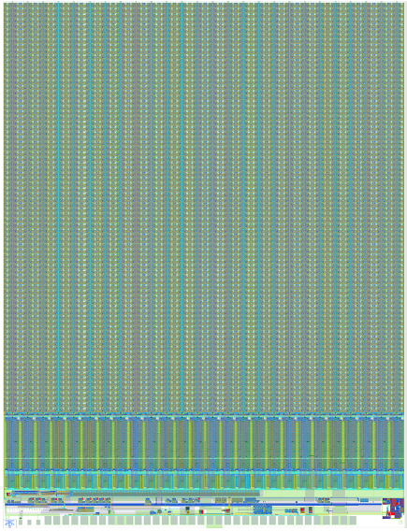
psi46dig pixel readout chip
turn
columns
rows
double
column
2 × 80 pixels
single pixel:
150 × 100 µm²
tilt
pixel array:
52 × 80 = 4160
80 data buffers / DC
24 time buffers / DC
ADC R/O buffer 160 MHz out

Slide 22
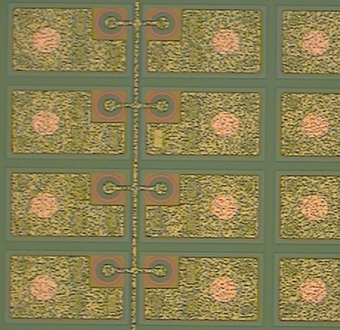
CMS barrel pixel sensor
ground grid
punch through bias dot
n pixel
p-spray
2 × 100 µm
2 × 150 µm
foto: Uni HH, 2012

Slide 23
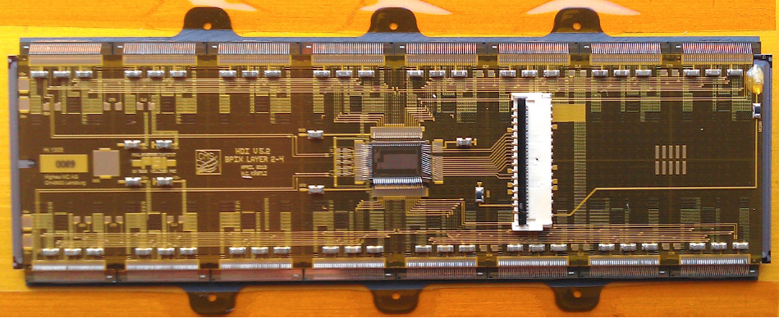
CMS barrel pixel module
micro twisted pair cables
Token bit
manager
wire bonds
High density
interconnect
Si sensor
16×64 mm²
66'560 pixels
glued
Read-out
chips
bump bonds
Si3N4
base strips
cooling
contact
glued
256 + X modules to be produced in HH
PSI 2013

Slide 24
Barrel pixel upgrade
Hybrid pixel
detector with
bump bonding
The upgraded pixel detector will have 1184 pixel modules in the barrel BPIX, compared
to 768 modules in the present detector, with an increase in the pixel count from 48 million
to 79 million. In the forward FPIX the number of modules will remain the same at
672. The new FPIX modules will be larger than in the present detector, increasing the
pixel count from 18 million to approximately 45 million
4 layers (now 3)
inner layer at 30 mm (now 44)
less material in tracking volume
new readout chip for 2·10³⁴/cm²/s
Notes:
In frames of CMS update , pixel detector will be modified.
The fourth barrel layer will be added using less material
in tracking volume.
Also new digital readout chips are developed for the upgrade.
It is planned to produce 350 pixel modules at DESY with Uni
Hamburg. It is also planned to do own bump bonding onside.

Slide 25
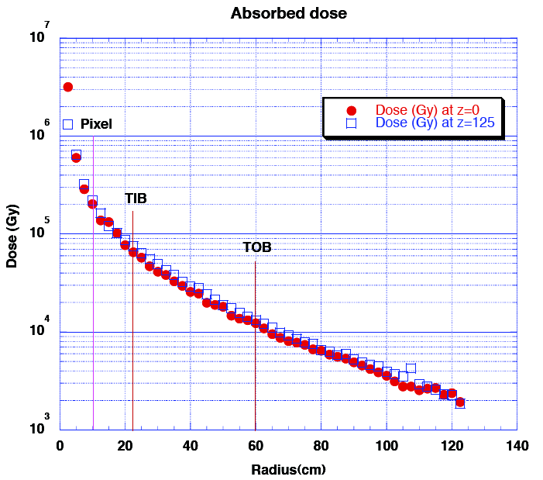
Tracker radiation dose
500 fb⁻¹
1 Gy = 100 Rad
Layer 1: 100 MRad
Layer 2: 40 MRad
Layer 3: 20 MRad
Layer 4: 13 MRad
Fluence:
1 MRad ≃ 3 10¹³/cm² pions
Pixel upgrade TDR 2012

Slide 26
CERN PS irradiation
CERN PS IRRAD 1: 24 GeV protons
psi46dig chip 202 with sensor = sample 1785
  29.10.2012, 9:26 – 16:00, F = 0.91 10¹⁴/cm² (±7.4%)
  D = 3 Mrad
psi46dig chip 203 with sensor = sample 1786
  28./29.10.2012, 17:05 – 8:45, F = 2.27 10¹⁴/cm²
  29.10.2012, 9:26 – 16:00, F = 0.91 10¹⁴/cm²
  30.10.2012, 9:27 – 12:52, F = 0.60 10¹⁴/cm²
  total F = 3.77 10¹⁴/cm² (±7.6%)
  D = 13 Mrad
stored at -20ºC
https://irradiation.web.cern.ch/irradiation/Dosimeter/Sets-2012.htm

Slide 27
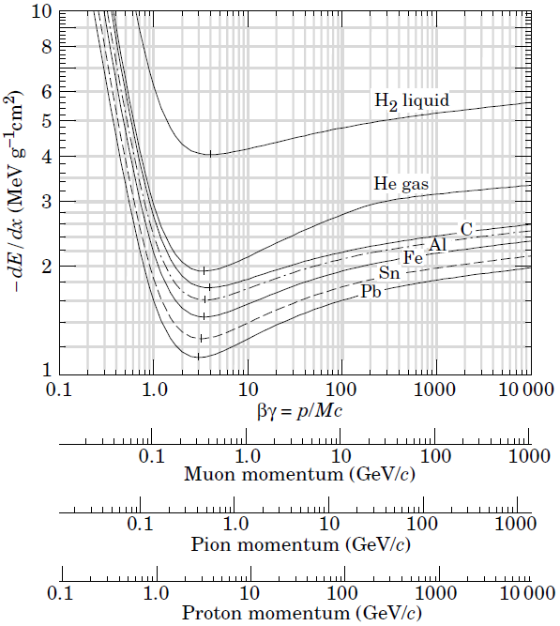
ionization
Ka Zyklotron:
0.2 GeV/c protons
factor 20 above LHC
CERN PS:
24 GeV/c protons
LHC:
0.7 GeV/c pions

Slide 28
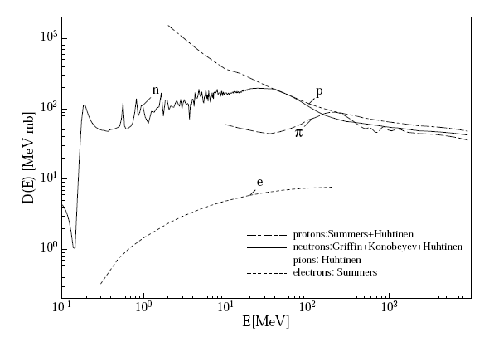
non-ionizing energy loss in silicon
non-ionizing energy loss (NIEL): displacement of atoms
Leakage current ~ NIEL
Ka Zyklotron:
23 MeV protons
factor 4 above LHC
NIEL
reference point:
1 MeV neutrons
LHC:
700 MeV
pions
CERN PS:
24 GeV
protons

Slide 29
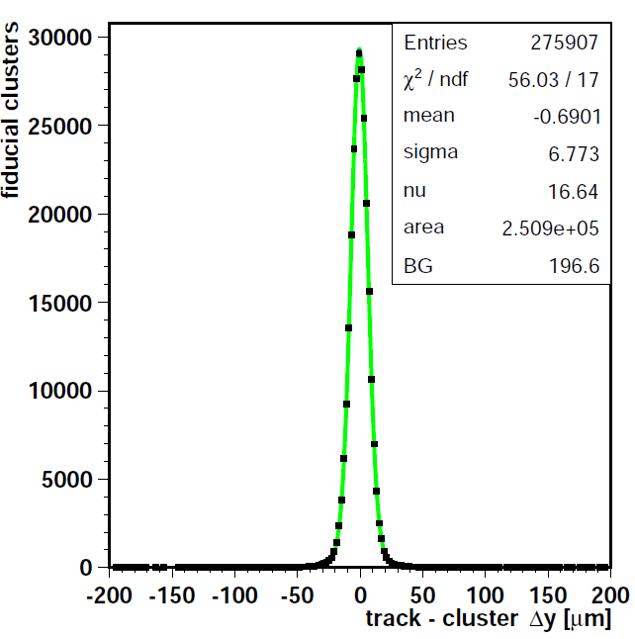
Resolution
run 10928-9, chip205, tilt 19.4
32
mm
105
mm
105
mm
psi46dig chip 205
  sensor design gap30
  threshold 1.5 ke
  Vbias -150V
  tilt 19.4º
  cross-talk correction
  Landau peak
Residual sigma 6.8 µm
  -telescope 4.5 µm
  CMS 5.1 µm

Slide 30
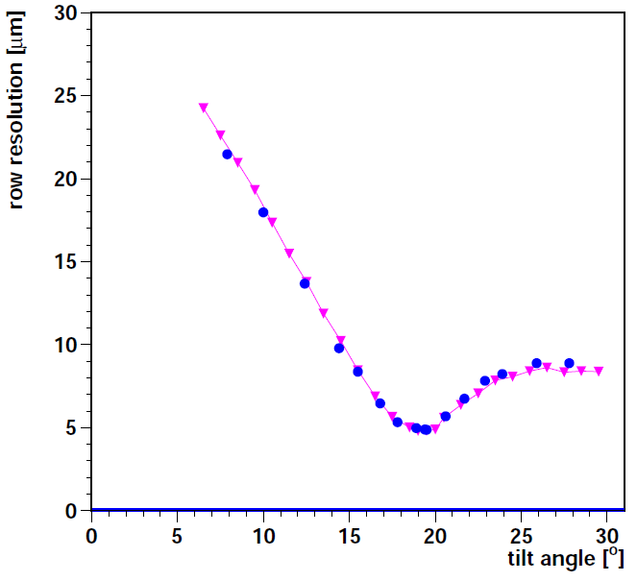
resolution vs tilt
4.5 µm
• psi46dig
▴ pixelav 294
psi46dig 205, 6 GeV, Aug 2013, +15ºC, -150V
  trim 30 = 1.5 ke
best: 5.1 µm at 19.5º (telescope subtracted)
pixelav with thickness 294 µm describes data
100 ×
294 µm
18.8º

Slide 31
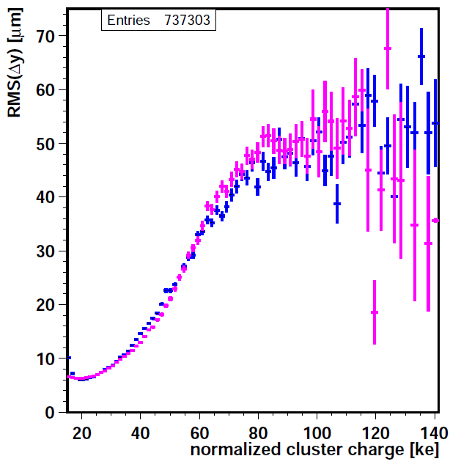
Resolution in the Landau tail
psi46dig chip 205
  gap 30 design
  Vbias -150V
  tilt 19.4º
  Weibull gain calibration
pixelav simulation
  full grid with dot
  tuned and smeared
Sensitive to delta-ray range
Select Landau peak:
  17 to 30 ke
• psi46dig
▴ pixelav 294

Slide 32
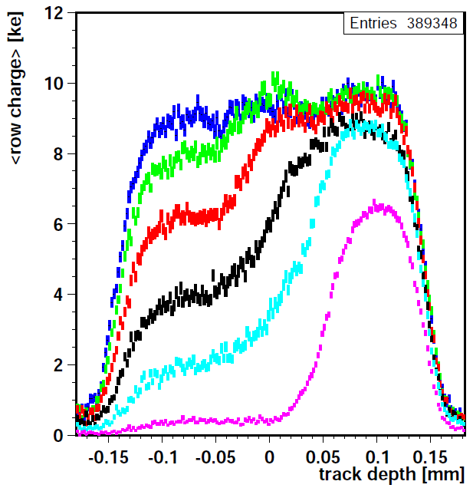
charge depth profile vs bias
dig 202i, 0.9E14p/cm², 11062-11126, 72º tilt
60 V
50 V
40 V
Chip 202i
  0.9 10¹⁴ p/cm²
tilt 72.4º, no turn
vary bias voltage from full to partial depletion
charge per pixel as function of track depth
  zero = mid-sensor
30 V
20 V
10 V

Slide 33
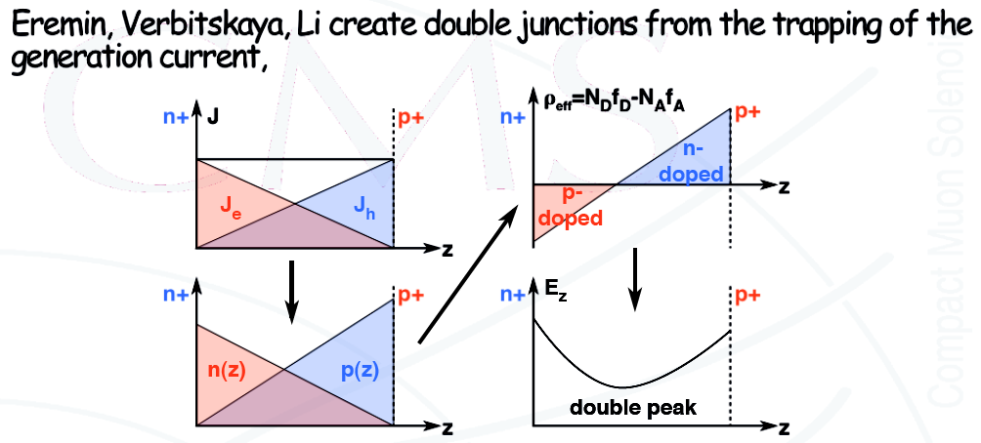
EVL model: trapped leakage current
Radiation damage creates deep (mid-gap) states
that induce leakage current.
Radiation induced shallow defects trap charge carriers.
3.
filled
traps =
space
charge
1.
e and h
currents
2.
carriers
4.
electric
field
M. Swartz, CMS Pixel Upgrade workshop, 9.10.2006

Slide 34

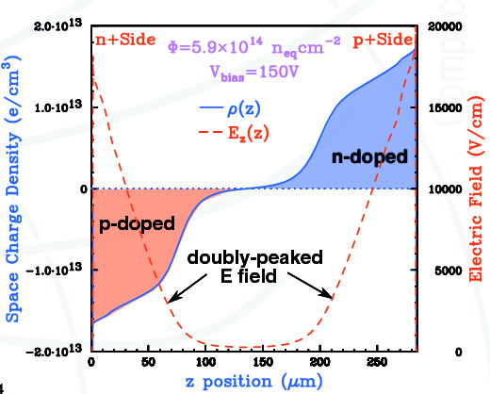
pixelav: tuned double junction model
fixed:
energy levels of defects
vary:
density of traps
capture cross sections
constraints:
leakage current
fit:
charge profiles
M. Swartz, CMS Pixel Upgrade workshop, 9.10.2006

Slide 35
pixelav references
M. Swartz, CMS note 2002/027: pixelav
  Nuclear Instruments and Methods in Physics Research A511 (2003) 88–91
A. Dorokhov et al, NIM A530 (2004) 71-76: beam test 2003
V. Chichia et al, arXiv:physics/0411143v2: beam test simulation
A. Dorokhov et al, NIM A560 (2006) 112-117: beam test 2004
M. Swaretz et al, NIM A565 (2006) 212-220: double junction
V. Chiochia et al, NIM A568 (2006) 51-55: double junction
M. Swartz et al., CMS note 2007/033: templates
  Proceedings of Science (Vertex 2007) 035

Slide 36
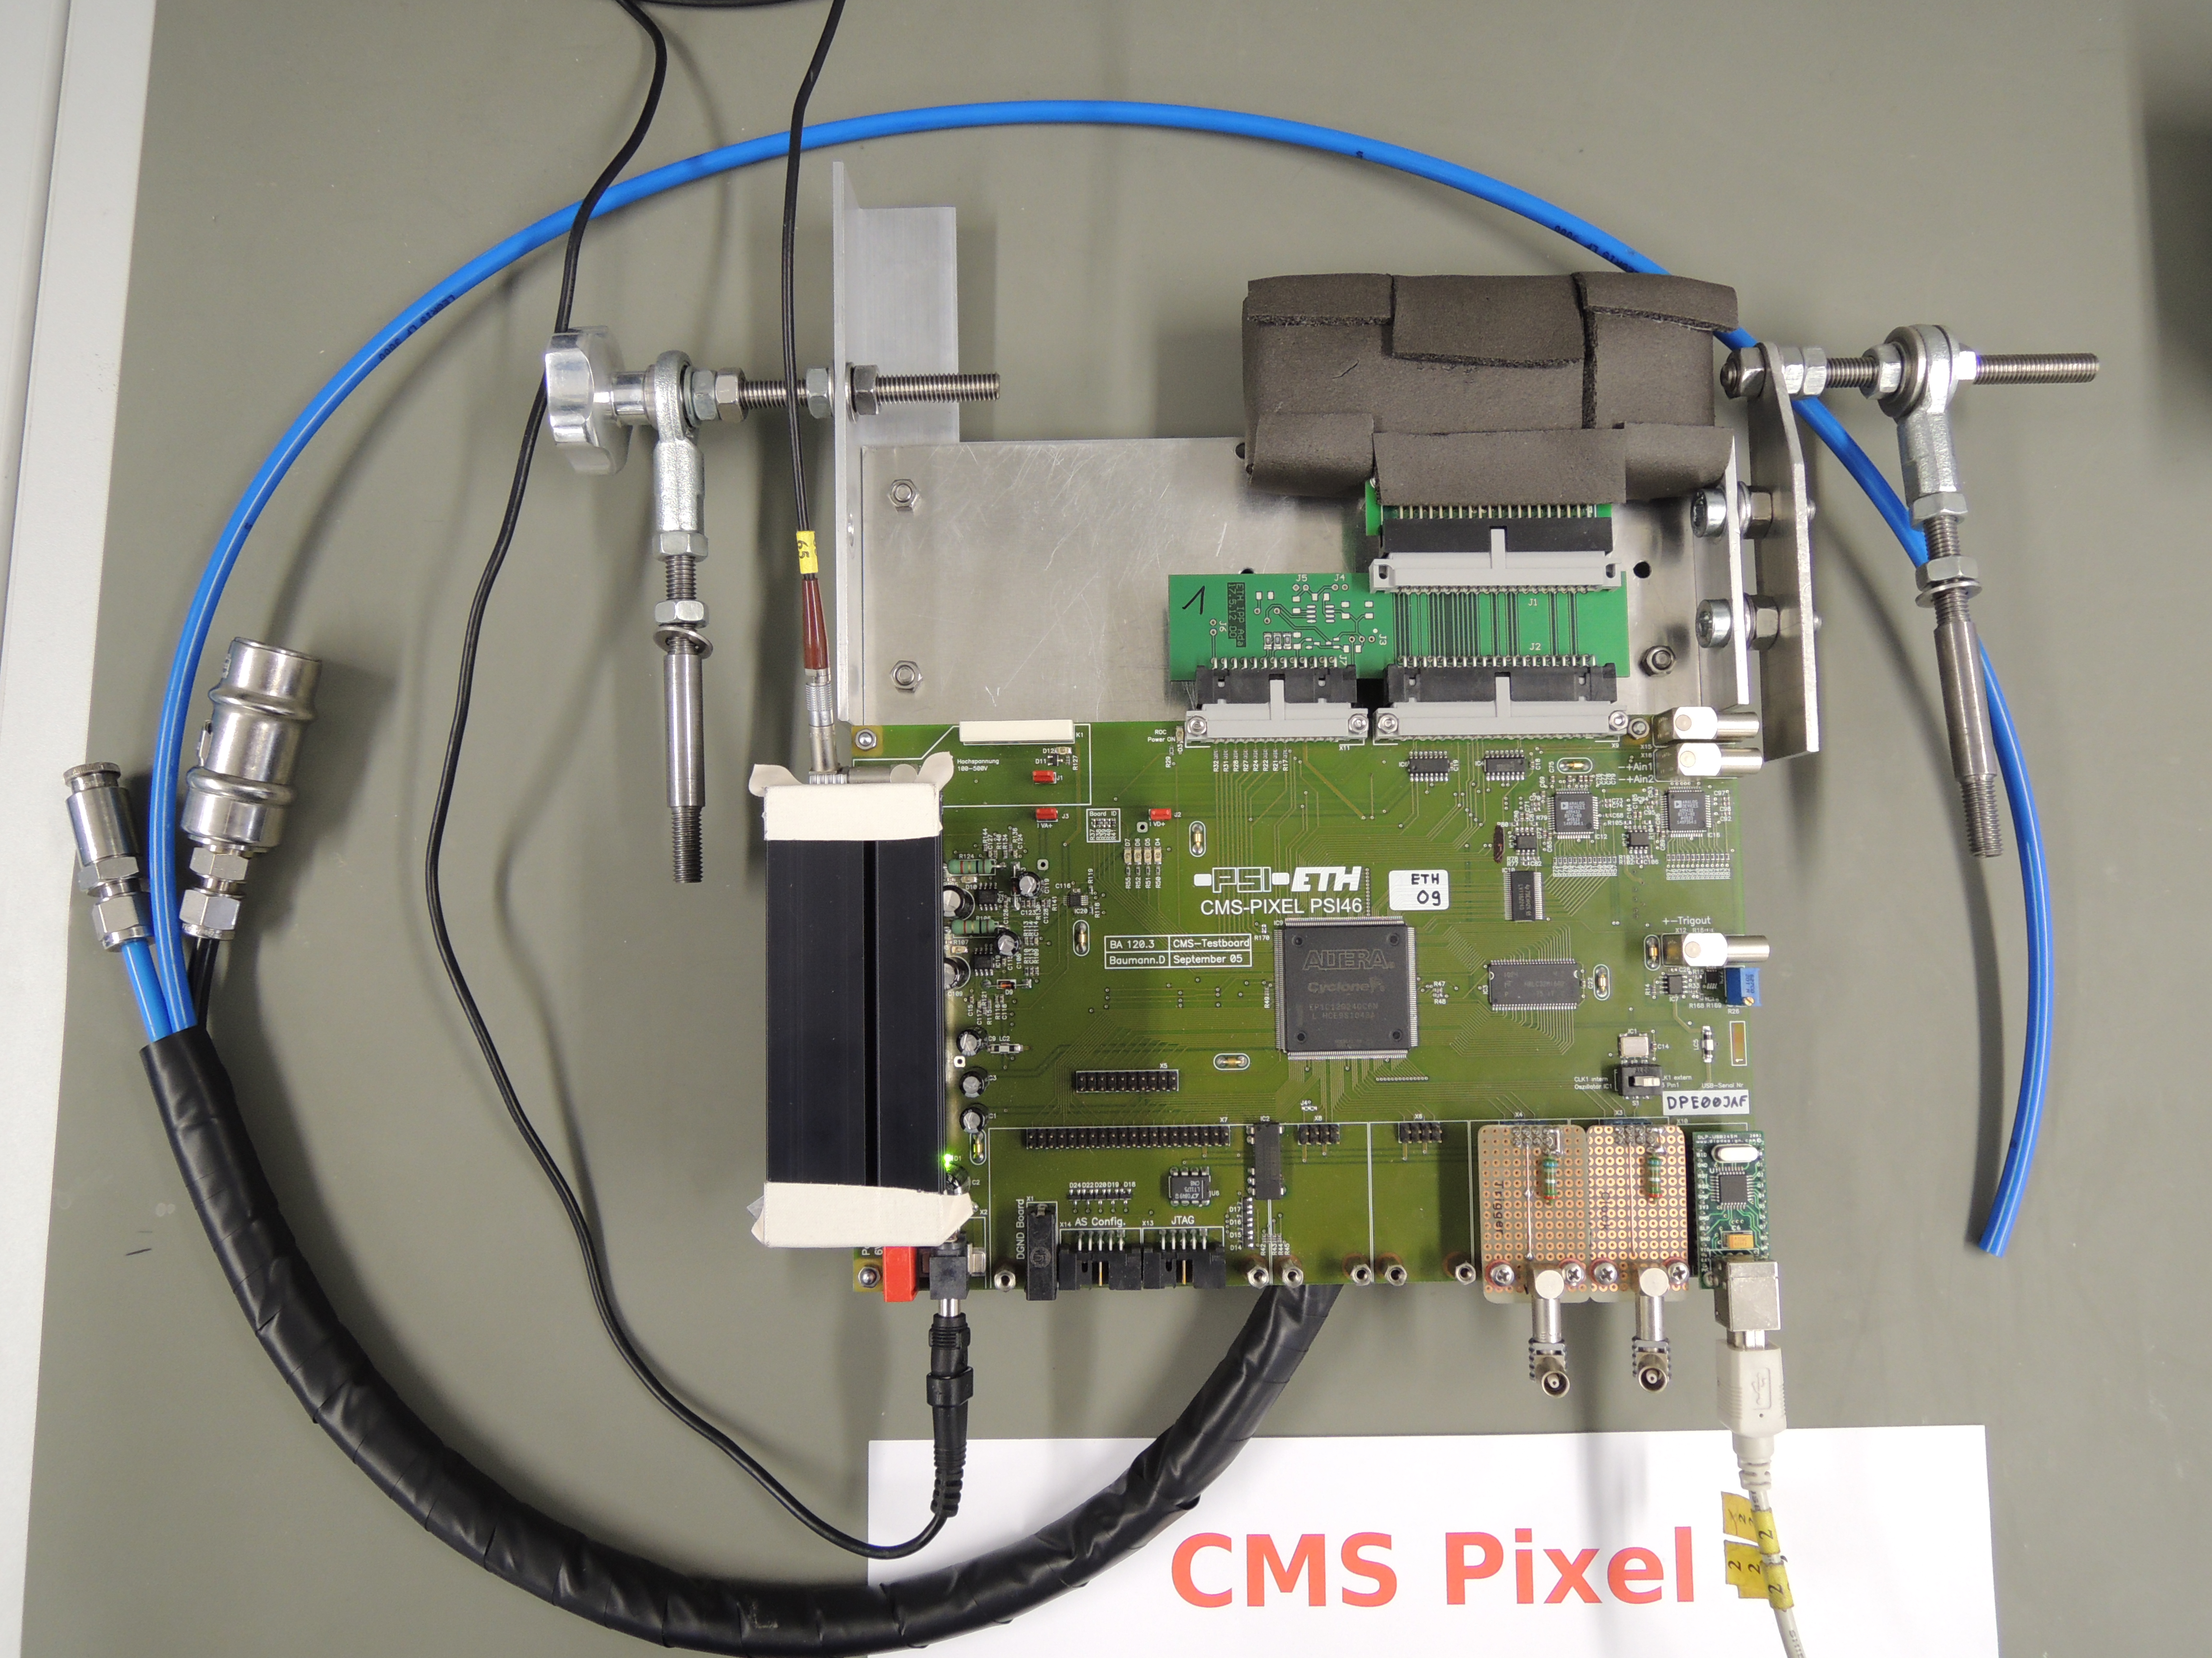
cooled single chip pixel detector
thanks to
Karsten
Gadow
armaflex
ethanol
dry N2

Slide 37
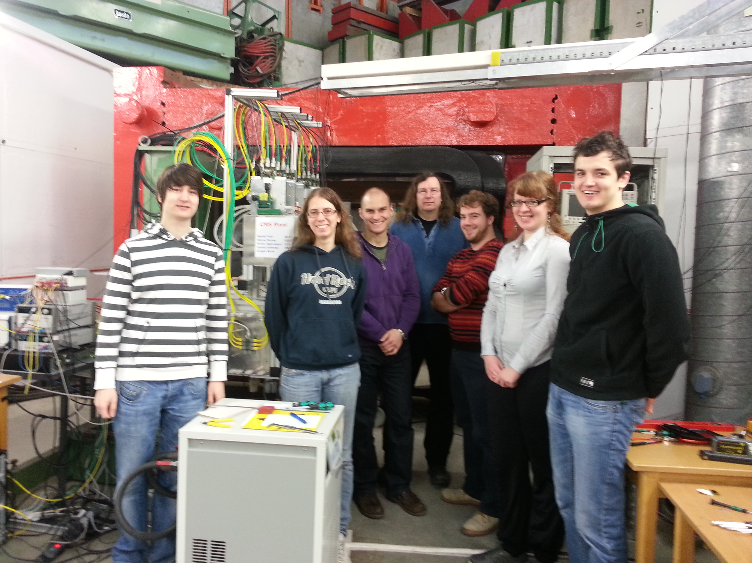
CMS pixel test beam team April 2013

