Slide 1
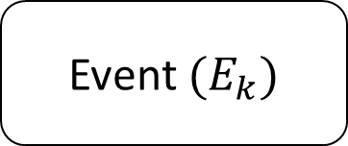
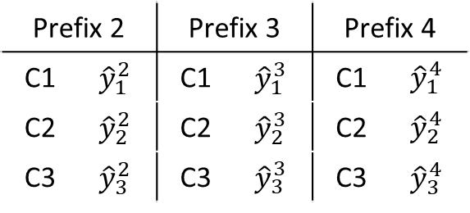

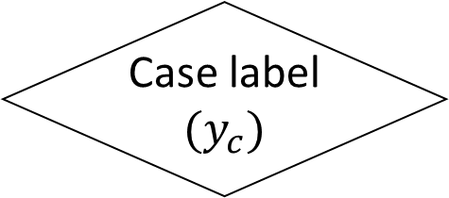
Event $(E_{k})$
Case label $(y_{c})$
No
Yes
Aggregation encoding
Performance measure for prefix length group
Save by prefix length group
Check training window
No
Prefix 2 |  | Prefix 3 |  | Prefix 4
C1 | $${\hat{y}}_{1}^{2}$$ | C1 | $${\hat{y}}_{1}^{3}$$ | C1 | $${\hat{y}}_{1}^{4}$$
C2 | $${\hat{y}}_{2}^{2}$$ | C2 | $${\hat{y}}_{2}^{3}$$ | C2 | $${\hat{y}}_{2}^{4}$$
C3 | $${\hat{y}}_{3}^{2}$$ | C3 | $${\hat{y}}_{3}^{3}$$ | C3 | $${\hat{y}}_{3}^{4}$$
Yes
Model update
${\hat{y}}_{caseid}^{prefix}$ = Predicted label

