Slide 1




Comparison between Pytorch & Tensorflow

Slide 2
Main Reference
Terry TaeWoong Um, #3.1. Tensorflow vs. PyTorch
https://www.youtube.com/watch?v=tNWatDufzDk

Slide 3
Source Code
https://github.com/ghlee0304/pytorch-basic-with-tensorflow/tree/master/comparison_tensorflow_pytorch

Slide 4

Pytorch
Tensorflow
dynamic
static
runtime debugging
difficult to debug
(Visdom)
Tensorboard
growing community
rich community
from low to high-level
low-level

Slide 5
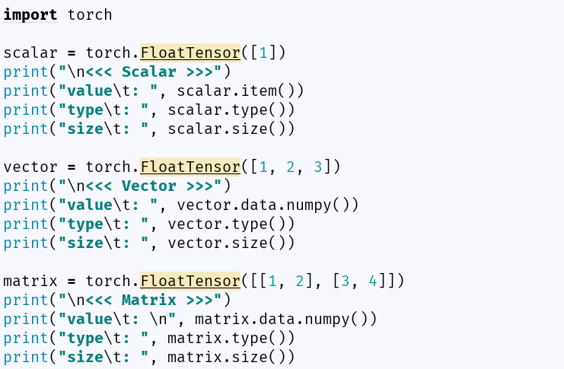
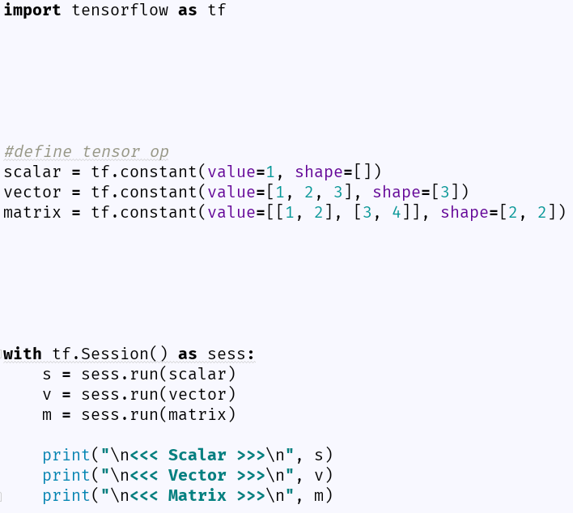
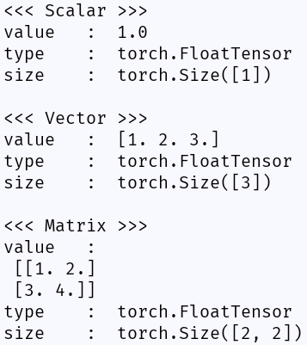
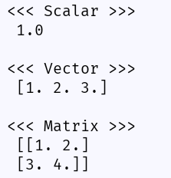
Pytorch
Tensorflow
Tensor
Tensor 정의
Session 실행
별도의 Session이 필요 없음

Slide 6
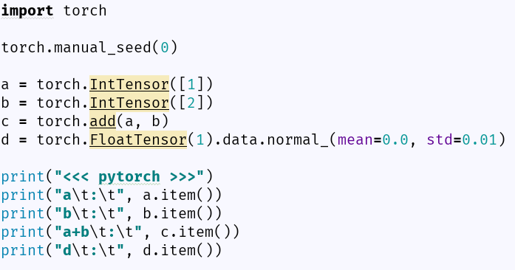
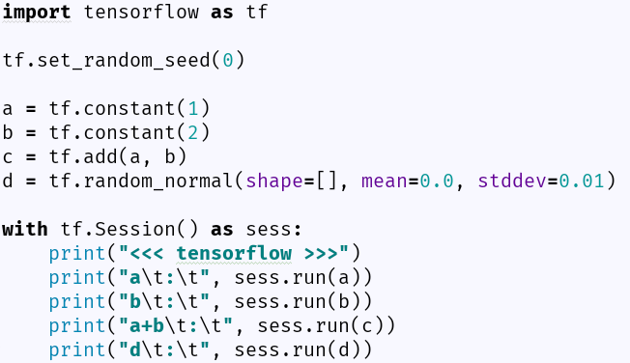
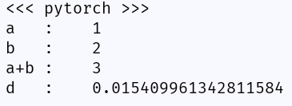
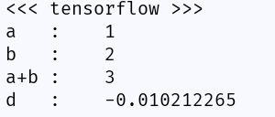
Pytorch
Tensorflow
Tensor (operation, random sample)
Tensor 정의
Session 실행

Slide 7
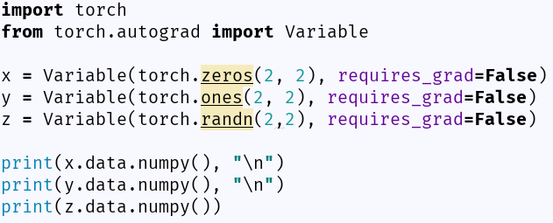
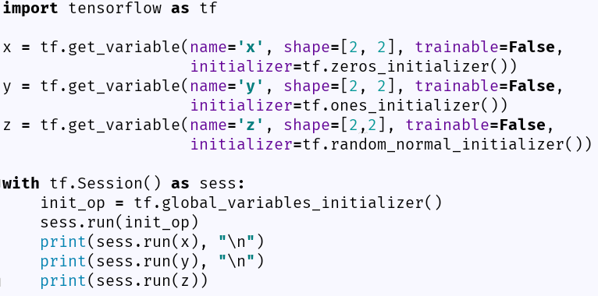
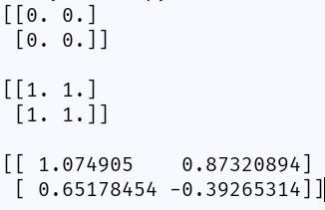
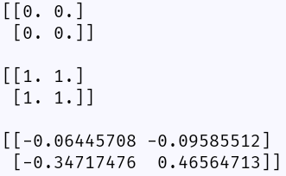
Pytorch
Tensorflow
Variable (no trainable)
초기화 필요

Slide 8
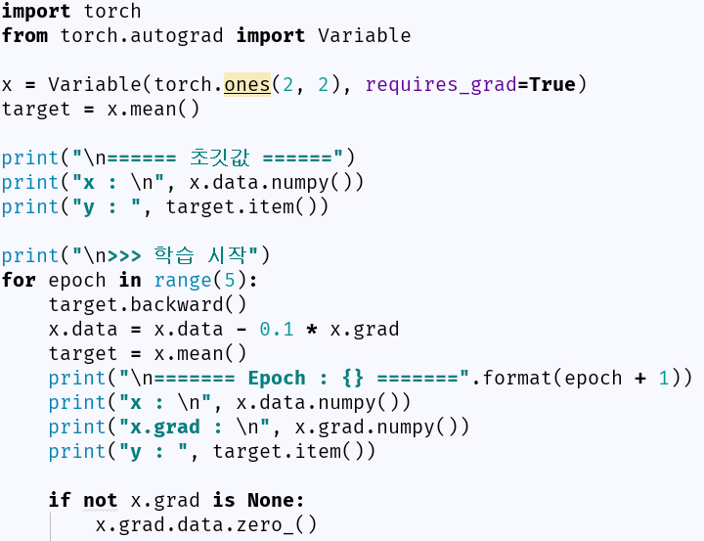
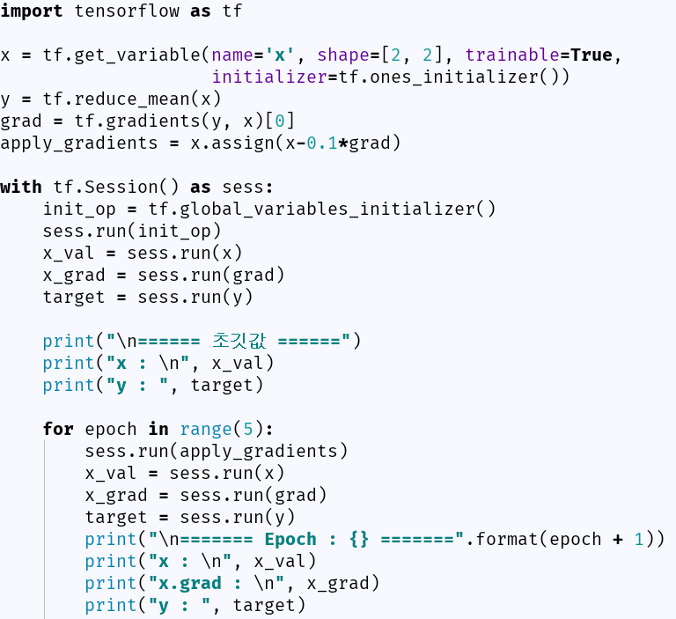
Pytorch
Tensorflow
Variable (trainable)
미리 정의가 필요
자동으로 기울기를 계산
변수에 기울기 정보

Slide 9
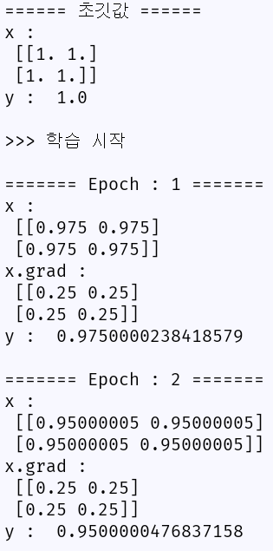
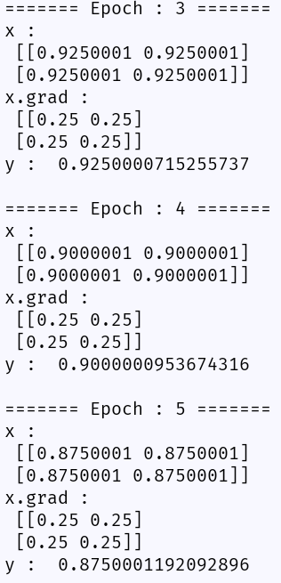
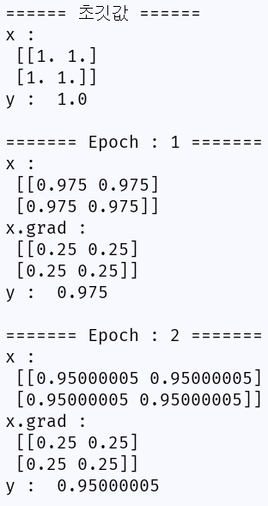
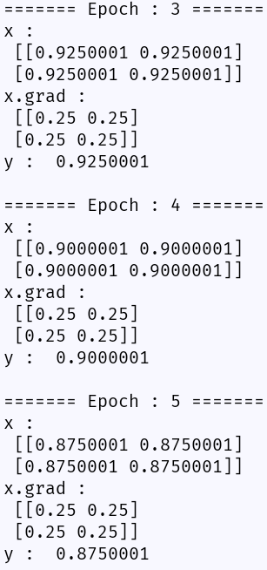
Pytorch
Tensorflow
Variable (trainable - 결과)

Slide 10
Pytorch
Tensorflow
dynamic
static
runtime debugging
difficult to debug
(Visdom)
Tensorboard
growing community
rich community
from low to high-level
low-level

Slide 11
Pytorch
Tensorflow
Model Basic Architecture
Parameter Setting : 파라미터 설정
Data Loader : 학습 데이터를 구축
Model : 학습 모델 정의
- forward
Solver : 학습 실행
- loss
- optimizer
- fit
- predict
Main
Parameter Setting : 파라미터 설정
Data Loader : 학습 데이터를 구축
Model : 학습 모델 정의
- build_model
- loss
- optimizer
- fit
- predict
Main

Slide 12
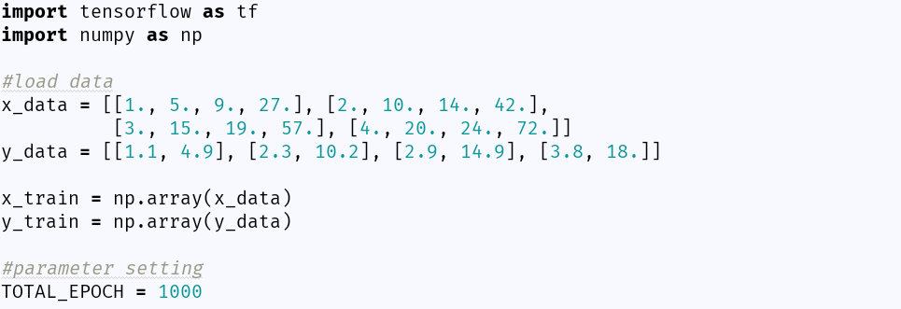
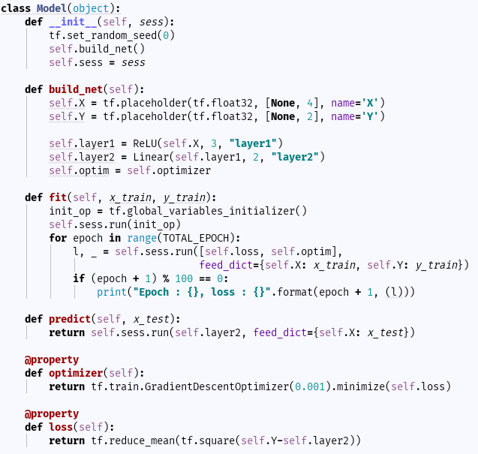
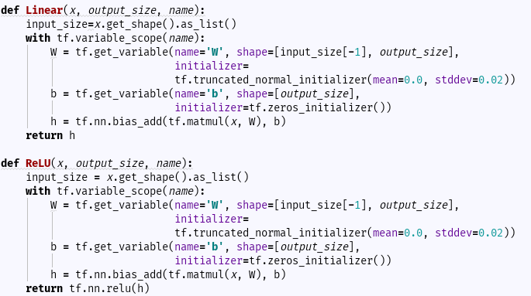
Tensorflow
Model Basic Architecture Code Example

Slide 13
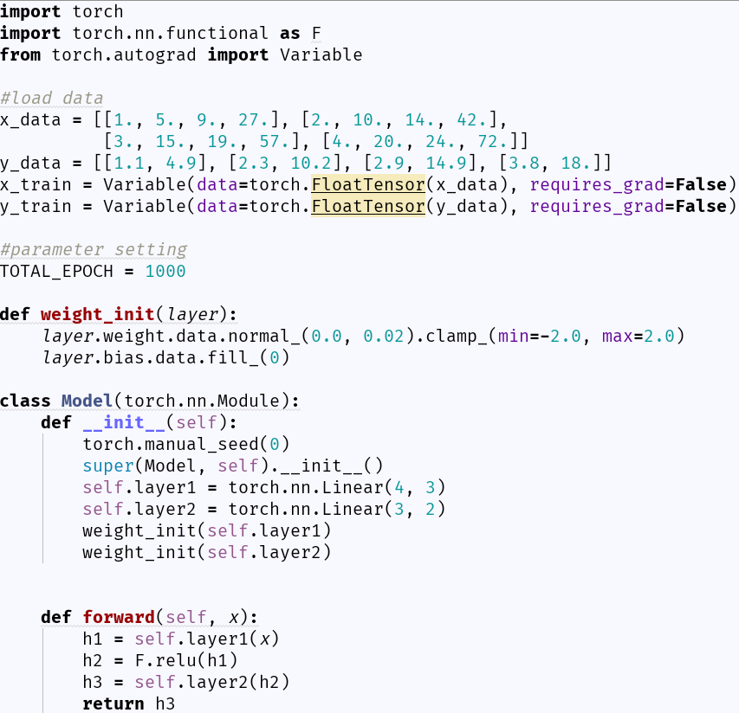
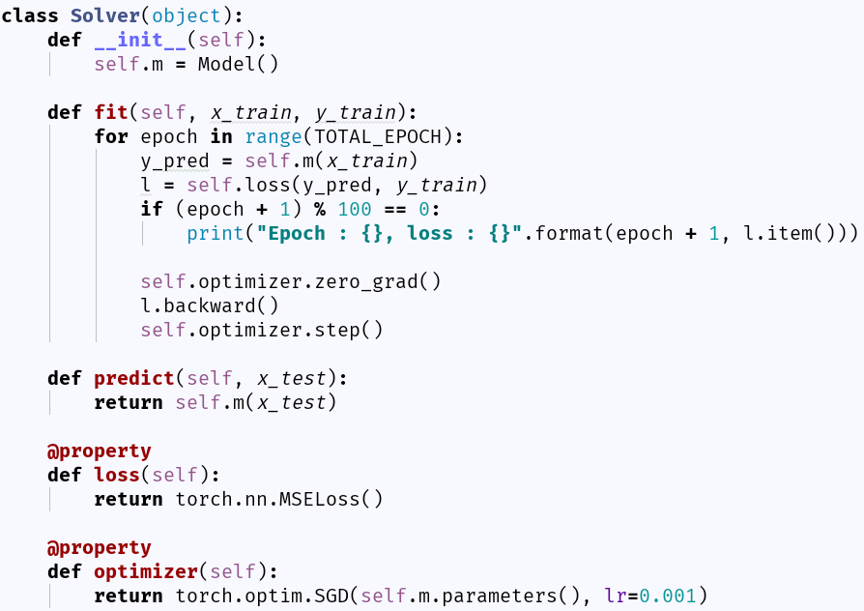
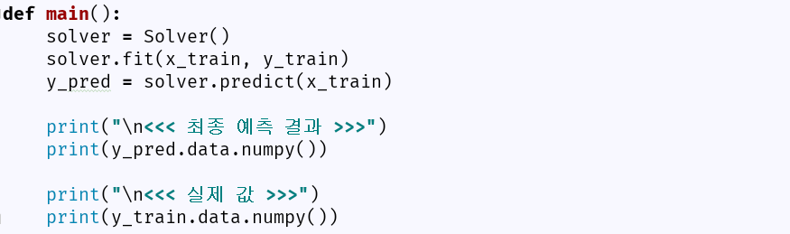
Pytorch
Model Basic Architecture Code Example

Slide 14
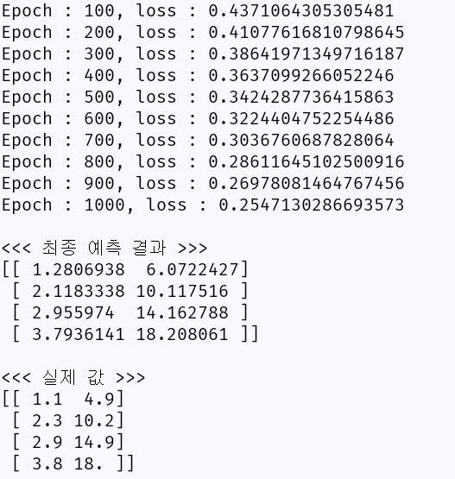
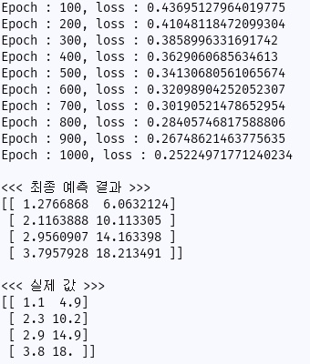
Pytorch
Tensorflow
Results

Slide 15
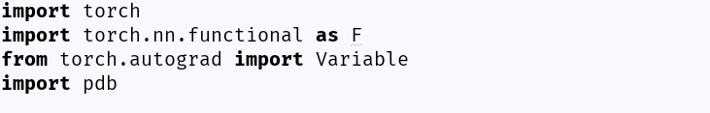
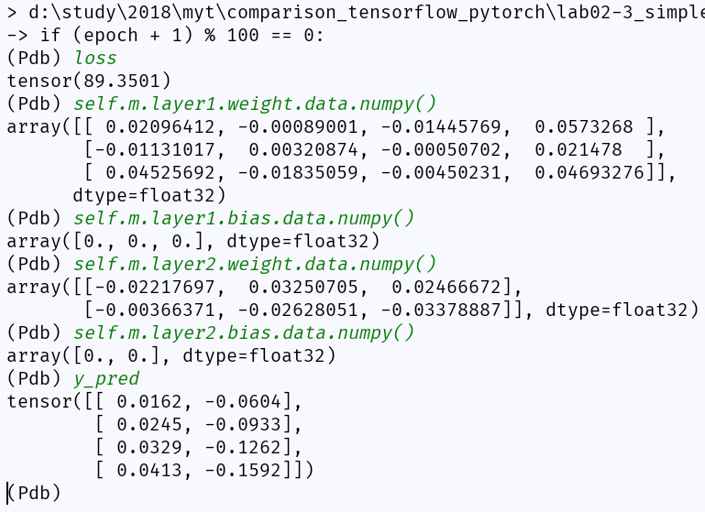
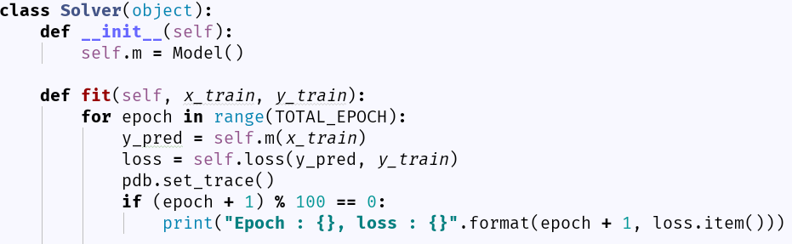
Pytorch
Pytorch debugging
* 보고자 하는 값들을 바로 확인 가능
pdb.set_trace()
원하는 지점에 추가

Slide 16
Pytorch
Tensorflow
dynamic
static
runtime debugging
difficult to debug
(Visdom)
Tensorboard
growing community
rich community
from low to high-level
low-level

Slide 17
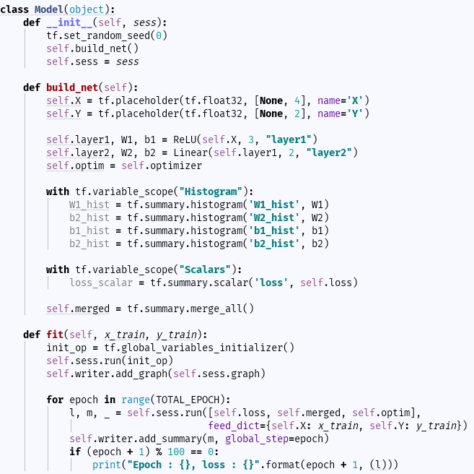

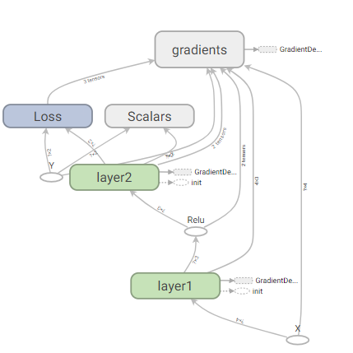
Tensorflow
Tensorboard
Graph
Histogram
Scalar
Merge
add_graph

Slide 18
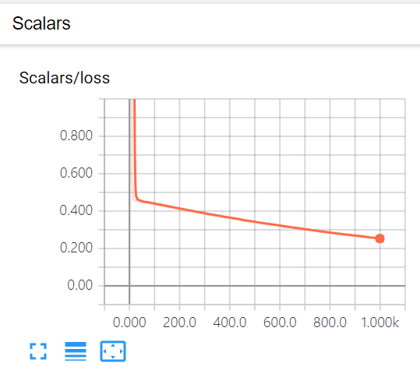
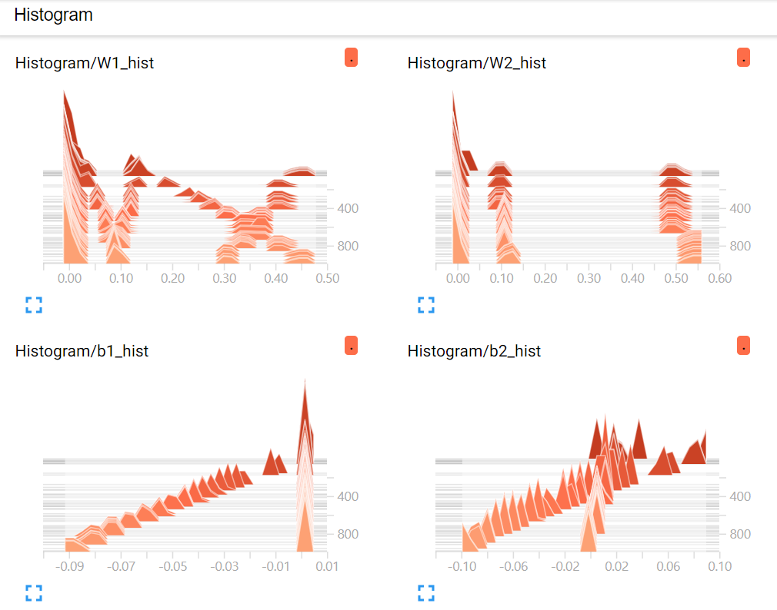
Tensorflow
Tensorboard
Scalar
Histogram

Slide 19
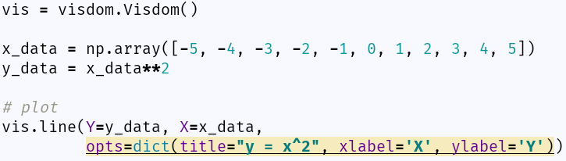

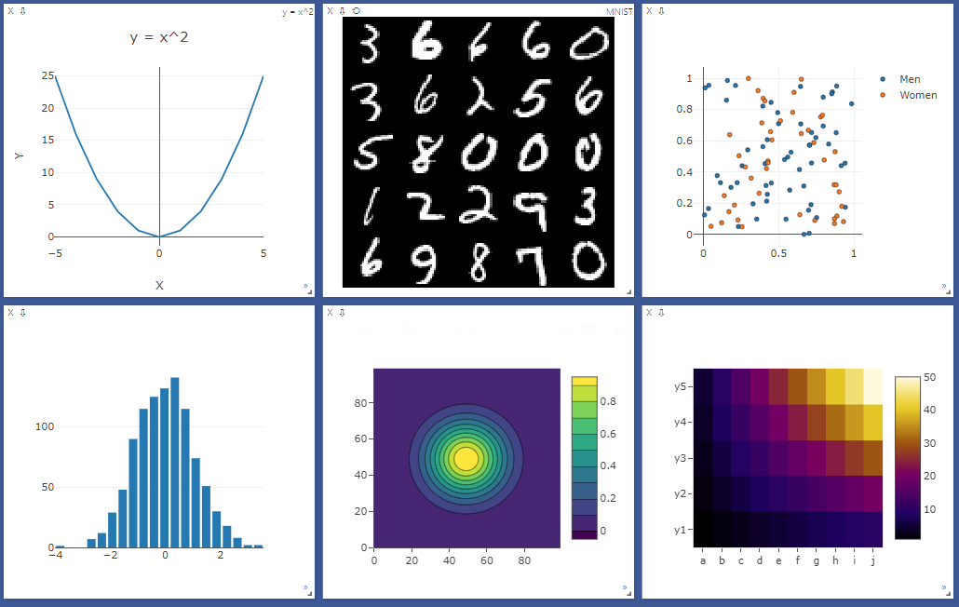
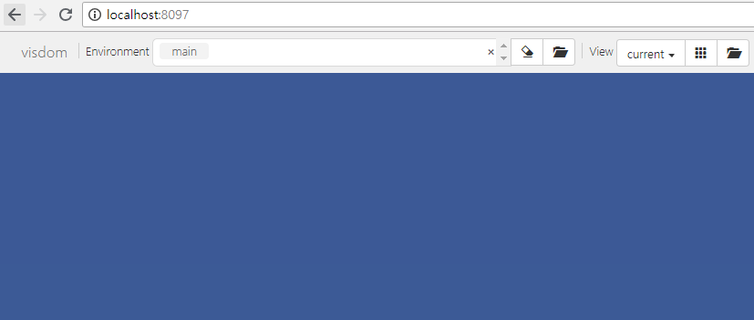
Pytorch
Visdom
https://github.com/facebookresearch/visdom
Visdom은 tensorboard와 다르게 계산 그래프
를 보여주는 기능을 하지 못함.
Tensorboard보다는 matplotlib과 기능이 유사
설치 :
서버 실행
서버 확인
예제 코드 및 결과

Slide 20
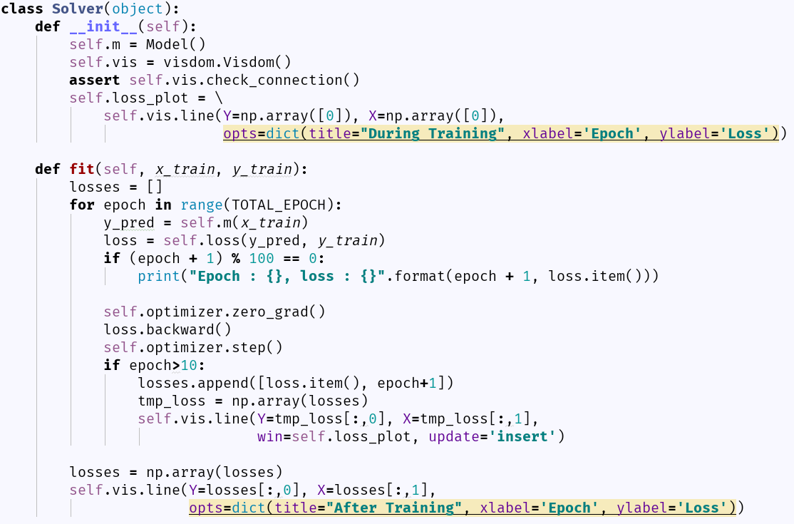

Pytorch
Visdom Real time plot Example
예제 코드 및 결과
Visdom server 결과 화면
최초 plot 설정
plot 업데이트
training 최종 결과를 plot

Slide 21
Pytorch
Tensorflow
dynamic
static
runtime debugging
difficult to debug
(Visdom)
Tensorboard
growing community
rich community
from low to high-level
low-level

Slide 22

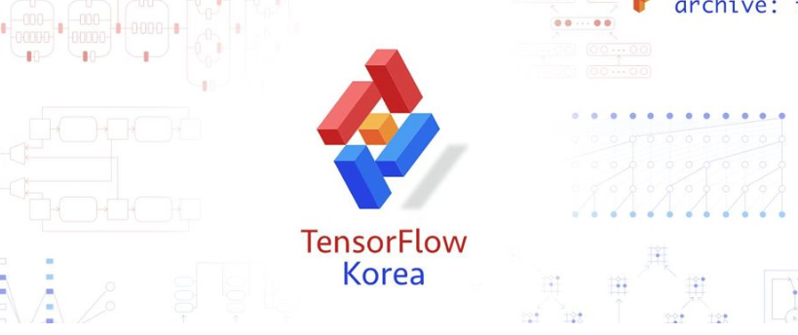
Pytorch
Tensorflow
Facebook Group
멤버 : 4,663명
멤버 : 35,941명

Slide 23
Pytorch
Tensorflow
dynamic
static
runtime debugging
difficult to debug
(Visdom)
Tensorboard
growing community
rich community
from low to high-level
low-level
(But, TFLearn, TF-slim, Keras)

