Slide 1
Data Analytics for
Yerevan’s Transportation
Name: Ghandilyan Lilit
Date: Fall 2018
Course name: ENV 211 Sustainable Cities

Slide 2
How can Yerevan’s transportation be improved using lots of data?

Slide 3
Where is the data coming from?
Smartphones
Roads and Vehicle sensors
GPS devices
Drones

Slide 4
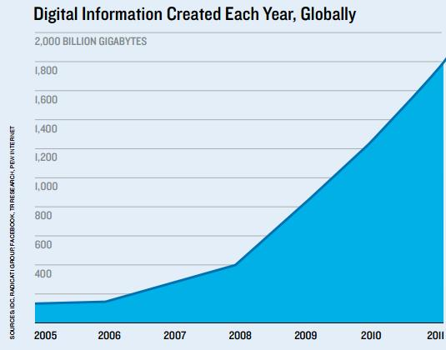
The scale of data

Slide 5
UN Sustainability Goals
Improving road safety (Goal 3)
Improving energy efficiency in the transport sector (Goal 7)
Development of quality, reliable, sustainable and resilient transport infrastructure (Goal 9)
Improvement of urban public transportation system (Goal 11)
Collaboration and partnership to develop sustainable transport system (Goal 17)

Slide 6
What are some problems it can solve?
Traffic congestions
Parking difficulties
Long commuting
Public transport inadequacy
Accidents and safety

Slide 7
Intervention

Slide 8

Where is my data coming from?

Slide 9
What does it look like?
Origin coordinates
Destination coordinates
Order created
Order completed
Fare

Slide 10
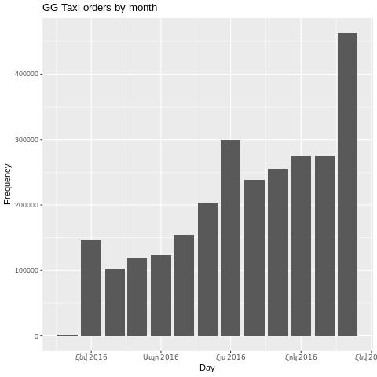
Which months are the busiest?

Slide 11
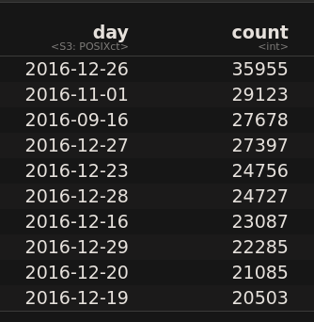
Which days are the busiest?

Slide 12
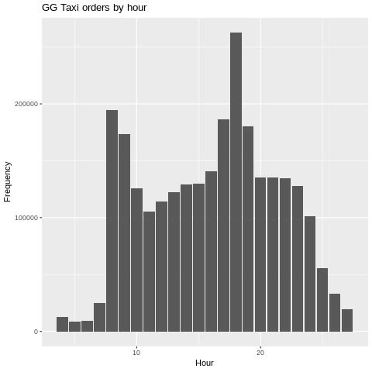
Which hours are the busiest?

Slide 13
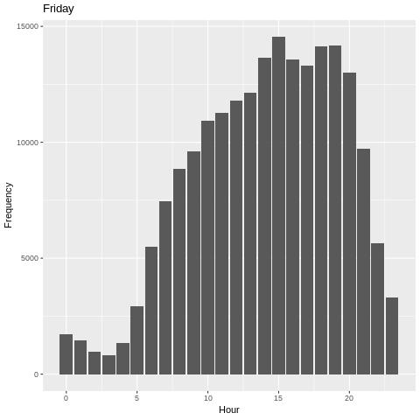
What about weekend busy hours?

Slide 14
How can this help Yerevan?
(examples)
Better traffic management on special days
Faster decision making when real-time data shows anomalies
Decisions such as when and where to add more public transportation means

Slide 15
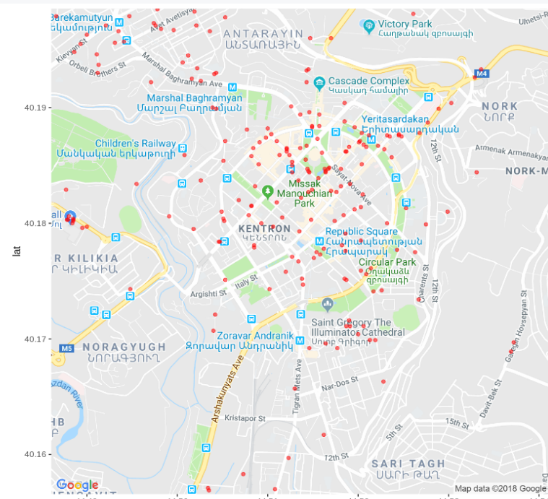
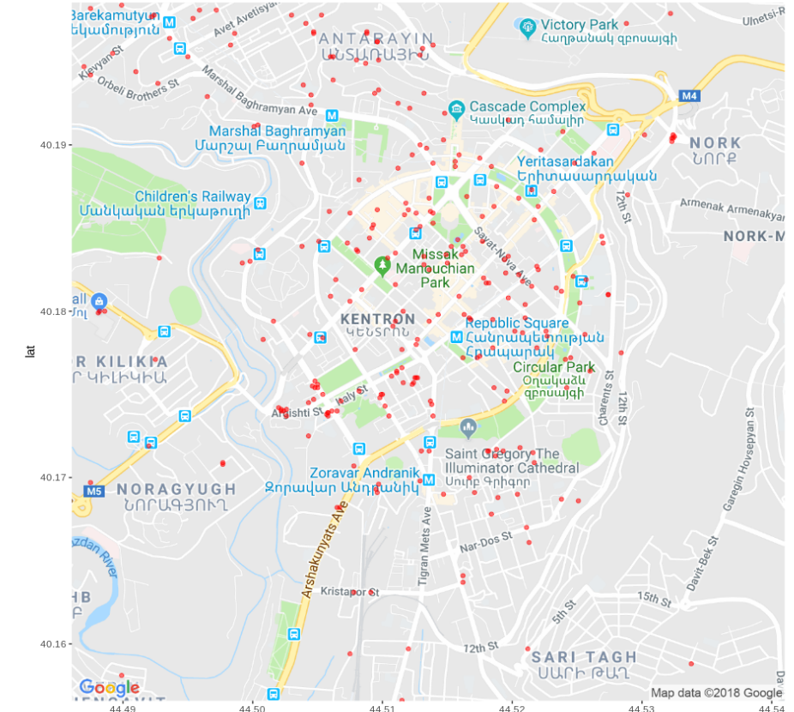
Where do people go for lunch?

Slide 16
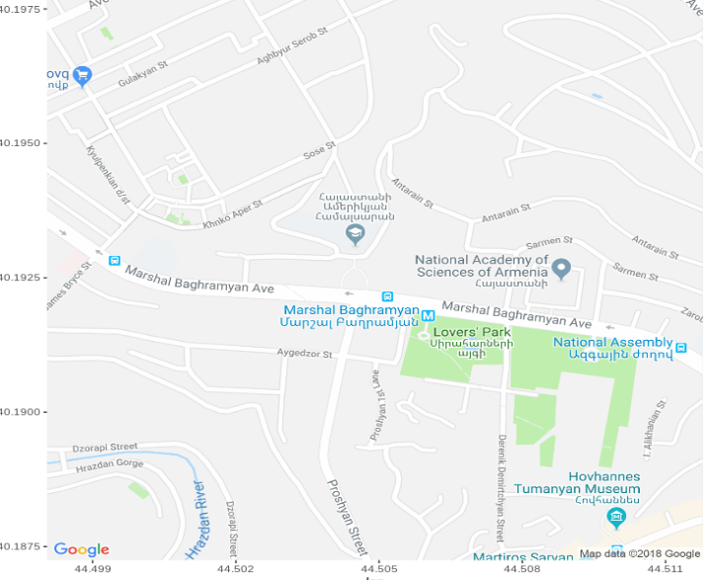
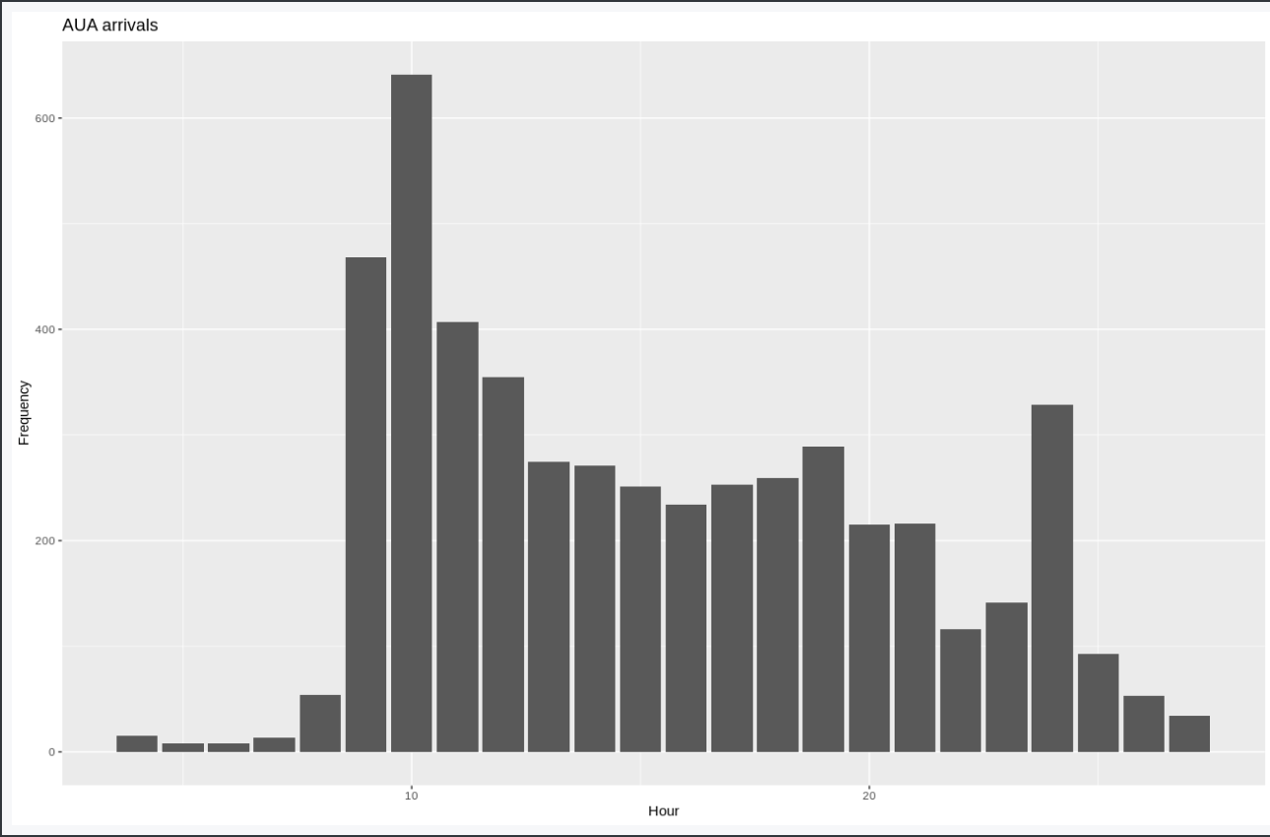
When do people come to AUA?

Slide 17
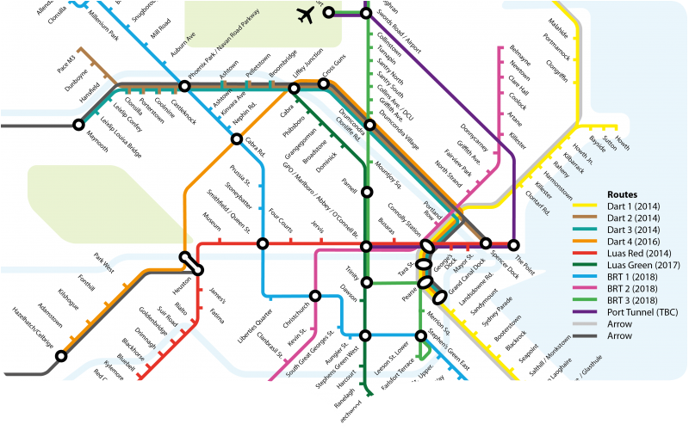
City of Dublin
GPS devices from 1000 buses
Optimal time to start bus lanes
Best place to add more lanes
Monitoring traffic in real time
Faster decision making
Improved mobility

Slide 18
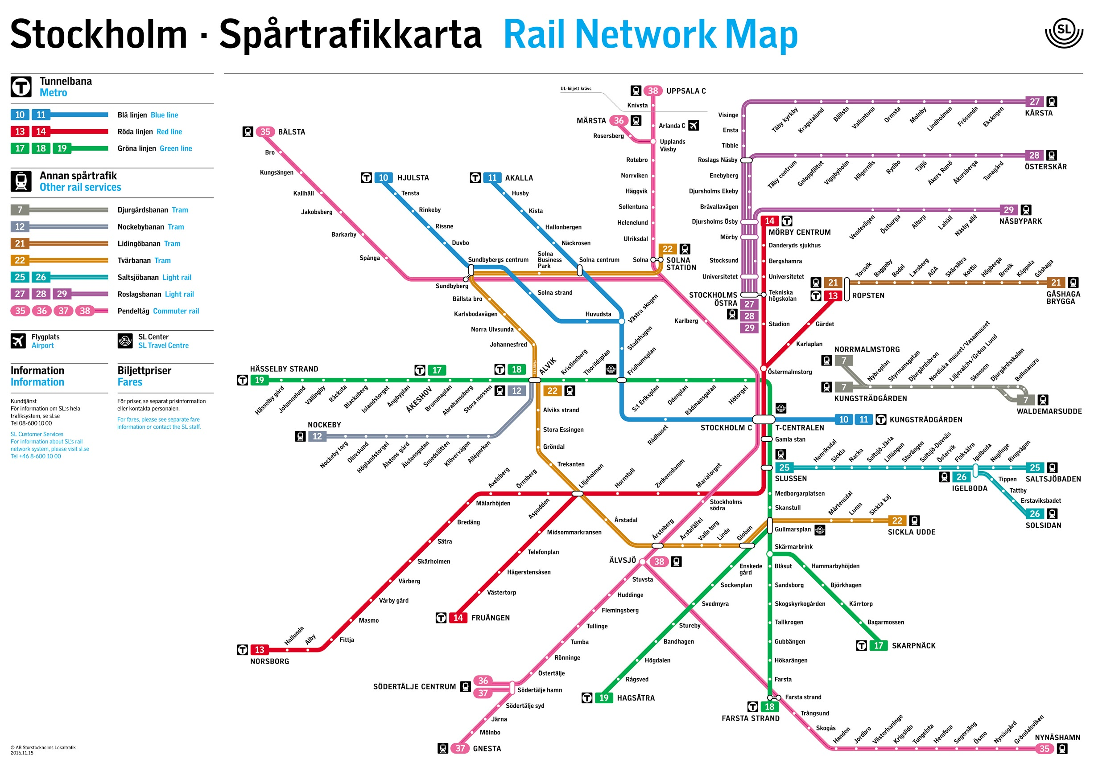
City of Stockholm
GPS devices from 120.000 vehicles
Combined with past traffic data
More accurate predictions for future traffic
The results served publics as well as police officers, fireman, urban planners.

Slide 19
Big data challenges
Converting bits into insights
Processing capacities
Storage space
Quality of data

Slide 20
Conclusion
Proposing to apply similar data analytics project to Yerevan...
As the number of cars in Yerevan is increasing, it is time to add data analytics to our toolbox to have smarter and more sustainable city.
Reduce traffic congestion
Identify traffic problems
Better monitor and manage the traffic
Improve traffic flow and mobility

Slide 21
Thank you!

Slide 22
References
[1] 68% of the world population projected to live in urban areas by 2050, says UN. (2018). Retrieved from https://www.un.org/development/desa/en/news/population/2018-revision-of-world-urbanization-prospects.html.
[2] Number of insured cars in Armenia has grown from 390,457 in 2011 to 457,878 in 2015. (2016). Retrieved from http://www.armbanks.am/en/2016/02/03/94938/
[3] Marr, B. (n.d.). How Much Data Do We Create Every Day? The Mind-Blowing Stats Everyone Should Read. Forbes. Retrieved from https://www.forbes.com/sites/bernardmarr/2018/05/21/how-much-data-do-we-create-every-day-the-mind-blowing-stats-everyone-should-read/#62de35360ba9.
[4] 17 Goals to Transform Our World. (2018). UN. Retrieved from https://www.un.org/sustainabledevelopment/.
[5] Ayed, A. B. (2015). Big Data Analytics for Logistics and Transportation. ResearchGate.

