Slide 1
FS neighbor structure
116112126
Keming li(李可明)

Slide 2
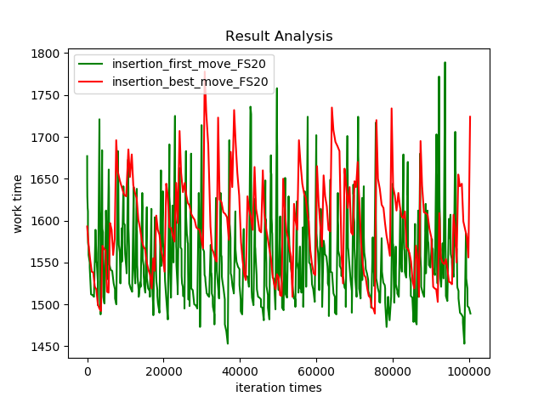
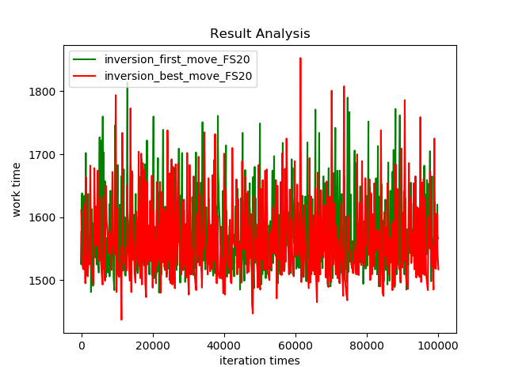
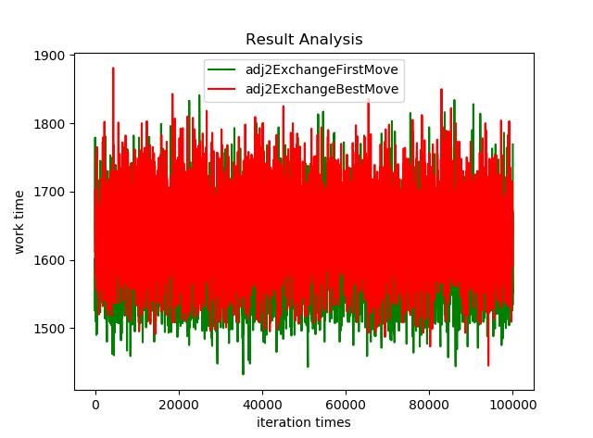
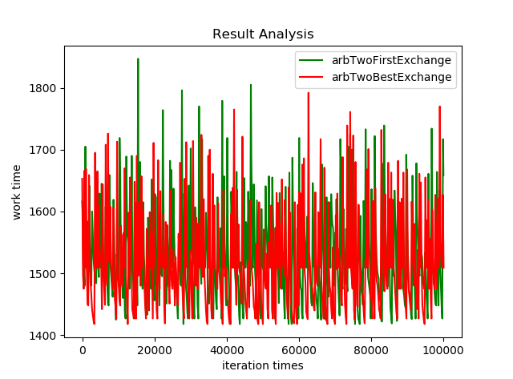
First Move, best move

Slide 3
First Move VS best move
Conclusion 1
For different neighbor structure, the first move and best move performance is different
The experience shows for insertion, the first move is better
For inversion, the best move is better
For adjacent 2 change, the first move is better
For arbitrary 2 change, 2 moves are almost the same
It seems that the insertion, adjacent 2 change is much easier been trapped into a local optical

Slide 4
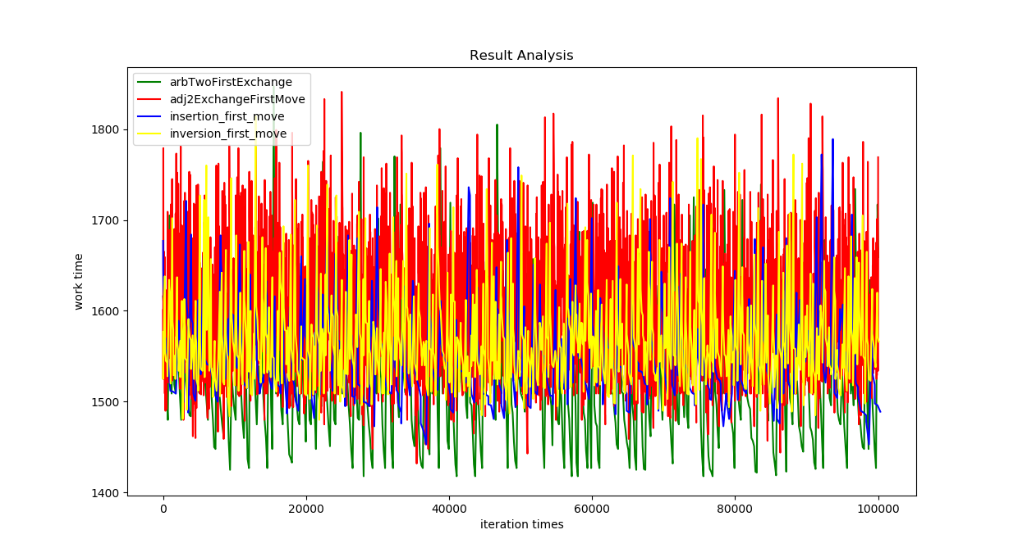
First move: arb>adjacent>insertion>inversion

Slide 5
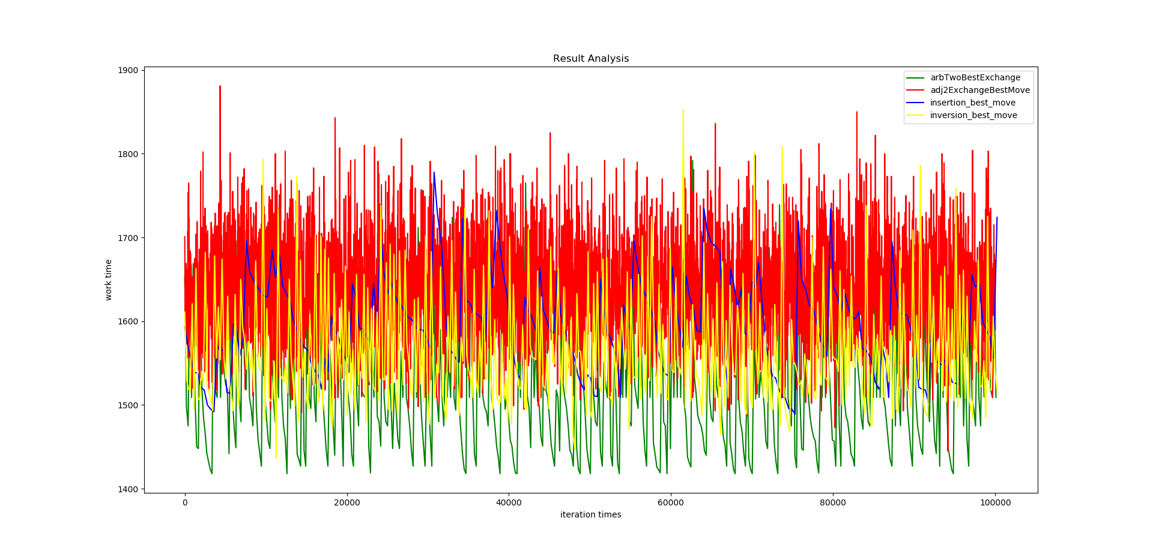
Best move: arb>inversion> adjacent> insertion

Slide 6
First Move VS best move
First move: arb>adjacent>insertion>inversion
Best move: arb>inversion> adjacent> insertion

Slide 7
More result should be included

