Slide 1
Cover Ratio Maximization
11612126 Li Keming 2020/2/21

Slide 2
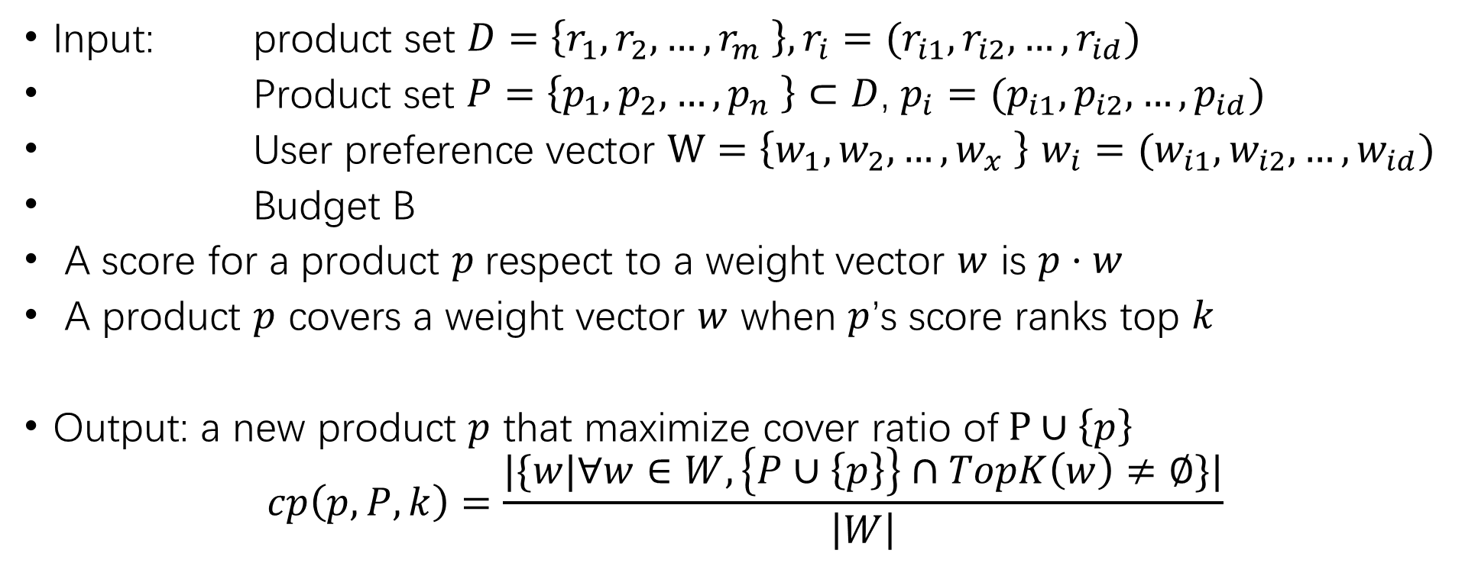
Cover Ratio Maximization
Input: product set $D=\left\{r_{1},r_{2}, …,r_{m} \right\}, r_{i}=(r_{i1}, r_{i2}, …,r_{id})$
Product set $P=\left\{p_{1},p_{2}, …,p_{n} \right\}⊂D$, $p_{i}=(p_{i1}, p_{i2}, …,p_{id})$
User preference vector $W=\left\{w_{1},w_{2}, …,w_{x} \right\}$ $w_{i}=(w_{i1}, w_{i2}, …,w_{id})$
Budget B
A score for a product $p$respect to a weight vector $w$ is $p·w$
A product $p$ covers a weight vector $w$ when $p$’s score ranks top $k$
Output: a new product $p$ that maximize cover ratio of$P∪\left\{p\right\}$
$$cp\left(p, P,k\right)=\frac{|\{w|∀w∈W, \left\{P∪\left\{p\right\}\right\}∩TopK\left(w\right)≠∅\}|}{\left|W\right|}$$

Slide 3
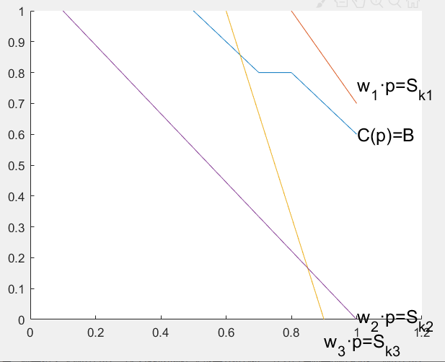

Have done for this week
Baseline using kSPR
A better solution using condition $C\left(p\right)≥B$
TODO
Can we use info of product set $P=\left\{p_{1},p_{2}, …,p_{n} \right\}$to do pruning?

Slide 4
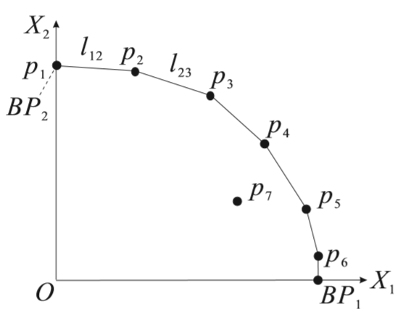
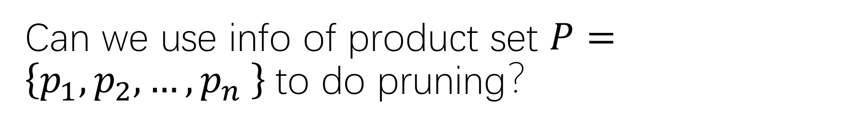
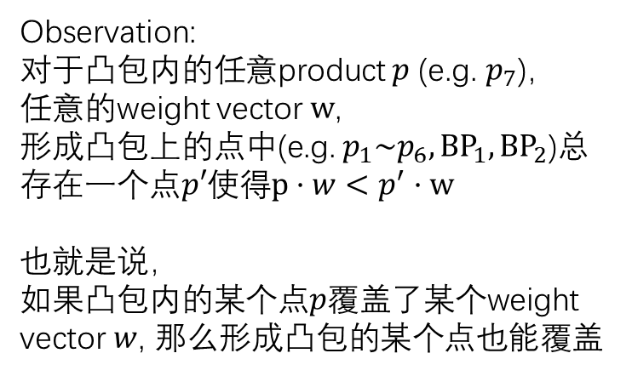
Can we use info of product set $P=\left\{p_{1},p_{2}, …,p_{n} \right\}$to do pruning？
Lemma 4. Let p be a tuple in D which is inside Conv(D) but is not on the surface of Conv(D). Then, HP(p) = 0. （k-hit query）
Observation:
对于凸包内的任意product $p$ (e.g. $p_{7}$)，
任意的weight vector $w$,
形成凸包上的点中(e.g. $p_{1}\sim p_{6}, {BP}_{1}, {BP}_{2}$)总存在一个点$p′$使得$p·w<p^{′}·w$
也就是说，
如果凸包内的某个点$p$覆盖了某个weight vector $w$, 那么形成凸包的某个点也能覆盖
Products in Product space

Slide 5
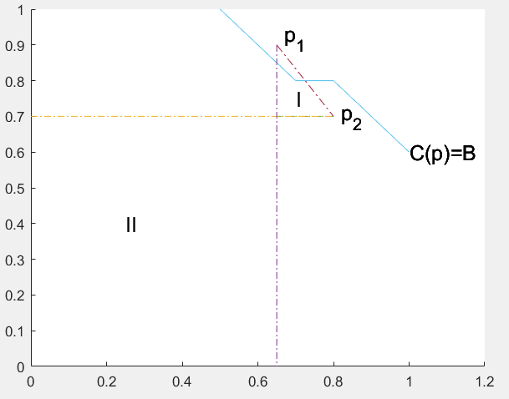

如果凸包内的某个点$p$覆盖了某个weight vector $w$, 那么形成凸包的某个点也能覆盖

