Slide 1
Weekly Report-- Cover Ratio Maximization
Keming Li 11612126

Slide 2
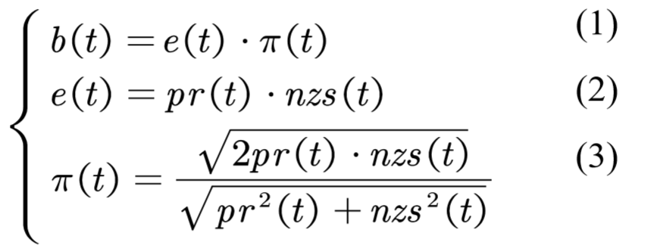

Paper review
220 Balanced Dominating top-k Queries over Uncertain Data
Data: score($nzs(t)$), probability$(pr(t))$

Slide 3
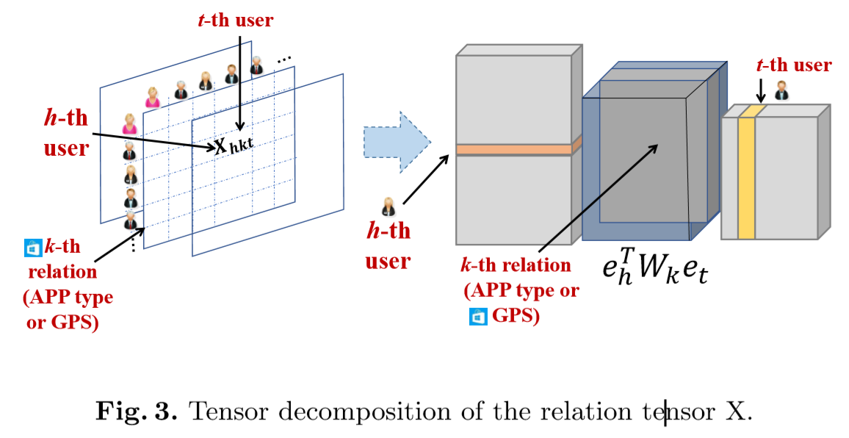
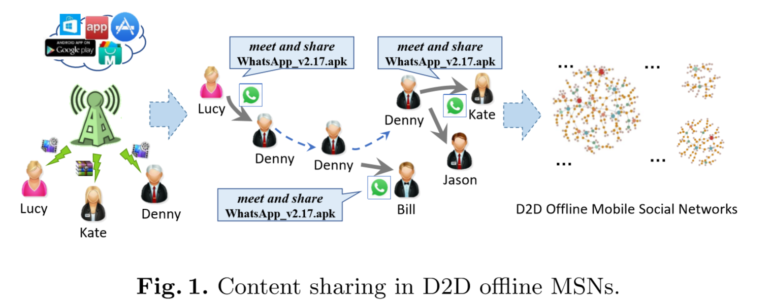

Paper review
233 Content Sharing Prediction for Device-to-Device (D2D)-based Oﬄine Mobile Social Networks by Network Representation Learning
Learn the tensor that represents users network
Tensor decomposition

Slide 4
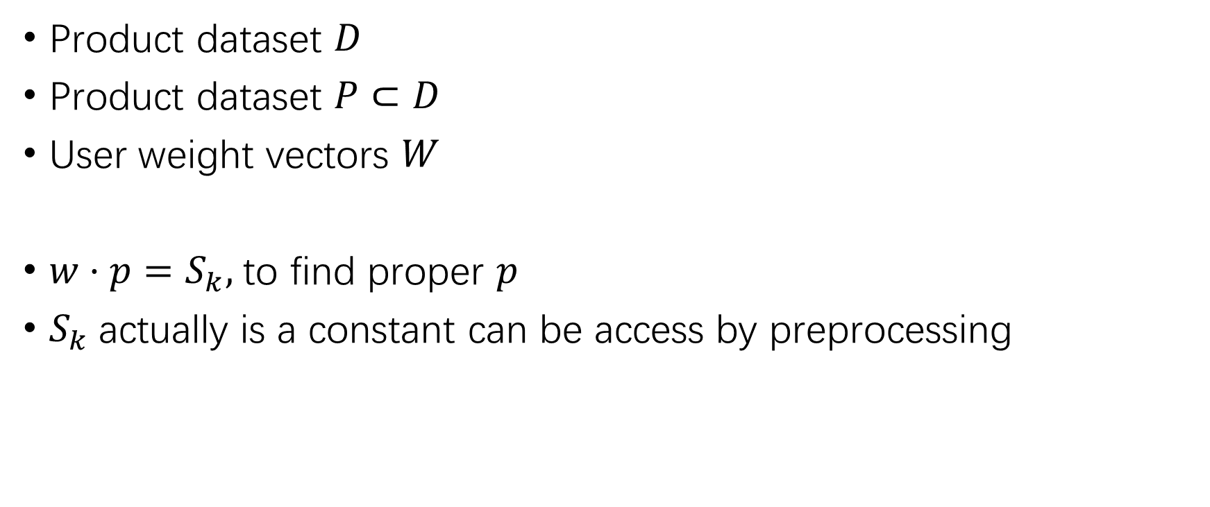

Cardinality of $W$ is more important
Product dataset $D$
Product dataset $P⊂D$
User weight vectors $W$
$w·p=S_{k},$to find proper $p$
$S_{k}$actually is a constant can be access by preprocessing

Slide 5
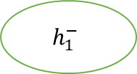






Exp1: Dataset U100K4MINI:
Cardinality: 100
Dimensionality: 4
k=30
ACTA, query 60 times
Avg running time: 514.304
Lp_solve: isFeasible()
After solve:
Avg running time: 0.000001
Less lp_solve is much more faster.
$$C\left(p\right)≤B$$
$$h_{1}^{+}$$
$$h_{1}^{−}$$
$$h_{1}^{+}∩h_{2}^{+}$$
$$h_{1}^{+}∩h_{2}^{−}$$
$$h_{1}^{−}∩h_{2}^{+}$$
$$h_{1}^{−}∩h_{2}^{−}$$

Slide 6
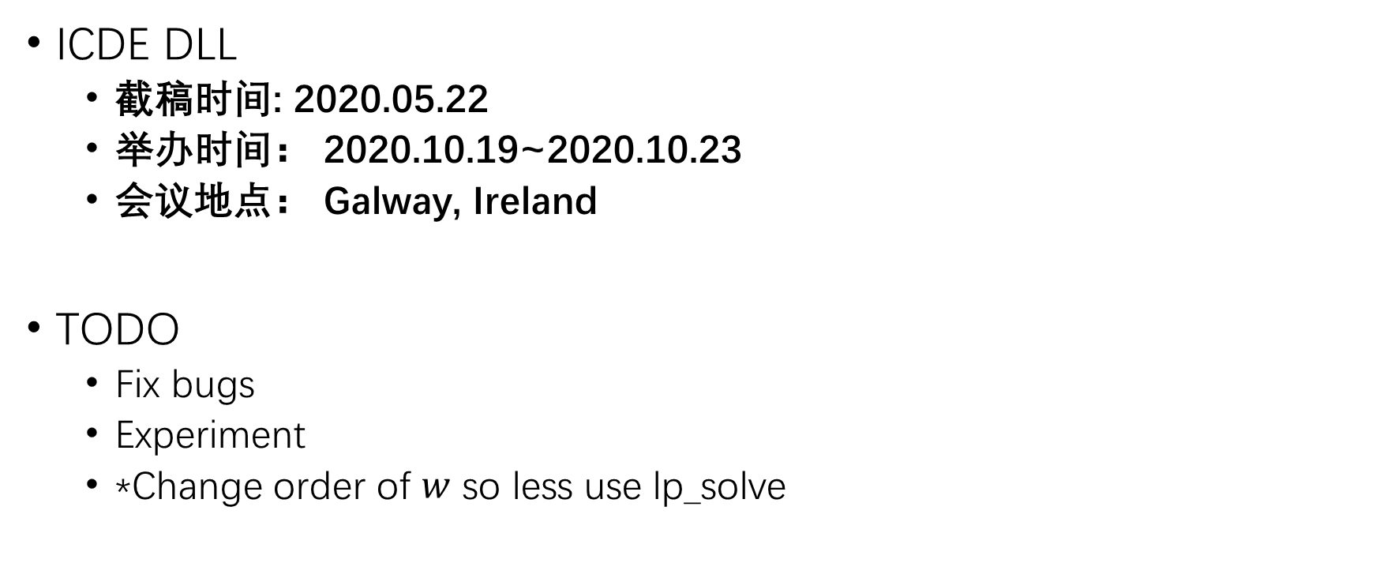
ICDE DLL
截稿时间: 2020.05.22
举办时间： 2020.10.19~2020.10.23
会议地点： Galway, Ireland
TODO
Fix bugs
Experiment
*Change order of $w$ so less use lp_solve

